Slide 1
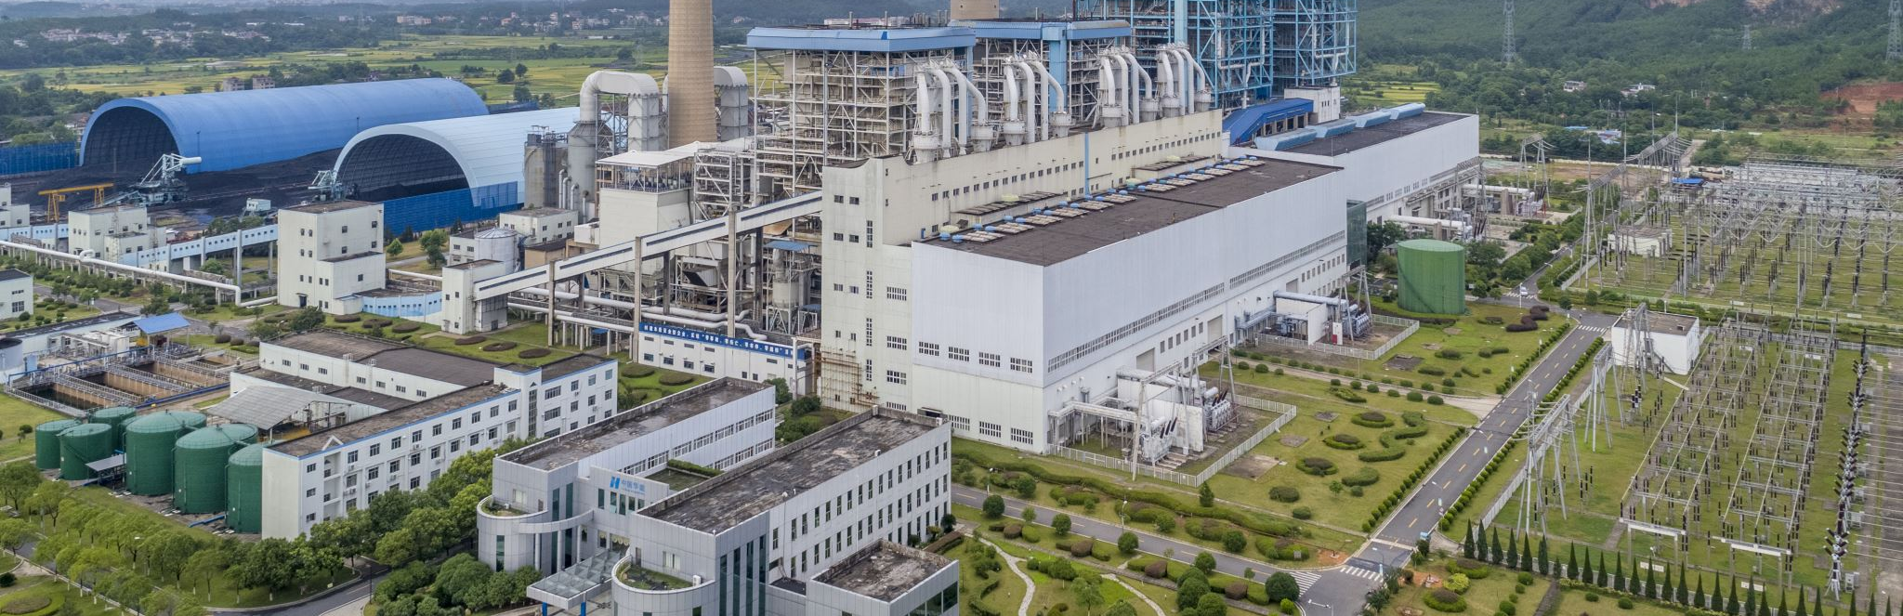
Food System Emissions
By Tony Pennoyer

Slide 2



Processing
Transportation
Land Use
Packaging
Retail
Consumption
Waste

Slide 3
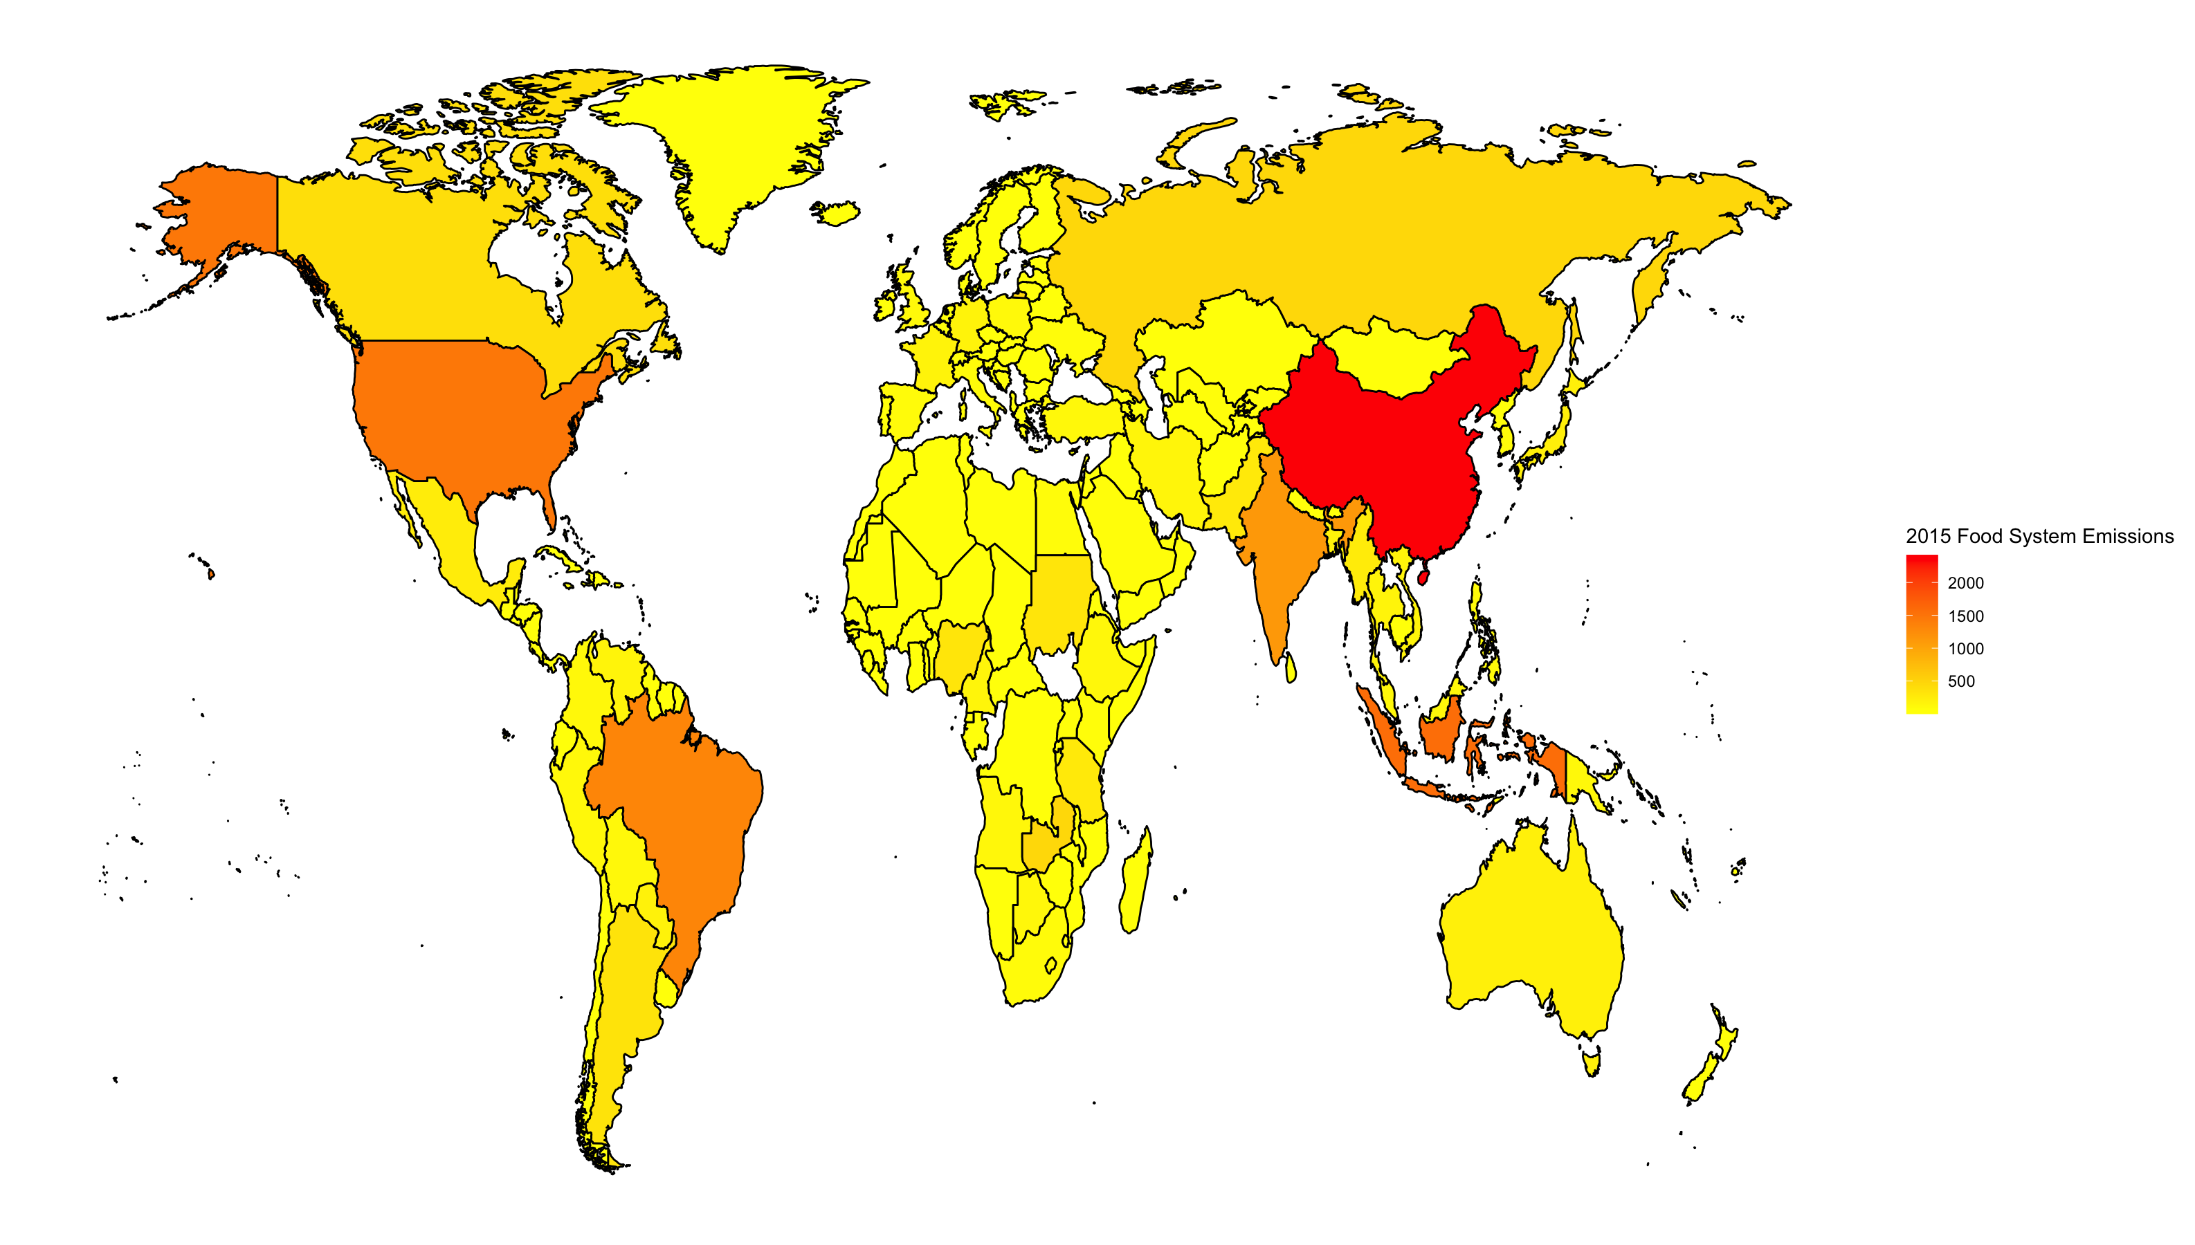

Slide 4
