Slide 1

Classic Car Valuation
By Tony Pennoyer

Slide 2

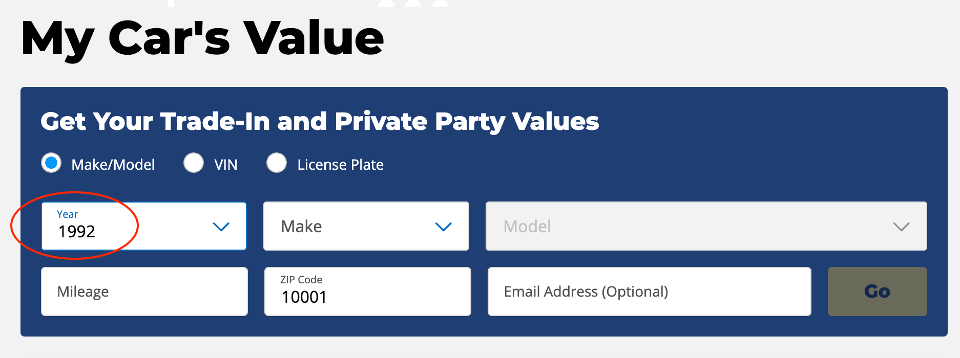
Background
Car valuation companies like Kelley Blue Book valuate thousands of cars in our current used car market
If your car was made from 1992 to 2021 and is one of the 40 makes they recognize, you can get an estimate from Kelley Blue Book

Slide 3
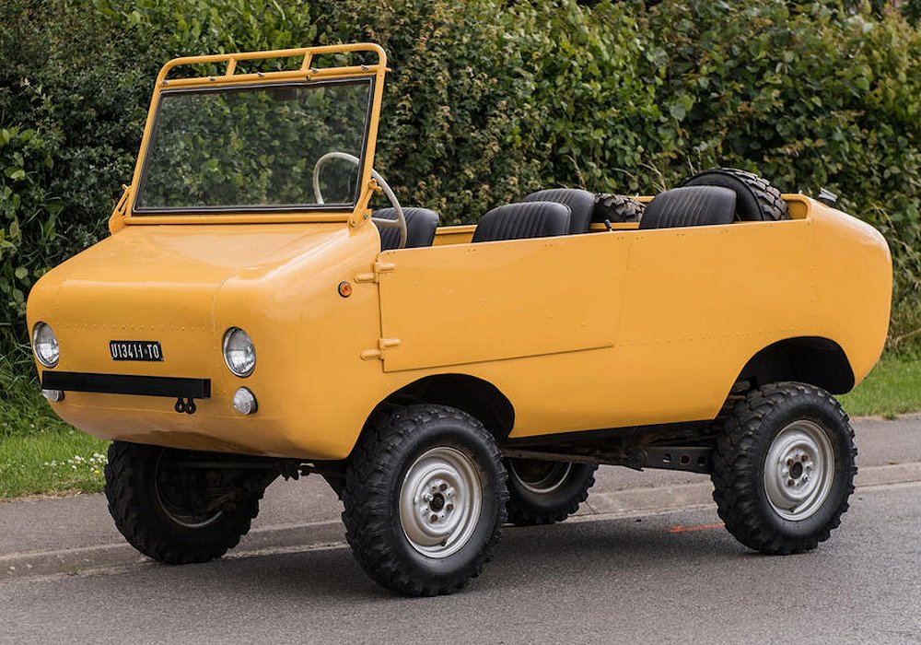

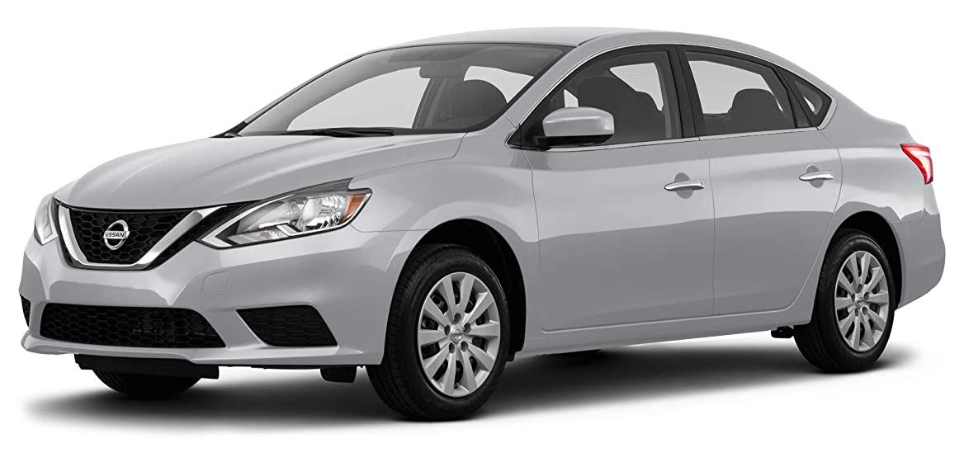
Background
While this does cover the vast majority of cars today it does not cover vintage, exotic or otherwise unusual ones
These sorts of cars are almost always sold at auction

Slide 4

Identifying this gap in the car valuation market, I searched for data that would provide values for all recently sold classic cars
To get this data I webscraped the worlds largest car auctioneer, RM Sotheby’s

Slide 5
The company is a partnership between, Sotheby’s, a fine art and collectibles auction house, and RM, a vintage car restoration company
Sold a 1962 Ferrari GTO, sold for $48.4 million dollars in 2018
RM Sotheby’s hold 5 main auctions a year in different venues throughout the US and abroad

Slide 6
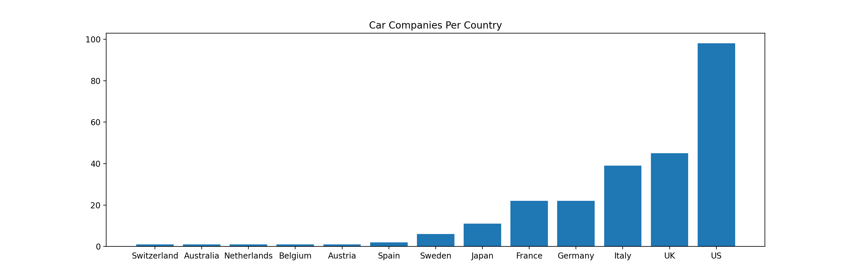
The Dataset
Total cars: 12,800
Total car makes: 256
Parameters included: Year, Make, Model, Origin Country, Sale Date, Sale Location

Slide 7
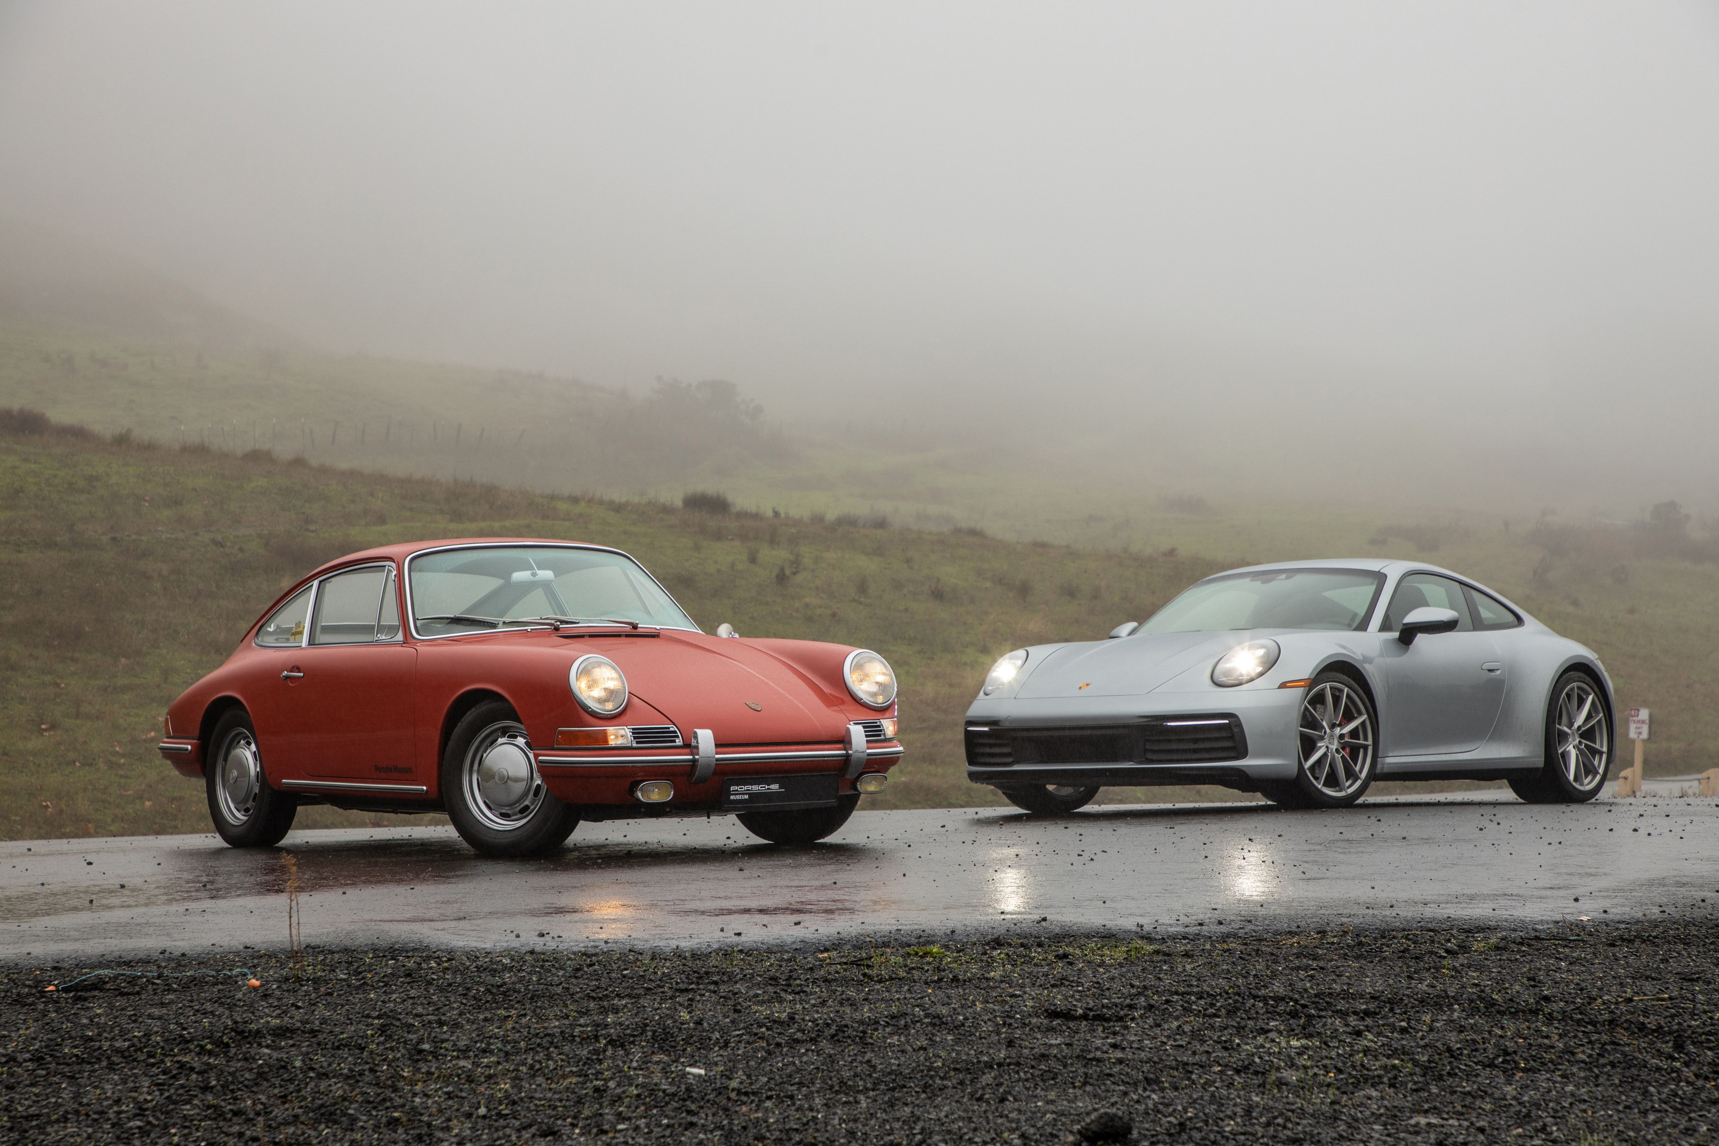
How much should I pay for a Porsche 911?
I chose this particular car to analyze because it was sold many times at every auction and has been produced every year since 1964

Slide 8
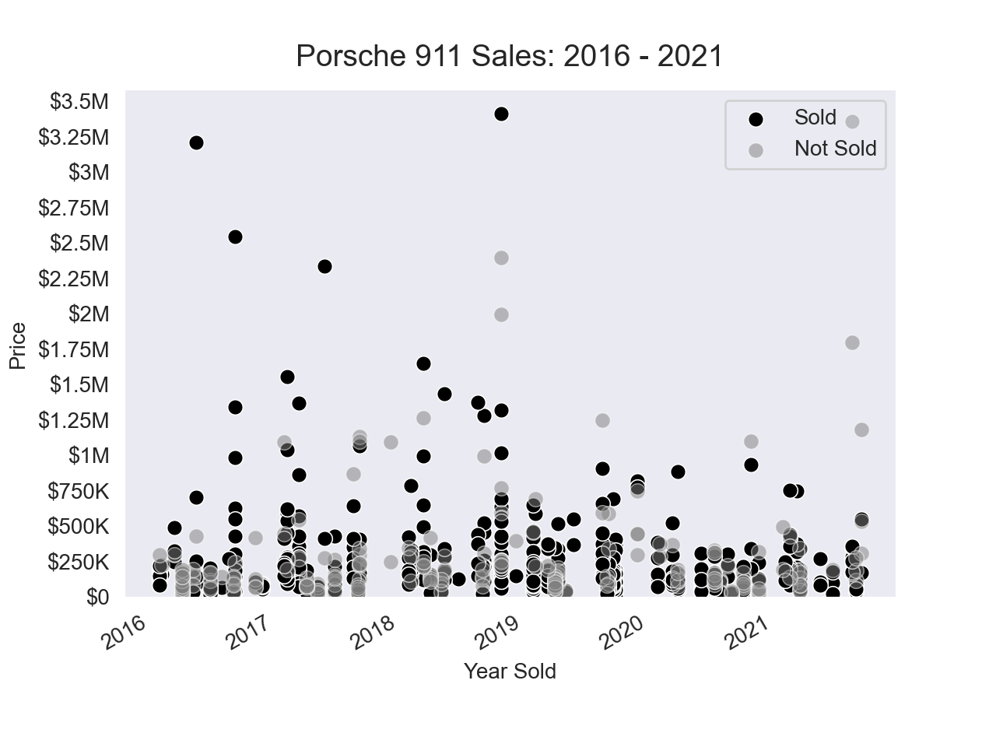

Slide 9
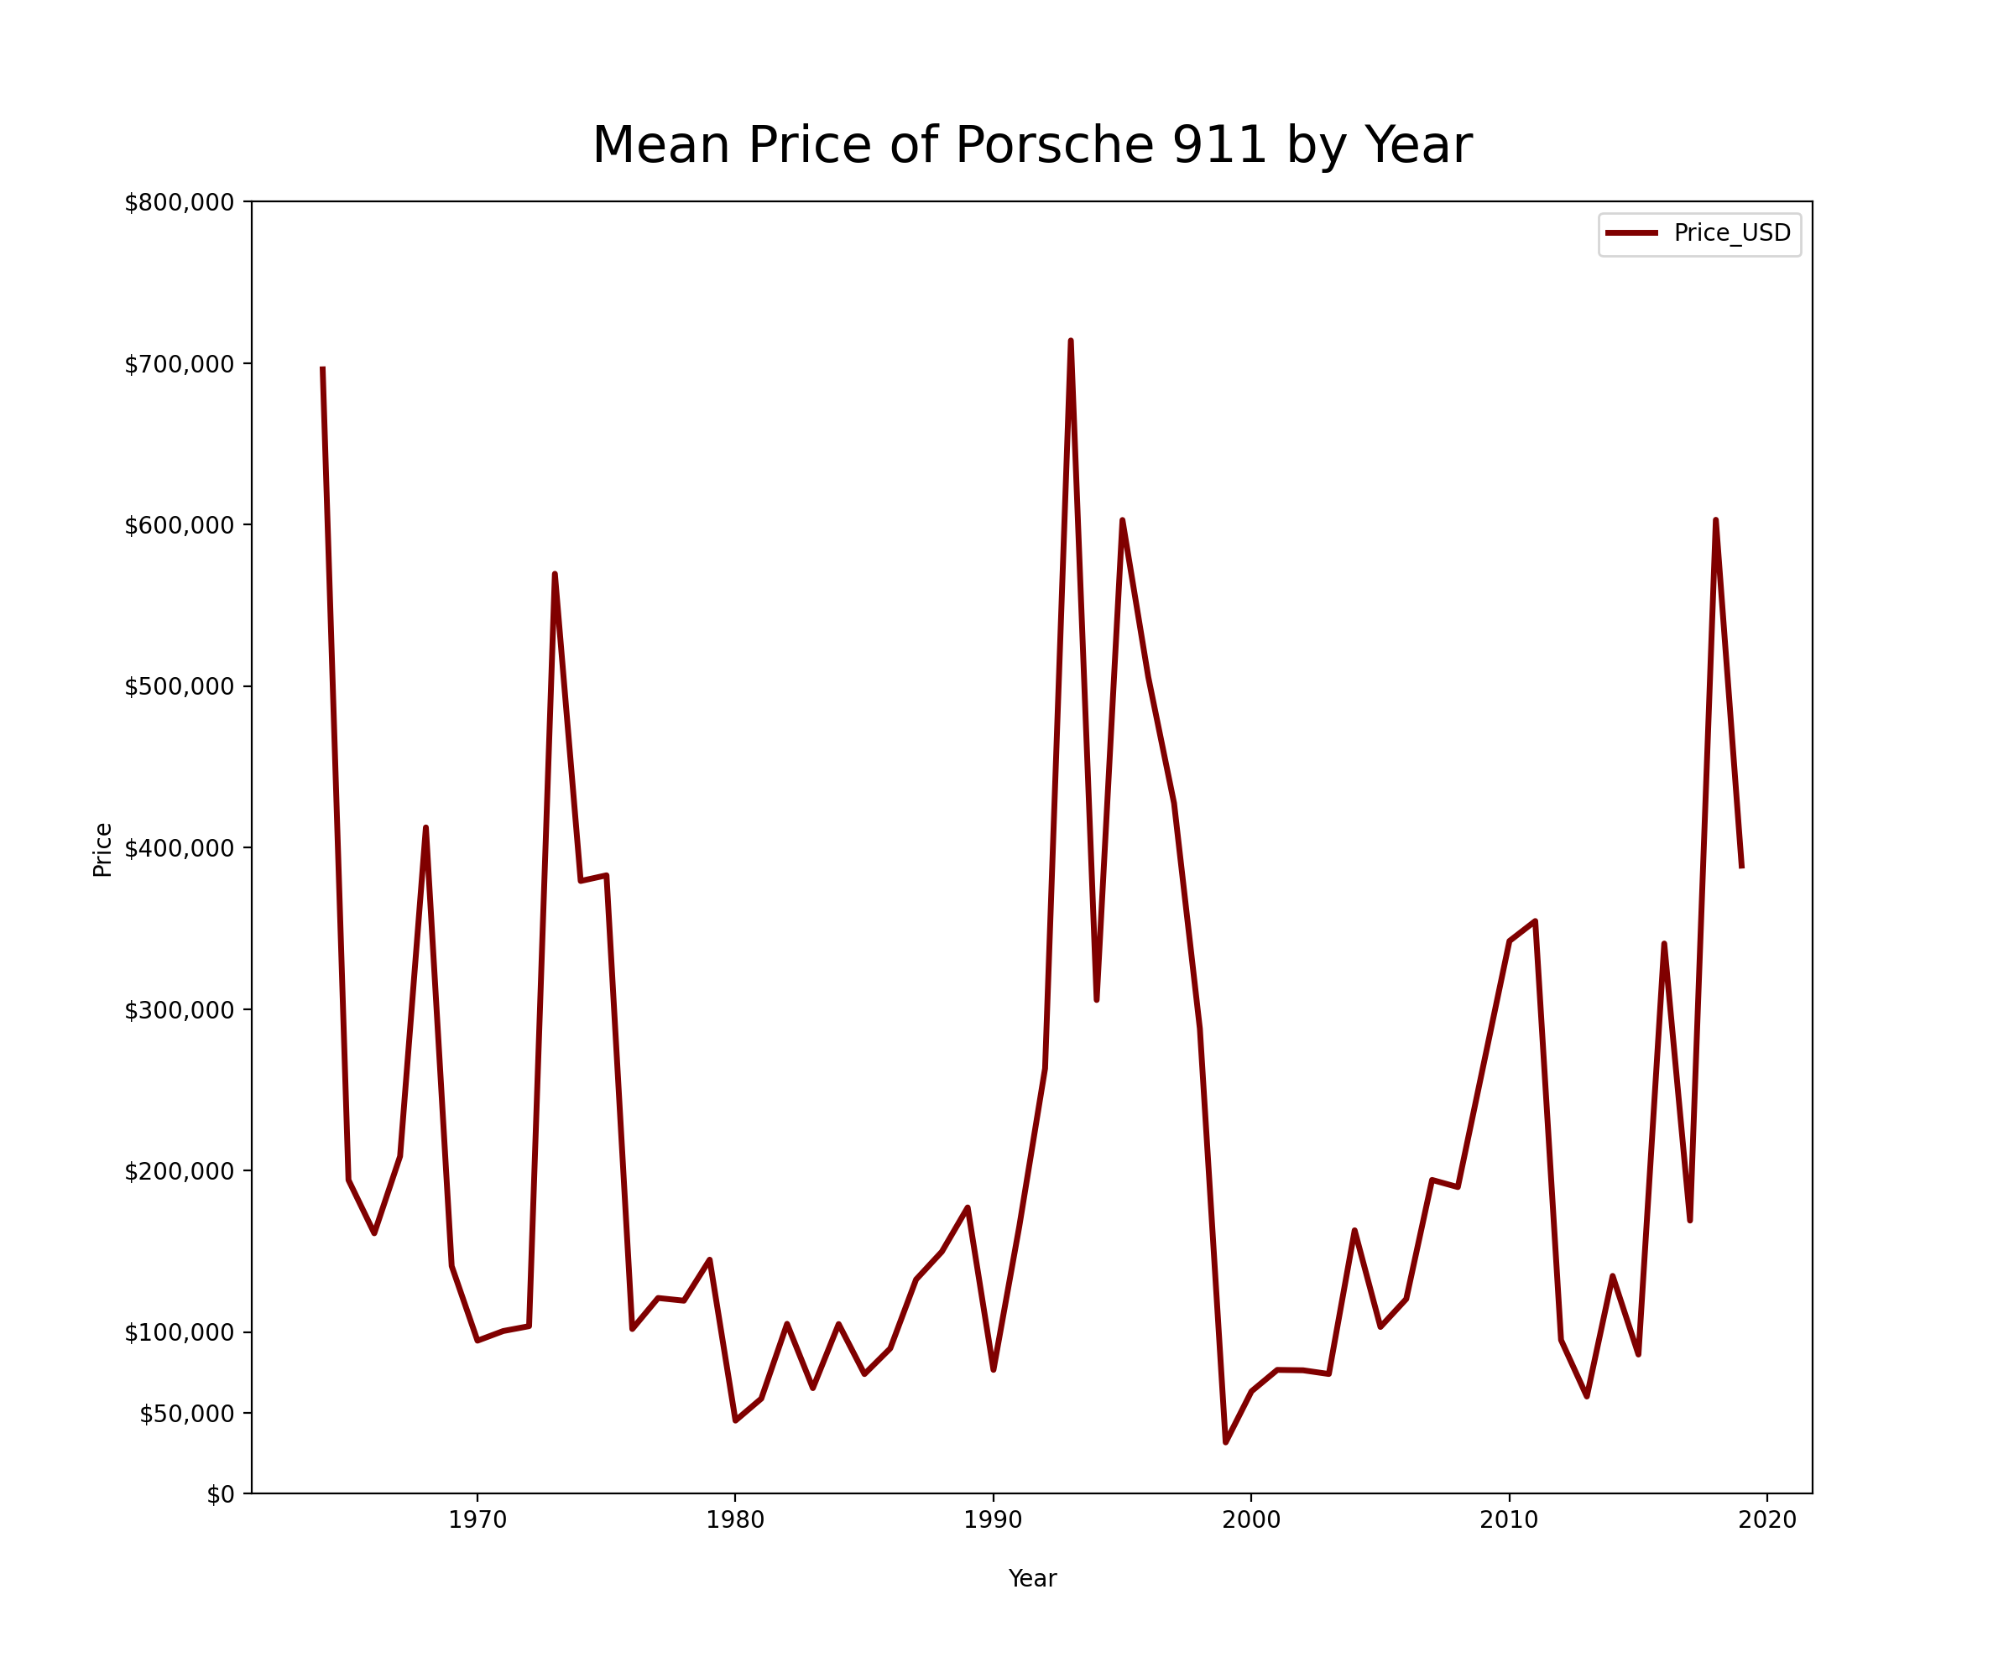
The value of a Porsche 911 depends heavily on what year it was produced
Those manufactured in the mid-90s are considered more desirable than those in the early 2000s

Slide 10
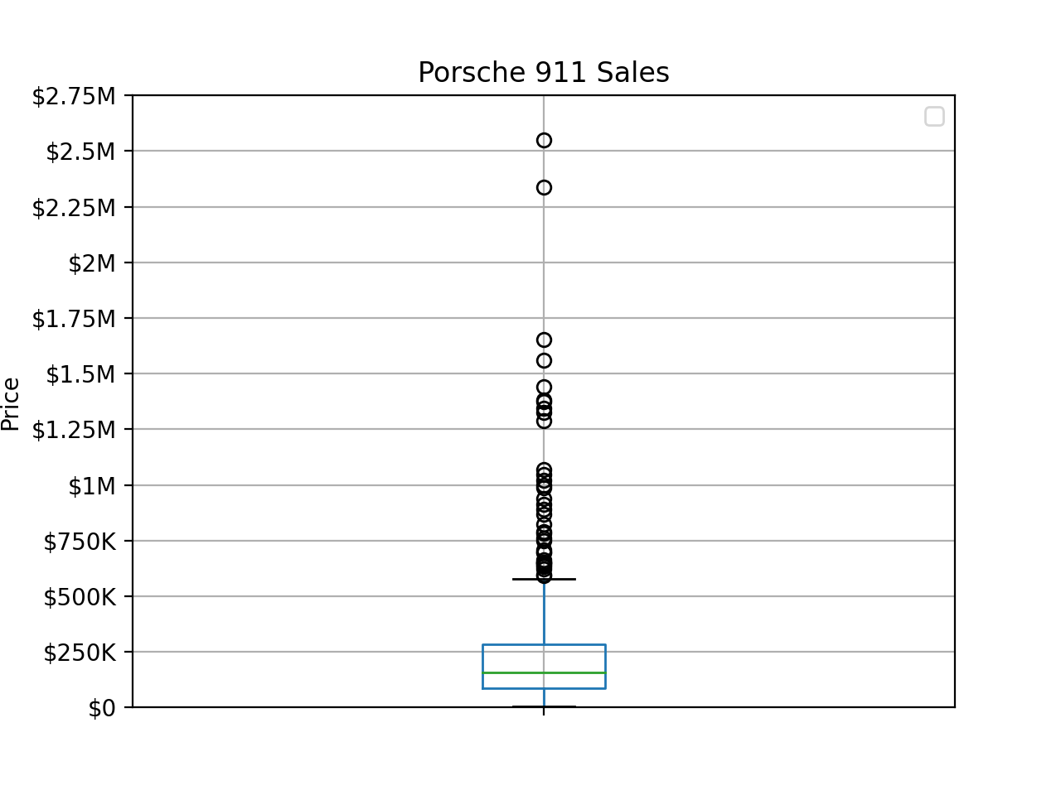
Average: $263,000
Median: $156,800
Standard deviation of $381,339
About 75% of all 911s were between $20,000 - $285,000

Slide 11
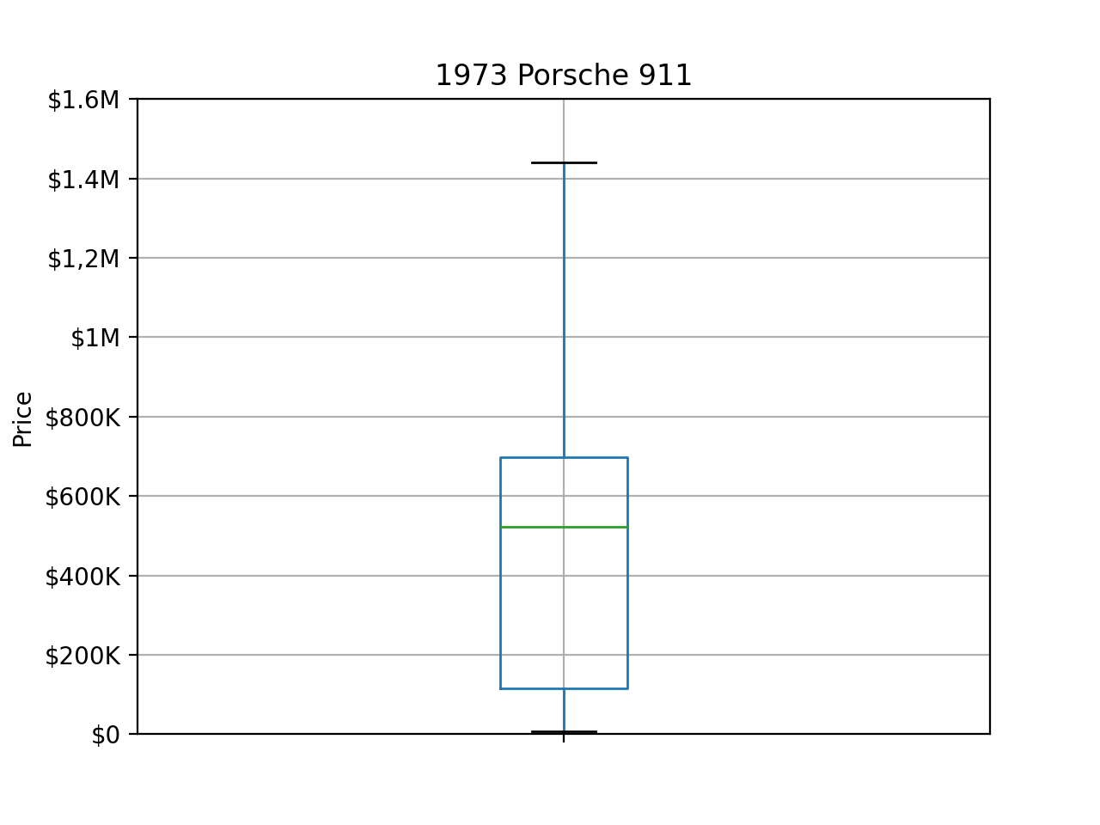
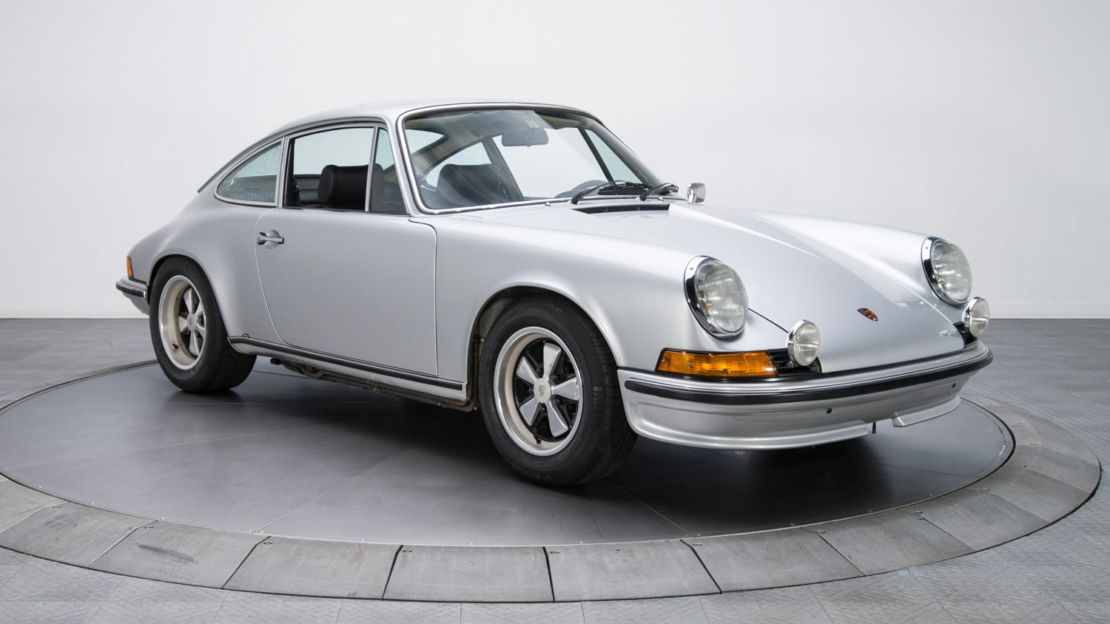
1973

Slide 12
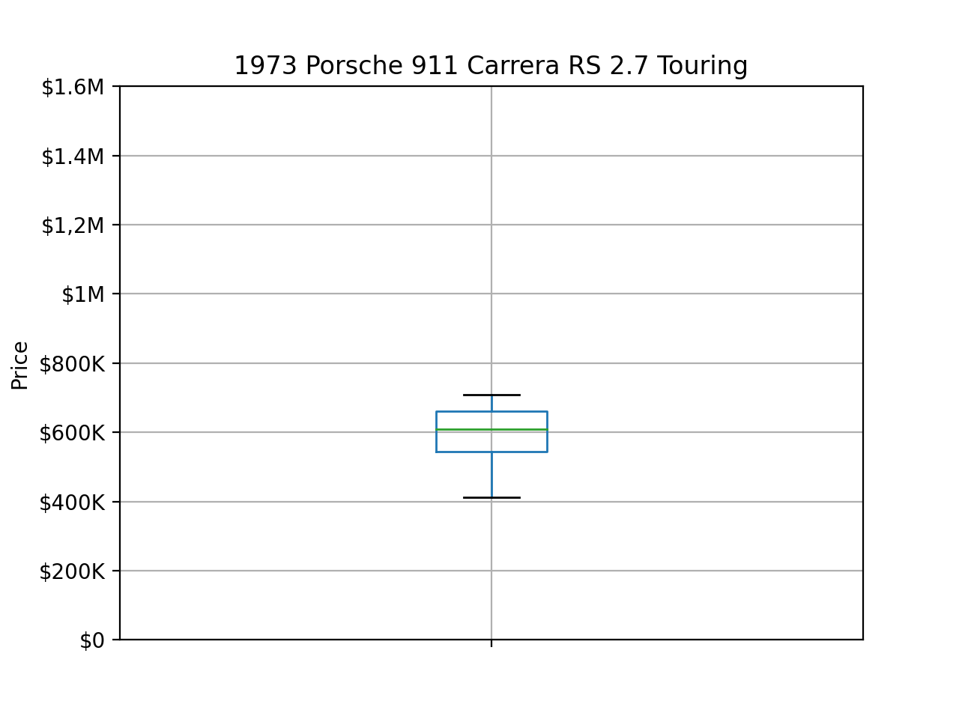
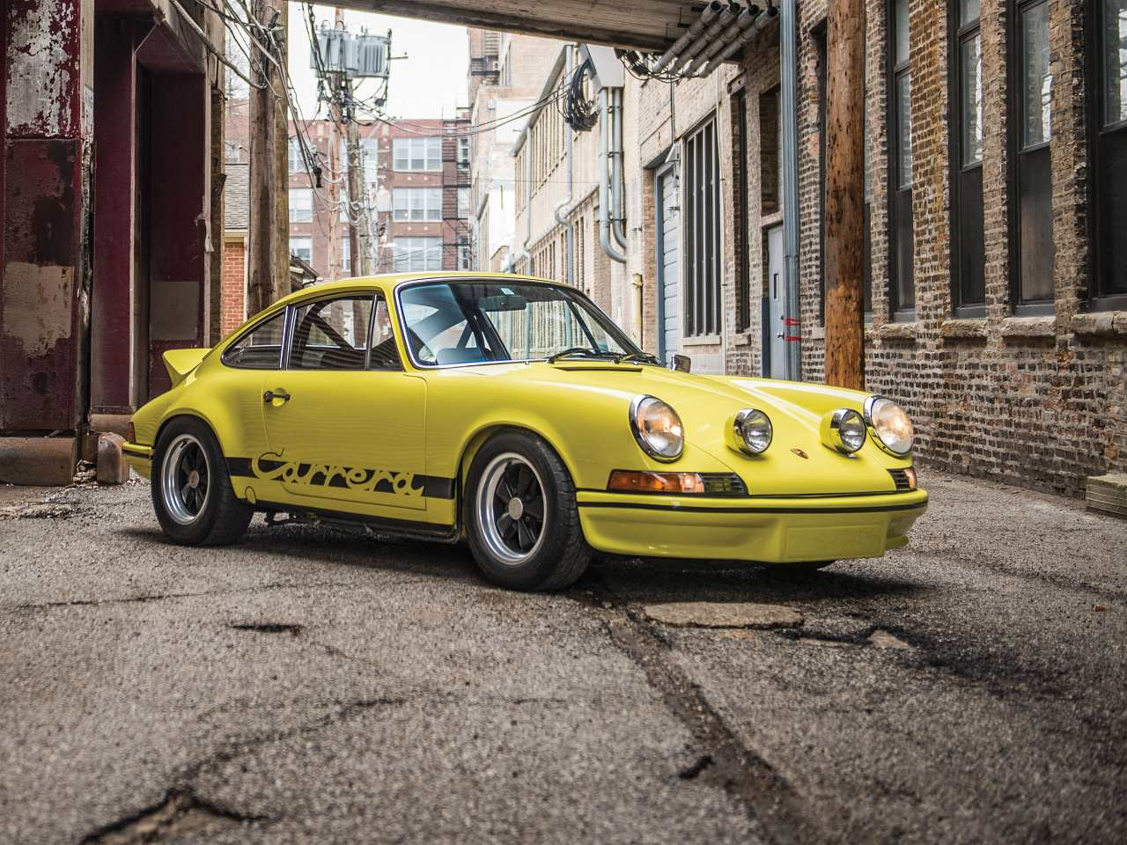
1973 Porsche 911 Carrera RS 2.7 Touring
Getting more specific…

Slide 13
Valuating a 1973 Porsche 911 Carrera RS 2.7 Touring
Condition categories:
Concourse = $661,251 - $708,064
Excellent = $608,333 - $661,250
Very Good = $544,612 - $608,332
Good = $412,000 - $544,611
(I decided to exclude a ‘Fair’ category as most of the cars that go to auction are in good shape)

Slide 14
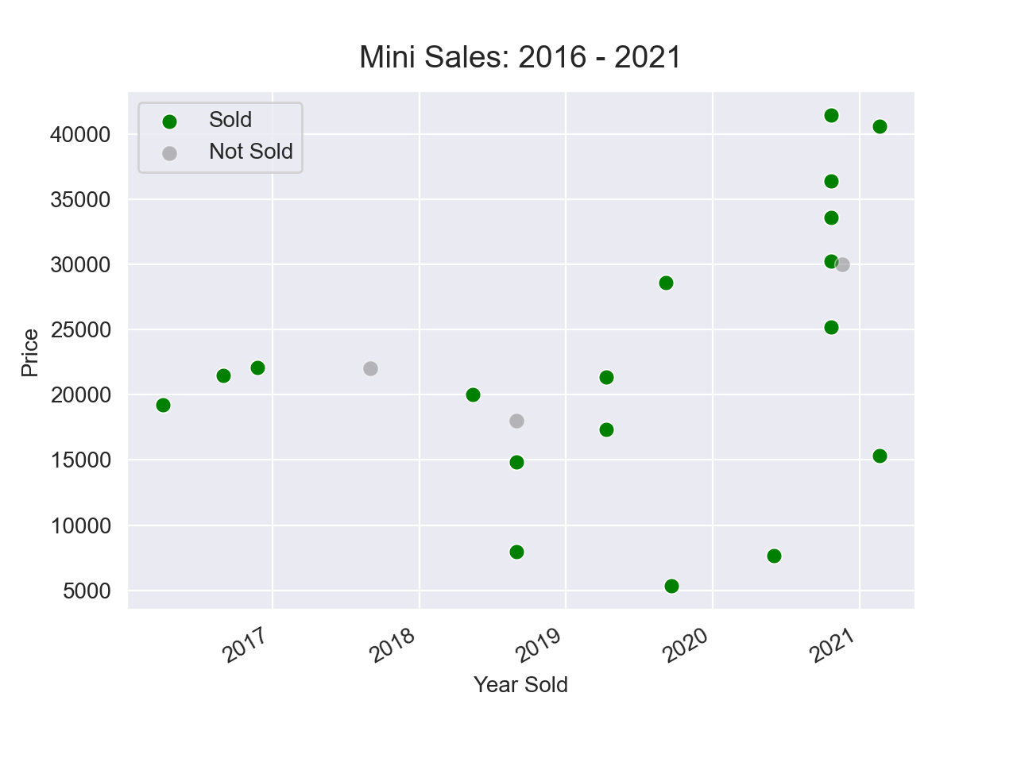
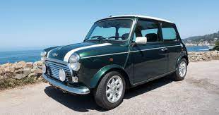

Slide 15
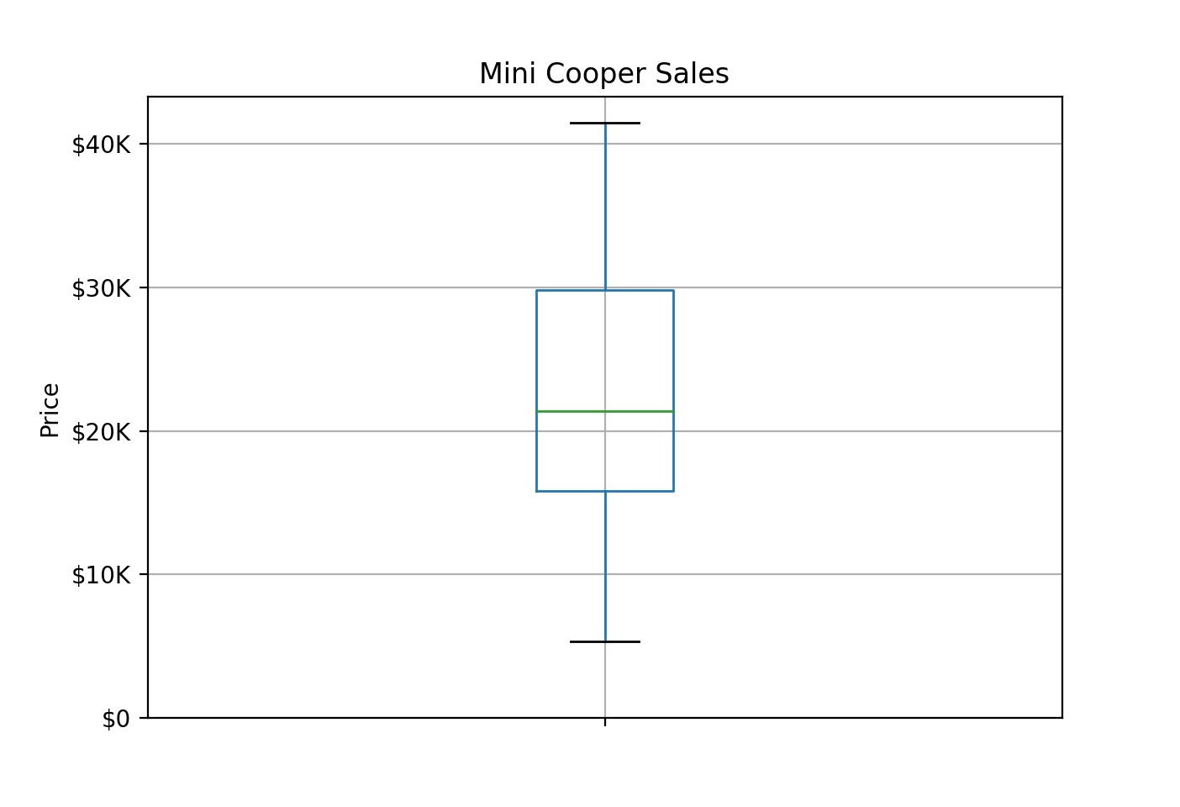

Slide 16
Valuating a Mini 1962 - 2000
Condition categories:
Concourse = $29,822 - $41,440
Excellent = $21,398 - $29,821
Very Good = $15,820 - $21,397
Good = $5,336 - $15,819

Slide 17
Further Analysis: Microcars

Slide 18
Further Analysis: Microcars
“a term often used for the smallest size of cars, with three or four wheels and often an engine smaller than 700 cc.”

Slide 19
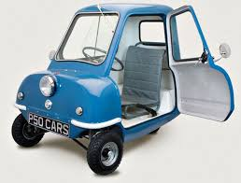
Further Analysis: Microcars
“a term often used for the smallest size of cars, with three or four wheels and often an engine smaller than 700 cc.”
Peel P50

Slide 20
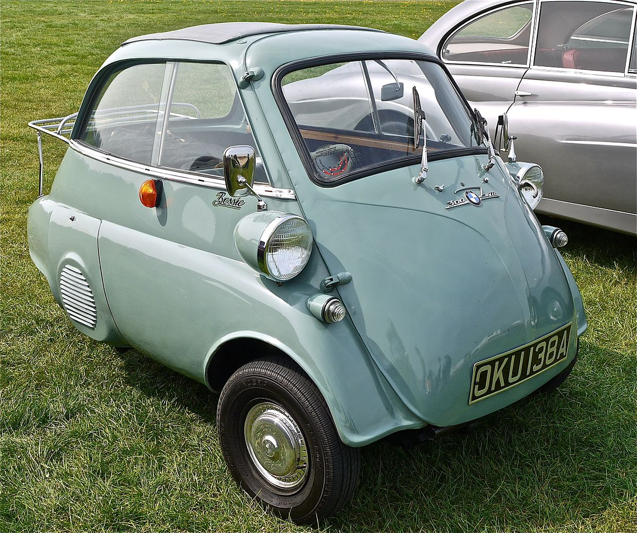
Further Analysis: Microcars
“a term often used for the smallest size of cars, with three or four wheels and often an engine smaller than 700 cc.”
Peel P50
BMW Isetta

Slide 21
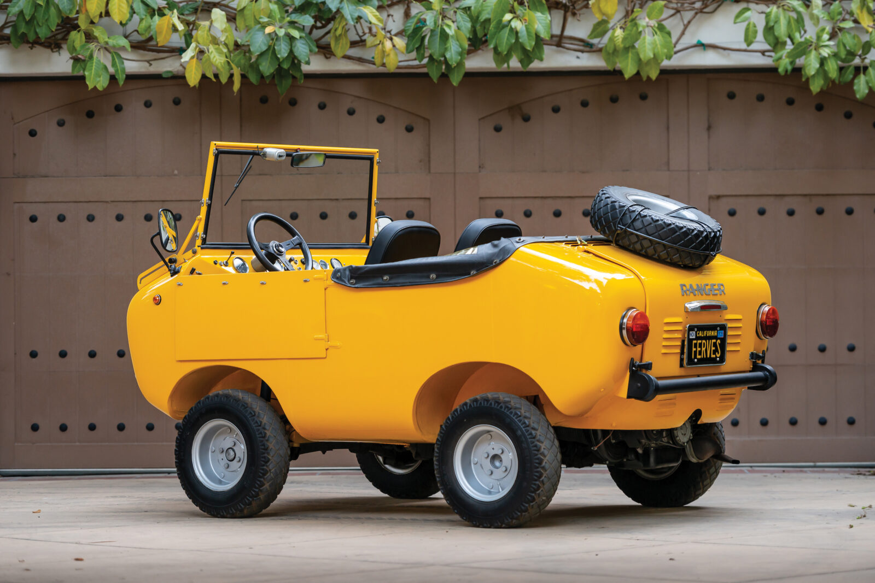
Further Analysis: Microcars
“a term often used for the smallest size of cars, with three or four wheels and often an engine smaller than 700 cc.”
Peel P50
BMW Isetta
Ferves Ranger

Slide 22
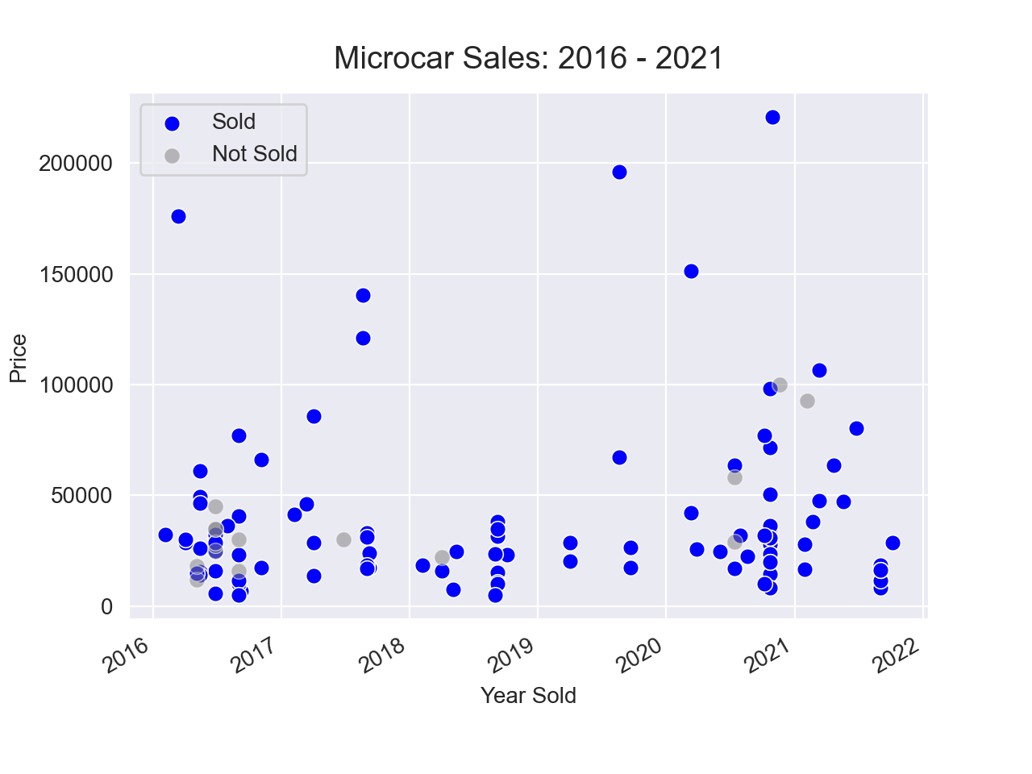

Slide 23
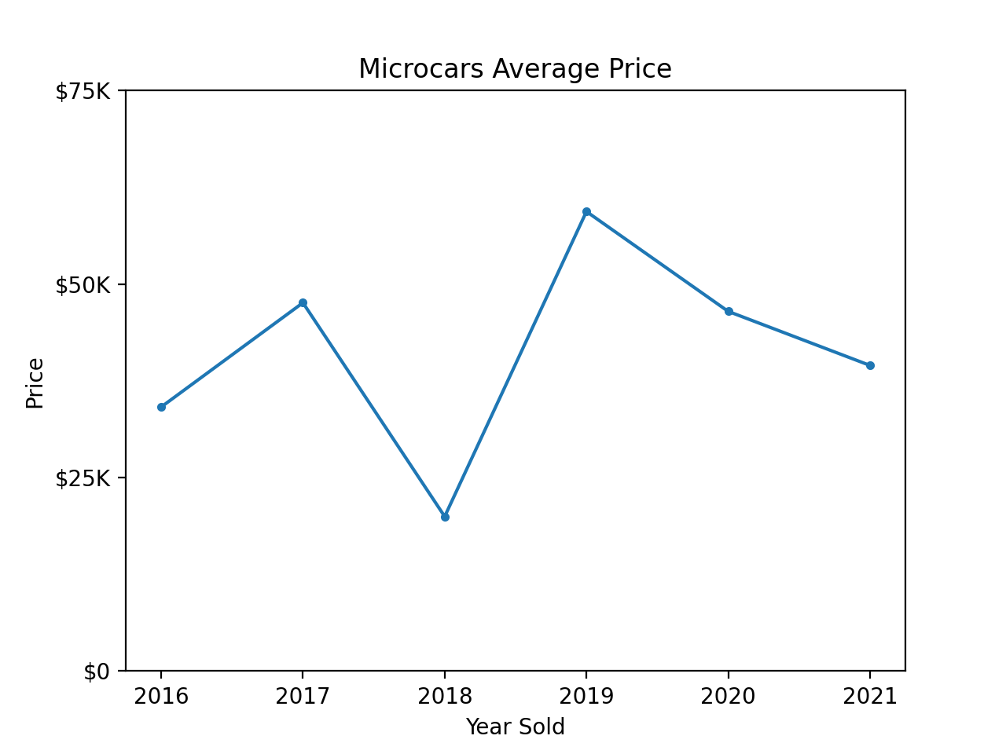

Slide 24
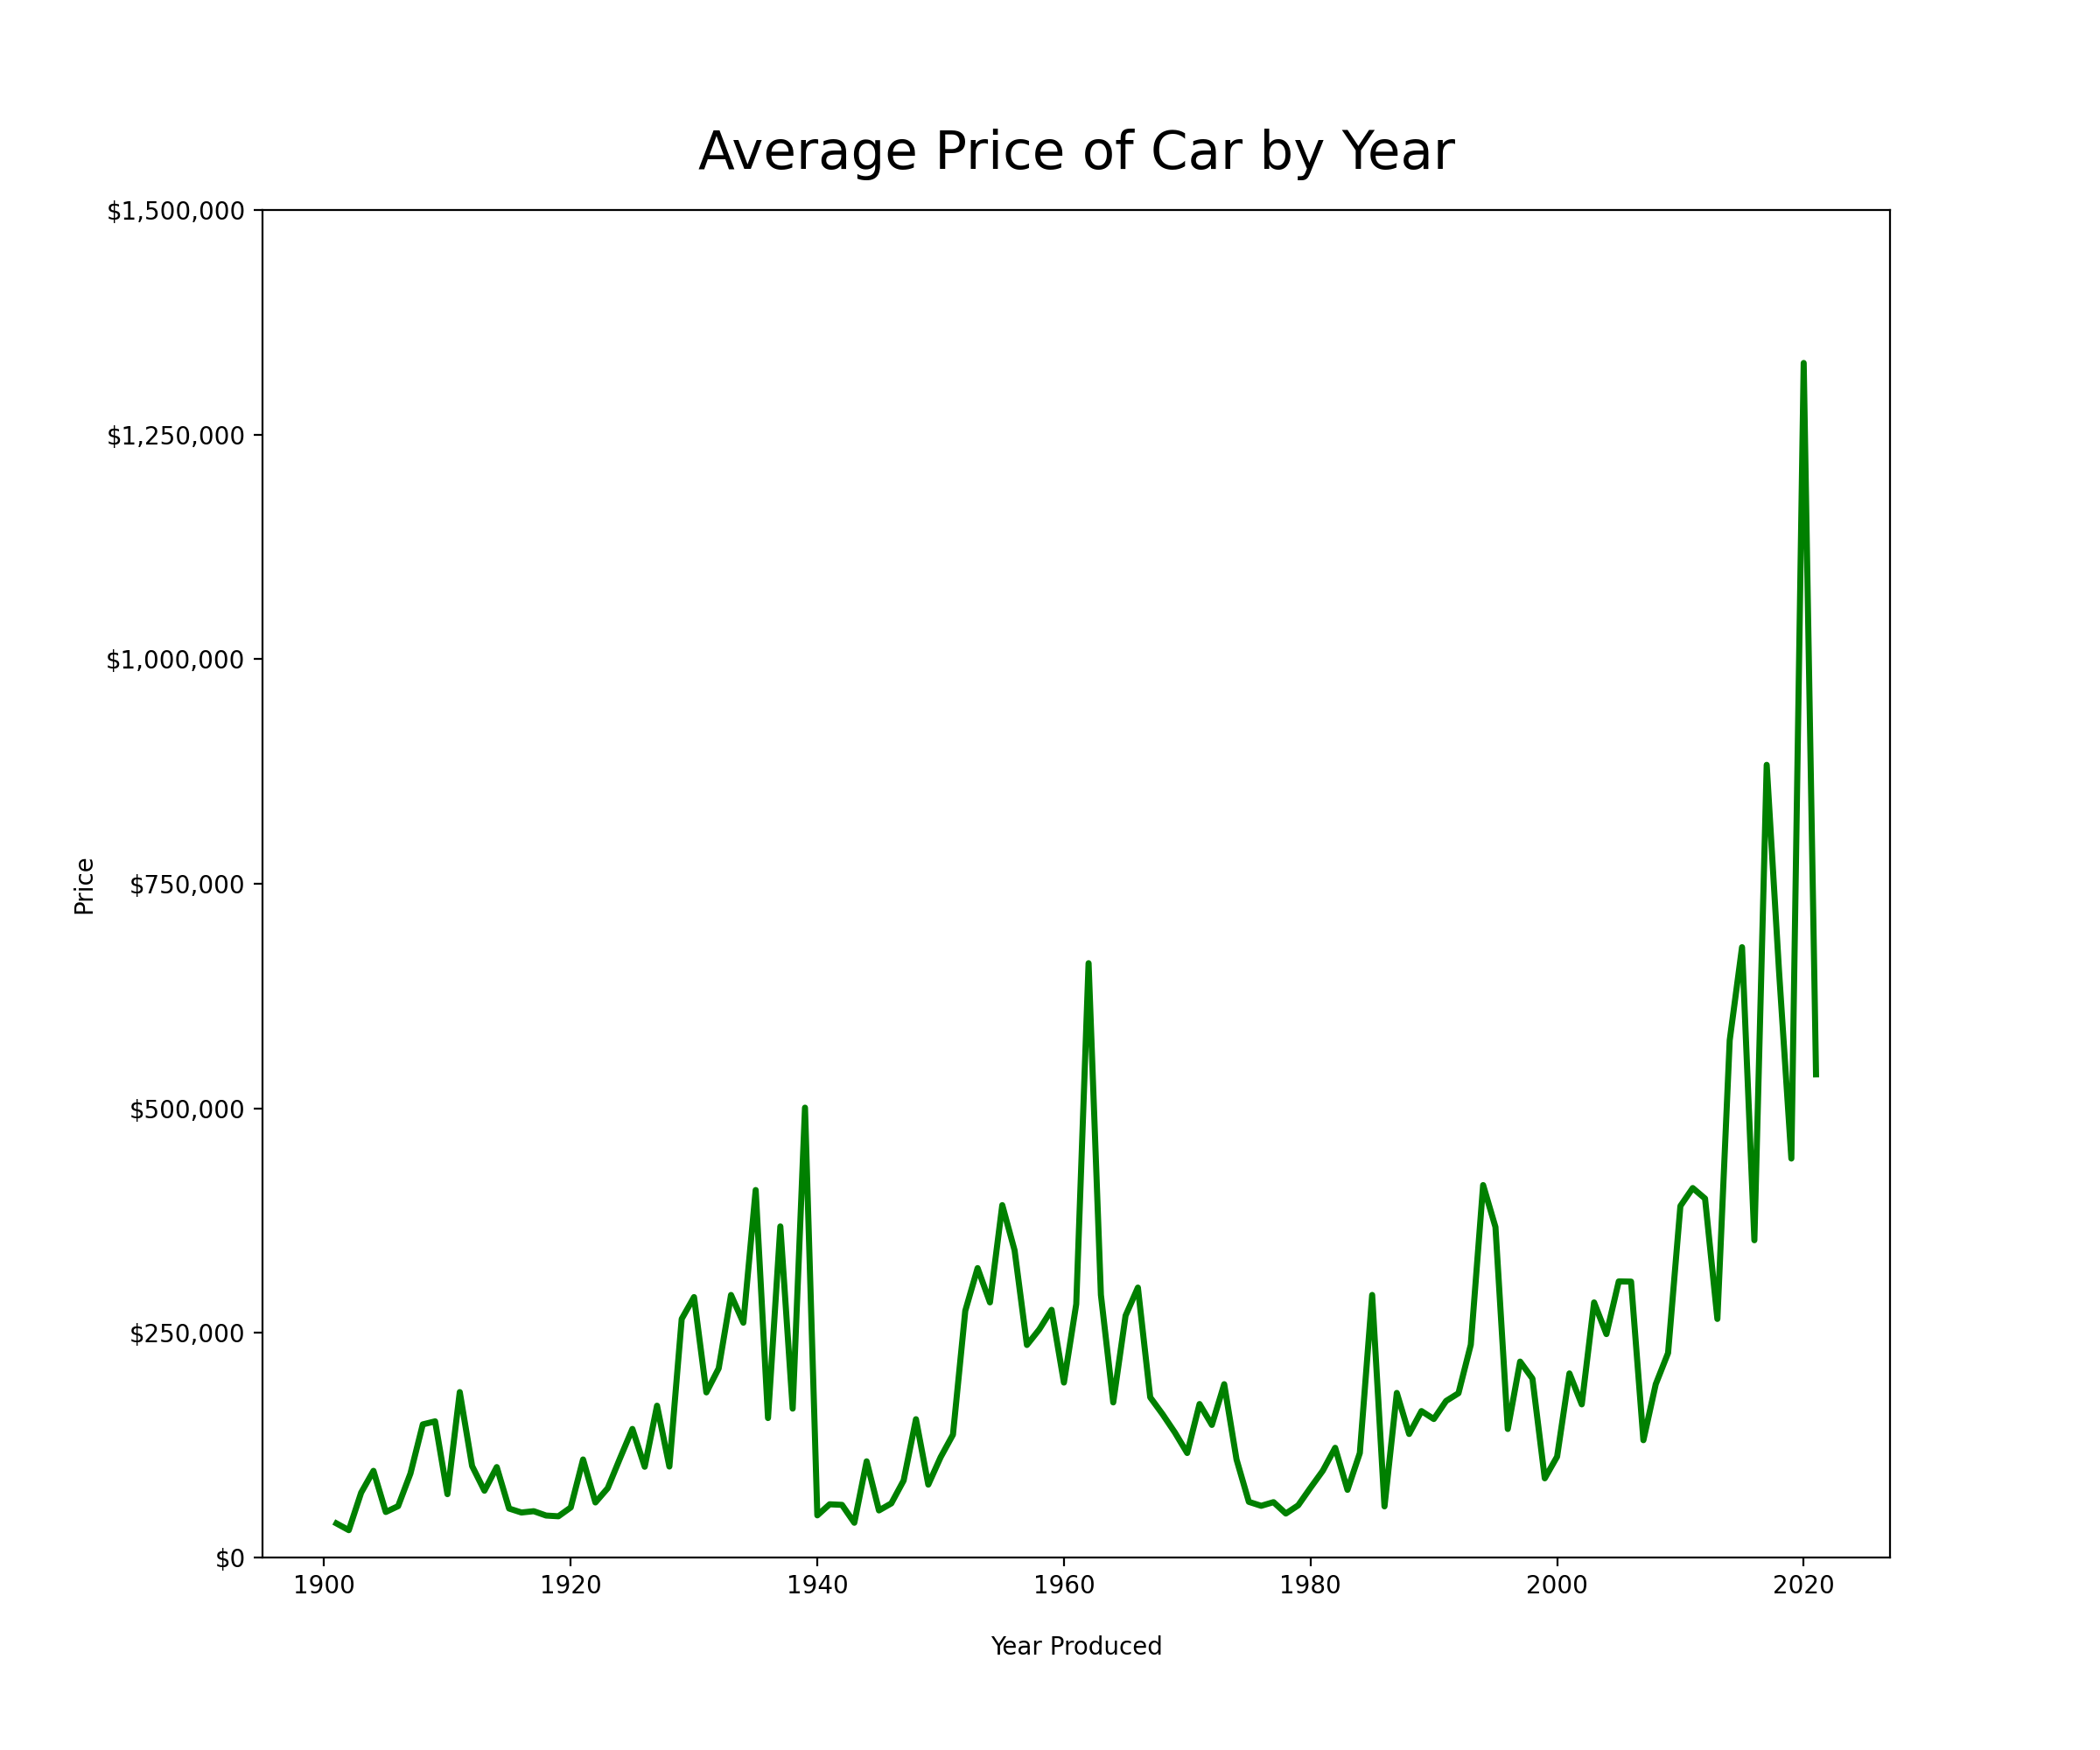

Slide 25
Limitations
The data I collected doesn’t give insight to the condition of the car
The value of used cars depends on their condition and its history. Both of these factors aren’t taken into account with the data I scraped
Because auctions typically get cars in great condition the prices may not be a good indicator for those in poor shape
Another limitation is that many cars are sold as private sales through auction houses, something they do not report

Slide 26


Going forward
While I webscraped the largest car auction company there are two others that have a big volume of sales as well
With the restriction of time I wasn’t able to get this data but hope to in the future
I would also like to obtain unique identifier for each car so I could track its individual value over the years

Slide 27
Questions?

