Slide 1
What’s My Old Car Worth?
By Tony Pennoyer

Slide 2

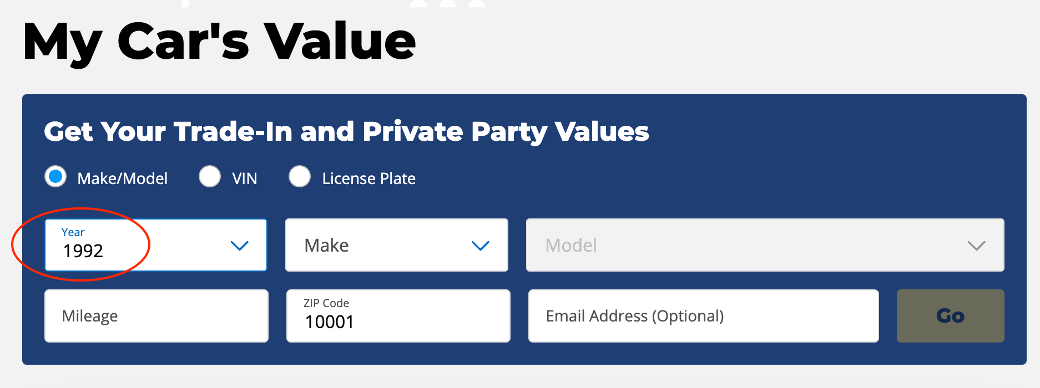
Background
Car valuation companies like Kelley Blue Book valuate thousands of cars in our current used car market
If your car was made from 1992 to 2021 and is one of the 40 makes they recognize, you can get an estimate from Kelley Blue Book

Slide 3
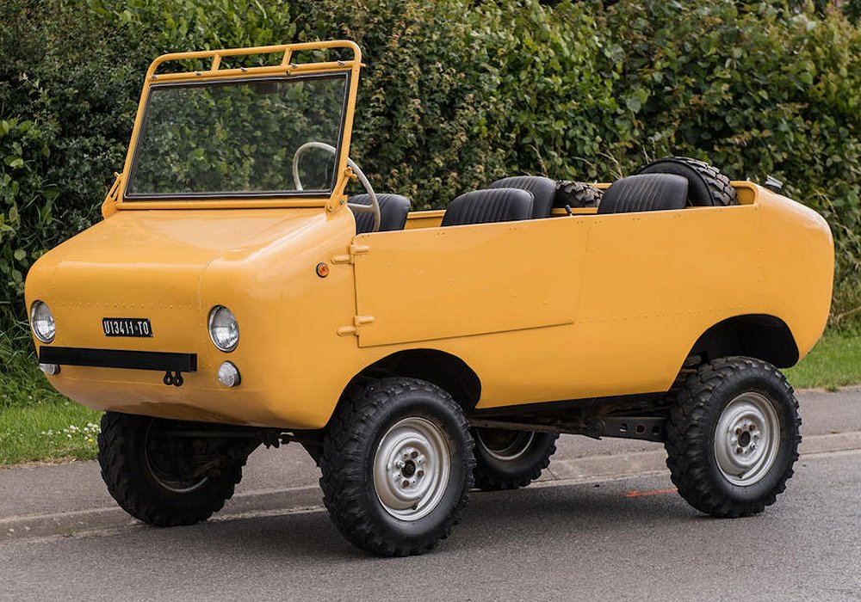

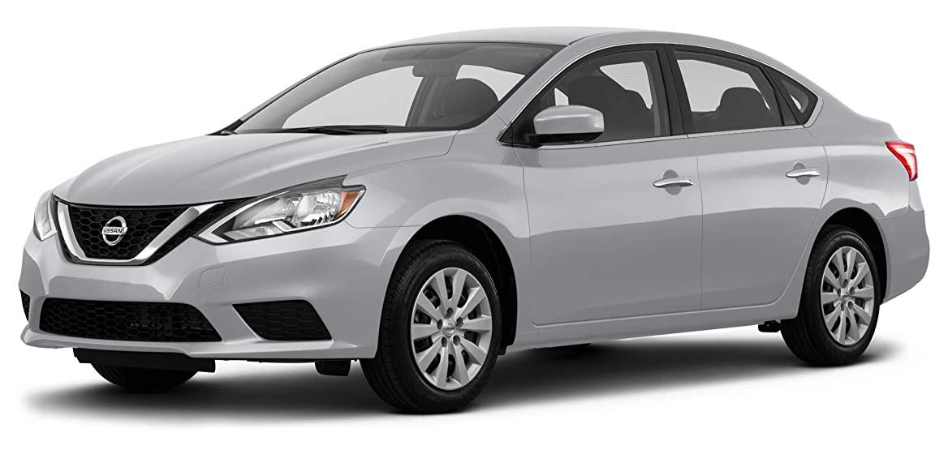
Background
While this does cover the vast majority of cars today it does not cover vintage, exotic or otherwise unusual ones
These sorts of cars are almost always sold at auction

Slide 4

Identifying this gap in the car valuation market, I searched for data that would provide values for all recently sold classic cars
To get this data I webscraped the worlds largest car auctioneer, RM Sotheby’s

Slide 5
In 2015, Sotheby’s, a fine art and collectibles auction house partnered with RM, a vintage car restoration company
Together they auction collector cars and hold the record for most expensive car sold at auction, a 1962 Ferrari GTO, sold for $48.4 million dollars, originally sold for $18,000
RM Sotheby’s hold 5 main auctions a year in different venues throughout the US and abroad

Slide 6

How much should I pay for a Porsche 911?
I chose this particular car to analyze because it was sold many times at every auction and has been produced every year since 1964

Slide 7
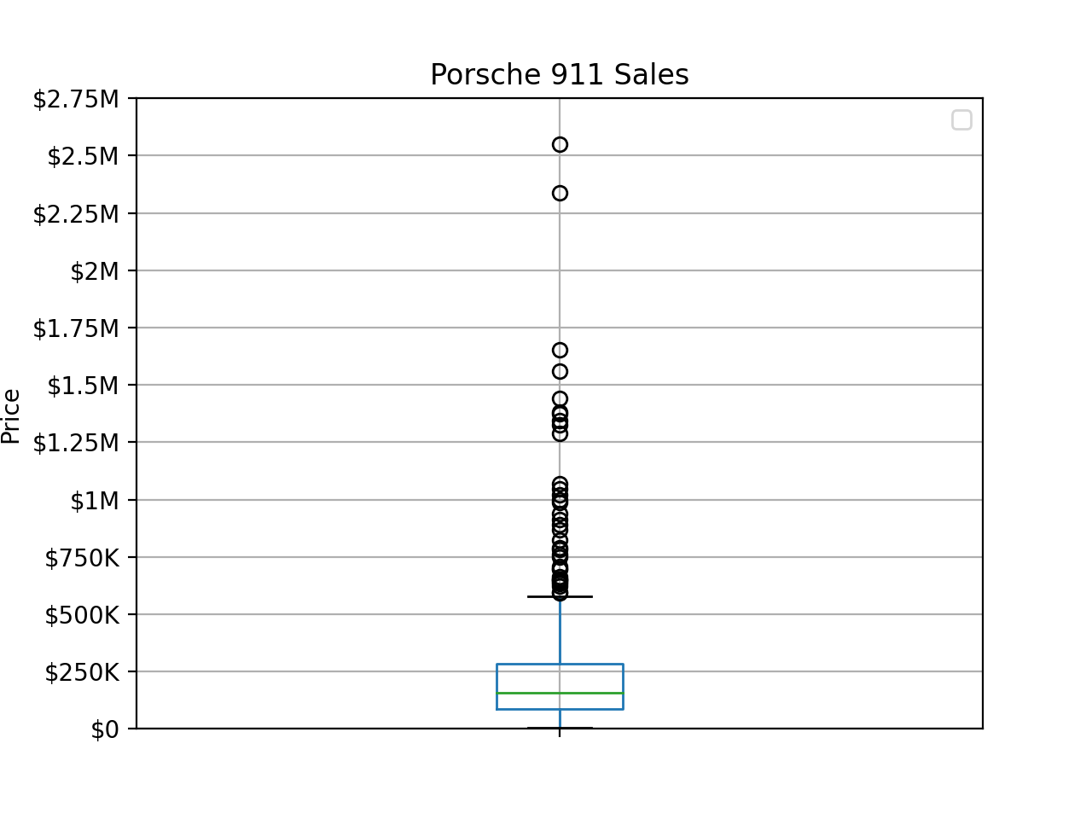
As you can see the variation is very high
The average selling price was $263,000
The median was $156,800 with a standard deviation of $381,339
The box plot shows ~75% of all 911s were between $20,000 - $285,000

Slide 8
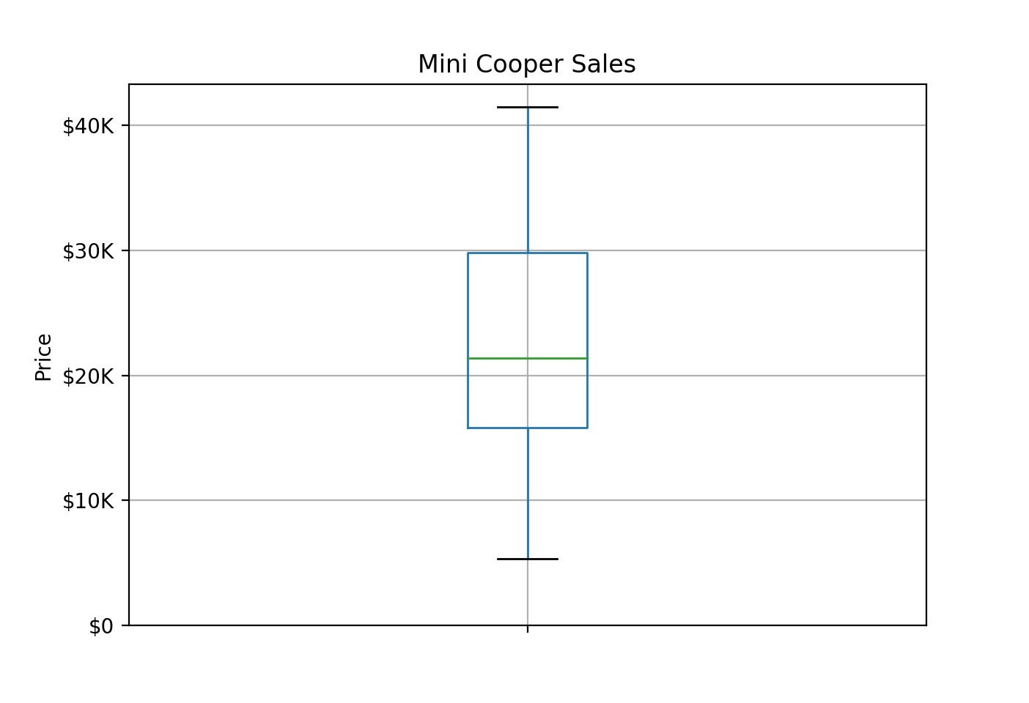
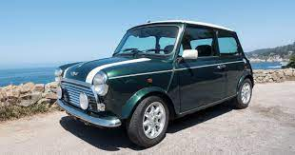
As a reference, here are Mini Cooper sales, which had much less variation

Slide 9
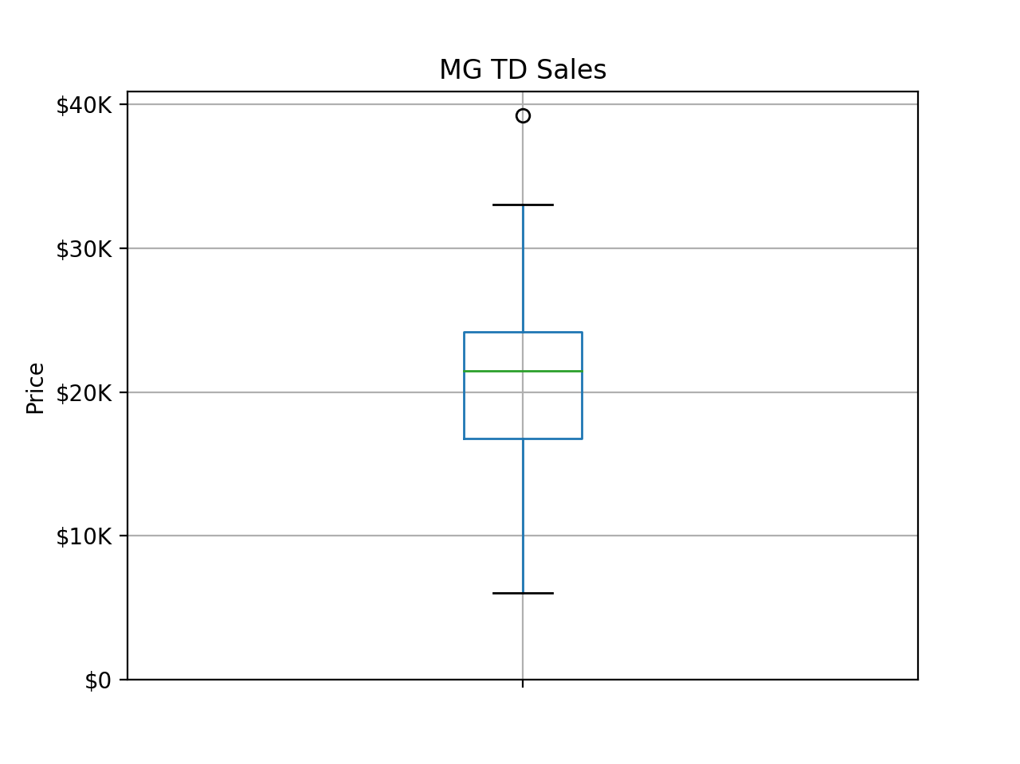
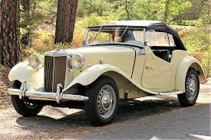
MG Sales show a similar variation

Slide 10
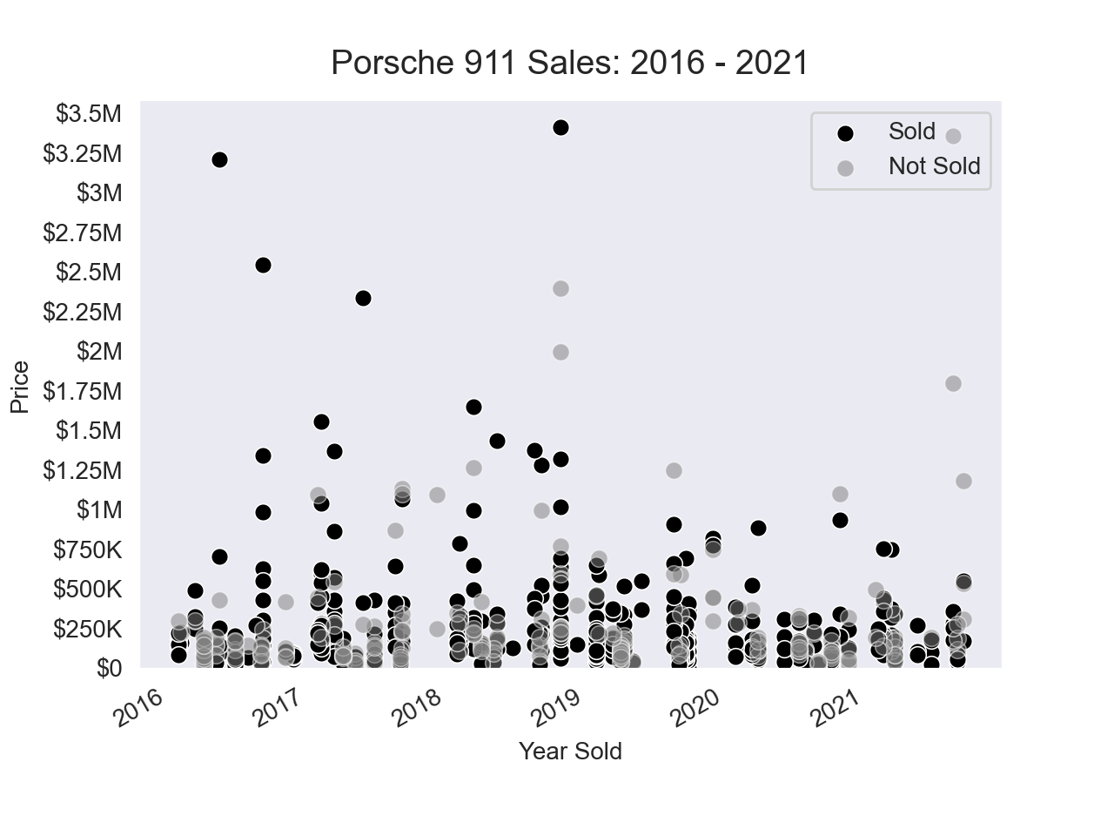

Slide 11
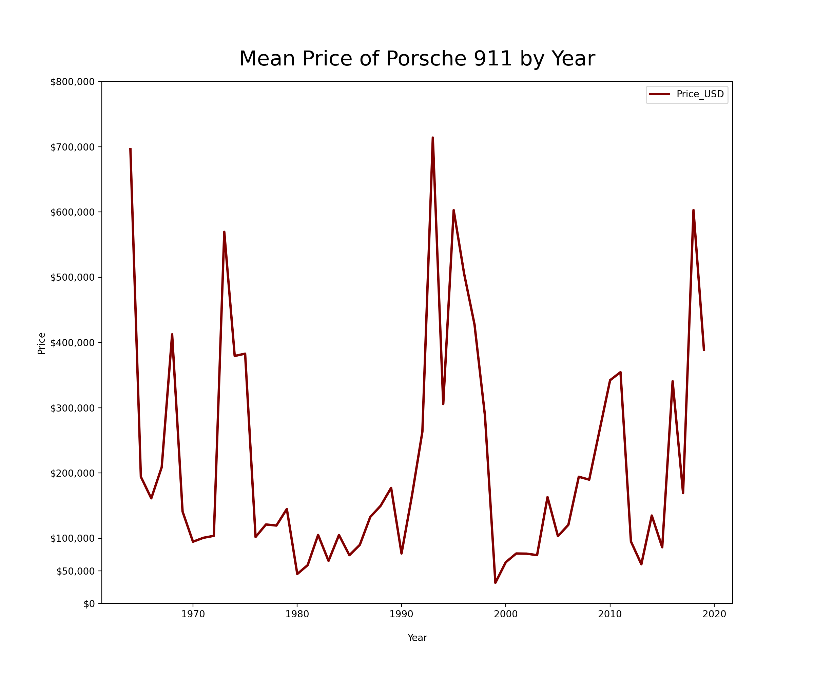
The value of a Porsche 911 depends heavily on what year it was produced
Clearly those manufactured in the mid-90s were considered more desirable than those in the early 2000s

Slide 12
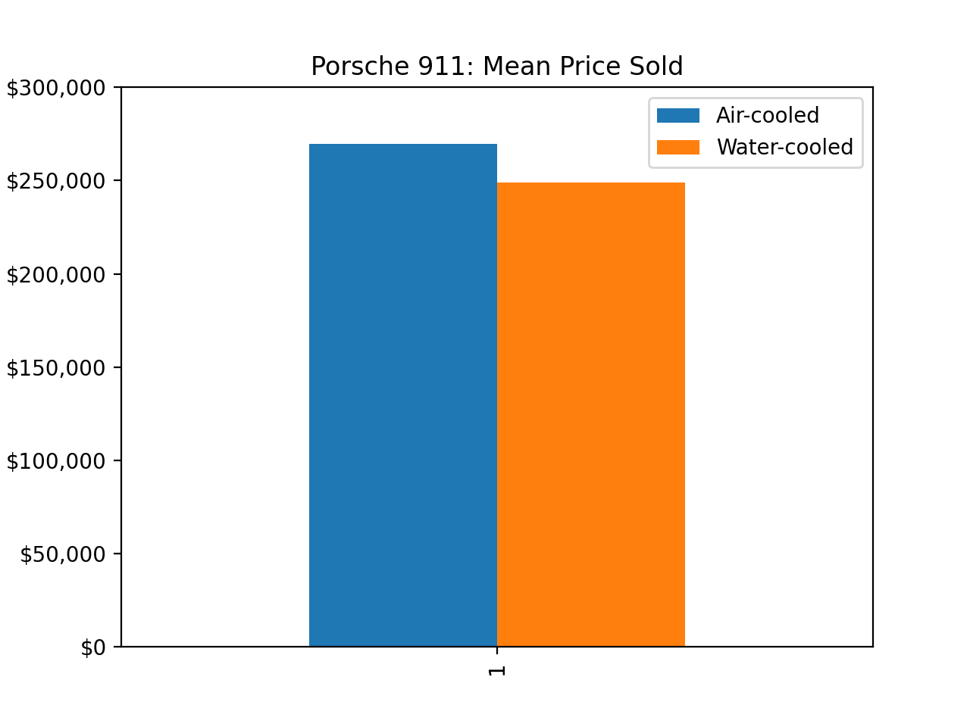

Slide 13
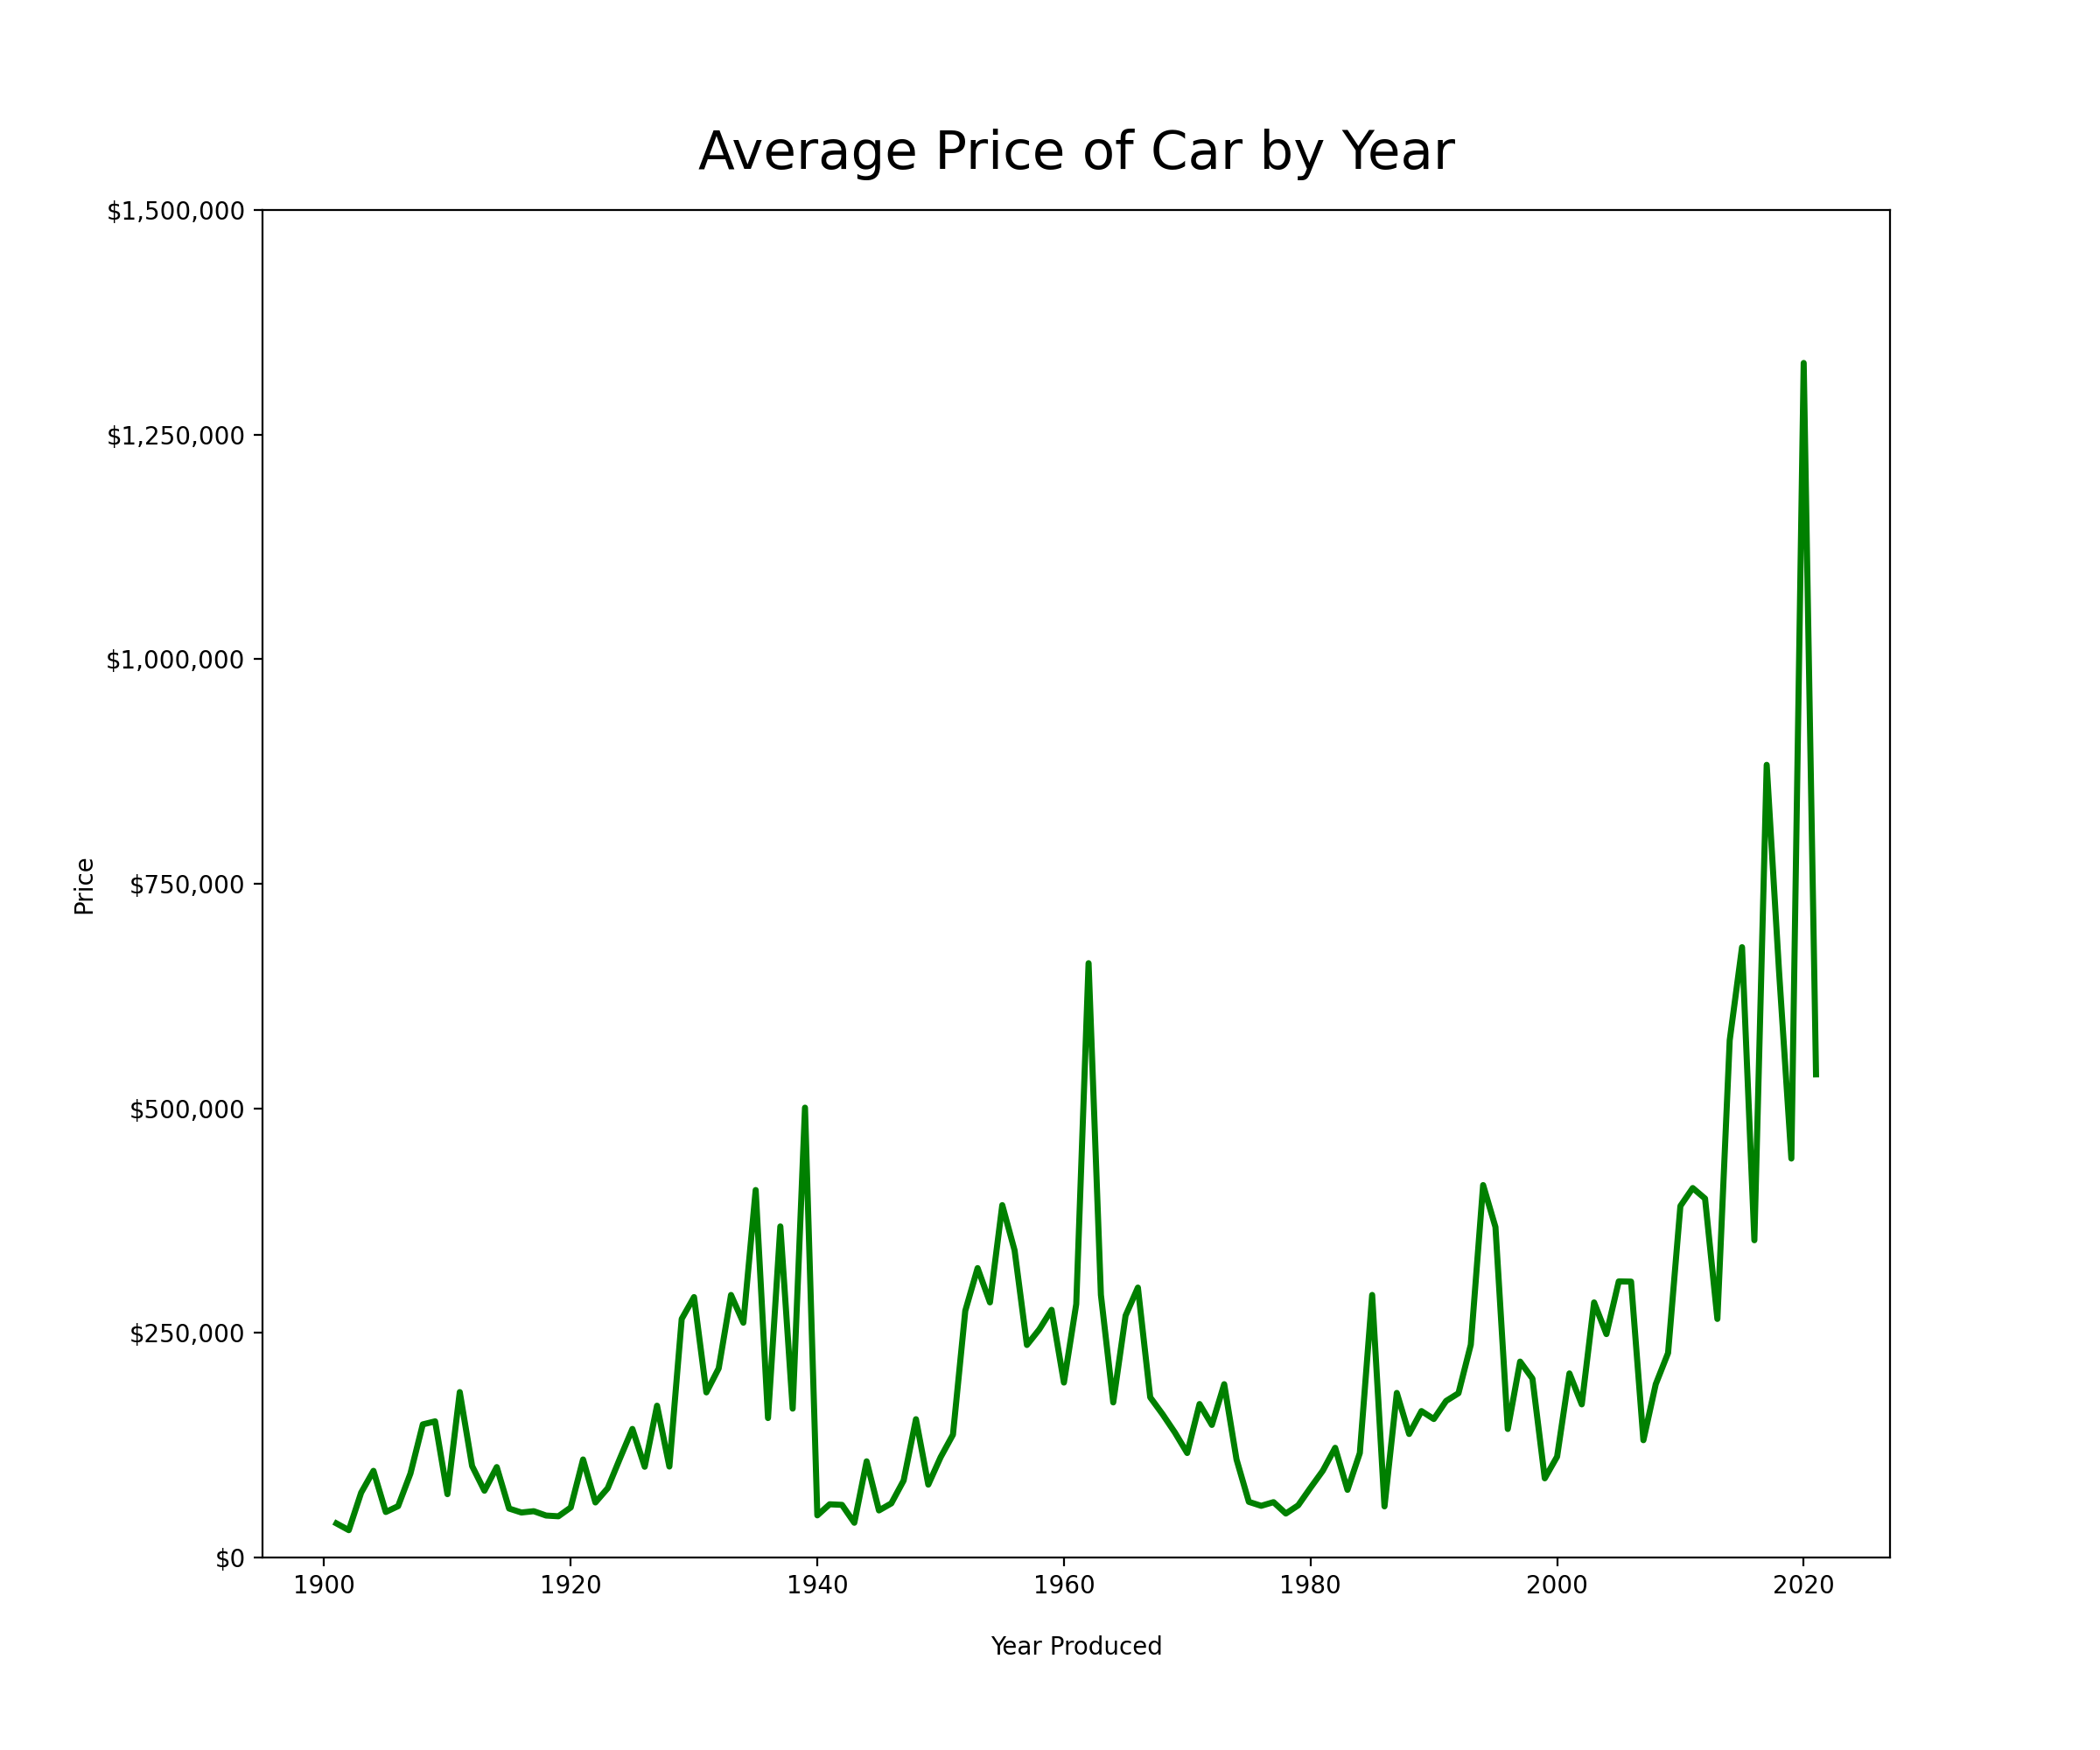

Slide 14
Limitations
Arguably the largest problem with the data I collected is that it does not give insight to the condition of the car
The value of used cars depends heavily on condition and its history. Both of these factors are not taken into account with the data I scraped
Because the auctions typically get cars in excellent condition the prices may not be a good indicator for those in poor shape
Another limitation is that many cars are sold as private sales through auction houses, something they do not report

Slide 15


Going forward
While I webscraped the largest car auction company there are two others that have a big volume of sales as well
With the restriction of time I wasn’t able to get this data but hope to in the future
I would also like to obtain unique identifier for each car so I could track its individual value over the years

