Slide 1
Problem Statement
The given data dump has been given to us by our marketing manager. For the goal of doing data analysis, we must deliver a tidy and well-organized file to analyse the single data which contains all the information.

Slide 2

Process of Organizing the Files

Slide 3

Taxonomy of the data
The given datasets are semi-structured. So In order to make a well-organized file we need to interchange semi structured data with structured data. The given datasets are in an EXCEL file. So we are using the PYTHON tool to arrange the given datasets.
Here are the 6 steps that we used to organize the datasets:
Delete any information that is not relevant.
Reduce data duplication.
Resolve systemic issues
Handle any omitted data.
Remove outliers from the data.
Verify your data.

Slide 4
Taxonomy of the data
The given datasets are semi-structured. So, In order to make a well-organized file we need to interchange semi structured data with structured data. The given datasets are in an EXCEL file. Here we are using the PYTHON tool to arrange the given datasets.
Here are the 6 steps that we used to organize the datasets:
Delete any information that is not relevant.
Reduce data duplication.
Resolve systemic issues
Handle any omitted data.
Remove outliers from the data.
Verify your data.

Slide 5
Data sets are in different excel formats
Imported everything into python
Then merge every files into single excel file.
Then edited the excel file, added two columns like month and hospital.
Deleted unwanted rows and columns manually using excel.

Slide 6
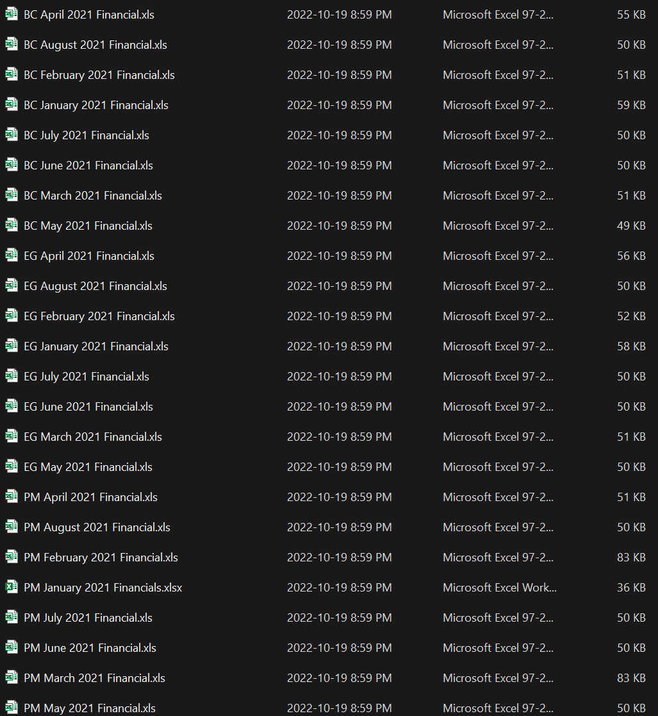
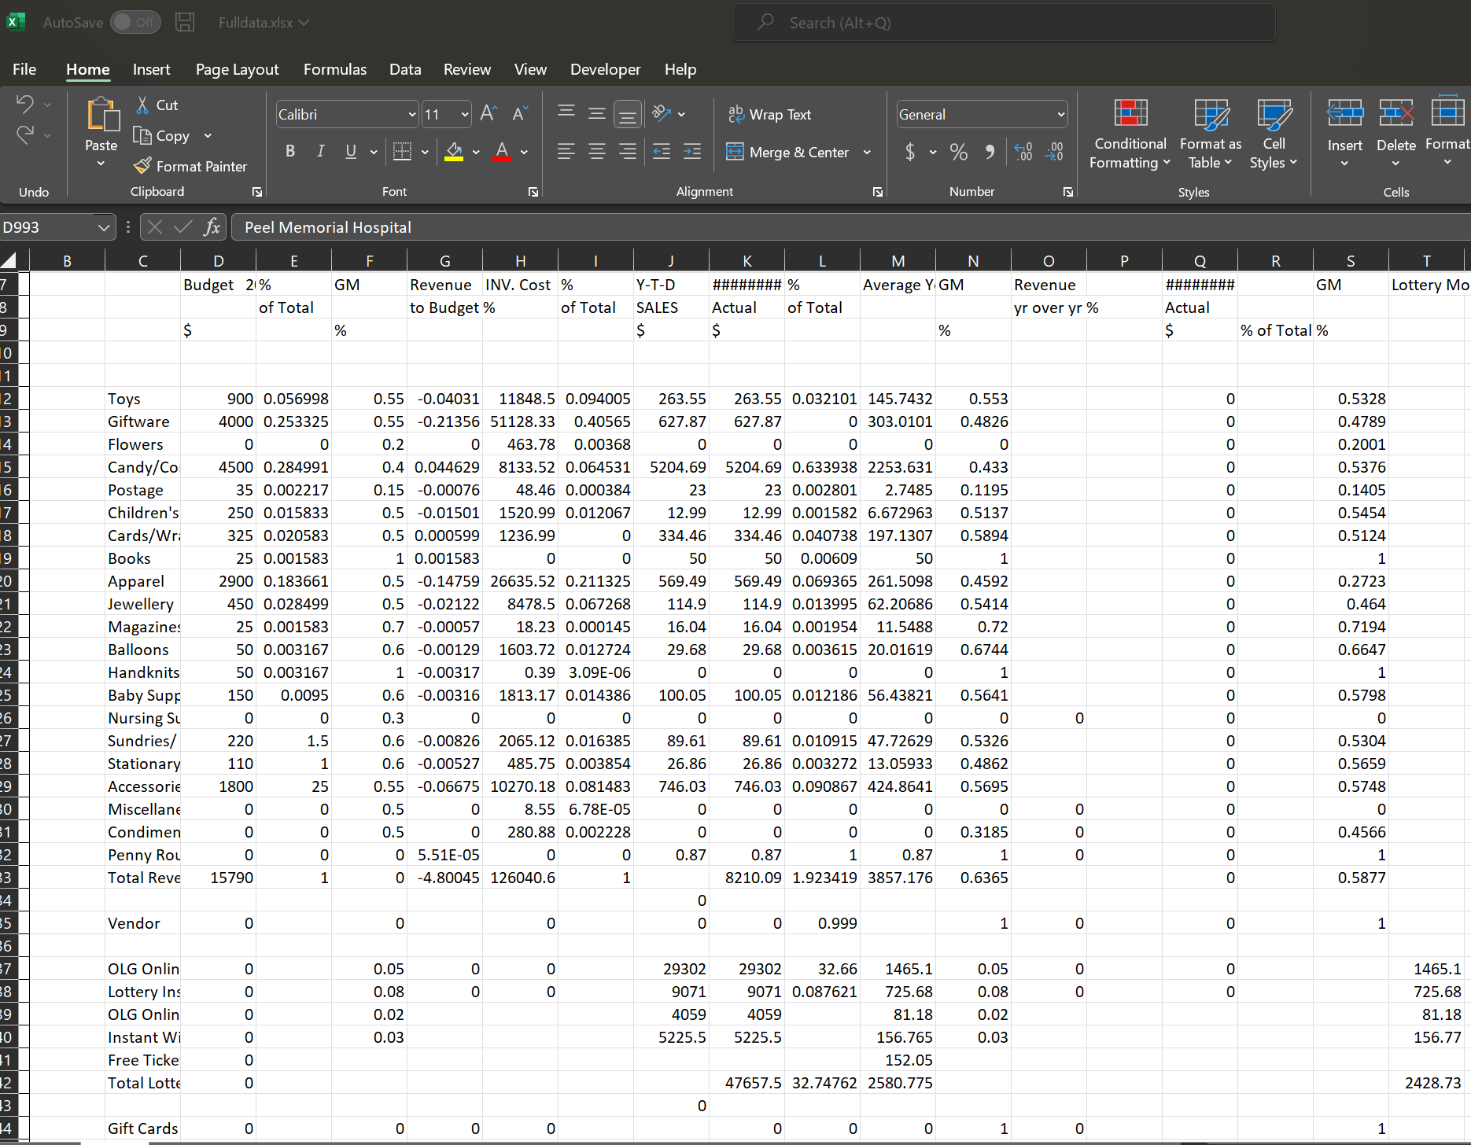
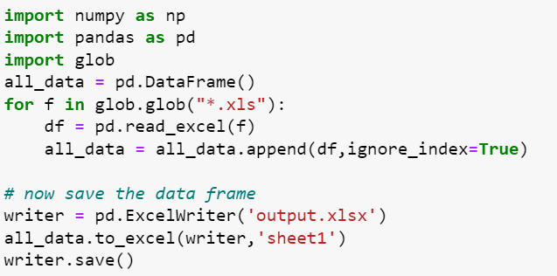

Slide 7
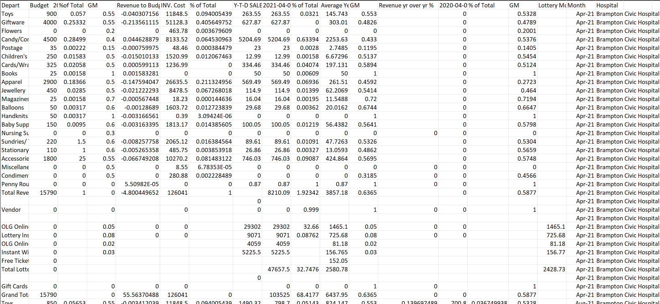
After merging all files into a single excel file, with the help of excel features organize the data, that is
By removing the unwanted columns and rows
By arranging the headings
By adding two extra columns, that is the Month and Hospital Name

Slide 8
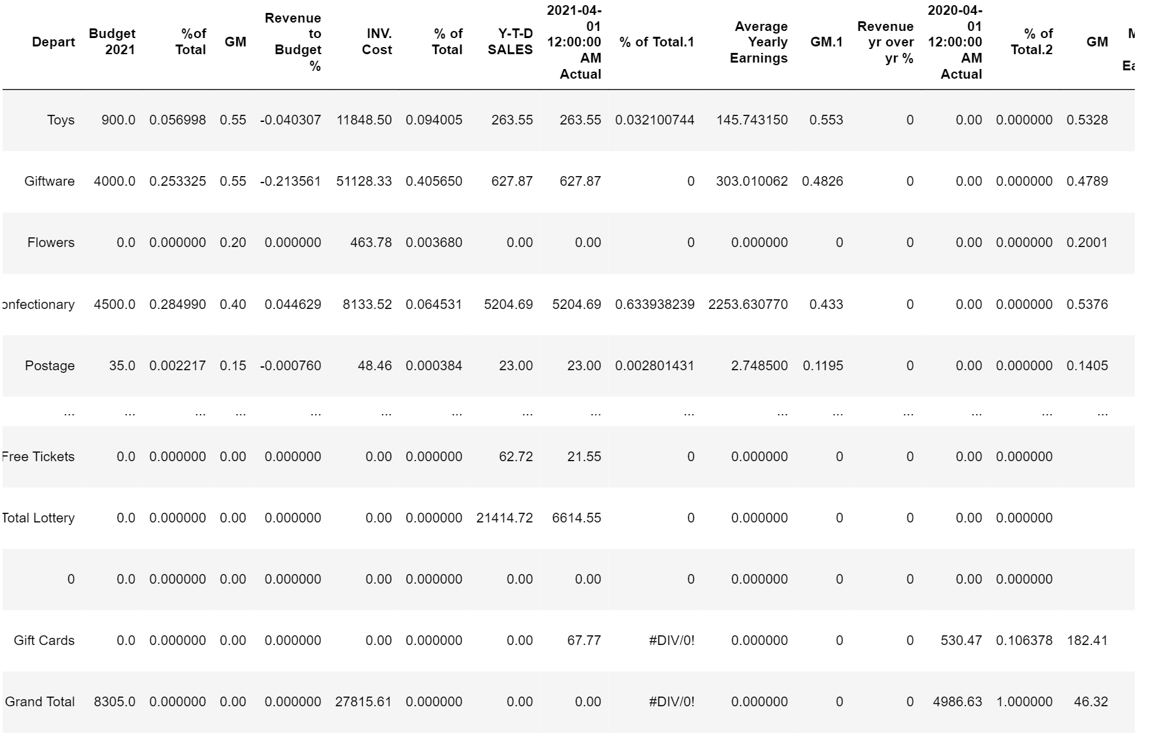
After organize the data in excel, import data into python then;
Filled the NaN values with zero, other filling methods like because backward filling and forward filling methods are not suitable for our data.

Slide 9
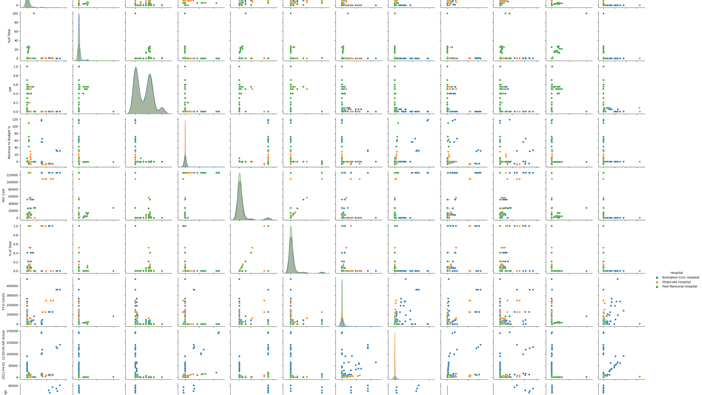

Slide 10
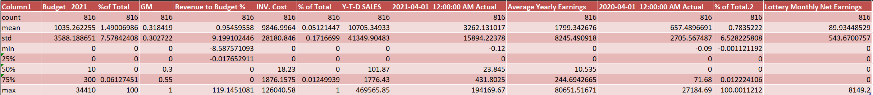
From the data visualisation we can see that there are many possible way to extract the information from the data.
The below data description shows that, we can remove outliers by removing the data in the first and last quartiles.
After that we can analyse the dataset and understand;
Which department holding the highest budget distribution and revenue return ?
What all the departments affecting the average yearly earnings the most ?
Which hospital performs better?

Slide 11
Video link;
https://drive.google.com/drive/folders/1lMdV4rSbRFTkiw4uqkp8I7lGCU-OFntX?usp=sharing

