Slide 1








Critic 1
…
Critic N
$$a_{i}$$
$$Q_{i}$$
MLP
$$o_{1}$$
$$a_{1}$$
…
$$o_{1}$$
$$a_{1}$$
MLP
$$o_{i}$$
Actor 1
…
Actor N
$$(o_{1},…,o_{N}, a_{1}, …, a_{n})$$

Slide 2













$$Q_{tot}$$
Mixing Network
S
$$Q_{tot}$$
$$Q_{i}$$
MLP
Critic 1
Critic N
+
…
$$(o_{1},…,o_{N}, a_{1}, …, a_{n})$$
$$W_{2}$$
S
$$o_{1}$$
$$a_{1}$$
…
$$o_{1}$$
$$a_{1}$$
+
$$a_{i}$$
$$W_{1}$$
MLP
Actor 1
…
Actor N
$$(Q_{1}, …, Q_{n})$$
$$o_{i}$$

Slide 3
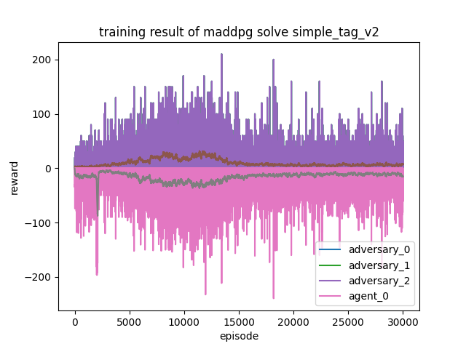
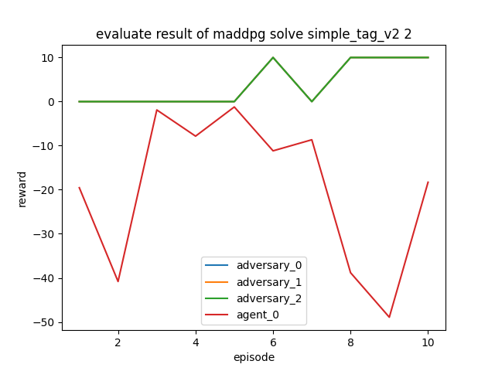
Training result of MADDPG
Evaluation result of MADDPG

Slide 4
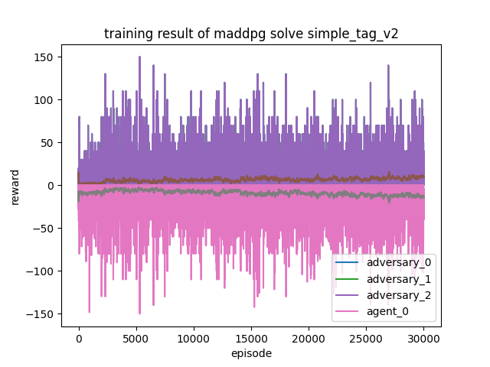
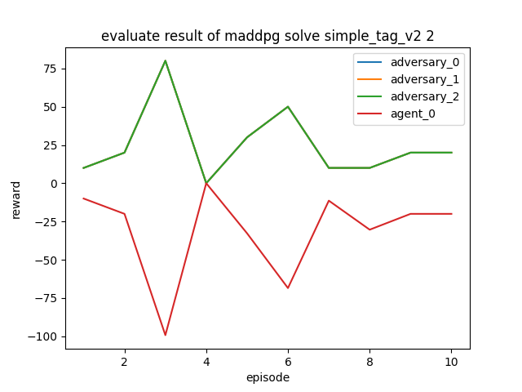
Training result of Deterministic QMIX
Evaluation result of Deterministic QMIX

