Slide 1

M C A F I N A L Y E A R M I N I P R O J E C T
MARGAM
Maternal Assistance for Rural Guidance And Monitoring
Presented by
Melbin K Madhu
Register No. MLM25MCA-2040 • S3 MCA
Department of Computer Applications
Mangalam College of Engineering, Ettumanoor
APJ Abdul Kalam Technological University
Guide
Ms. Kavitha S • Assistant Professor
2026 – 2027

Slide 2
INTRODUCTION
02
Introduction
Four stakeholders
MARGAM is a role-based web application designed to bring key maternal and child healthcare activities into one coordinated digital workflow.
Government • ASHA Worker • Doctor • Mother
01
Centralized records
02
Timely follow-up
03
Monitoring & reporting
Mother, baby, growth, vaccination and appointment information is managed through role-specific modules.
Vaccination schedules, appointment status and notifications support ongoing care.
Government dashboards and reports provide an overview of healthcare activity.
The project focuses on improving coordination and accessibility of information rather than replacing clinical judgement.
MARGAM • MCA FINAL YEAR MINI PROJECT
2

Slide 3
02 • OVERVIEW
03
Abstract
MARGAM is a Django and Bootstrap 5 web application developed to organize maternal and child healthcare activities through a centralized platform. It provides role-based access for Government officials, ASHA workers, Doctors and Mothers. The implemented system supports maternal and baby records, vaccination scheduling and tracking, doctor appointment management, notifications, health information and government-level monitoring.
P
Problem
Fragmented records and follow-up processes.
S
Solution
One role-aware digital workflow.
O
Outcome
Structured information and better visibility.
DJANGO + BOOTSTRAP 5
SQLITE
CHART.JS
MARGAM • MCA FINAL YEAR MINI PROJECT
3

Slide 4
03 • THE CHALLENGE
04
Problem Definition
How can maternal and child healthcare information be coordinated digitally without relying on fragmented records and manual follow-up?
Records
Vaccination
Healthcare information can be scattered across separate records.
Paper-based schedules make follow-up harder to manage.
Coordination
Monitoring
Government, ASHA workers, Doctors and Mothers need a common workflow.
Aggregating information for monitoring and reporting can be time-consuming.
MARGAM • MCA FINAL YEAR MINI PROJECT
4

Slide 5
GOALS
05
Objectives
01
Role-based access
02
Mother & baby records
03
Vaccination management
Dedicated portals for Government, ASHA Worker, Doctor and Mother.
Maintain structured maternal, baby and health information.
Define schedules, generate due records and track vaccination status.
04
Appointment workflow
05
Growth monitoring
06
Government oversight
Support doctor availability, booking and status updates.
Record baby measurements and present growth information visually.
Provide dashboards, reports, notifications and healthcare content management.
MARGAM • MCA FINAL YEAR MINI PROJECT
5

Slide 6
05 • BEFORE MARGAM
06
Existing System
The project targets a workflow dominated by manual records and separate stakeholder interactions.
Mother / Baby
Field Worker
Doctor
Government
Information captured
Records updated
Consultation / appointment
Monitoring & reporting
LIMITATIONS
• Information may be maintained across separate records and interactions.
• Vaccination follow-up can depend on manual tracking.
• Stakeholders may not have a shared, role-specific view of the same information.
• Monitoring and reporting require information to be collected and organized.
MARGAM • MCA FINAL YEAR MINI PROJECT
6

Slide 7
06 • OUR SOLUTION
07
Proposed System
MARGAM replaces the fragmented workflow with a single role-based digital platform.
Government
Doctor
ASHA Worker
Mother
Baby
Manage & monitor
Appointments & records
Field-level updates
Personal care access
monitoring
↑
What changes
✓
Key improvement
Centralized records • role-based dashboards • automated vaccination workflow • appointment status tracking.
Relevant information becomes available through one coordinated application instead of separate manual processes.
MARGAM • MCA FINAL YEAR MINI PROJECT
7

Slide 8
07 • BOUNDARIES
08
Scope of the Project
The final implementation focuses on the core web workflow. Extensions are kept separate as future scope.
IN SCOPE
FUTURE APPLICATIONS
• Role-based authentication and dashboards
• Mother & baby profile management
• Pregnancy and growth records
• Vaccination scheduling and status tracking
• Doctor availability and appointment booking
• Notifications, health tips, food and disease information
• Government monitoring, projects, resources and reports
• Native mobile application
• SMS alerts for low-connectivity areas
• AI-assisted health risk prediction
• GPS-assisted field monitoring
• Wearable-device integration
• Offline entry with later synchronization
MARGAM • MCA FINAL YEAR MINI PROJECT
8

Slide 9
08 • RESEARCH GROUNDING
09
Literature Review
Title & Year | Author / Year | Technology / Method | Performance / Finding
Maternal and Child Vaccination System (2025) — BASE PAPER | Kavitha et al., 2025 | Digital maternal & child healthcare | Integrated maternal care & vaccination monitoring
Vaccidoc: Child Vaccination System (2021) | Salawu, 2021 | Web + SMS tracking | Improved vaccination adherence
VacChain (2022) | Alnssayan et al., 2022 | Secure EMR / vaccination records | Improved security & transparency
Vaccine Management System (2023) | Kamal Acharya, 2023 | Digital scheduling & reports | Better vaccination compliance
Digitalization of Home-Based Records (2023) | Geldof et al., 2023 | Digital home records | Improved record accessibility
Digital Health Technologies for MCH (2023) | Till et al., 2023 | Digital / mobile health | Enhanced maternal & child care
Antenatal Care Management Platform (2023) | Aliyi et al., 2023 | ANC platform | Improved ANC tracking
Vaccidoc (2025) | Kajale et al., 2025 | Web-based reminders | Reduced missed vaccinations
Digital Health Platform for Maternal Health (2025) | Ajayi, 2025 | Digital maternal health | Enhanced maternal care
The supplied review mainly reports qualitative findings; no directly comparable accuracy/F1 metrics are claimed for MARGAM.
MARGAM • MCA FINAL YEAR MINI PROJECT
9

Slide 10
09 • TOOLSET
10
Technologies Used
01
Frontend
02
Backend
HTML • CSS • JavaScript • Bootstrap 5
Python • Django
03
Database
04
Visualization
SQLite
Chart.js
05
Event-driven logic
06
Application Model
Django Signals
Role-based modular architecture
The implementation uses open-source web technologies and a modular Django structure.
MARGAM • MCA FINAL YEAR MINI PROJECT
10

Slide 11
10 • ENVIRONMENT
11
Software & Hardware Requirements
SW
Software Requirements
HW
Hardware Requirements
• Python / Django runtime
• SQLite database
• Modern web browser
• HTML, CSS, JavaScript & Bootstrap support
• Chart.js for dashboard visualization
• Standard development laptop / desktop
• Sufficient RAM and storage for the development environment
• Network access when the application is hosted or accessed remotely
DEVELOPMENT ENVIRONMENT
The project is designed to run as a conventional Django web application without specialized hardware.
MARGAM • MCA FINAL YEAR MINI PROJECT
11

Slide 12
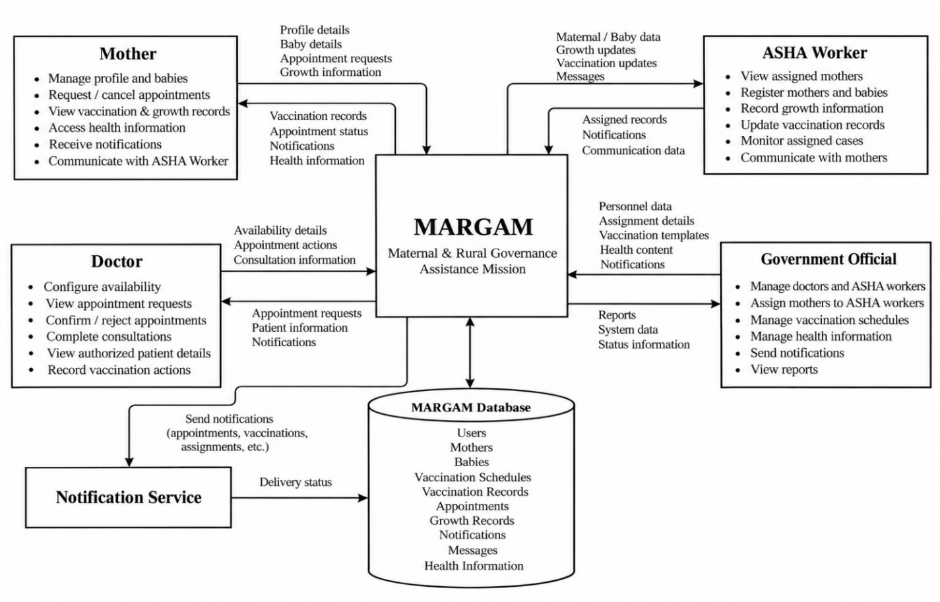
11 • UNDER THE HOOD
12
System Architecture
MARGAM • MCA FINAL YEAR MINI PROJECT
12

Slide 13
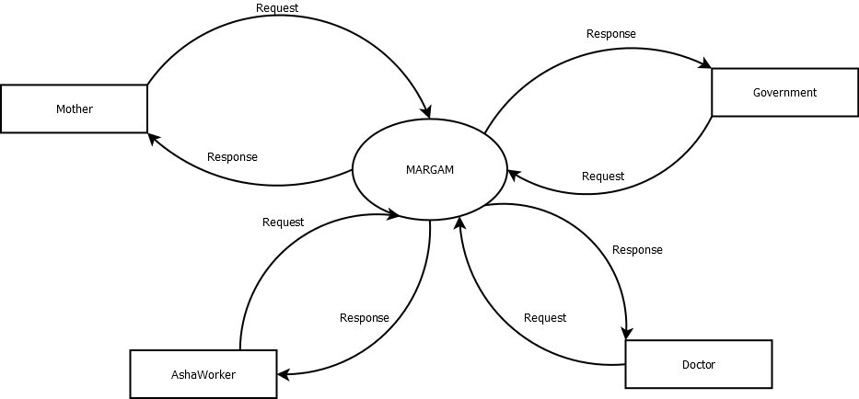
12 • SYSTEM DESIGN
13
Design Diagrams
Data Flow Diagram — Level 0
MARGAM • MCA FINAL YEAR MINI PROJECT
13

Slide 14
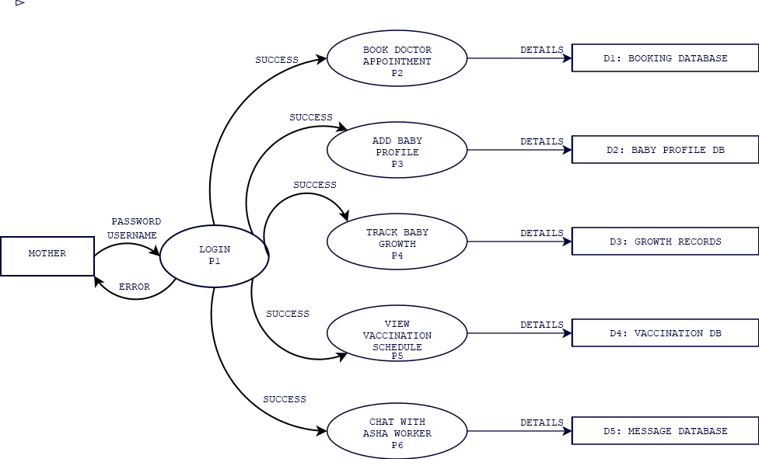
SYSTEM DESIGN
Data Flow Diagram — Level 1 (Mother)
MARGAM • MCA FINAL YEAR MINI PROJECT
14

Slide 15
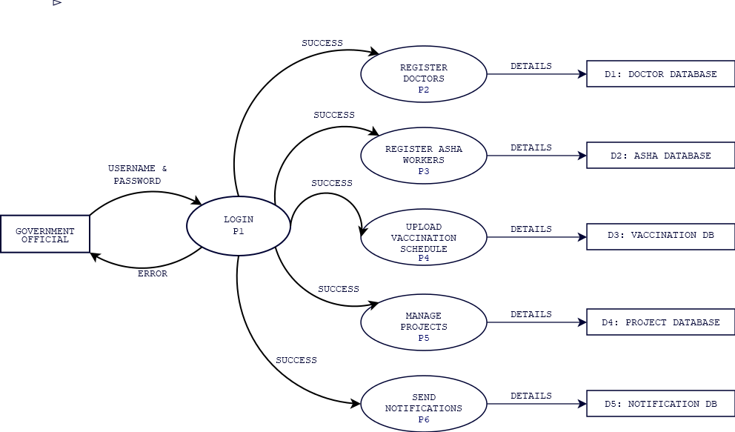
SYSTEM DESIGN
Data Flow Diagram — Level 1 (Government)
MARGAM • MCA FINAL YEAR MINI PROJECT
15

Slide 16
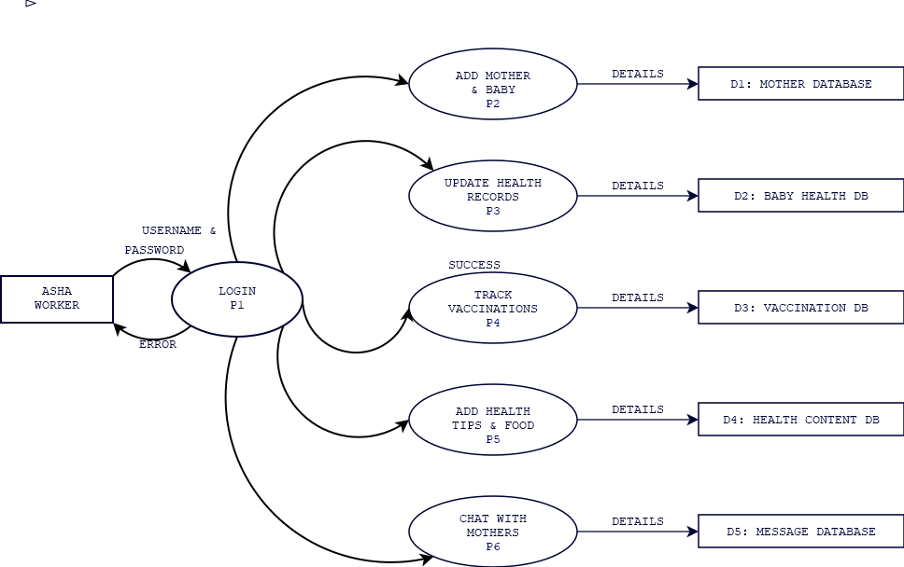
SYSTEM DESIGN
Data Flow Diagram — Level 1 (AshaWorker)
MARGAM • MCA FINAL YEAR MINI PROJECT
16

Slide 17
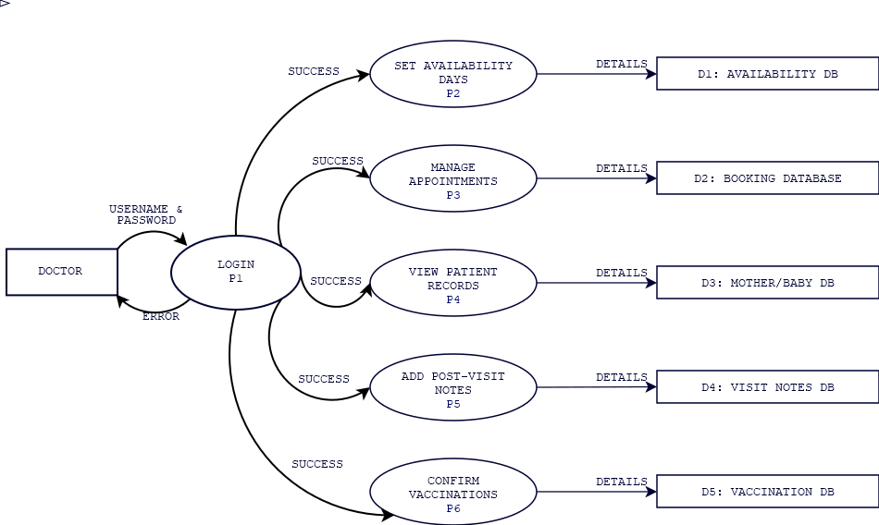
SYSTEM DESIGN
Data Flow Diagram — Level 1 (Doctor)
MARGAM • MCA FINAL YEAR MINI PROJECT
17

Slide 18
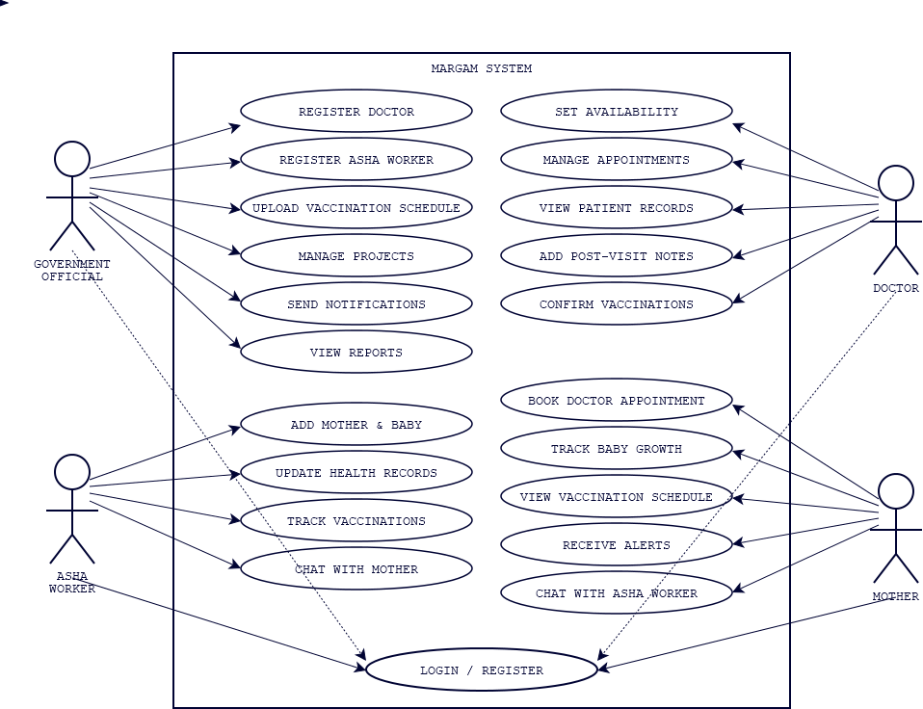
SYSTEM DESIGN
Use Case Diagram
MARGAM • MCA FINAL YEAR MINI PROJECT
18

Slide 19
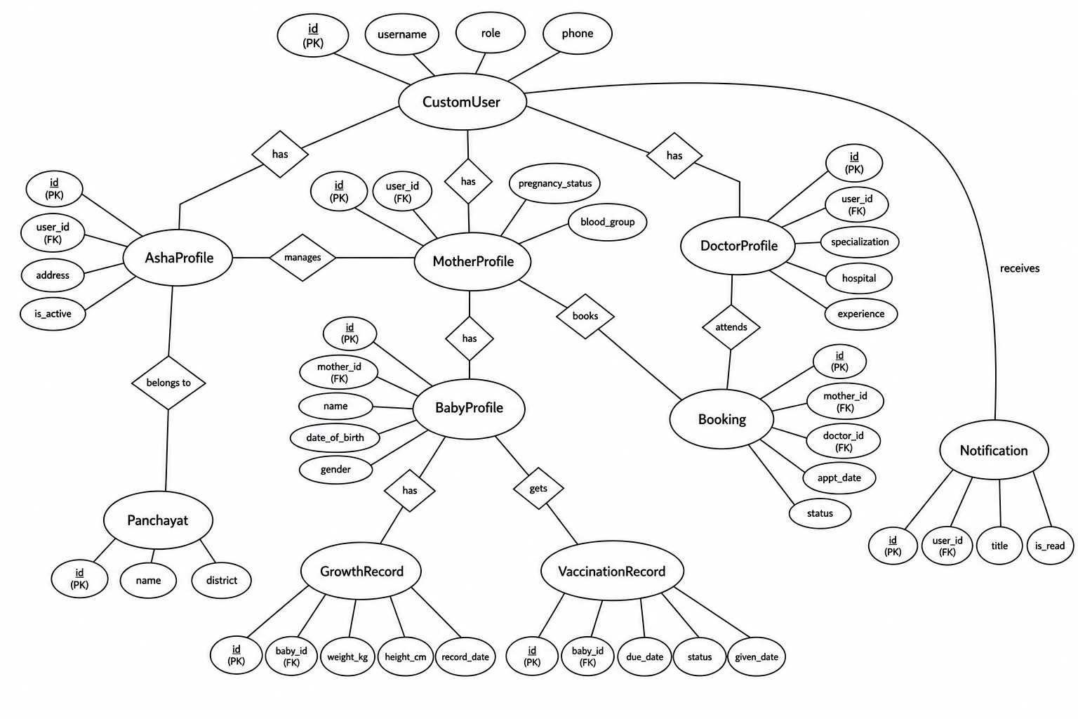
SYSTEM DESIGN
ER Diagram
MARGAM • MCA FINAL YEAR MINI PROJECT
19

Slide 20
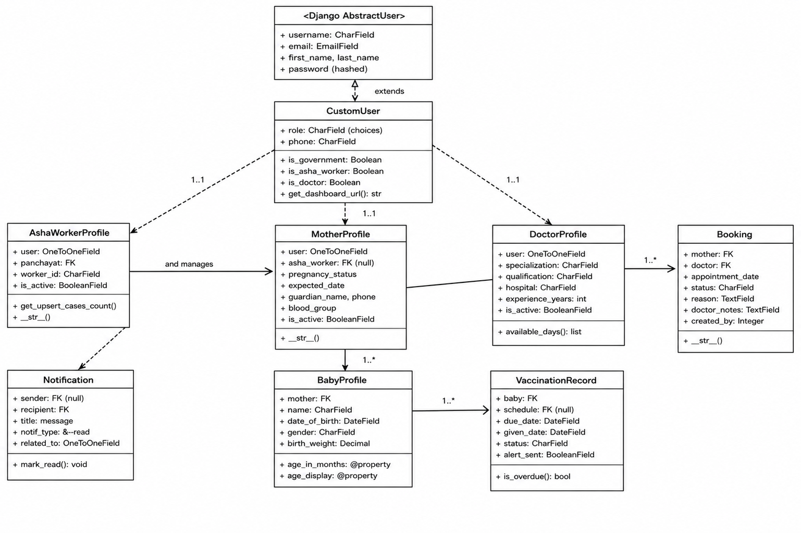
SYSTEM DESIGN
Class Diagram
MARGAM • MCA FINAL YEAR MINI PROJECT
20

Slide 21
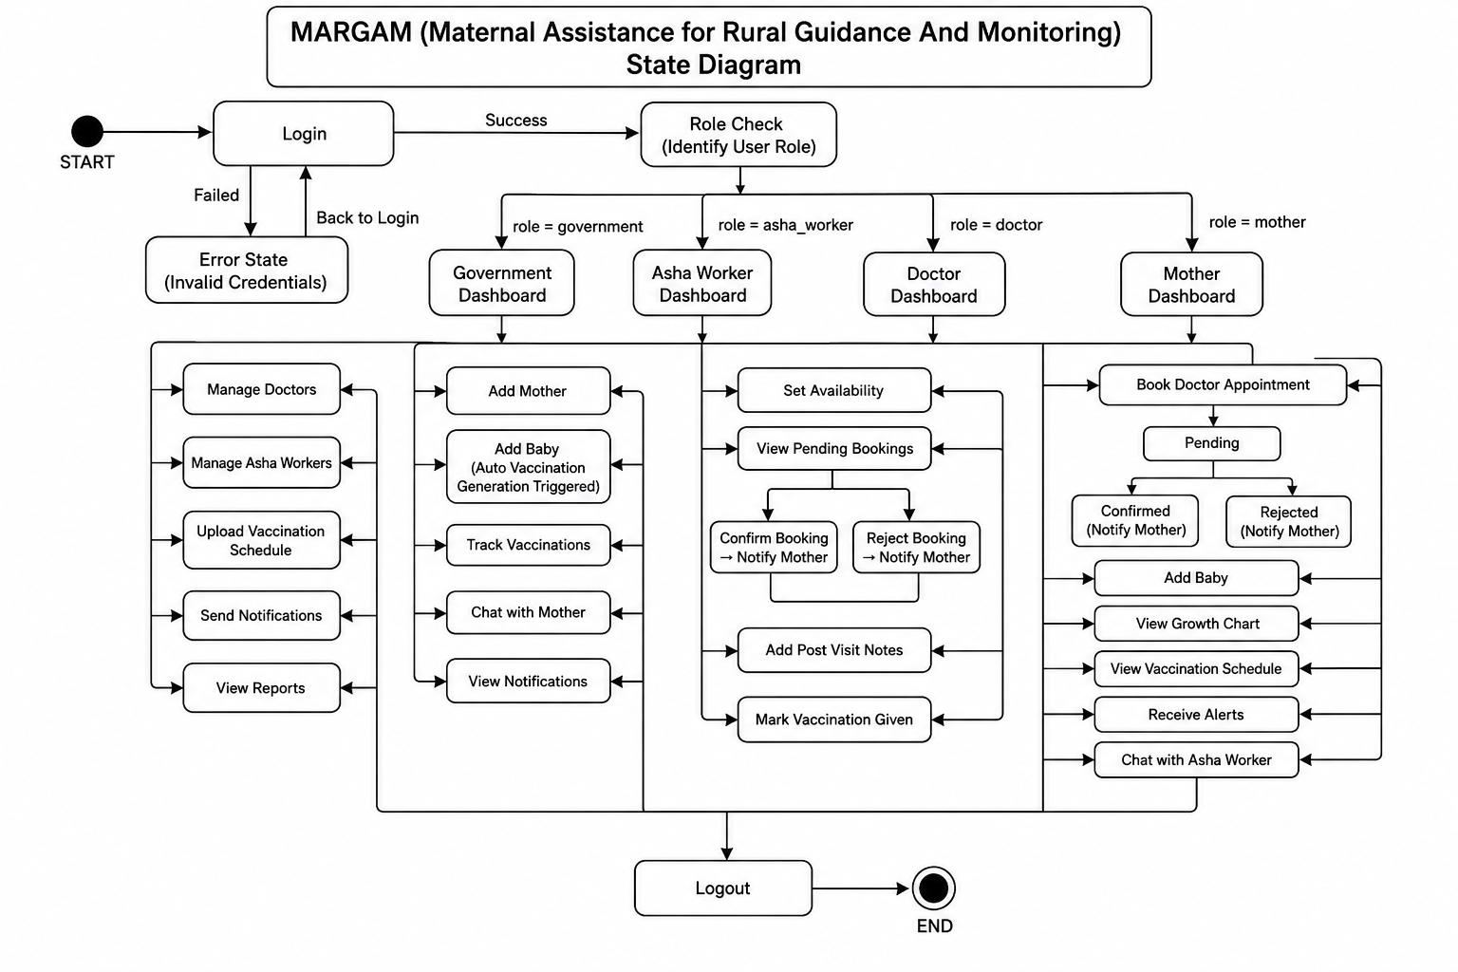
SYSTEM DESIGN
State Diagram
MARGAM • MCA FINAL YEAR MINI PROJECT
21

Slide 22
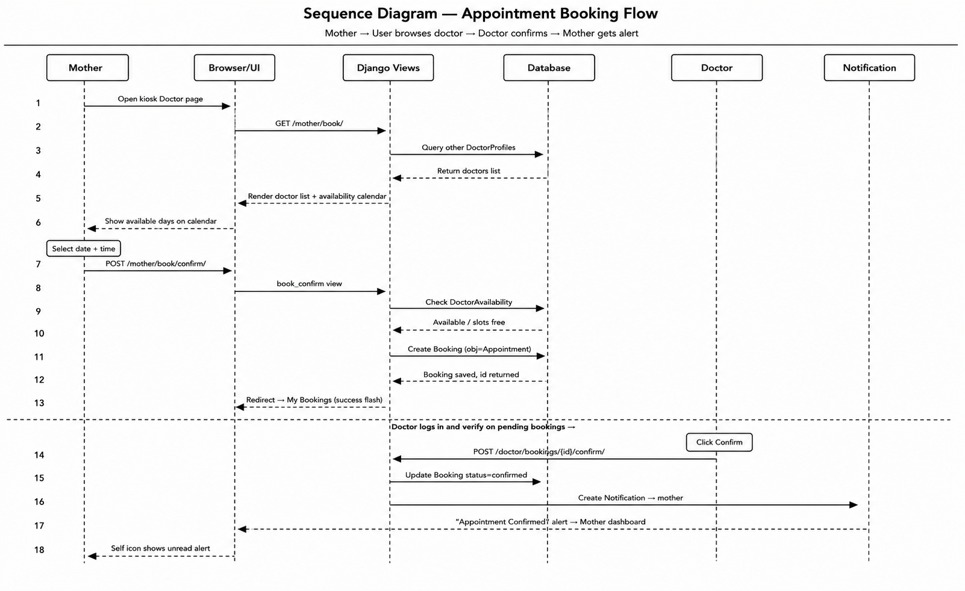
SYSTEM DESIGN
Sequence Diagram
MARGAM • MCA FINAL YEAR MINI PROJECT
22

Slide 23
13 • BUILDING BLOCKS
14
Module Description
01
Government Module
02
ASHA Worker Module
Manage doctors and ASHA workers, vaccination schedules, projects, resources, health information, notifications and reports.
Manage mothers and babies, update health records, growth data and vaccination status.
03
Doctor Module
04
Mother Module
Set availability, manage appointments, view patient details and update vaccination / care information.
Access pregnancy and baby information, vaccination schedules, growth, appointments, alerts and health information.
MARGAM • MCA FINAL YEAR MINI PROJECT
23

Slide 24
14 • APPROACH
15
Methodology
01
02
03
04
05
06
Requirement Analysis
System Design
Database Design
Backend Development
Frontend Development
Testing & Refinement
Identify roles, workflows and functional needs.
Prepare architecture, DFD/UML and module structure.
Model users, mothers, babies, vaccinations and appointments.
Implement Django models, views, URLs and business logic.
Build responsive role-specific interfaces.
Validate core workflows and access control.
Development principle
Build in modules → validate each layer → integrate the complete workflow.
MARGAM • MCA FINAL YEAR MINI PROJECT
24

Slide 25
15 • IMPLEMENTATION
16
Implementation
01
Authentication & Access
02
Vaccination Logic
03
Appointments
Custom user roles and role-specific dashboard routing.
Baby registration can trigger creation of vaccination records from schedule templates.
Doctor availability and booking states support the consultation workflow.
04
Notifications
05
Growth Monitoring
06
Government Monitoring
Vaccination and appointment updates are stored as in-app notifications.
Weight, height and head circumference records support baby tracking.
Dashboard aggregates key counts and visual summaries for oversight.
Implementation structure: accounts • core • government • ASHA • doctor • mother
DJANGO MODELS
VIEWS + URLS
TEMPLATES
SIGNALS
SQLITE
MARGAM • MCA FINAL YEAR MINI PROJECT
25

Slide 26
16 • OUTCOME
17
Results / Analysis
The implementation currently covers the core project workflow identified during development.
✓
Authentication
✓
Role Management
✓
Mother Module
✓
Vaccination Tracking
✓
Doctor Appointment Booking
✓
Government Dashboard
✓
Notifications
38
automated test methods defined
across the main Django apps
Observation
The system provides a unified workflow for role-based records, vaccination, appointments, notifications and monitoring.
No ML accuracy/F1 or clinical outcome metric is claimed because MARGAM is a management web application, not a predictive model.
MARGAM • MCA FINAL YEAR MINI PROJECT
26

Slide 27
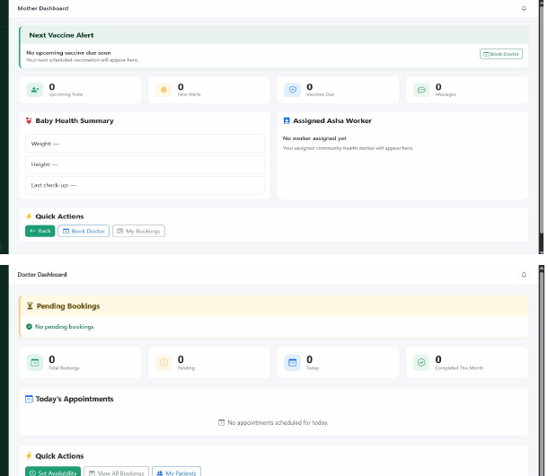
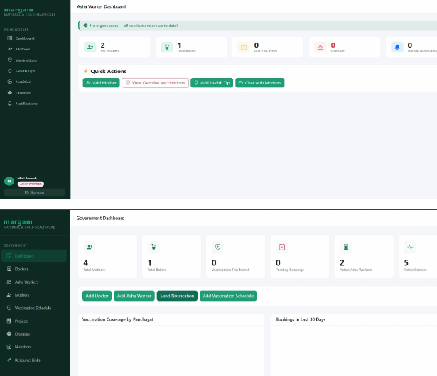
17 • OUTPUT
18
Screenshots / Output
Interface / dashboard snapshot
Functional interface snapshot
The current deck source contains interface snapshots from the implemented design. Replace these with the latest final-build screenshots before submission if the UI has changed.
LOGIN
DASHBOARD
MODULE UI
REPORTS
MARGAM • MCA FINAL YEAR MINI PROJECT
27

Slide 28
18 • ANALYSIS
19
Comparison with Existing System
Feature | Existing System | Proposed System
Processing | Manual / fragmented | Centralized digital workflow
Record Access | Separate records | Role-based access to structured records
Vaccination | Manual tracking | Schedule templates + tracking
Appointments | Separate coordination | Availability + booking + status
Security | Limited role separation | Role-based authentication & access control
Accessibility | Information scattered | Relevant information in one application
Reporting | Manual aggregation | Dashboard + reports + charts
Comparison reflects the workflow targeted by MARGAM; it does not claim measured clinical outcome improvement.
MARGAM • MCA FINAL YEAR MINI PROJECT
28

Slide 29
19 • VALIDATION
20
Testing
Automated test coverage is present across the main Django applications. The table shows representative cases.
Test Case | Expected Result | Validation in Project | Status
Valid Login | Login successful | Automated test method defined | Covered
Invalid Login | Error / login rejected | Automated test method defined | Covered
Unauthorized Dashboard Access | Access restricted | Automated test method defined | Covered
Vaccination Workflow | Vaccination records created / updated | Automated workflow test defined | Covered
Appointment Workflow | Booking status changes correctly | Automated workflow test defined | Covered
Data Isolation | User cannot access another user's data | Access-isolation tests defined | Covered
38 test methods are present in the supplied source. Execution was not independently run in this presentation-building environment, so no unverified “Pass” claim is shown.
MARGAM • MCA FINAL YEAR MINI PROJECT
29

Slide 30
20 • LIVE WALKTHROUGH
Demo Video
21
MARGAM • MCA FINAL YEAR MINI PROJECT
30

Slide 31
BENEFITS
22
Advantages
✓
Centralized
✓
Role-aware
✓
Automated vaccination
One application connects the four project roles and their healthcare workflows.
Each stakeholder receives a focused dashboard and permitted actions.
Government schedule templates can generate baby vaccination records automatically.
✓
Better visibility
✓
Structured follow-up
✓
Extensible foundation
Dashboards, charts, notifications and reports make project information easier to monitor.
Appointment statuses and vaccination states make pending actions visible.
Django modularity allows additional healthcare services and integrations to be added later.
MARGAM • MCA FINAL YEAR MINI PROJECT
31

Slide 32
22 • HONEST ASSESSMENT
23
Limitations
!
Web-first
The current implementation is browser-based; no native mobile application is included.
!
Offline Sync
Offline entry and synchronization are not claimed as a completed current feature.
!
Local Database
SQLite is suitable for the project environment; production-scale deployment may require a different database setup.
!
No Predictive AI
MARGAM manages healthcare information but does not currently perform AI-based risk prediction.
!
No Clinical Study
The project does not include real-world clinical deployment or measured healthcare outcome data.
MARGAM • MCA FINAL YEAR MINI PROJECT
32

Slide 33
Conclusion
A unified digital workflow for maternal & child healthcare management.
MARGAM brings Government officials, ASHA workers, Doctors and Mothers into one role-based platform. The implemented system combines structured records, vaccination scheduling, appointments, notifications, health information and monitoring features in a single Django application.
The project provides a practical foundation that can be extended into a larger digital maternal and child healthcare platform.
CENTRALIZED
ROLE-BASED
AUTOMATED
EXTENSIBLE
MARGAM • MCA FINAL YEAR MINI PROJECT
33

Slide 34
24 • NEXT STEP
25
Future Scope
→
Mobile Application
→
SMS Alerts
→
AI-Assisted Risk Prediction
Extend the web workflow to Android / iOS.
Support reminders where continuous web access is difficult.
Explore models for identifying potential health risks.
→
GPS Field Monitoring
→
Wearable Integration
→
Offline Synchronization
Support location-aware ASHA worker coordination.
Capture selected health measurements from supported devices.
Allow local entry and synchronization when connectivity returns.
MARGAM • MCA FINAL YEAR MINI PROJECT
34

Slide 35
25 • SOURCES
26
References
[1] O. Salawu, “Implementation of Web-Based Architecture for Child Immunization Information Management System Integrated with SMS Reminder,” 2021.
[2] A. A. Alnssayan et al., “VacChain: A Blockchain-Based EMR System to Manage Child Vaccination Records,” 2022.
[3] K. Acharya, “Vaccine Management System Project Report,” 2023.
[4] M. Geldof, N. Gerlach, and A. Portela, “Digitalization of Home-Based Records for Maternal, Newborn, and Child Health,” 2023.
[5] A. Aliyi, B. Mesfin, F. Hassen, et al., “Antenatal Care Management Platform,” 2023.
[6] S. Till et al., “Digital Health Technologies for Maternal and Child Health,” 2023.
[7] R. Kajale, N. Shaikh, and G. Nagendre, “Vaccidoc: Child Vaccination Management System,” 2025.
[8] T. Ajayi, “Digital Health Platform for Maternal Health,” 2025.
[9] O. Kavitha et al. “Maternal and Child Vaccination System (2025),” 2025.
Reference details are formatted from the bibliographic information available in the supplied project materials.
MARGAM • MCA FINAL YEAR MINI PROJECT
35

Slide 36
Thank You
Questions & Discussion
MARGAM • Maternal Assistance for Rural Guidance And Monitoring
MARGAM • MCA FINAL YEAR MINI PROJECT
36

