Slide 1
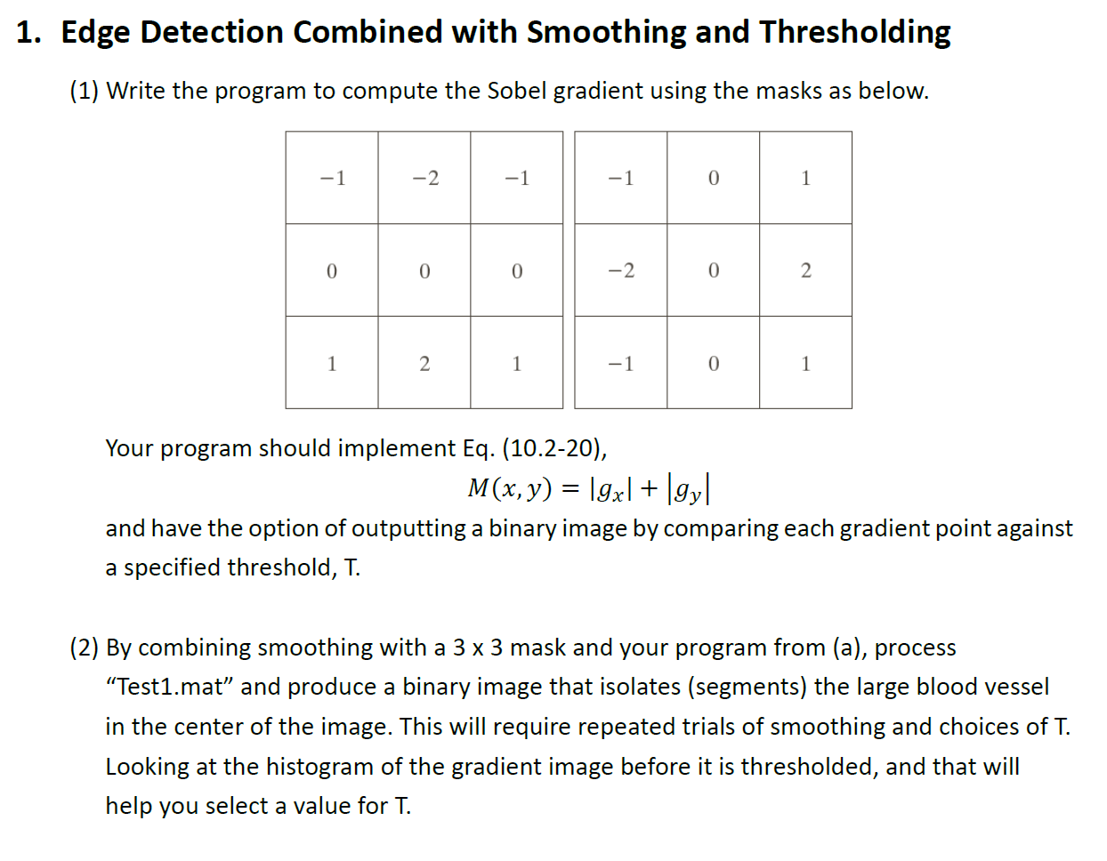
Note：
Write your own Sobel gradient based on the equation;
Display all images and histograms;
Smoothing before edge detection using 3*3 mask (Section 3.5.1, Smoothing spatial filter);
Choose T by observing histogram of gradient image.

Slide 3
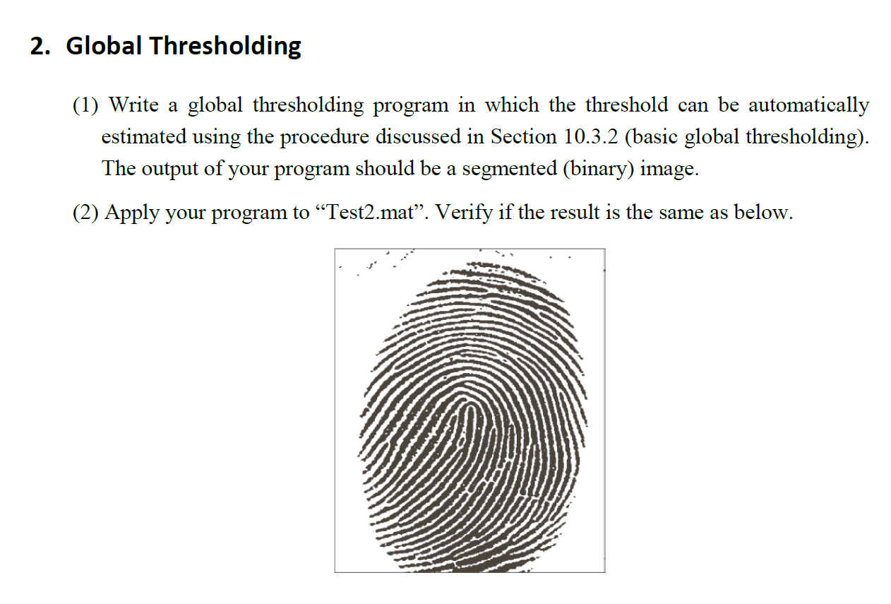
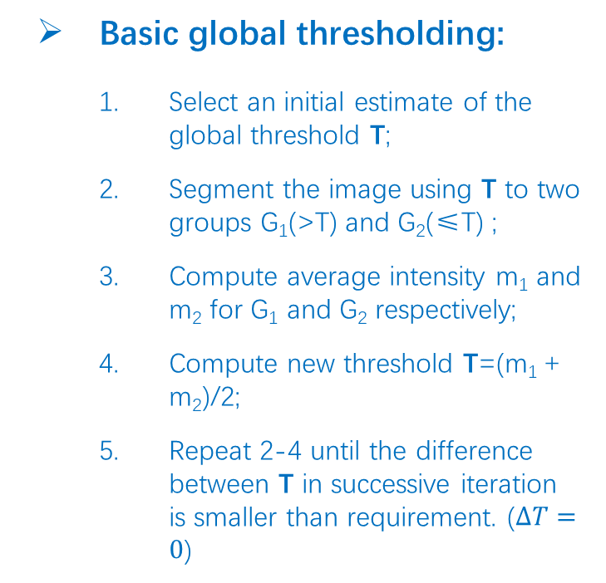
Basic global thresholding:
Select an initial estimate of the global threshold T;
Segment the image using T to two groups G₁(>T) and G₂(≤T) ;
Compute average intensity m₁ and m₂ for G₁ and G₂ respectively;
Compute new threshold T=(m₁ + m₂)/2;
Repeat 2-4 until the difference between T in successive iteration is smaller than requirement. ($∆T=0$)

Slide 4
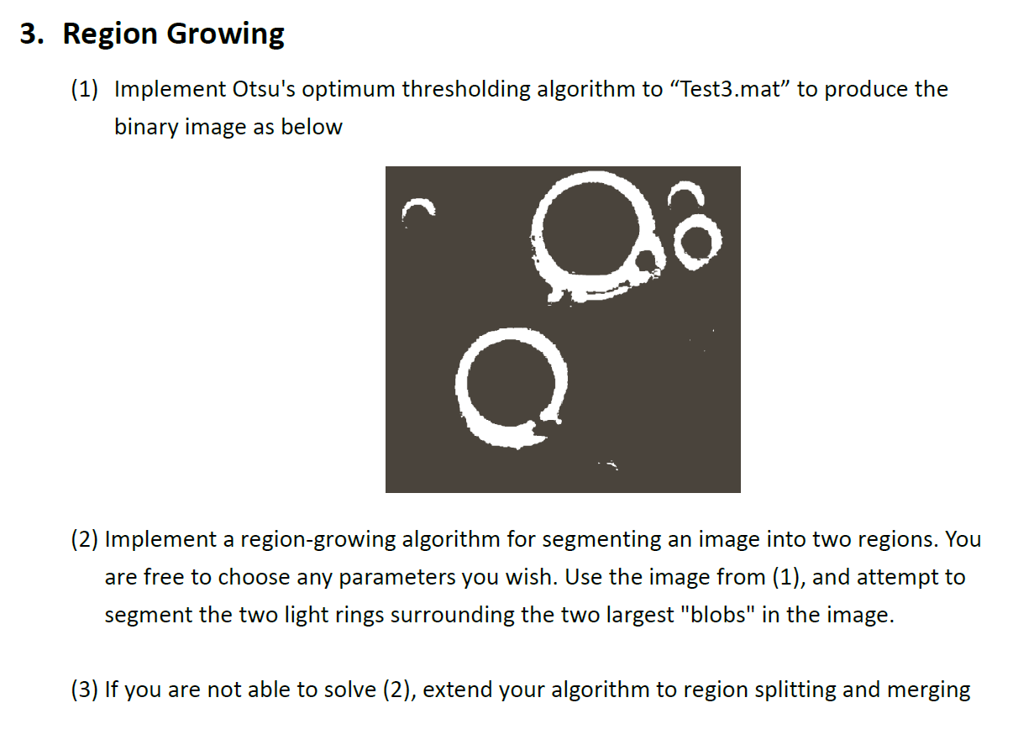
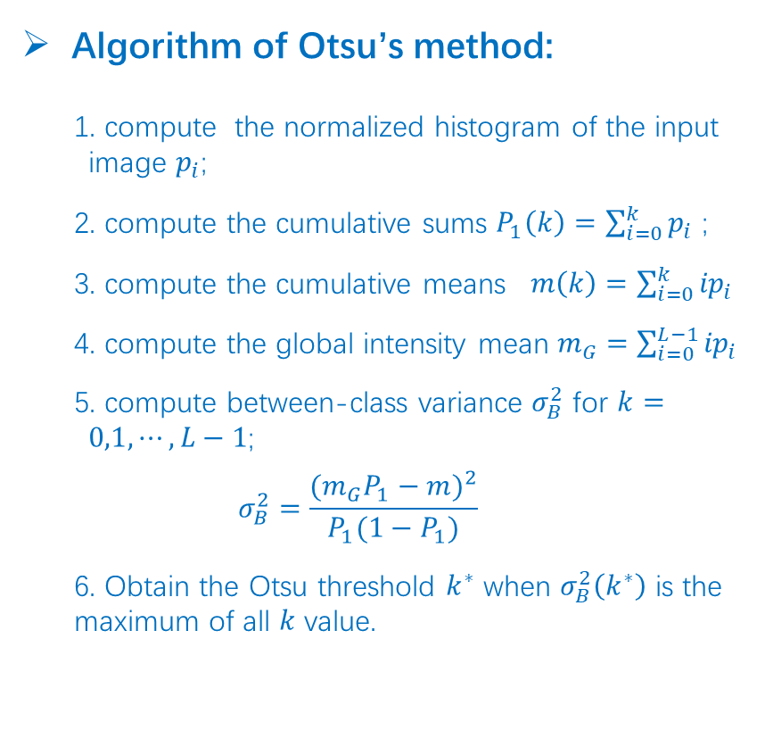
Algorithm of Otsu’s method:
compute the normalized histogram of the input image $p_{i}$;
compute the cumulative sums $P_{1}\left(k\right)=\sum_{i=0}^{k}{p_{i}}$ ;
compute the cumulative means $m\left(k\right)=\sum_{i=0}^{k}{{ip}_{i}}$
compute the global intensity mean $m_{G}=\sum_{i=0}^{L−1}{{ip}_{i}}$
compute between-class variance $σ_{B}^{2}$ for $k=0,1,⋯,L−1$;
$$σ_{B}^{2}=\frac{{(m_{G}P_{1}−m)}^{2}}{P_{1}(1−P_{1})}$$
6. Obtain the Otsu threshold $k^{∗}$ when $σ_{B}^{2}\left(k^{∗}\right)$ is the maximum of all $k$ value.

Slide 5
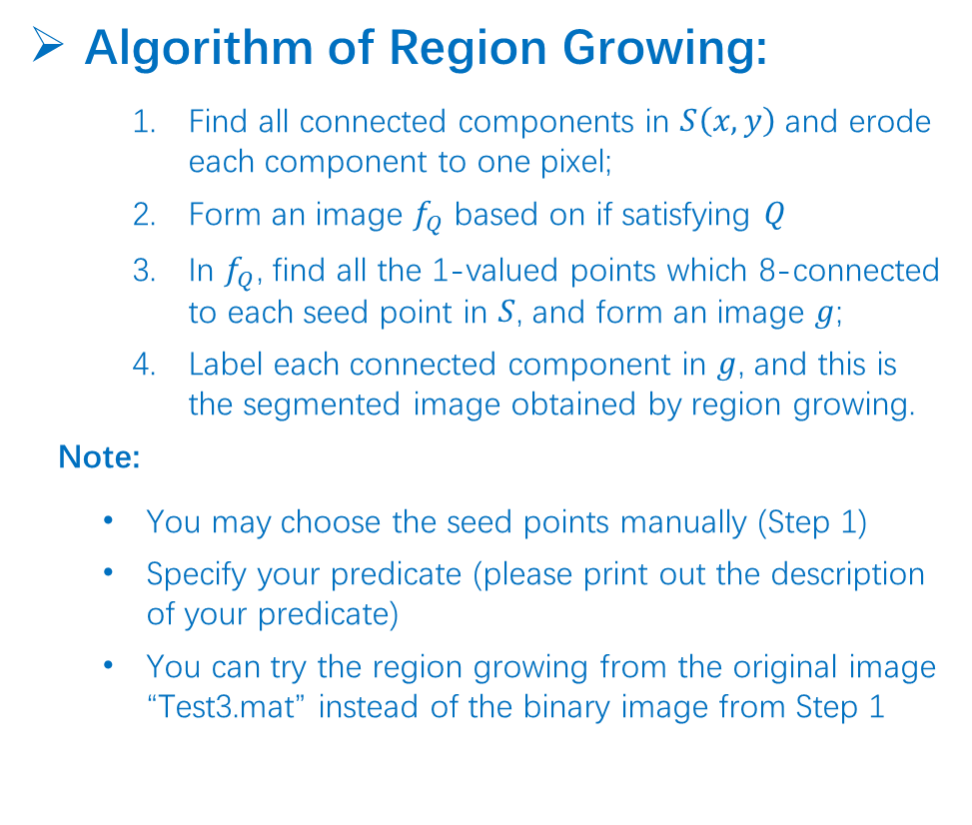
Algorithm of Region Growing:
Find all connected components in $S\left(x,y\right)$ and erode each component to one pixel;
Form an image $f_{Q}$ based on if satisfying $Q$
In $f_{Q}$, find all the 1-valued points which 8-connected to each seed point in $S$, and form an image $g$;
Label each connected component in $g$, and this is the segmented image obtained by region growing.
Note:
You may choose the seed points manually (Step 1)
Specify your predicate (please print out the description of your predicate)
You can try the region growing from the original image “Test3.mat” instead of the binary image from Step 1

