Slide 1
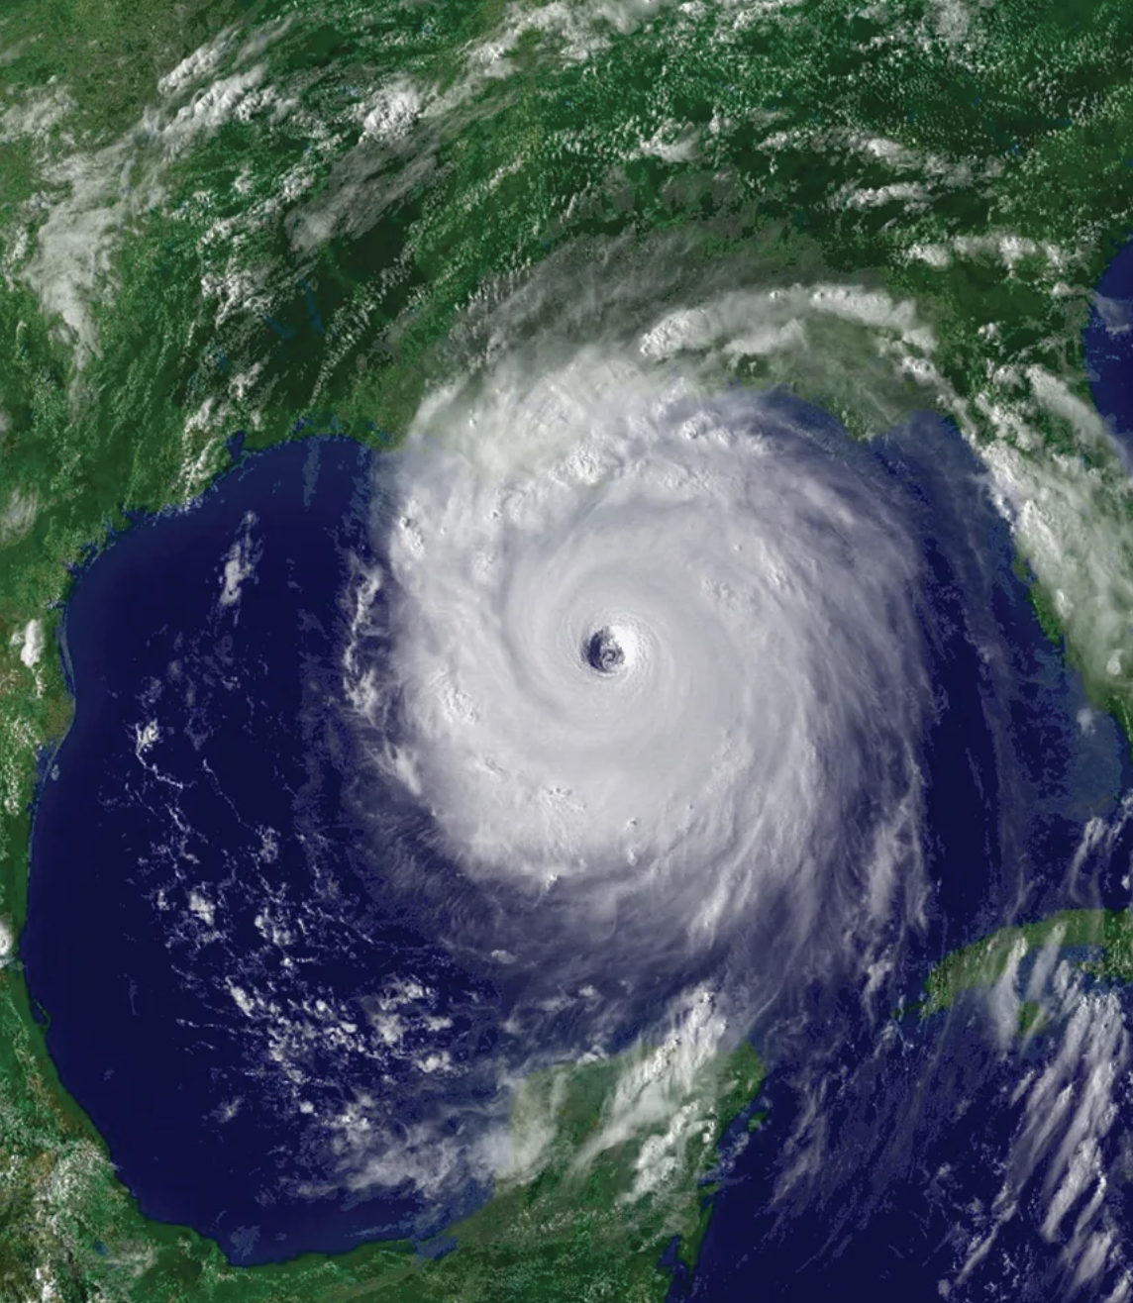
Global temperatures are warming fast.
It is causing more hurricanes to become stronger

Slide 2
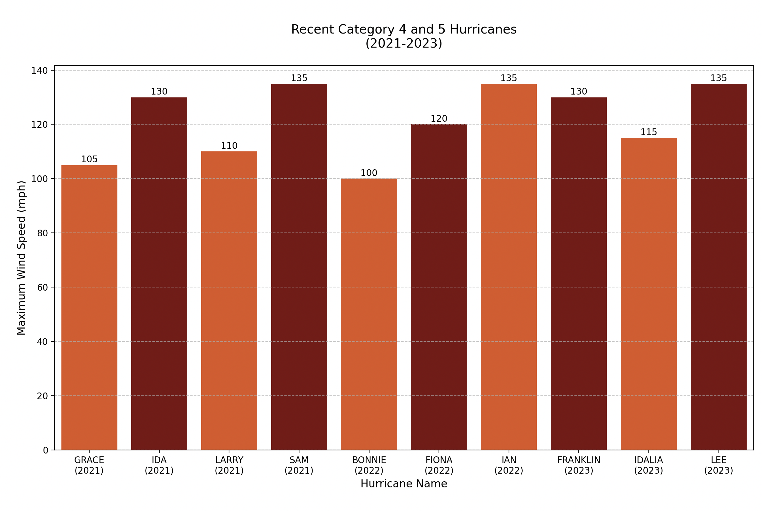
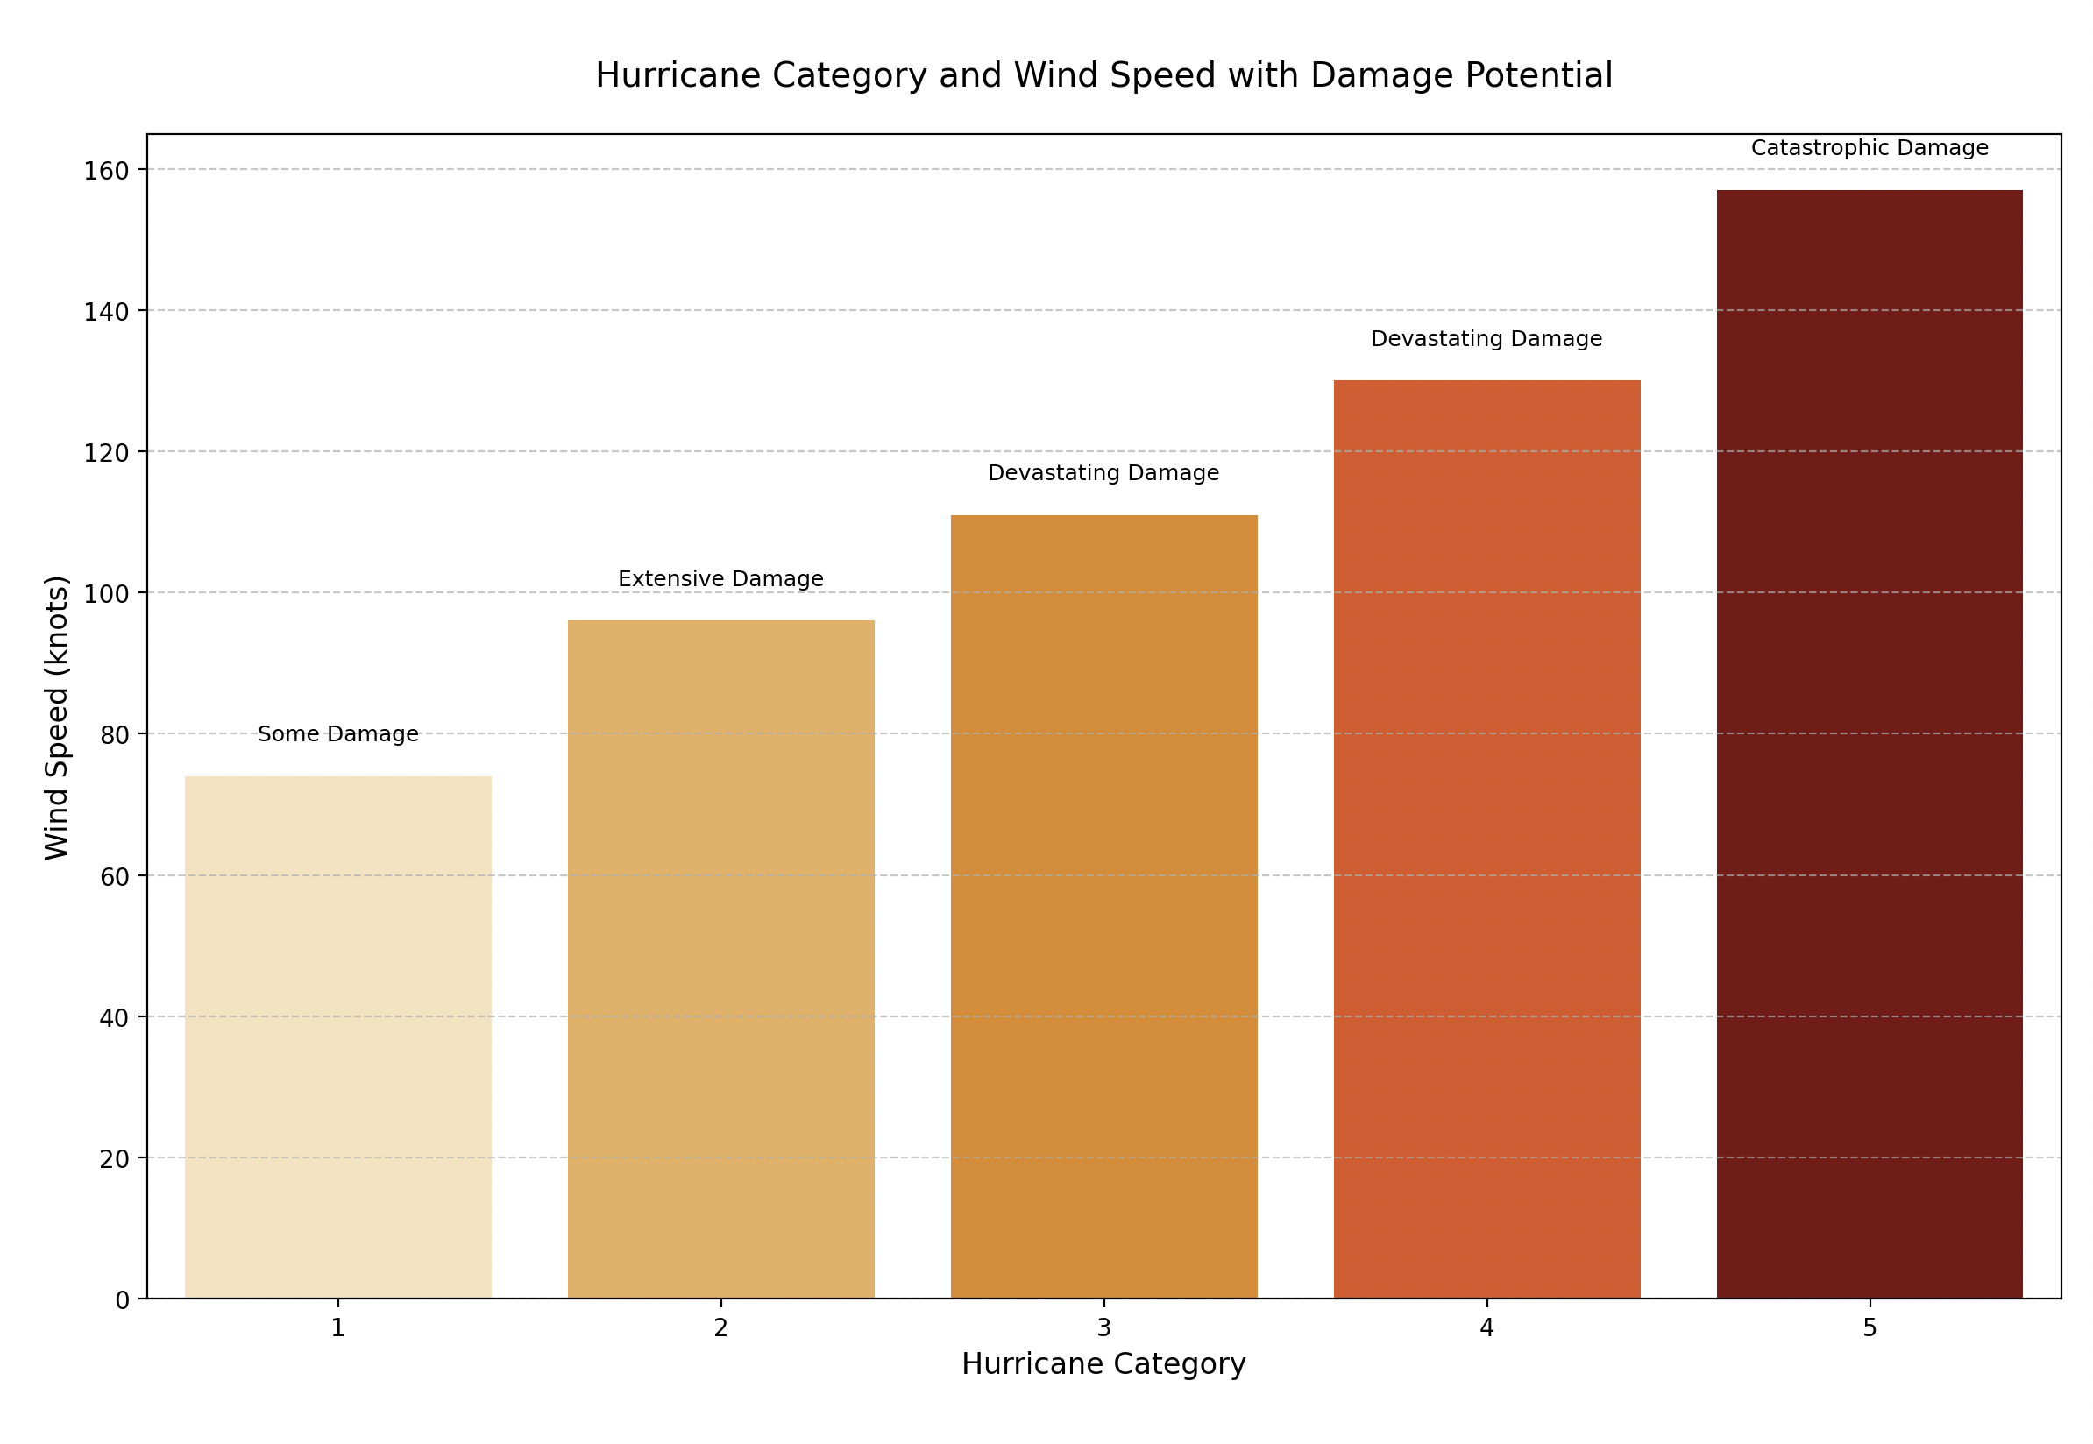
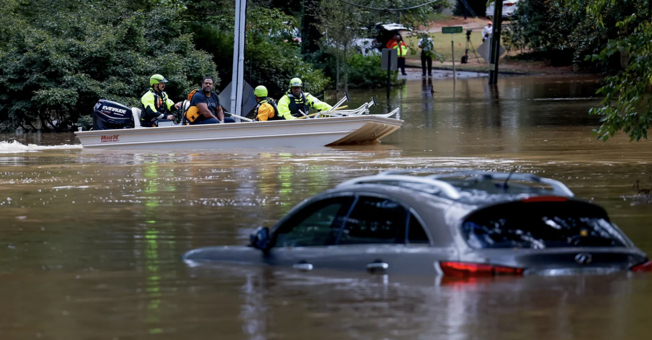
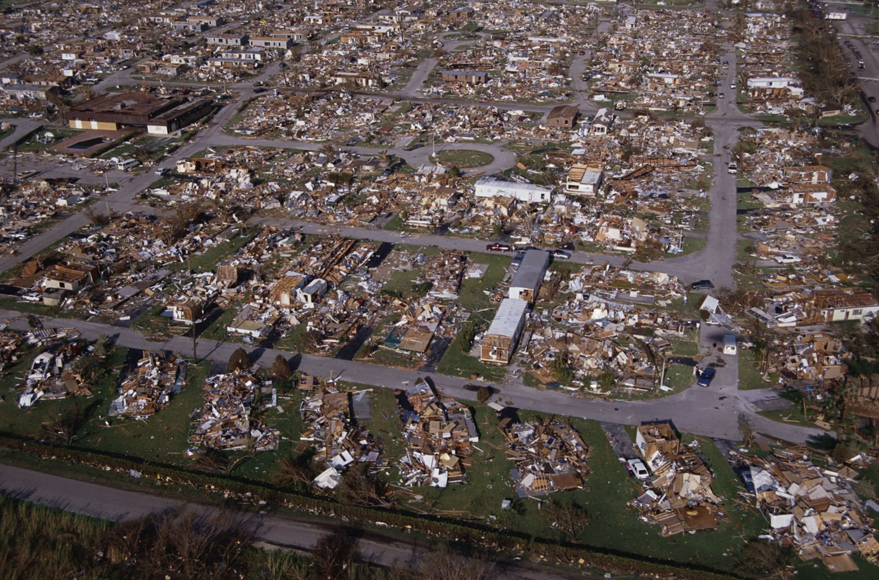

Slide 3
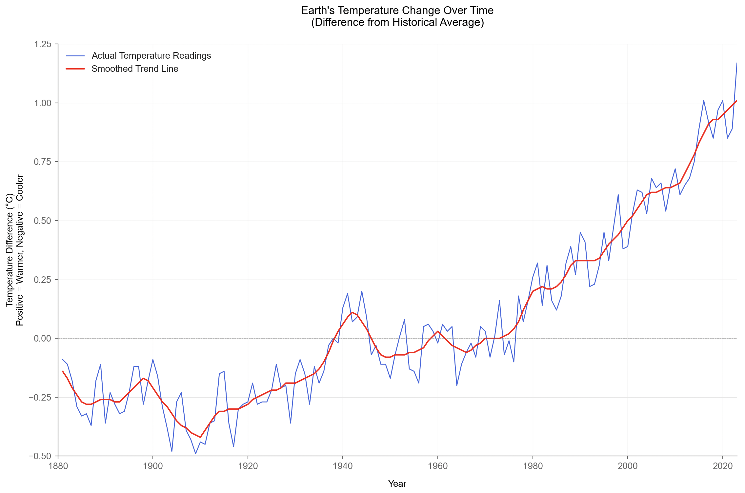
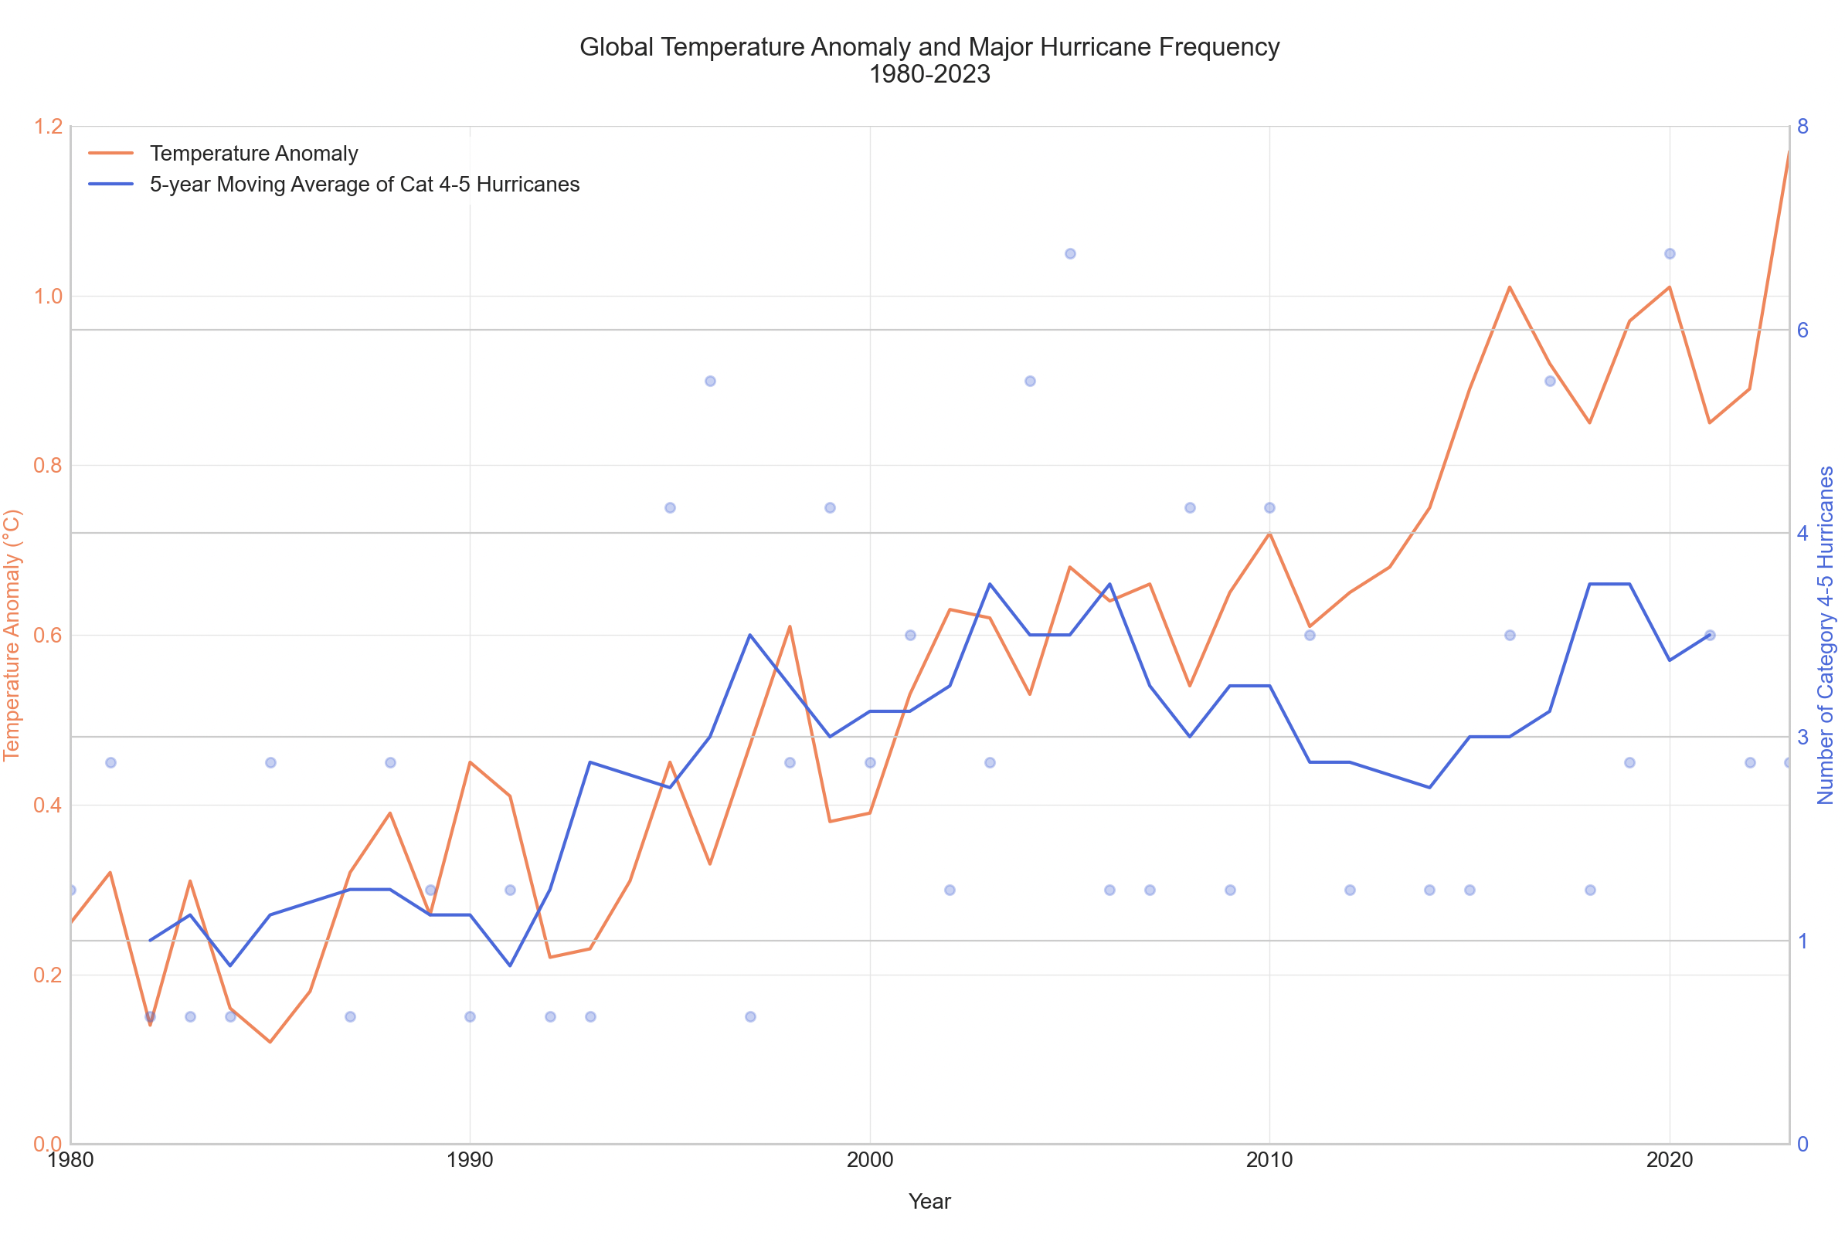
Our planet has been getting steadily warmer since we started tracking temperatures. Think of it like a fever - Earth's temperature has climbed from about 0.4°F above normal to almost 2°F above normal. That might not sound like much but imagine if your normal body temperature of 98.6°F suddenly became 100.6°F - you'd definitely feel sick! This warming has sped up dramatically since 2000.
As the Earth has warmed, we're seeing more super-strong hurricanes (Categories 4 and 5). While the number of these powerful storms goes up and down naturally from year to year, we've had some record-breaking hurricane seasons since 2000. The years 2005 and 2017 were particularly active, with more major hurricanes than we typically see.
These stronger storms are showing up more often as ocean temperatures rise, though other factors affect hurricane formation too.

