Slide 1
Tony Fraser
Story 6
10 November 2024

Slide 2
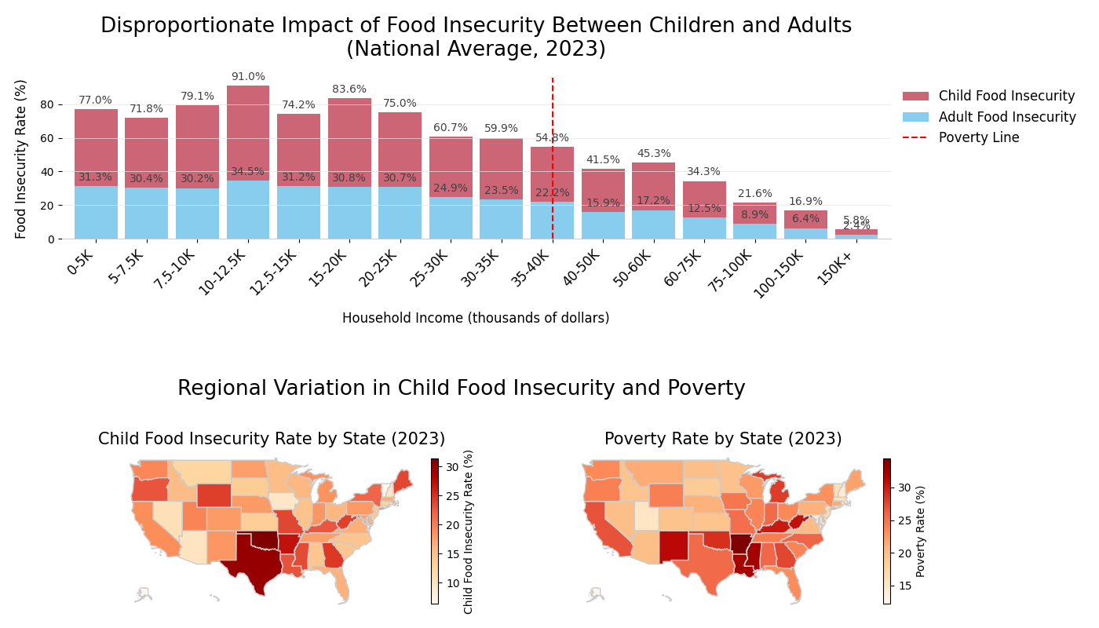

Slide 3
The Pitch
Senator, our analysis reveals an alarming pattern of child food insecurity that demands immediate attention. In households making less than $35,000, over 30% of children face food insecurity – that’s double the rate of higher-income households. And this isn't just a "poor states" problem; even relatively wealthy states have significant pockets of child hunger.
More troubling, children consistently face higher food insecurity rates than adults across all income levels. Their food insecurity today will impact their health and education, creating a cycle of poverty that affects us all.
These children are our future workforce and leaders. We can act now. We have them in school every day - let's strengthen our intervention there.

