Slide 1
Ecommerce Website
Tony Tian FDM Group

Slide 2
Website features
User account: register, log in, change password
Products: view other people’s products, sell and buy products
Shopping cart: add products into shopping cart
Order history: See what you have bought in the past

Slide 3
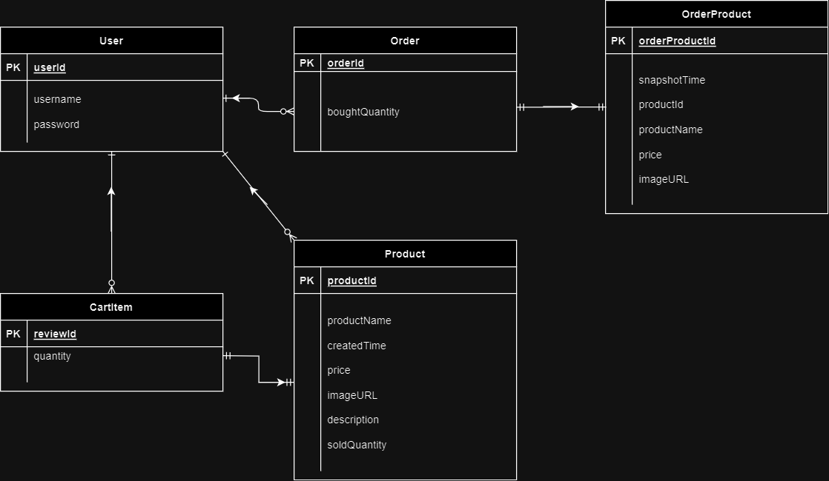
Entity relation

Slide 4
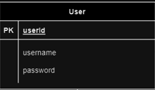
Project Overview
Spring Boot Backend + React Frontend
Backend Security:
Allows request to "/api/v*/registration/**", "/api/v*/users/login/**“,
"/api/v*/products/“(GET Only) without authentication
Others require basic authentication (username password)
Credentials are sent in request header, stored in browser’s local storage
The Users table (Stores encoded password)

Slide 5
Products Table
Foreign Key: userId (Many to One)
Indicating who created the product

Slide 6
Cart items Table
Foreign Key: userId (Many to One)
Indicating who created the cart item
Foreign Key: productid (One to One)
Indicating what is the cart item

Slide 7
Orders table
Foreign Key: userId(Many to One)
Indicating who submitted the order
Foreign Key: orderProduct(One to One)
Indicating which product is in the order
Order Product is a snapshot of the product, Cascade all.

Slide 8

Order product table
Record the product’s ID, name, price, imageURL
at snapshot time(when user bought the product)

Slide 9
Submitting an order
Three things will happen:
Shopping cart gets cleared
Orderded products’ sold quantity get updated
Product snapshotted, the order saved in `Orders` Table

Slide 10
User account access
The usual features:
A user can only modify its own products, view their own shopping cart and order history.
Visitor can only access products and product details with out logging in

Slide 11
Thank you!
To do: add review feature, buyers can rate products on a scale of 1 to 5.

Slide 12
Q&A

