Slide 1
From Demo to Production
A Year of Agentic AI in Financial Markets
Anton Antonov, Head of AI & Quant, dxFeed
Munich-London, September 2026

Slide 2
About dxFeed
dxFeed is a subsidiary of Devexperts, with the primary focus of delivering financial markets information to buy-side and sell-side institutions and individuals, specifically to traders, data analysts, quants and portfolio managers.
6M
End-Users through direct and B2B2C relationships
200,000
Simultaneous streaming clients
3.5M
Instruments
(Equities, Futures, Options, Indices, FX, Crypto, etc.)
>100
B2B clients around
the world

Slide 3
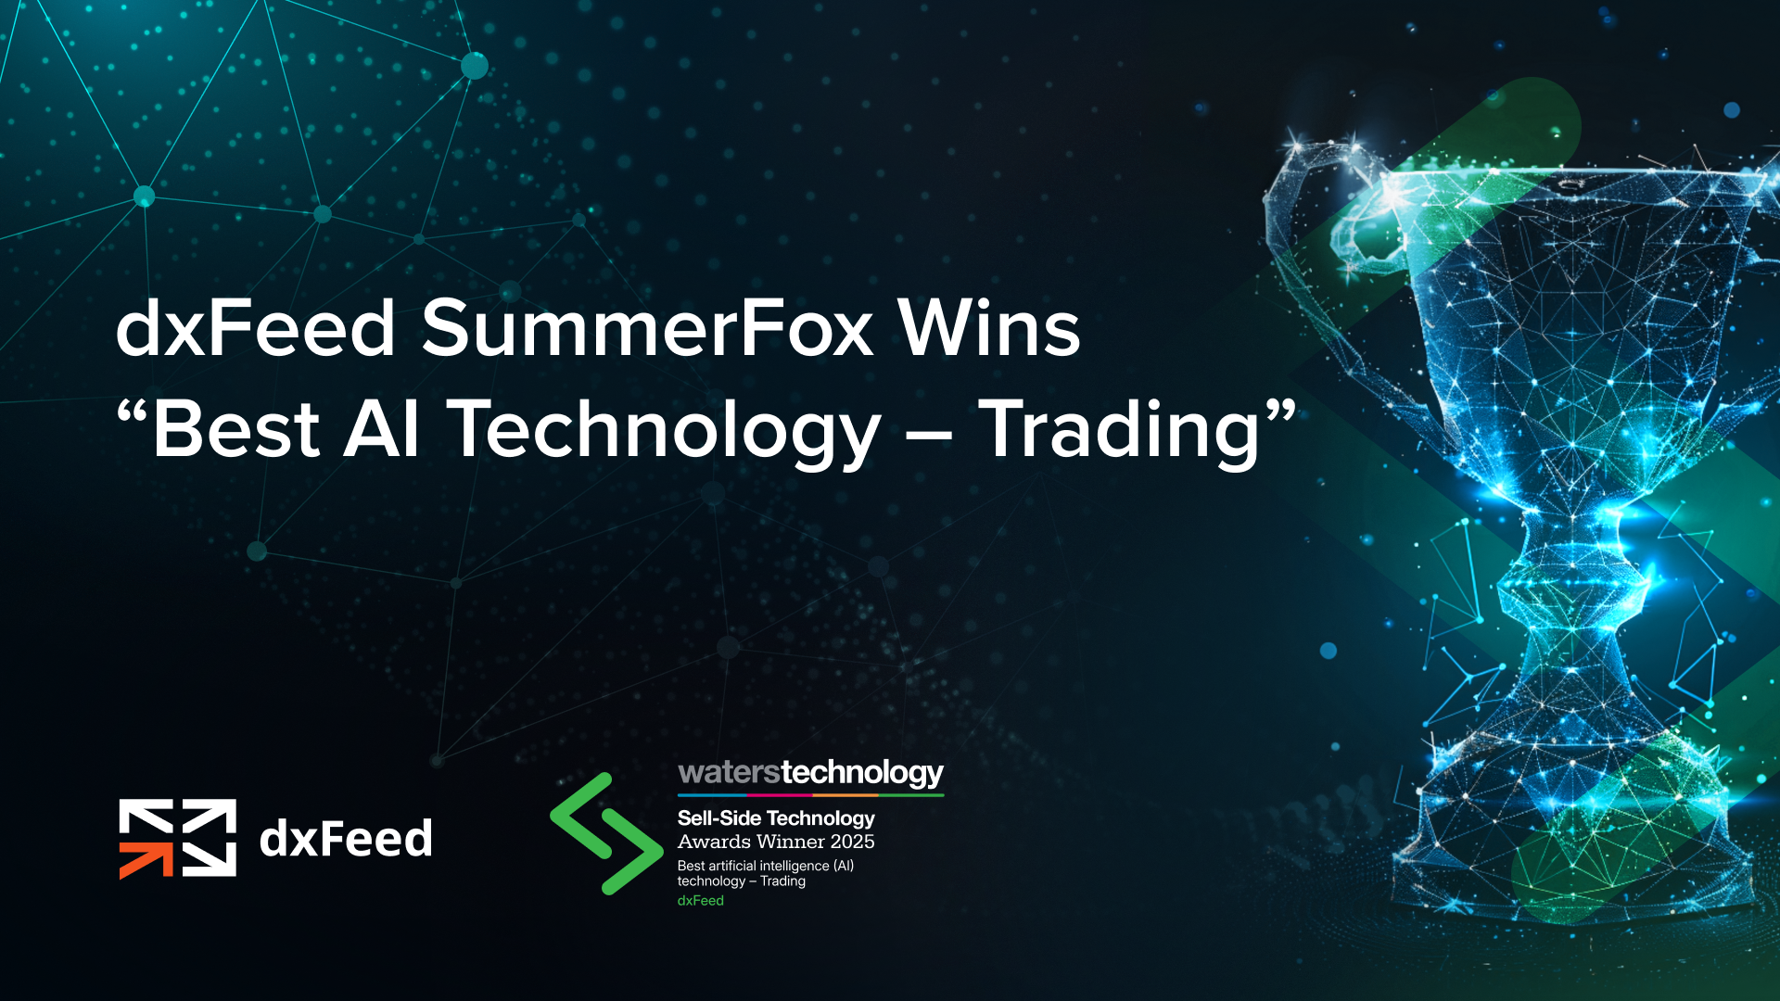

What we shipped this year
Product | Headline
Grenadier-2 | Capable of streaming full US equity universe @ 4,000 RPS; production latency p50 51 ms
GDELT News -> SummerFox | Licence-free news source, live in SummerFox; includes stocks, commodities, crypto
dxMCP | Market data + Grenadier + SummerFox on one MCP surface

Slide 4

The model stopped being the interesting part
Everything that makes AI work in production
now lives in the harness around it.
Three proofs from one year of shipping:
  a gateway that turns products into tools,
  a pipeline that buys model judgement by the call,
  and a product with no LLM in it at all.
🍓

Slide 5
dxMCP: what's on the surface
Model Context Protocol: the open standard for connecting AI applications to external systems.
Layer | On the surface today
Market data | Candles / OHLC, trades & quotes, instrument profiles (IPF), fundamentals, news
Screening | Options and underlying scanners - 400+ datapoints
Products as tools | Grenadier anomaly scores, SummerFox per-symbol and portfolio summaries
Consumers | AI agents and human operators, e.g. any MCP client on a desktop Products: DXcharts, DXtrade AI agent, SummerFox

Slide 6
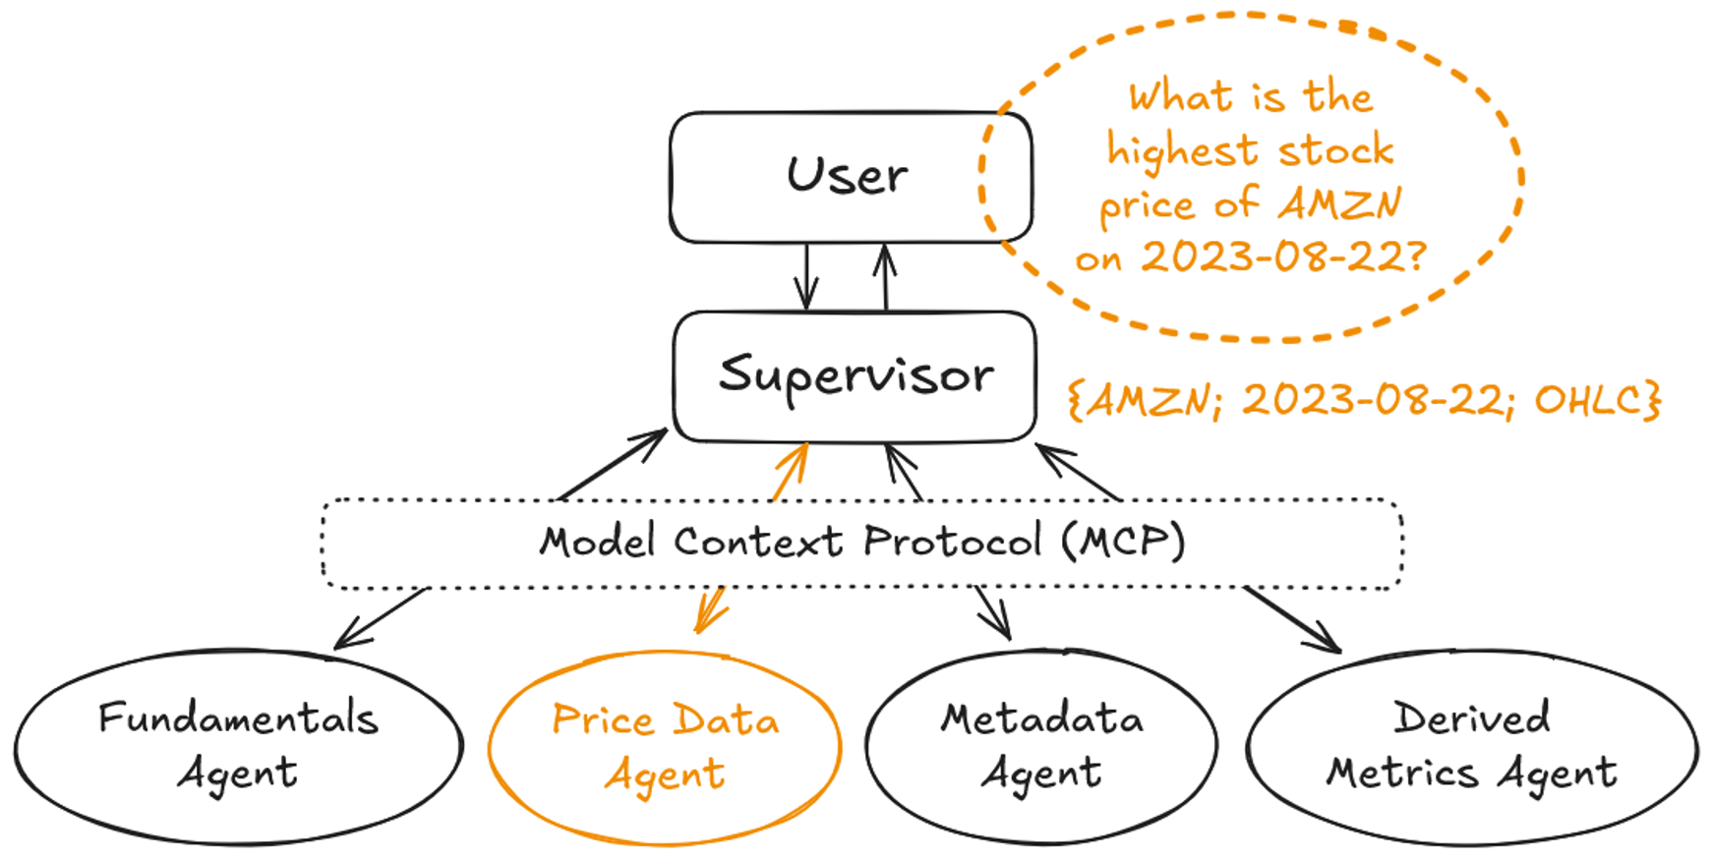

Slide 7
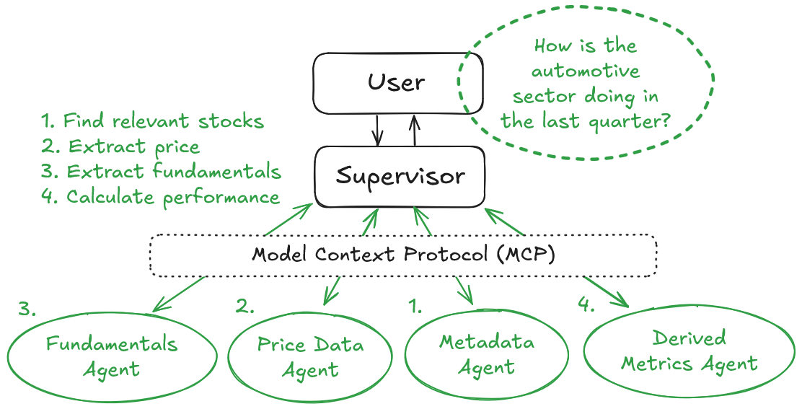

Slide 8


Products as tools, not just apps
News
Candles Scanners
IPF Fundamentals
SummerFox reports
Grenadier scores
MCP Client
SummerFox @ Amazon EC2
AWS Bedrock
AI & non-AI
agents
Application code
Agent
Agent
Agent

Slide 9
Decision rule #1: when MCP is the right answer
Use it when
Don’t use
The answer already exists somewhere authoritative
The model just needs to fetch it correctly
More than one consumer will want the same data
As a substitute for a calculation engine
When the consumer is one fixed pipeline – just call the API
To deal with a data-quality problem upstream

Slide 10
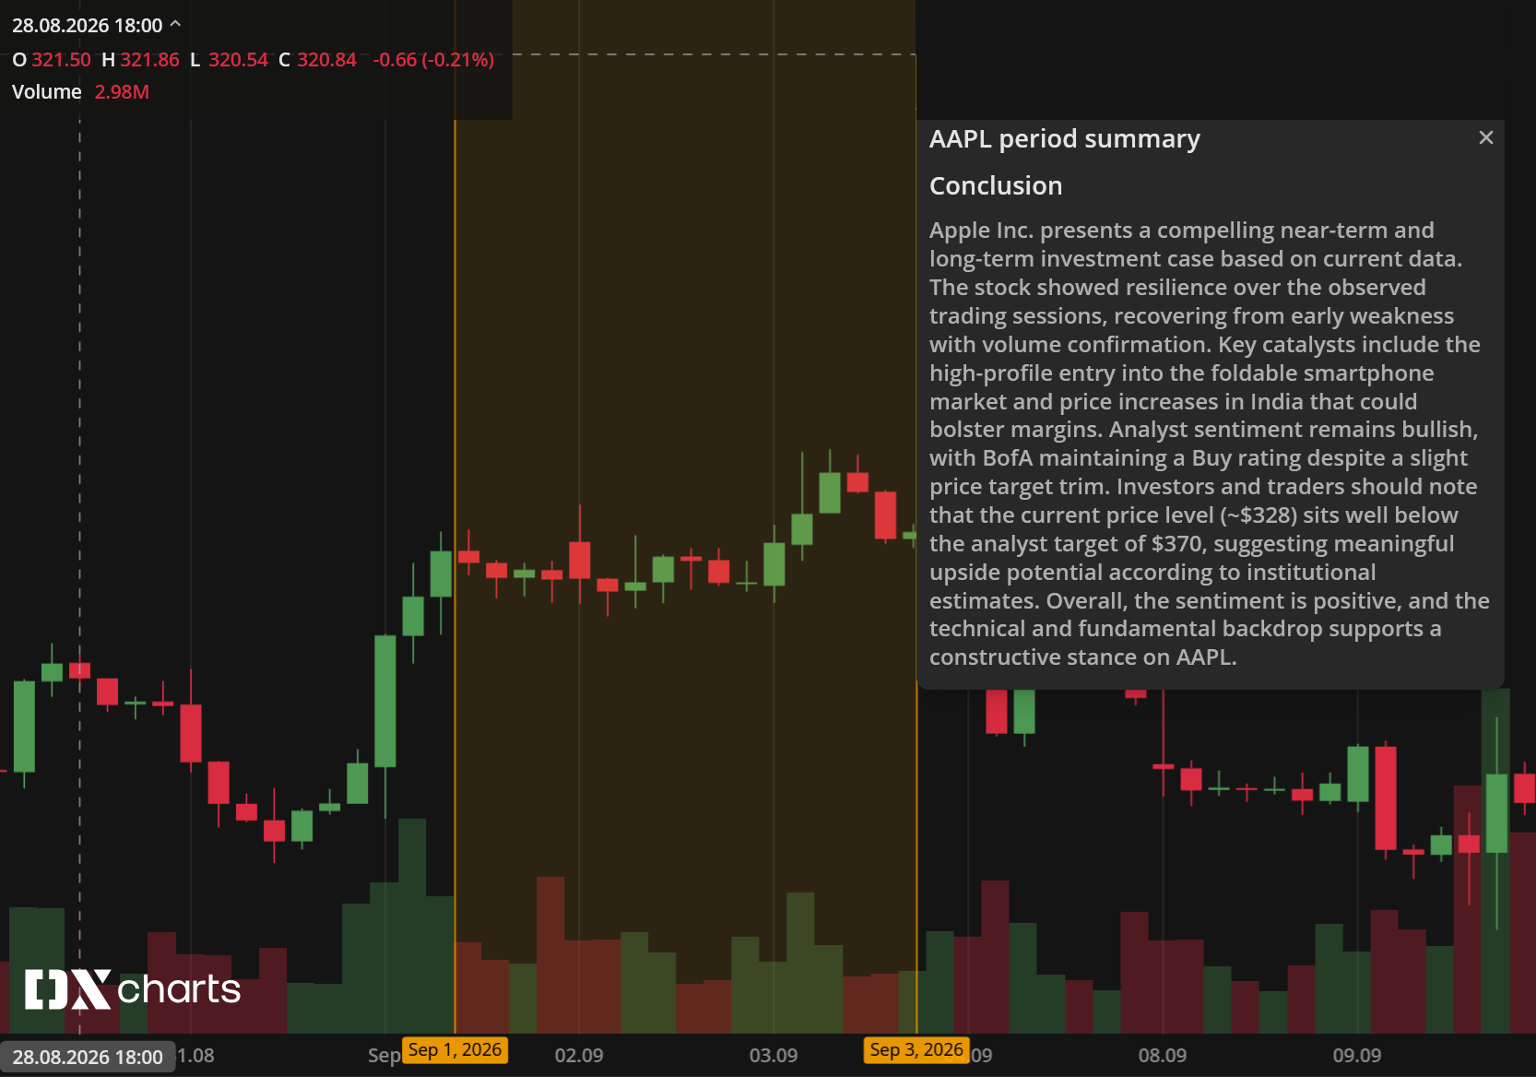
SummerFox: the market report, written by agents
Ask about a stock or a portfolio, get a structured report in seconds
Every number & data point comes from dxFeed: candles, news, fundamentals, instrument profiles
One report, any language
Per-symbol & portfolio views
Now with licence-free financial news on Google's GDELT GKG (BigQuery public dataset)

Slide 11
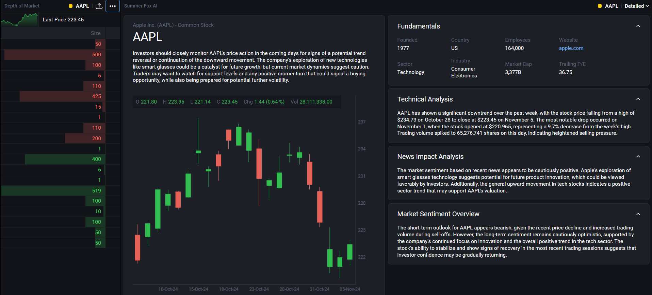
dxFeed SummerFox in Action
What is the high-level outlook?
What data-driven insights are there?
How do recent news affect the stock?
What is the current market consensus?

Slide 12
A headline is not a ticker
What the text says | The trap | What gets stored
"Marvell to join S&P 500" | The louder name is not the subject | stock:MRVL primary index:SPX secondary
"[…] Source: Nasdaq", "A quiet day on Nasdaq" | The org name produces bogus NDAQ matches | nothing
"COMP rises 2%" with no class prefix | Compass Inc. or the Nasdaq Composite? The string cannot tell you | nothing, not guessed
Extracting symbol is a judgement – exactly where an LLM is both necessary and dangerous.

Slide 13
Still no silver bullet
Article
LLM-for-everything
Store (DB)
raw text
Traps: LLM inference costs, Runtime, Precision
data used in downstream tasks
Text volume: ~330 tokens / article | LLM cost: $0.4 – $8 per Mtok | Runtime: 6 s/call | Precision (article -> ticker)
All articles: ~49 K/day | $6.5 – $130/day | ~8 hrs/day | 27%

Slide 14
Four layers, each with one job
the only probabilistic stage!
Article
Rule matchers
Enrichment gate
LLM
Universe validation
Store (DB)
raw text
deterministic candidates
who is worth LLM money
final say on symbols
3% of the volume
dxFeed IPF / universe files
never decided by the model
Text volume: ~330 tokens / article | LLM cost: $0.4 – $8 per Mtok | Runtime: 6 s/call | Precision (article -> ticker)
All articles: ~49 K/day | $6.5 – $130/day | ~8 hrs/day | 27%
Gated: 1350/day | <$4/day | 14 min/day | 68%

Slide 15
Decision rule #2: where the model belongs
Put the model where judgement is genuinely required.
Put deterministic code on both sides of it.
Make something other than the model decide what gets stored.
This results in predictable costs, runtime, and precision.

Slide 16
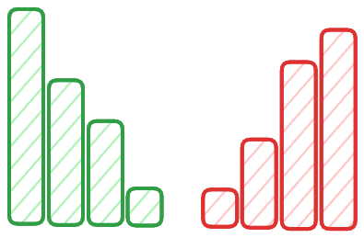
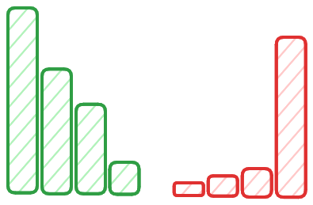
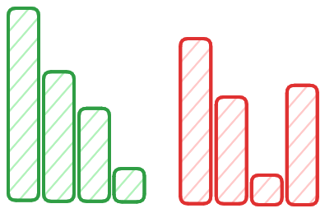
Sometimes the harness contains no model at all
Grenadier: a 0-100 anomaly score for the order book of every US-listed stock, once a second, from one in-house model.
No LLM anywhere in it!
The needle in the haystack problem: rare & fuzzily defined events
Rule-based or feature engineered conditions:
  must be manually constructed or selected
  must be calibrated and recalibrated, may get outdated quickly

Slide 17
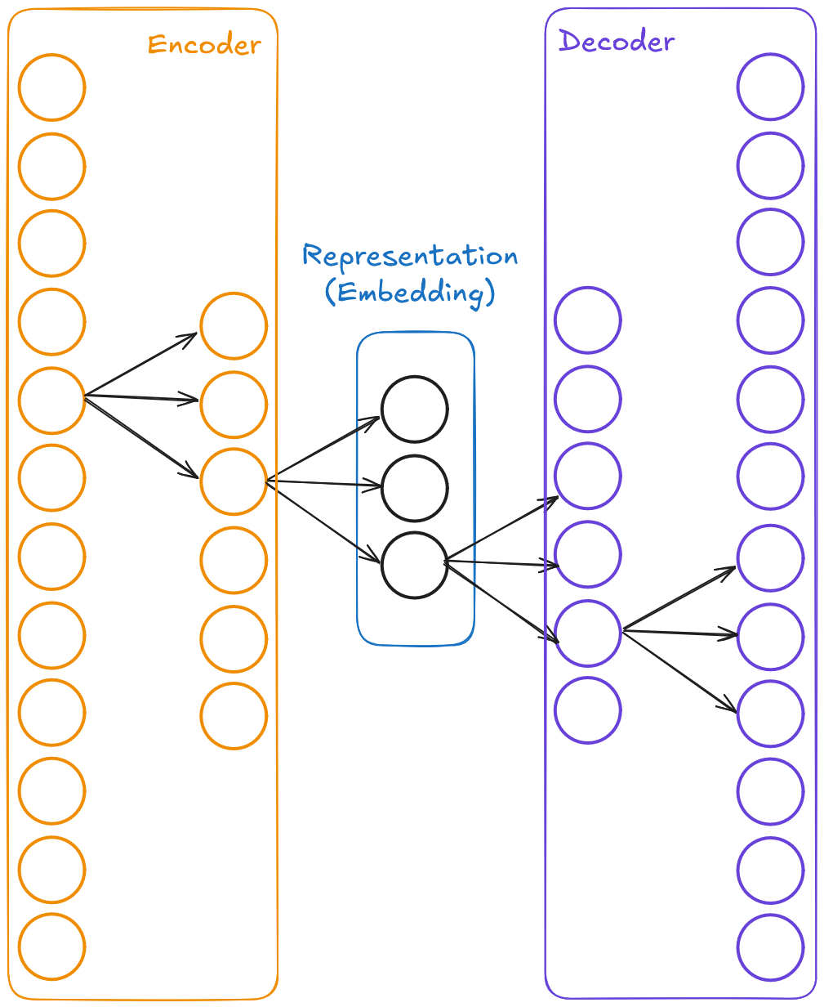
The bet: one universal model, or a zoo
The key risk:
"Transfer learning fails: a universal model that covers a wide instrument universe is unfeasible."
Fallback plan: a per-symbol model zoo.
One unsupervised autoencoder, 20 GB of proprietary L2 order-book data
Generalises to new instruments without retraining

Slide 18
Target vs delivered
 | Target | Delivered
Coverage | 2,600+ US stocks | Full US equity universe
Throughput | 2,600 RPS (1/symbol/sec) | 4,000 RPS
Latency (same region) | Sub-second | p50 51 ms p99 223 ms
Running cost | Fixed budget per month | ~1/5 of the budget ~1/20 for a representative subset

Slide 19
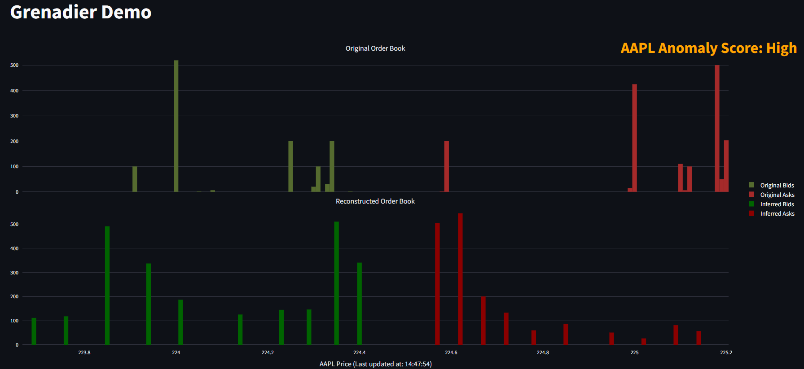
dxFeed Grenadier in Action
Large volume concentration far from the spread
Anomaly-free state of the order book

Slide 20
Decision rule #3: when to train your own model
 | Use an LLM when… (SummerFox) | Train your own when… (Grenadier)
The input | is language: headlines, filings, a question a human typed | is a numeric signal: 20 GB of order-book snapshots
"Correct" means | a judgement a human expert would agree with | a statistic: reconstruction error against what normal looks like
The knowledge | lives in the world: companies, events, context | lives only in your data: there's no LLM that ever saw it
Volume & latency | thousands of calls a day, seconds are fine | thousands of inferences a second, forever, with sub-second latency (no LLM does that at any price!)
Economics | pay per call because each call is worth it | pay per day/month because load is tested and predictable

Slide 21
Six evals, three buckets
Type | Our layer | What it catches
Code | Data: assertions vs source of truth | Wrong values
Code | Tool: trace replay against golden traces (SummerFox) | Right answer, wrong call
Code | Config: label menus test-pinned to the prompt | Config drift
Code | Model: precision/recall on a held-out labelled set (Grenadier) | Detection quality
Model-graded | Agent: faithfulness, no fabrication (Inspect, Deepeval) | Plausible fiction
Human | Sampled review of production traces, back into the golden set | Everything we didn't think of

Slide 22
Bonus: quality control and AI economics
Noise floor: ~40% of articles come back different on identical input
No reproducibility: measure old-vs-old before you measure old-vs-new
Each prompt edit, no matter how trivial, is a new deployment
Approach your AI-related costs on a per-call, not per-month, basis
Multi-vendor fallback helps deal with outages and model degradations
Token accounting must be built into the audit trail

Slide 23
The blueprint
Does the answer already exist somewhere authoritative?
MCP fetch it correctly; never compute it
Is judgement genuinely required?
A model – gated approach deterministic code on both sides, something else decides what is stored
Narrow task, high volume, your own data?
Train your own model no LLM does 2,600 inferences a second at any price
Key call: establish key metrics and estimate design decisions before you start scaling.

Slide 24
Key Takeaways
The model is a component. The harness is the product.
Provide facts as tools via MCP.
Rely on LLM judgement in a gated model.
Form numeric, high-volume, high-throughput signals in your own specialised model.
Price and measure every call before you pay for it, or the pilot never becomes a product.
Sometimes the right harness contains no LLM at all.

Slide 25
dxFeed SummerFox: AI-driven market reporting
https://dxfeed.com/solutions/summerfox-market-intelligence-plus-ai/

Slide 26
dxFeed Grenadier: L2-based anomaly detection
https://dxfeed.com/solutions/dxfeed-grenadier/
Press release: https://dxfeed.com/dxfeed-grenadier-recognized-as-best-ai-based-solution/

Slide 27

Thank you!
Anton Antonov
antonov@dxfeed.com
linkedin.com/in/tonytonov

