Slide 1
Data Science - Capstone Project
By - Anthony valantra
Mentor - Mike Badescu

Slide 2
Dataset

Slide 3
Dataset
Source - https://www.kaggle.com/ludobenistant/hr-analytics
About data
14,999 Observations
Observations are described by 10 attributes

Slide 4
Dataset – Contd.
satisfaction_level - Employee Level of satisfaction. It ranges from 0 (low satisfaction) to 1 (high satisfaction)
last_evaluation - Latest performance evaluation rating of employee. It ranges from 0 (low rating) to 1 (high rating)
number_project - Number of projects completed while at work.
average_montly_hours - Average monthly work hours at workplace.
time_spend_company - Number of years spent in the company.
Work_accident - Whether the employee had a workplace accident. 1 indicates accident.
left - Whether the employee left the workplace or not. 1 means left .
promotion_last_5years - Whether the employee was promoted in the last five years. 1 means promoted and 0 means no promotion in last 5 years.
sales - Department in which they work for. Eg: accounting, hr, IT, management, marketing, etc.
salary - Salary as high, medium & low.

Slide 5
Problem Statement

Slide 6
Problem Statement
HR dataset provides various attributes that concerns employees satisfaction level like average monthly work hours, accidents, salaries, promotion, evaluation rating etc.
We will be analyzing the these attributes to identify why our best and most experienced employees leaving prematurely.
We will be building a predictive model to determine how long employee would stay and their probability in leaving.

Slide 7
Data Exploration & facts

Slide 8
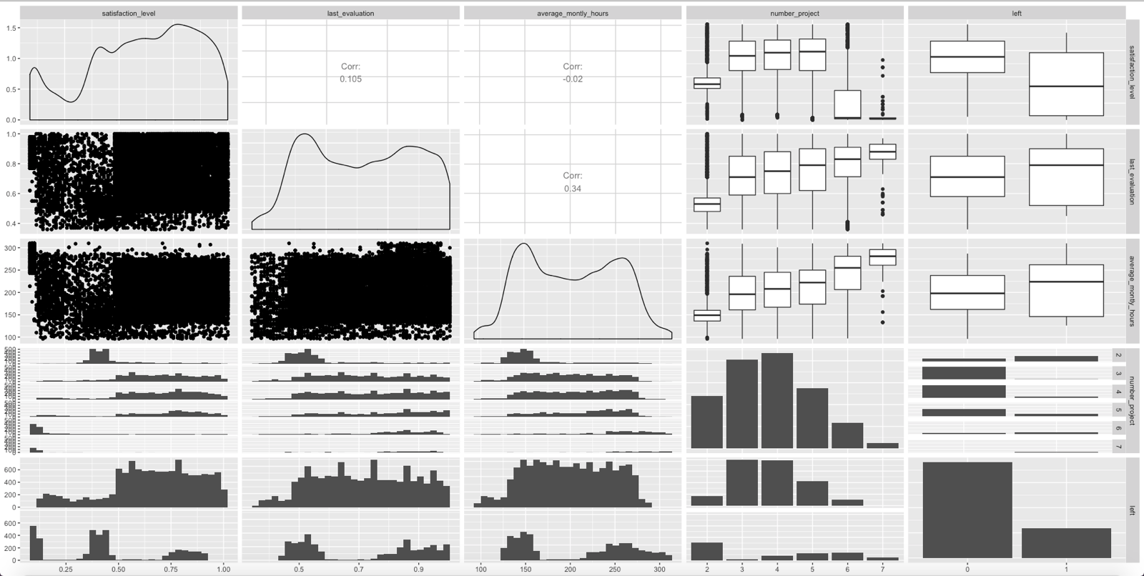

Slide 9
satisfaction_level
number_project seems to have high satisfaction for employees who had 3-5 projects. Beyond this satisfaction level nose-dives.
Is the projects getting routine and mundane?
Cause for concern as these are experienced employees, need for innovation?
Also left=1 (or employees leaving) is high at lower satisfaction level

Slide 10
last_evaluation
last_evaluation seems to have a very slight impact on employees leaving,
employees with higher evaluation is more likely to leave than ones with lower rating.
last_evaluation seems to be higher with employees with more projects under their belt.

Slide 11
average_monthly_hours
Looks like both last_evaluation and average_monthly_hours increasing with number_projects that employees have under their belt.
Are employees enrolled in multiple projects or in an effort of better ratings employees are spending more hours and hence gradually starts getting into low satisfaction level and eventually quit ?

Slide 12
number_project
Initially from 2- 5 projects we can see satisfaction_level improving, but satisfaction_level dips for 6 and above
last_evaluation keeps improving with number_projects, infact its very high for 6 and above projects
Number of employees staying however shows that very few stay beyond 5 projects.
HR exercise should focus on retaining highly productive employees

Slide 13
left
Satisfaction_level of low , medium and high levels show sudden increase in employees leaving
Employees in mid and high rating seems to leave more often.
Employees putting low average monthly hours show high percent of employees leaving, at mid level percent of employees leaving are low and then starts getting higher towards higher average monthly hours.

Slide 14
Overall
It seems employees leaving with few years of joining with low satisfaction_level, evaluation rating and low average monthly hours.
At around mid performance of 2-5 projects, around 200 monthly work hours employees low percent of employees leave the company.
How can the company retain more experience employees involved in 5 + projects?

Slide 15
Unsupervised Algorithm

Slide 16
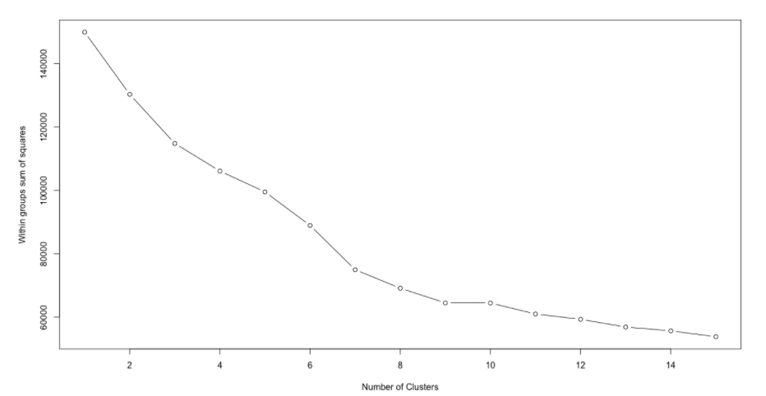
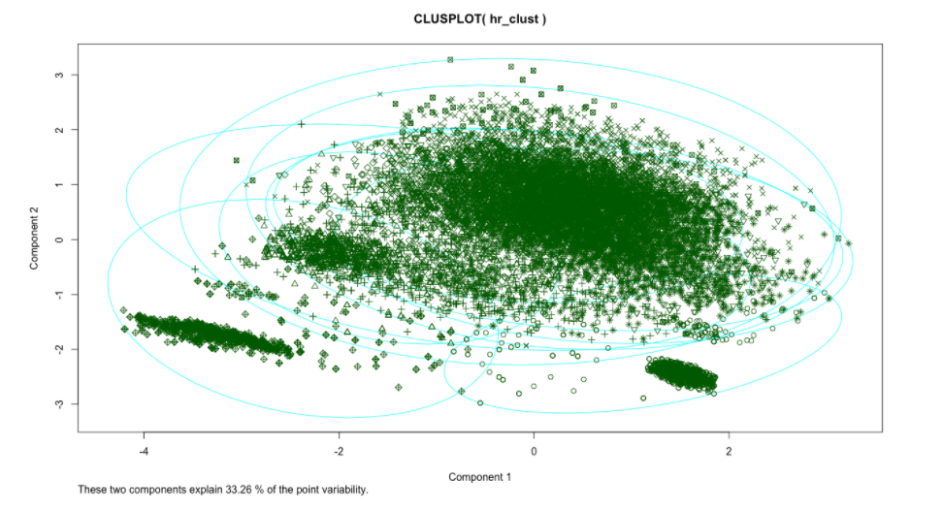
Cluster Analysis
Used K-means clustering
Found 11 clusters as ideal number of clusters
Two components explain only 33.26% of point variability

Slide 17
Supervised Algorithm

Slide 18
Prediction and Regression
Linear regression to predict ‘time spend in company’
Logistics regression to predict the probability of employee leaving the company
Random forest to predict the probability of employee leaving the company

Slide 19
Linear Regression

Slide 20
Linear Regression
Linear regression to predict ‘time spend in company’
Adjusted R-squared: 0.09456 and Multiple R-squared: 0.09614
Ran the model on test data
The correlation coefficient of prediction on test was low 0.2653889
Root mean squared errors (RMSE) was 1.4
Overall the model’s performance was poor, indicating the attributes in dataset has low correlation to predict dependent variable time_spend_company

Slide 21
Logistics Regression
Logistics regression to predict ‘left’
Model had for training data set
Accuracy : 0.8612
Sensitivity : 0.9221
Specificity : 0.6664
For test dataset
Accuracy : 0.862
Sensitivity : 0.9182
Specificity : 0.6821
Overall the model’s performance was good, had good accuracy and sensitivity but poor specificity

Slide 22
Random Forest
Random forest to predict ‘left’
Model had for training data set
Accuracy : 0.9872
Sensitivity : 0.9975
Specificity : 0.9545
For test dataset
Accuracy : 0.9793
Sensitivity : 0.9961
Specificity : 0.9258
Overall the model’s performance was excellent.

Slide 23
Performance comparison
 | glm_train | glm_test | rf_train | rf_test
Accuracy | 0.8612 | 0.862 | 0.9872 | 0.9793
Kappa | 0.6061 | 0.612 | 0.9644 | 0.9418
AccuracyLower | 0.8549 | 0.8491 | 0.9851 | 0.9736
AccuracyUpper | 0.8674 | 0.8741 | 0.9892 | 0.9841
AccuracyNull | 0.7619 | 0.7619 | 0.7619 | 0.7619
AccuracyPValue | 0 | 0 | 0 | 0
McnemarPValue | 0 | 0.0553 | 0 | 0
Sensitivity | 0.9221 | 0.9182 | 0.9975 | 0.9961
Specificity | 0.6664 | 0.6821 | 0.9545 | 0.9258
Pos Pred Value | 0.8984 | 0.9024 | 0.9859 | 0.9772
Neg Pred Value | 0.7278 | 0.7226 | 0.9916 | 0.9866
Precision | 0.8984 | 0.9024 | 0.9859 | 0.9772
Recall | 0.9221 | 0.9182 | 0.9975 | 0.9961
F1 | 0.9101 | 0.9102 | 0.9917 | 0.9866
Prevalence | 0.7619 | 0.7619 | 0.7619 | 0.7619
Detection Rate | 0.7026 | 0.6996 | 0.76 | 0.7589
Detection Prevalence | 0.782 | 0.7753 | 0.7708 | 0.7766
Balanced Accuracy | 0.7943 | 0.8001 | 0.976 | 0.9609

