Slide 1
Airbnb Data
Description: InsideAirbnb provides quarterly data for the last year for each region from airbnb. This dataset provides assumed active listings as of December 20, 2021 for Portland, Oregon.
Source: http://insideairbnb.com/get-the-data/

Slide 2
Zillow Data
Description: InsideAirbnb provides quarterly data for the last year for each region from airbnb. This dataset provides assumed active listings as of December 20, 2021 for Portland, Oregon.
Source: http://insideairbnb.com/get-the-data/

Slide 3
Database
SQLite
Created database in Pandas and loaded tables from Pandas to SQLite
Queried tables from SQLite for machine learning model and webapp

Slide 4
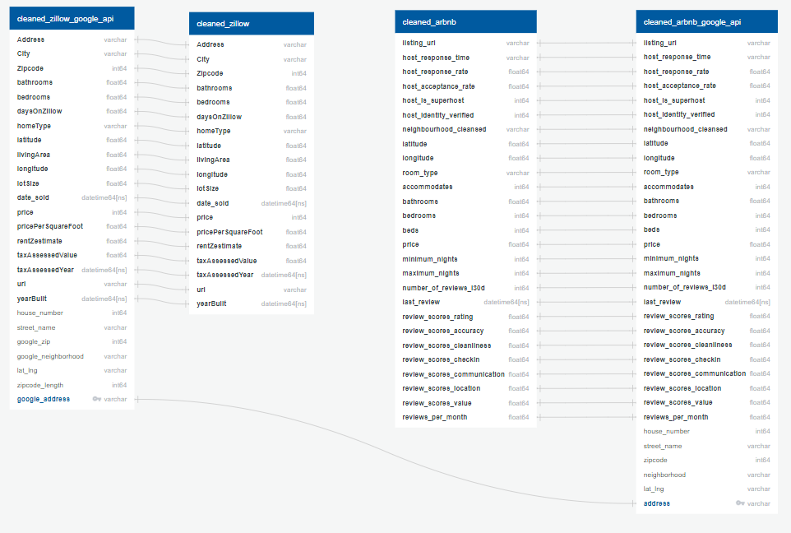
ERD

Slide 5
Airbnb Data ETL
78 columns
3734 rows
Drop columns not enhancing analysis (i.e. host name)
Filter to only include entire home rentals (vs. room rentals)
Drop NAN values
Change Boolean values from t and f to 1 and 0
Change # bath from string/object to int64
Drop NAN values
Convert review date to datetime
Change price from string to number and acceptance rates from string to percentages
26 columns
2101 rows
Something on outliers? – should re reapply bed bath outlier filters here so looking at the same thing?

Slide 6
Zillow Data ETL
348 columns
25731 rows
Drop columns not enhancing analysis (i.e. Zillow ID)
Filter to only include sold homes
Rename columns for ease of use and understanding
Change # bath from string/object to int64
Convert dates from object to datetime
Drop duplicates and NAN
Eliminate outliers for # beds, # baths, lot size, living area using 1.5IQR method
19 columns
18266 rows

Slide 7
APIs for Additional Data and Table Join in SQL
Airbnb Table Doesn’t Have Address
Airbnb Table with Address
SQL Inner Join
Google Maps Reverse Geocoding API*
New Table with Airbnb and Zillow Overlap Data
Zillow Table Doesn’t Have Neighborhood
Zillow Table with Neighborhood
*Google Reverse Geocoding API uses Latitude and Longitude to Determine Address and Neighborhood

