Slide 1


PREPARED FOR
UNESCO
DIGITAL LEARNING WEEK 2026
TEACHER AGENCY · PRACTICE & RESEARCH
From AI Tool Users
to AI Agent Creators
Helping teachers shape AI support for learning.
Haiyang Xin · CocoRobo Ltd.
Paris · 2026
Notes:
00:00–00:20 | 20 seconds
Good morning. I’m Haiyang Xin from CocoRobo. We work with teachers to build AI support for learning. Today, I will share our practice, our research, and the partnership that connects them.
[Sources]
Original 18-slide presentation, slide(s) 1. https://tonyxinvip.github.io/slides/teacher-agent-creators/ ; supporting evidence: https://cocorobo.hk/unesco2026/teacher/
Evidence and interpretation:
Evidence scope follows the original deck. Design implications are not additional experimental findings.
Cover photo: user-supplied IMG_3940.gif, a teacher workshop discussion in Pingshan. A still frame is used; no people or scene elements were generated.

Slide 2

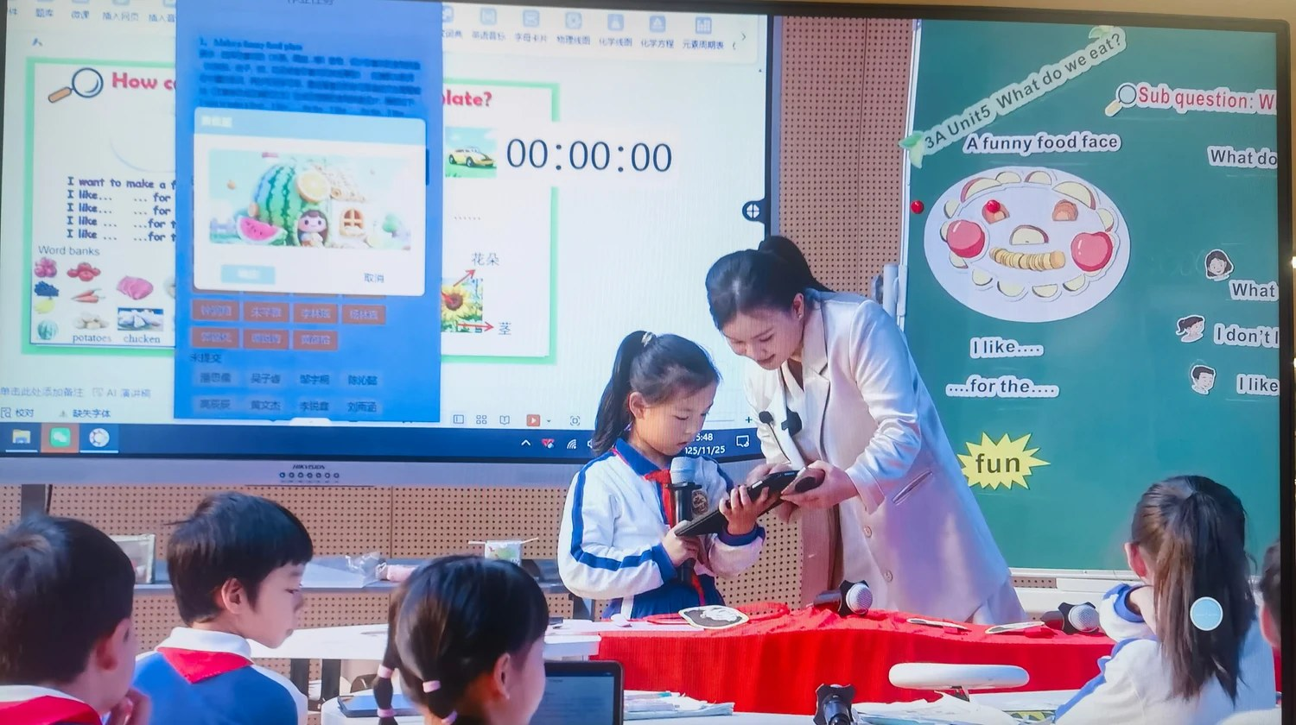
A SHARED STARTING POINT
What is a pedagogical AI agent?
An AI helper set up for a clear teaching or learning goal.
In our work, “pedagogical” means for teaching and learning.
Teachers shape it
They set its role, materials, steps and limits.
It supports learning
It asks questions, guides practice and gives feedback.
Why use one?
Turn a teaching plan into support that can be tested, reused and revised.
English speaking practice · Pingshan
The teacher sets the purpose. The agent provides the agreed support.
CocoRobo · UNESCO Digital Learning Week 2026
02 / 17
Notes:
00:20–01:05 | 45 seconds
First, what is a pedagogical AI agent? It is an AI helper with a clear teaching or learning goal. A teacher sets its role, materials, steps and limits. For example, it can guide English practice and give feedback. Why use one? It turns a teaching plan into support we can test, use again and improve. The purpose comes from the teacher.
[Sources]
Working definition used in this talk, based on the presenter’s teacher-designed agent programme. This is an operational definition, not a claim that all pedagogical agents have the same architecture or are fully autonomous.
Photo and English-class example: Pingshan Education Bureau, AI-Empowered Education source deck, slide 1 (district-s1-img2.jpeg). Reuse and revision are design affordances, not claims of proven learning gains.

Slide 3

TEACHERS SHAPE AI’S ROLE
One goal. Two views.
Teacher agency means having the ability and room to make teaching choices.
1 · Practice
2 · Research
How do policy, local support and teacher design work together?
What do teachers learn as they build agents? What helps them keep creating?
1,000+
teachers reached across four Shenzhen districts
and partner schools
Our teacher development work: April 2025–April 2026
CocoRobo · UNESCO Digital Learning Week 2026
03 / 17
Notes:
01:05–01:35 | 30 seconds
Our goal is teacher agency: the ability and room to make teaching choices. First, I will share practice, from policy to classroom design. Then, I will share research on teacher learning. Our wider programme reached over one thousand teachers.
[Sources]
Original 18-slide presentation, slide(s) 2–3. https://tonyxinvip.github.io/slides/teacher-agent-creators/ ; supporting evidence: https://cocorobo.hk/unesco2026/teacher/
Evidence and interpretation:
Evidence scope follows the original deck. Design implications are not additional experimental findings.
Original 18-slide presentation, slide(s) 4–6. https://tonyxinvip.github.io/slides/teacher-agent-creators/ ; supporting evidence: https://cocorobo.hk/unesco2026/teacher/
Evidence and interpretation:
Evidence scope follows the original deck. Design implications are not additional experimental findings.

Slide 4
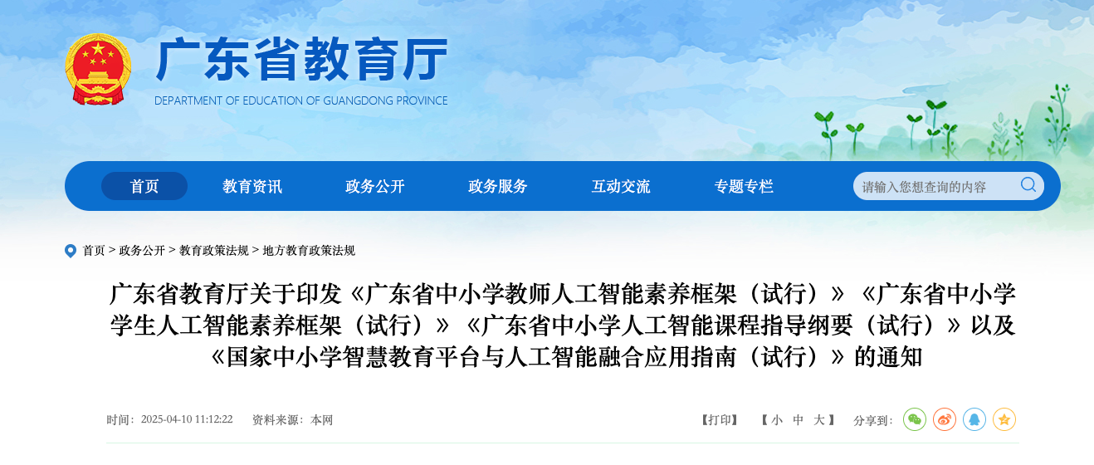
1 · PRACTICE / PROVINCIAL POLICY
Guangdong: shared goals
for AI education
Two literacy frameworks + one curriculum outline
2 + 1
Teacher AI literacy
Teachers’ knowledge, skills and responsibilities.
Student AI literacy
Understand and use AI with care and good judgment.
AI curriculum outline
Goals, content and teaching across school stages.
Guangdong Department of Education
9 April 2025 · Trial documents
Connect teacher learning, student goals and the curriculum.
CocoRobo · UNESCO Digital Learning Week 2026
04 / 17
Notes:
01:35–02:15 | 40 seconds
Let us start with Guangdong province. In April twenty twenty-five, it issued two AI literacy frameworks and one curriculum outline. One framework guides teachers. One sets goals for students. The outline connects those goals with courses across school stages. This gives local work a shared direction. The lesson is to connect teacher learning, student goals and the curriculum.
[Sources]
Official Guangdong Department of Education notice, dated 9 April 2025, republished by Xinhui Education Bureau on 11 April 2025: https://www.xinhui.gov.cn/gzjg/qzfgzbm/jmsxhqjyj/zcwj/content/post_3281407.html .
Exact titles: 广东省中小学教师人工智能素养框架（试行）; 广东省中小学学生人工智能素养框架（试行）; 广东省中小学人工智能课程指导纲要（试行）. The notice has a fourth attachment on integrating the national platform; this slide focuses on the requested 2+1 package. The third provincial document is a curriculum outline, not the separately issued national AI general-education guide.
Official PDFs: https://www.xinhui.gov.cn/attachment/0/336/336265/3281407.pdf ; https://www.xinhui.gov.cn/attachment/0/336/336266/3281407.pdf ; https://www.xinhui.gov.cn/attachment/0/336/336267/3281407.pdf .
Primary drafting-team account: South China Normal University, 1 May 2025, https://news.scnu.edu.cn/71155/469 . English labels are concise translations. Notice image: user-supplied 42030.png, an authentic screenshot of the Guangdong Department of Education website. The crop shows the department header, complete notice title and website publication date (10 April 2025). The signed document was issued on 9 April 2025. The original full screenshot is preserved in the online assets. Policy is context, not a claim that Guangdong formally joined this particular research partnership or caused the earlier Shenzhen platform. The takeaway is our synthesis.

Slide 5
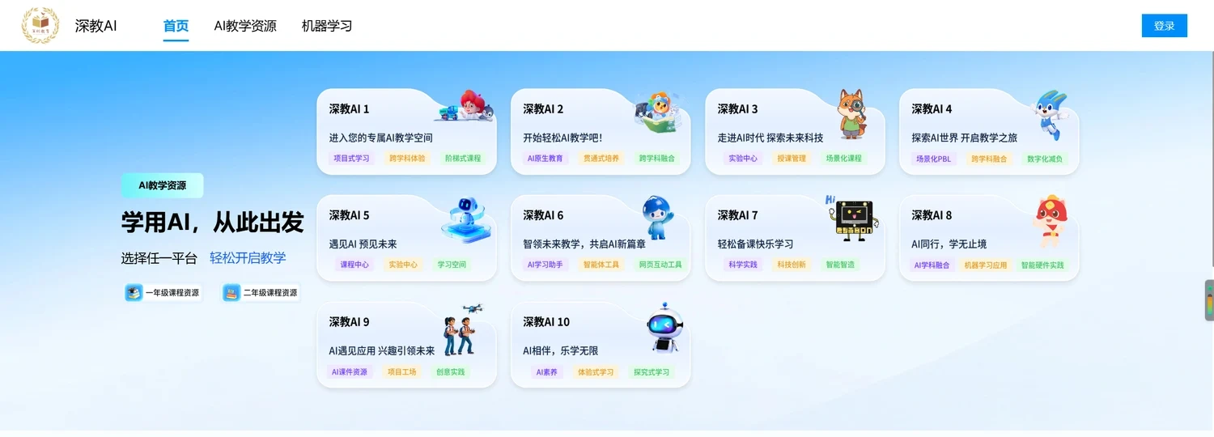
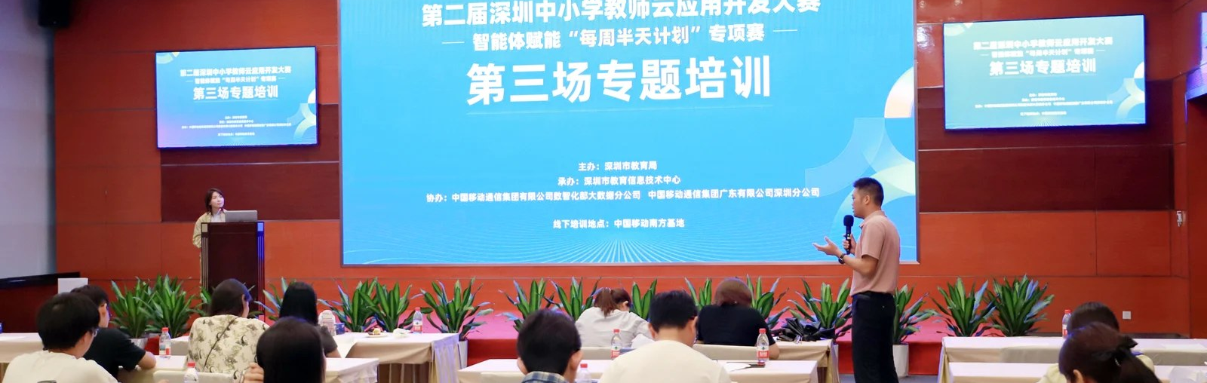
1 · PRACTICE / SHENZHEN MUNICIPAL EDUCATION BUREAU
Shenzhen: access
and chances to create
A shared starting point
Shenjiao AI brings together 10 approved learning platforms.
Teachers create applications
Three city contests drew over 2,000 teachers.
City platform and teacher application contest
Give teachers access to tools—and chances to build with them.
CocoRobo · UNESCO Digital Learning Week 2026
05 / 17
Notes:
02:15–02:45 | 30 seconds
At the city level, Shenzhen provides a shared platform called Shenjiao AI. It brings together ten approved learning platforms. Three contests also drew over two thousand teachers to create applications. The city connects access with chances to build. This is how local support can help teachers act.
[Sources]
素材2.pptx, slides 1–2. Institutional source supplied by the presenter as the Shenzhen Municipal Education Bureau material.
Evidence and interpretation:
Slide 1 reports launch in August 2023, access for 1,191 primary and secondary schools, 10 approved learning platforms, and 依效付费. It does not define the payment metric. Slide 2 reports three teacher cloud-application contests from 2024, over 2,000 participating teachers and 93 selected works. Reach and selected works are implementation outputs, not estimates of learning effects.
The “Lesson to share” is our interpretation of the documented approach, not a measured causal finding.
Images: Shenzhen Education Bureau source deck, slide 1 (city-s1-img1.png) and slide 2 (city-s2-img4.jpeg).

Slide 6

1 · PRACTICE / PINGSHAN DISTRICT EDUCATION BUREAU
Pingshan: help teachers lead AI use
Learn, build and improve
Three groups of teachers moved from prompts to teaching agents.
Teachers decide
In English practice, AI gives feedback. Teachers set the standards.
AI pioneer teacher programme · Pingshan
Write prompts → Build agents → Test and revise
Help teachers build AI support and decide how to use it.
CocoRobo · UNESCO Digital Learning Week 2026
06 / 17
Notes:
02:45–03:20 | 35 seconds
Access is a start. Teachers also need ways to learn. In Pingshan, three groups moved from prompts to teaching agents. They shared designs and improved them. In the English class shown earlier, AI gives feedback. Teachers set the standards. The lesson is to help teachers both build AI support and decide how to use it.
[Sources]
AI-Empowered_Education（英文168）.pptx, slide 1. Supplied as the Pingshan District Education Bureau case. The existing programme timeline is documented in the original deck, slides 4–7.
Evidence and interpretation:
The supplied slide describes three training cohorts, a progression from prompts to teacher-created agents, and a primary English speaking class with instant AI feedback and teacher-set standards. Its 1,000+ training figure is not used as a research sample or added to other reach figures. Awards and claims of national ranking are omitted. The slide mentions a 66-second field case; this talk uses the supplied still image and does not budget a video.
The “Lesson to share” is our interpretation of the documented approach, not a measured causal finding.
Photo: IMG_3939.png supplied by the presenter in this conversation, showing the group at the second Pingshan primary and secondary school AI pioneer teacher professional-learning programme. The on-site banner identifies the Pingshan programme. The photo illustrates participation in practice; it does not establish the size of the research sample or identify a particular research cohort. Used as pingshan-teacher-group.webp. The classroom image on slide 2 remains the supplied Pingshan English case.

Slide 7

1 · PRACTICE / LIYUAN EDUCATION GROUP, FUTIAN
Liyuan: teachers shape the standards
Agree on the criteria
Experts draft indicators. Teachers rate them. The team finalizes the set.
Build, test and revise
Turn the criteria into an AI analysis tool. Try it in class and use teacher feedback.
Teachers develop shared practices · Liyuan
Involve teachers in the standards that guide AI.
CocoRobo · UNESCO Digital Learning Week 2026
07 / 17
Notes:
03:20–03:55 | 35 seconds
Skills matter. Shared standards matter too. At Liyuan Education Group, experts drafted classroom criteria. Teachers rated them. The team agreed on the final set. These criteria became an AI classroom-observation tool. The team tried it in lessons and revised it with teacher feedback. Teachers helped shape the standards that guide AI.
[Sources]
集团AI成果展示(1).zip → 荔园教育集团AI教育成果展示-英文版.pptx, slide 3; Chinese version, slide 3 embedded process graphic. Teacher support described in slide 2 and PPT稿件中英文版.docx.
Evidence and interpretation:
The five-stage process describes expert drafting of a four-level indicator system, scoring by about 50 teachers, finalization by a nine-person research group, AI model and tool development, and classroom testing with revision using teacher feedback. Do not present the design and trial process as established measurement validity. The support system also includes self-study micro-courses, group training, visiting coaching and technical Q&A. International recognition and pilot-school claims are not needed for this takeaway.
The “Lesson to share” is our interpretation of the documented approach, not a measured causal finding.
Photo: Liyuan Education Group source deck, slide 2 (group-s2-img3.jpeg, teacher collaboration). The five-stage process is documented in slide 3.

Slide 8
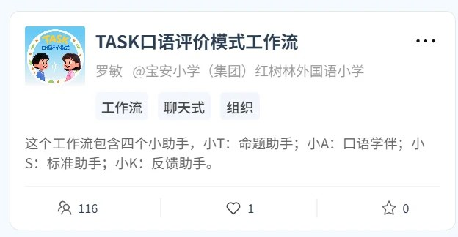
1 · PRACTICE / ENGLISH · TEACHER LUO MIN
Bao’an: give each agent a clear job
T · Task design
Help the teacher create speaking tasks.
A · Practice and assessment
Act as an AI speaking examiner.
S · Standards
Match activities to the criteria.
K · Feedback
Use learning data to give feedback.
Ms Luo’s TASK workflow · CocoRobo
TASK = Tasksheets · Assessments · Standards · Key competences
Start with the teaching method. Then give AI clear roles.
CocoRobo · UNESCO Digital Learning Week 2026
08 / 17
Notes:
03:55–04:30 | 35 seconds
Now consider a real teaching task. In Bao’an, Ms Luo developed an English speaking method called TASK. Four agents have clear jobs. T helps design tasks. A supports practice and assessment. S checks the standards. K gives feedback from learning data. The teaching method comes first. Then we decide where AI can help.
[Sources]
案例PPT（罗老师）.pptx, slides 1–2. User identifies this as the Bao’an English subject case. The workflow screenshot credits 罗敏 (Luo Min), 宝安小学（集团）红树林外国语小学.
Evidence and interpretation:
TASK means Tasksheets, Assessments, Standards and Key competences. The material describes an oral-assessment model and a CocoRobo workflow with four agents: T supports task design; A combines oral practice and assessment; S matches activities to standards; K provides feedback using data analysis. The figure documents four roles, not a verified linear routing sequence. The talk describes intended functions, not measured assessment accuracy, fairness or student gains.
The “Lesson to share” is our interpretation of the documented approach, not a measured causal finding.

Slide 9
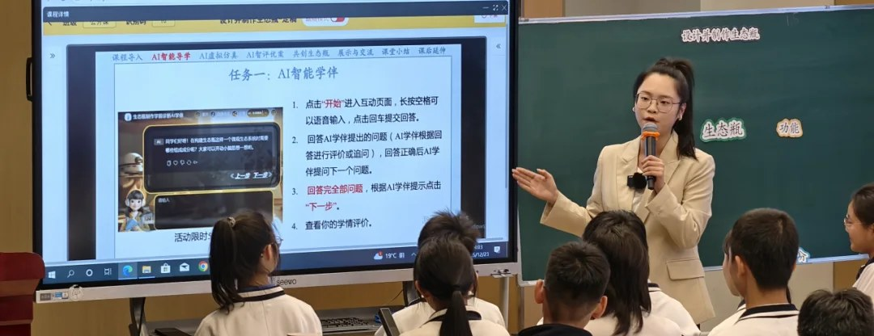
PRACTICE → RESEARCH
Why does practice
need research?
A working example is a start. We also need to understand how it works.
Learn what changes
How do teachers’ designs and choices develop?
Understand the conditions
What helps teachers keep creating?
Make lessons useful elsewhere
What needs to change in another school?
Biology inquiry · Futian Liyuan Primary School
Use evidence to improve tools, training and classroom practice.
CocoRobo · UNESCO Digital Learning Week 2026
09 / 17
Notes:
04:30–05:15 | 45 seconds
These cases show what we can build. But a working example cannot tell us everything. In this biology lesson, teachers still need to decide how much help AI should give. We need research to understand how teachers learn that judgment. What helps them keep creating? What must change in another school? Evidence helps us improve the tools and training, and share lessons others can use.
[Sources]
Original 18-slide presentation, slide(s) 8. https://tonyxinvip.github.io/slides/teacher-agent-creators/ ; supporting evidence: https://cocorobo.hk/unesco2026/teacher/
Evidence and interpretation:
Evidence scope follows the original deck. Design implications are not additional experimental findings.
This transition motivates systematic inquiry; transfer is a research purpose, not an established finding. RPP rationale: https://rpp.wtgrantfoundation.org/about/ .

Slide 10
2 · RESEARCH / TIMELINE & OUTPUTS
A year of practice,
evidence and revision
Three teacher groups in Pingshan · April 2025–April 2026
APR 2025
SEP 2025
APR 2026
First prompts and agents
Subject groups and workflows
Deeper study of teacher learning
Evidence: designs, revisions, platform use, surveys and interviews.
4 accepted conference papers
Ongoing journal work
AERA 2026: 2 · ISLS 2026: 2
Boundary Learning synthesis
Each round informed the next. Research returns to practice.
CocoRobo · UNESCO Digital Learning Week 2026
10 / 17
Notes:
05:15–06:00 | 45 seconds
Our research follows three teacher groups in Pingshan over twelve months. It began with prompts and first agents. It grew into subject groups and workflows. We then deepened the study of teacher learning. We used designs, revisions, platform use, surveys and interviews. Four conference papers were accepted: two at AERA and two at ISLS. Our Boundary Learning journal paper is still in progress. Each round helps improve the next.
[Sources]
Original 18-slide presentation, slide(s) 4, 9–10, 17. https://tonyxinvip.github.io/slides/teacher-agent-creators/ ; supporting evidence: https://cocorobo.hk/unesco2026/teacher/
Evidence and interpretation:
Evidence scope follows the original deck. Design implications are not additional experimental findings.
The four practice cases are not four research cohorts. As reported in the original deck, the research programme includes four accepted conference papers and an ongoing Boundary Learning synthesis. Related preprints: https://arxiv.org/abs/2605.13906 and https://arxiv.org/abs/2605.12934 .
Image: it-training.jpeg from the original presentation. It illustrates the programme setting, not a chart or additional research result.
Verified against supporting page sections A Sustained Programme and Research Outputs: https://cocorobo.hk/unesco2026/teacher/ (checked 8 September 2026). Timeline dates describe programme rounds; they are not paper acceptance dates. Paper acceptance status is reported in the presenter’s submission materials.
AERA 2026: Teachers’ Behavior in Building Agents Based on Hierarchical Clustering and Thematic Analysis (roundtable); Empowering Teachers as Creators of Pedagogical Agents: An Integrated Perspective of Constructionism, ICAP, and TPACK (poster).
ISLS 2026: An Activity-Theoretical Approach to Teacher Professional Development in Pedagogical AI Agent Design (long paper, https://arxiv.org/abs/2605.12934); Modeling AI-TPACK in Practice: Insights from Teachers’ Multi-Agent Workflow Design (short paper, https://arxiv.org/abs/2605.13906). Boundary Learning is ongoing, not an accepted fifth paper. This slide does not claim every paper used all three cohorts or that acceptance dates followed the final round. Teacher evidence does not establish causal student learning gains.

Slide 11
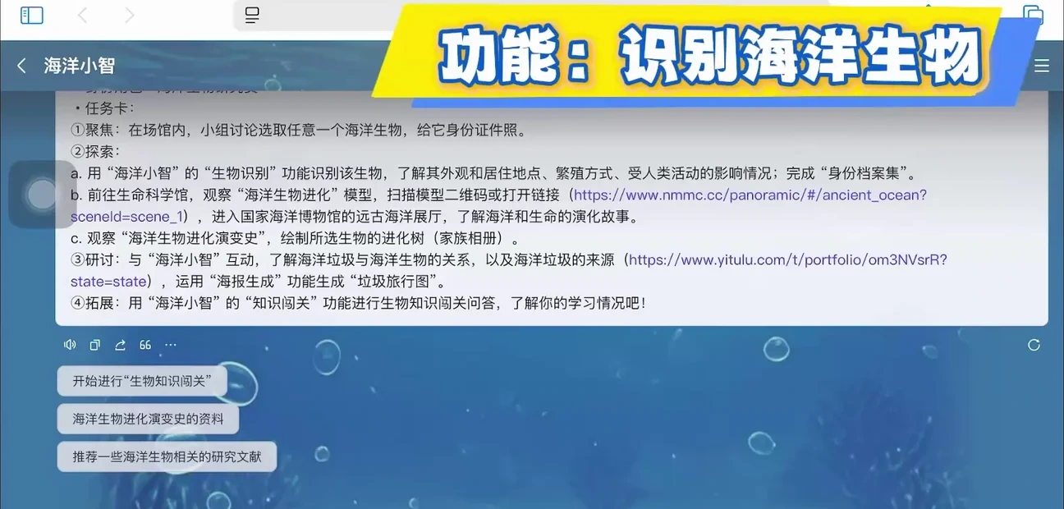
2 · RESEARCH / FINDING 1
Building agents makes
teaching choices visible
A teaching idea becomes a design that can be tested and changed.
Make choices clear
What should the agent do? What should the student do?
Learn through testing
Test it. Discuss what happens. Improve it.
Teacher-made application · city contest example
Look at what teachers build and revise, as well as what they report.
CocoRobo · UNESCO Digital Learning Week 2026
11 / 17
Notes:
06:00–06:30 | 30 seconds
The first finding is about learning by making. Building an agent makes teaching choices visible. What should AI do? What should students do? Teachers can test those choices and change the design. We can then study how their ideas develop. This gives us more than a survey of how confident they feel.
[Sources]
Original 18-slide presentation, slide(s) 11, 13. https://tonyxinvip.github.io/slides/teacher-agent-creators/ ; supporting evidence: https://cocorobo.hk/unesco2026/teacher/
Evidence and interpretation:
Evidence scope follows the original deck. Design implications are not additional experimental findings.
Image: Shenzhen Education Bureau source deck, slide 2 (city-s2-img5.png). This teacher-made application is an illustration of a design artifact; it is not presented as part of the Pingshan research sample.

Slide 12

2 · RESEARCH / FINDING 2
Teachers need support
to keep creating
Some create and revise
Others explore. Some take little part.
Training is only a start
Choice, skills, belonging and
school support matter.
Teachers reviewing an English-assessment task · programme material
Give teachers time, trusted peers and people they can turn to for help.
CocoRobo · UNESCO Digital Learning Week 2026
12 / 17
Notes:
06:30–07:00 | 30 seconds
The second finding is about continued creation. Some teachers kept building. Others explored, or took little part. Training alone did not make everyone an active creator. Teachers need choice, skills, trusted peers and school support. These findings help us redesign professional learning, with time and help beyond the workshop.
[Sources]
Original 18-slide presentation, slide(s) 12–13. https://tonyxinvip.github.io/slides/teacher-agent-creators/ ; supporting evidence: https://cocorobo.hk/unesco2026/teacher/
Evidence and interpretation:
Evidence scope follows the original deck. Design implications are not additional experimental findings.
Photo: english-assessment.webp from the original presentation, slide 9 classroom example.

Slide 13
2 · RESEARCH / A WORKING FRAMEWORK
Boundary Learning:
deciding where AI belongs
Teachers learn to decide when AI should help—and when it should step back.
01
Task
02
AI limits
Is this a good task for AI?
Can it do the task well?
03
Responsibility
04
Design
Who should make the key decisions?
What roles, steps and limits
should we set?
A working framework, still under development.
Example: if AI answers too soon, ask students to try first.
CocoRobo · UNESCO Digital Learning Week 2026
13 / 17
Notes:
07:00–07:40 | 40 seconds
Together, these studies lead to a working idea called Boundary Learning. Teachers learn where AI belongs. Is the task right for AI? Can it do it well? Who should decide? What roles and limits should we set? If AI answers too soon, for example, ask students to try first. This framework is still developing. It helps keep student thinking at the centre.
[Sources]
Original 18-slide presentation, slide(s) 3, 14. https://tonyxinvip.github.io/slides/teacher-agent-creators/ ; supporting evidence: https://cocorobo.hk/unesco2026/teacher/
Evidence and interpretation:
Evidence scope follows the original deck. Design implications are not additional experimental findings.
Original 18-slide presentation, slide(s) 15. https://tonyxinvip.github.io/slides/teacher-agent-creators/ ; supporting evidence: https://cocorobo.hk/unesco2026/teacher/
Evidence and interpretation:
Evidence scope follows the original deck. Design implications are not additional experimental findings.

Slide 14
OUR MODEL / RESEARCH–PRACTICE PARTNERSHIP
Four partners make
the work possible
An RPP brings partners together over time to study and improve a shared problem.
CocoRobo · enterprise
University teams
Lead the programme; build, improve
and support the tools.
CUHK · HKU · EdUHK:
research design, theory and analysis.
Government partners
Schools & teachers
Local coordination, policy alignment
and access.
Real needs, classroom trials
and teaching decisions.
Together, we connect classroom needs, working tools and research.
CocoRobo · UNESCO Digital Learning Week 2026
14 / 17
Notes:
07:40–08:35 | 55 seconds
Where did these results come from? They grew through a research-practice partnership, or RPP. We work on shared problems over time. CocoRobo leads the programme, builds and improves the tools, and supports teachers. University teams bring research methods and analysis. Government partners organize local support. Schools and teachers bring real needs, trials and teaching judgment. Together, we can connect these strengths in ways each partner would struggle to sustain alone. The company turns classroom needs and research ideas into tools people can use. Feedback then guides the next design.
[Sources]
Programme partnership and roles: https://cocorobo.hk/unesco2026/teacher/ , sections An RPP-informed Model and Collaboration note; presenter confirmation in this conversation. Partners include university research teams from CUHK, HKU and EdUHK, district education partners, schools and teachers; do not imply each university coauthored every paper or the provincial government is a formal partner in the specific research programme. CocoRobo’s documented role includes programme leadership, technical implementation, platform iteration, teacher training and PD redesign.
RPP conceptual grounding: William T. Grant Foundation, About RPPs, https://rpp.wtgrantfoundation.org/about/ , drawing on Coburn, Penuel and Geil (2013): sustained collaboration, jointly defined problems, mutual benefit, research production and use. This deck interprets the documented programme through an RPP lens; four stakeholder types alone do not define an RPP.
Complementarity and the value of enterprise participation are the presenter’s analysis of the mode of work, not a controlled comparison, a historical first or measured superiority over single-sector projects. Research independence, consent and teachers’ pedagogical judgment remain important to the model.

Slide 15
WHAT OTHERS CAN TAKE AWAY
Make the partnership
useful in practice
Build teacher agency through shared work.
1
Start with a shared teaching problem
Let teachers help define the goals and the questions.
2
Connect creation, evidence and redesign
Use findings to change tools and professional learning.
3
Fund the work between meetings
Support coordination, technical help and teacher time.
Judge success by better teaching choices and usable knowledge.
CocoRobo · UNESCO Digital Learning Week 2026
15 / 17
Notes:
08:35–09:10 | 35 seconds
So what can others take away from this model? Start with a shared teaching problem. Let teachers help define it. Connect creation, evidence and redesign. Support the work between meetings, including technical help and teacher time. Papers matter. So do better tools and teaching choices. This is how partnership can turn local practice into useful knowledge.
[Sources]
Original 18-slide presentation, slide(s) 16. https://tonyxinvip.github.io/slides/teacher-agent-creators/ ; supporting evidence: https://cocorobo.hk/unesco2026/teacher/
Evidence and interpretation:
Evidence scope follows the original deck. Design implications are not additional experimental findings.
The three recommendations synthesize the four supplied practice cases and the reported teacher-learning studies. They are recommendations, not additional measured outcomes.
Partnership recommendations also draw on https://rpp.wtgrantfoundation.org/about/ . They are recommendations based on this programme and RPP principles, not measured partnership effects.

Slide 16

LET’S LEARN FROM EACH OTHER
You are welcome
in Shenzhen.
Visit our schools. Meet the teachers.
See their work in real lessons.
Shenzhen is honoured to host APEC this year.
APEC Economic Leaders’ Meeting
18–19 November 2026 · Shenzhen, China
APEC China 2026 · official emblem
Contact me to explore a school visit and exchange ideas.
CocoRobo · UNESCO Digital Learning Week 2026
16 / 17
Notes:
09:10–09:40 | 30 seconds
I would like to invite you to see this partnership in Shenzhen. This year, the city hosts the APEC leaders’ meeting on November eighteenth and nineteenth. Visit our schools. Meet the teachers and see their work in real lessons. Please contact me to explore a visit. We would love to learn from you too.
[Sources]
APEC dates and host city: Shenzhen Municipal Foreign Affairs Office, 12 August 2026, https://fao.sz.gov.cn/xxgk/zyxw/content/post_1961390.html (checked 8 September 2026). Also APEC Secretariat, 12 December 2025: https://www.apec.org/press/news-releases/2025/china-unveils-apec-2026-theme-and-priorities-in-shenzhen . The slide identifies the announced city, not an unconfirmed building or official school-visit programme.
Official APEC China 2026 emblem: Xinhua, 12 December 2025, https://www.xinhuanet.com/20251212/1d1dad261ca34e259c55c672e8497cfe/c.html . Image: https://www.xinhuanet.com/20251212/1d1dad261ca34e259c55c672e8497cfe/202512121d1dad261ca34e259c55c672e8497cfe_912aa6ef9651489b8acd6054075d0fbb.jpg . Identity cross-checked against the official host-year website https://www.apec2026.cn/ and Shenzhen government announcement https://www.sz.gov.cn/en_szgov/news/latest/content/post_12546149.html (checked 8 September 2026). Emblem reproduced without alteration.

Slide 17
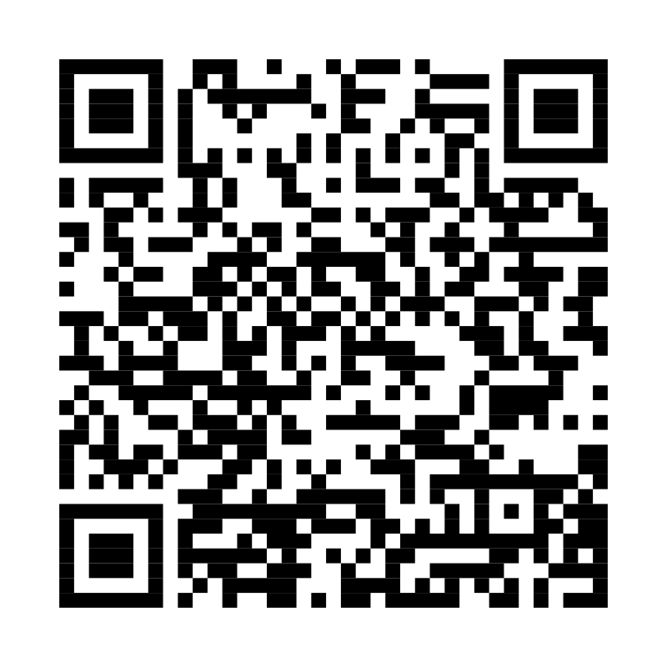
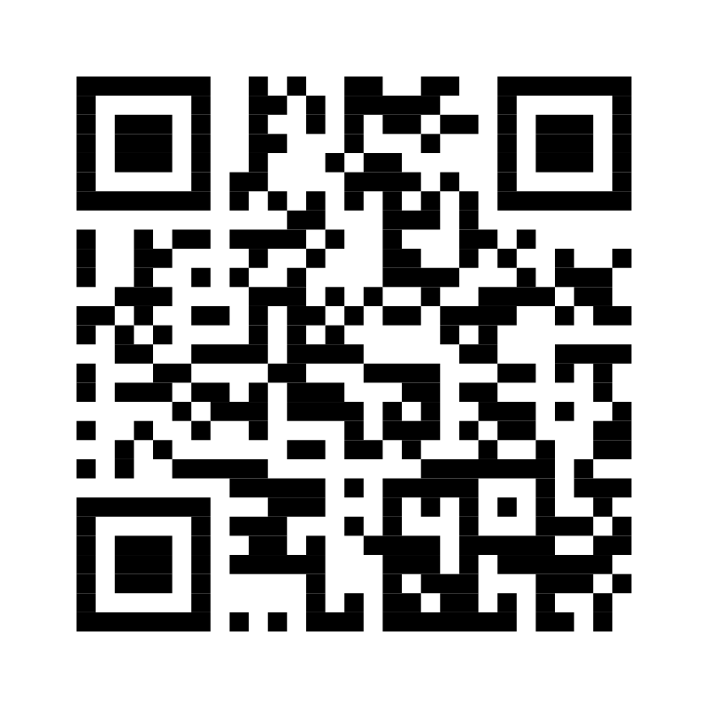
VISIT · SHARE · COLLABORATE
Let’s keep
learning together.
This
presentation
Submission
materials
Scan the slides or explore the full
submission and research.
Haiyang Xin ·
Founder & CEO, CocoRobo Ltd.
tony@cocorobo.cc
Online slides ·
current version
UNESCO submission ·
studies and evidence
Contact me to arrange a school visit.
Notes:
09:40–09:55 | 15 seconds
These two codes link to this presentation and our submission materials. My email is on the screen. Please stay in touch, and come to Shenzhen. Thank you.
[Sources]
Presenter-supplied contact: tony@cocorobo.cc. QR destinations: https://tonyxinvip.github.io/slides/teacher-agent-creators-10min/ and https://cocorobo.hk/unesco2026/teacher/. QR codes encode these exact URLs; they are not third-party tracking links.

