Slide 1

Survey of Reconfigurable Accelerator in Large-Scale Data Center and Cloud
Project Presentation of CSC6031: Advanced Computer Architecture
● Presenter: Liu Yuxuan
Email: yuxuanliu1@link.cuhk.edu.cn
The Chinese University of Hong Kong, Shenzhen

Slide 2
01
Introduction to Reconfigurable Accelerator and FPGA
CONTENTS
Applying FPGAs in Large-Scale Data Center
Case Study of Microsoft Project Catapult
02
03
Challenges and Opportunities of FPGAs in the Cloud
04
Conclusion

Slide 3
01
Reconfigurable Accelerator and FPGA
PART
Introduction, Background, and Motivation

Slide 4
What is Reconfigurable Accelerator?
Background: Slowing of Moore’s Law
Domain-Specific Architecture (DSA) as a desperate way for further speedup
Seeks further performance and energy gain by sacrificing homogeneous to heterogeneous
Switch from architecture-dominant to application-dominant
Three Major Types of DSA
Graphics Processing Unit (GPU)
Reconfigurable Accelerator (FPGA)
Application-Specific Integrated Circuits (ASIC)

Slide 5
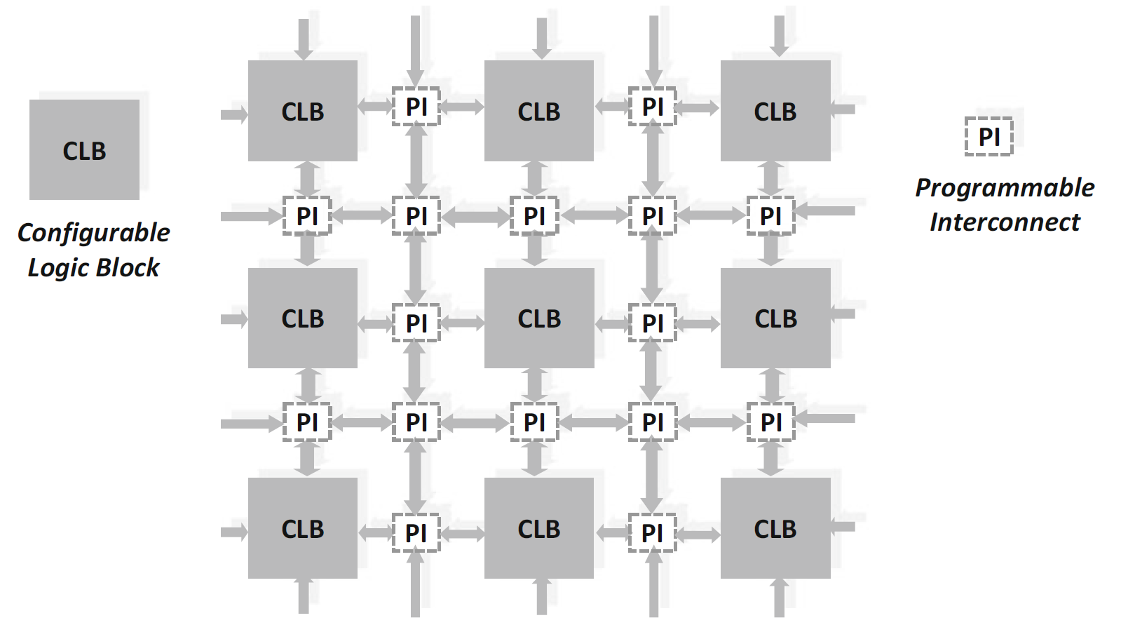
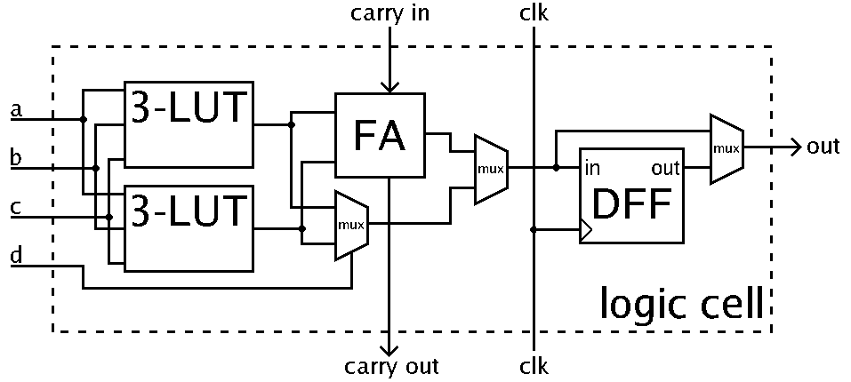
What is FPGA?
Field Programming Gateway Array
Programmable logic blocks and interconnects that can reconfigure after manufacture
Logic blocks contain look-up tables (LUTs), flip-flops that can implement logic functions
Fig.1 General FPGA Architecture
Fig.2 Simplified Example of a Logic Cell

Slide 6
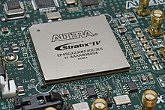
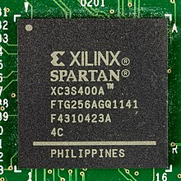
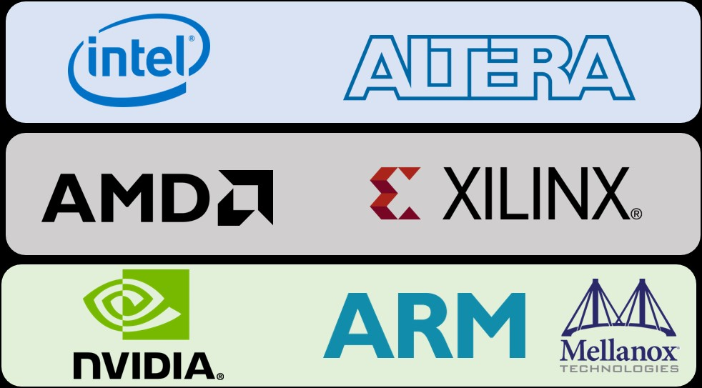
Why FPGA? — Market and Players
Huge Size & Growth in FPGA Market
6.5 billion USD global FPGA market
48% Compound Annual Growth Rate (CAGR) between 2020 and 2027
Serves over 1 million hosts for Microsoft Azure SmartNICs application
Major FPGA Service Providers
Microsoft (Project Catapult, Brainwave, and Azure SmartNICs)
Amazon Web Services (AWS) EC2 F1
Major FPGA Manufacturers
Xilinx (Acquired by AMD in 2022)
Altera (Acquired by Intel in 2015)
Straix IV FPGA from Altera
Spartan FPGA from Xilinx

Slide 7
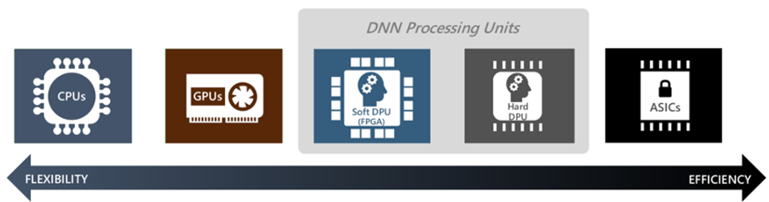
Why FPGA? — Flexibility-Efficiency Trade-Off
Good Balance Between Flexibility and Efficiency
Flexibility: Reconfigurability means lower non-recurrent expense (NRE) and faster deployment
Alibaba has reported 75% savings in TCO by using FPGAs to oversee product images on its e-commerce site.
Efficiency: Higher throughput than CPU, more energy efficient and lower latency than GPU
FPGA Here
Fig.3 Trade-Off between Flexibility and Efficiency

Slide 8
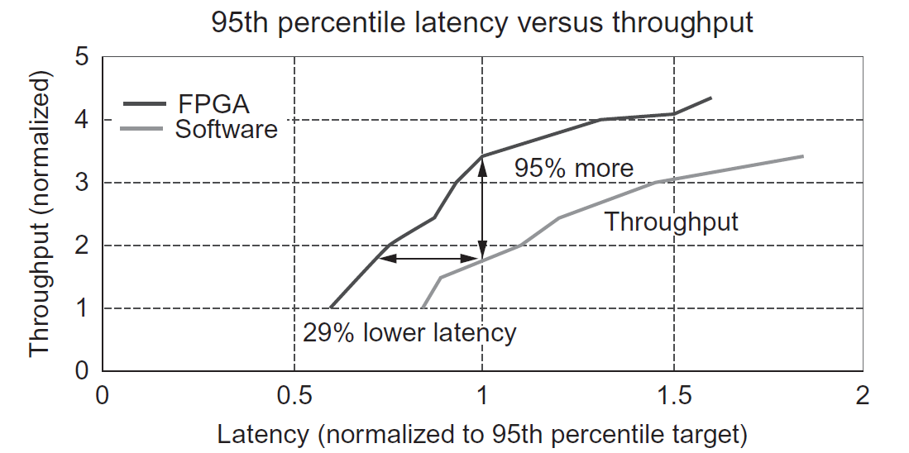
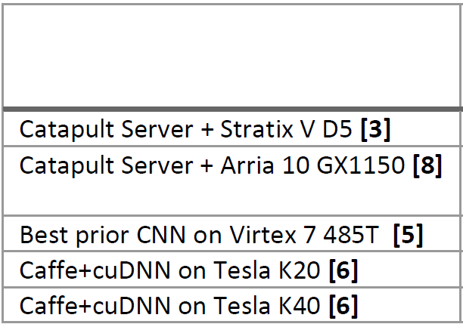
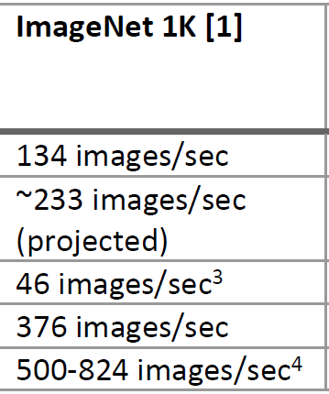
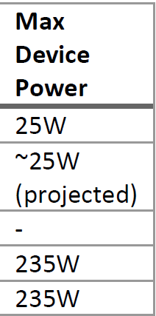
Why FPGA? — A Closer Look at Performance
Compared with CPU
Catapult on Bing’s Web Search Ranking Application
95% more throughput with the same latency
29% lower latency under the same throughput
Compared with GPU
Catapult on Image Classification
90% power save
remain 40% to 50% peak throughput
Fig.4 Throughput and Latency Comparison for Web Search Ranking
FPGA
GPU
Fig.5 Comparison of Image Classification Throughput and Power Consumption

Slide 9
02
FPGAs in Large Scale Data Center
Case Study of Microsoft Project Catapult
Align with Textbook Chapter 7.5
PART

Slide 10

Milestone of Microsoft Project Catapult
Proposal Initiate
2010
Propose to use FPGAs at scale to accelerate web search
2011
First Prototype Developed
Catapult v0 accelerating Bing IndexServer Engine
Release Catapult v1 ISCA’14
2014
Deploy on 1632 servers accelerating web search services
2016
Release Catapult v2 MICRO’16
Deploy on 5760 servers accelerating major web search and network services
Release Brainwave ISCA’18
2018
Use FPGAs to accelerate DNN and SmartNICs

Slide 11
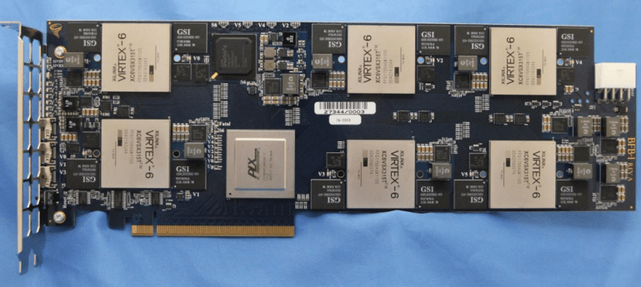
Catapult v0 — Straightforward But Poor Design
Motivation & Goal
Achieve the required capacity for a large-scale reconfigurable fabric
Six-in-One Board Design
Six Xilinx Virtix-6 FPGA on one daughter board
FPGAs inter-connected in a mesh network with general-purpose I/Os
FPGA serves as local compute accelerator (co-processor)
Problems
Inelastic FPGA Resources
Incompatible power and physical space for the board
Single-Point-Of-Failure
Limited Functionality of local co-processor architecture
Fig 6. Photograph of Catapult v0 Board

Slide 12
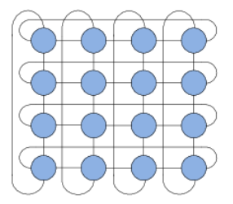
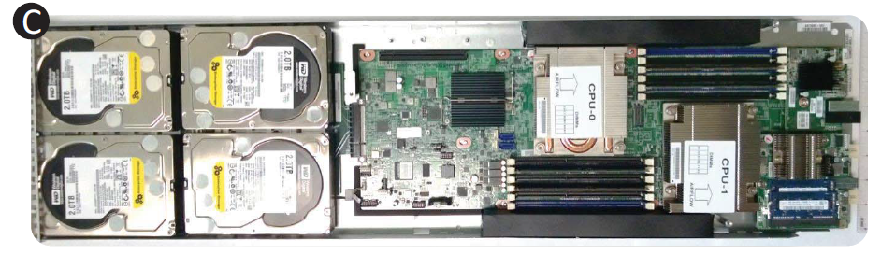
Catapult v1 — A Global View
Motivation & Goal
Elastic, low-latency, and good failure detection & recovery
One-in-One Board Design
One Altera Straix V FPGA on one daughtercard with 8GB DRAM
Inter-FPGA direct secondary network in 2D 6x8 torus (48 as a rack)
FPGA serves as local and remote compute accelerator (co-processor)
Use one local FPGA through PCIe
Use remote FPGAs with secondary network
Cost & Power Consumption
Less than 30% extra system TCO
Less than 10% extra server power
Fig 7. 2D 6 x 8 Torus Network Topology
FPGA Here
Fig 8. Diagram of 1U, half-width server hosting the FPGA board

Slide 13
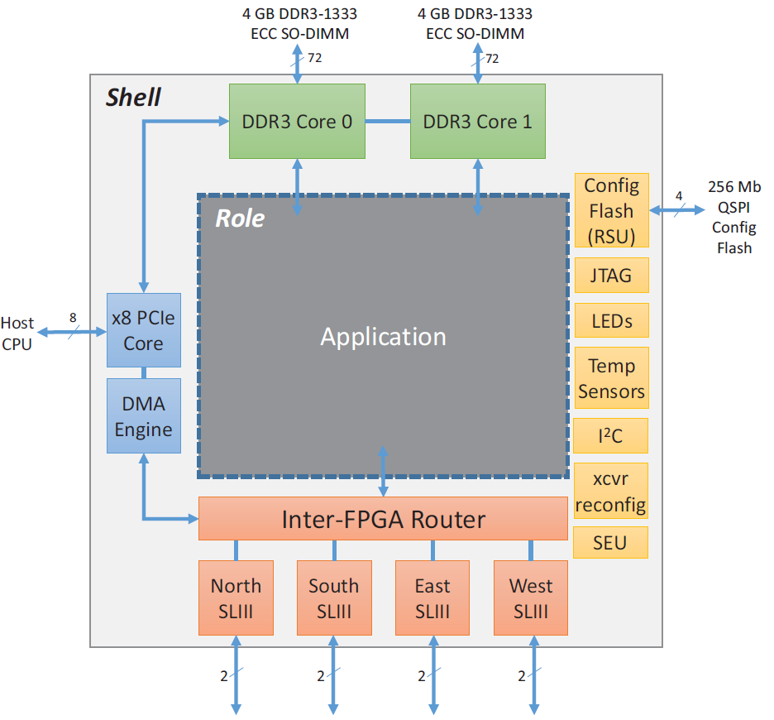
Catapult v1 — Shell & Role Architecture
Motivation
A simple and accessible interface to software application
Enhance user productivity and design re-use
Resilience and debugging support
Partial Reconfiguration with Shell/Role Architecture
Split all programmable logic blocks into shell & role
Shell (23%): reusable common logic across application
Not configurable logics by the application
Role (77%): Acceleration Application logic itself
Configurable logics by the application
Fig 8. Shell & Role Architecture for Catapult v1

Slide 14
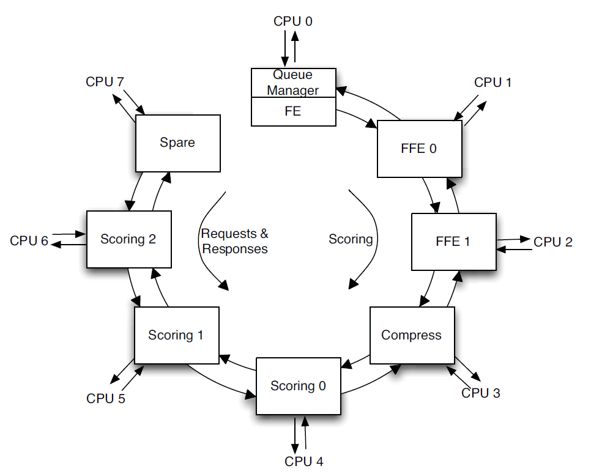
Catapult v1 — Accelerate Bing Ranking Service
Macro-pipeline with Multiple FPGA
1 FPGA for Feature Extraction (FE)
2 FPGAs for Free-Form Expressions (FFE)
1 FPGA for Compression
3 FPGAs for Machine-Learning Scoring Models
1 FPGA for redundancy in case of failure
Some Useful Terms for Later Understanding
<Query, Document> pair as input request
Query: user-input keywords for searching
Document: web pages, files or videos
Free-Form Expression
Combine multiple extracted features to be a hybrid feature
Fig 9. Roles of FPGAs on the Reconfigurable Fabric

Slide 15
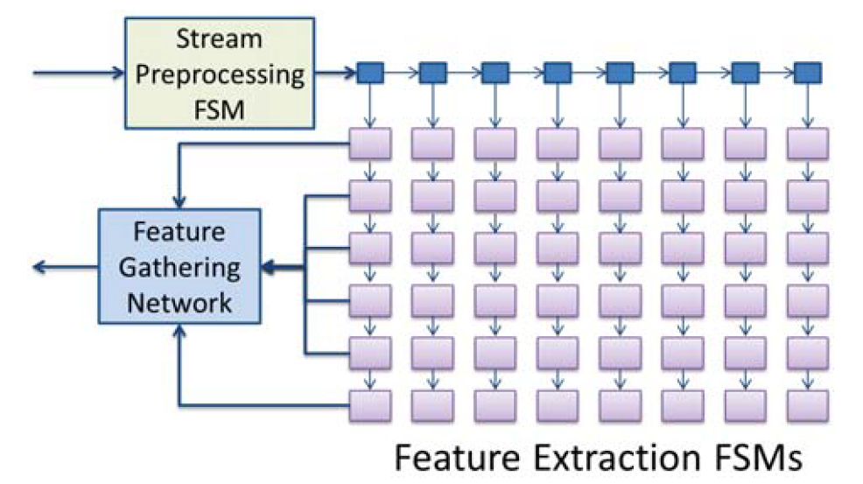
Catapult v1 — Accelerate Feature Extraction with MISD
Why MISD for FE?
Need to compute thousands of different features
of the same document, which is read-only in this stage
Multiple operations performed on the same data
Different feature needs different computation, hard to SIMD parallelism
Multi-threading is not needed as the document is shared and read-only, energy in-efficiency BTW
How MISD performs parallelism?
43 unique FE state machines in parallel on one document
Merge similar computations in one state machine for better throughput
Gather feature values from feature extraction state machines
Fig 9. MISD Parallelism with FSMs

Slide 16
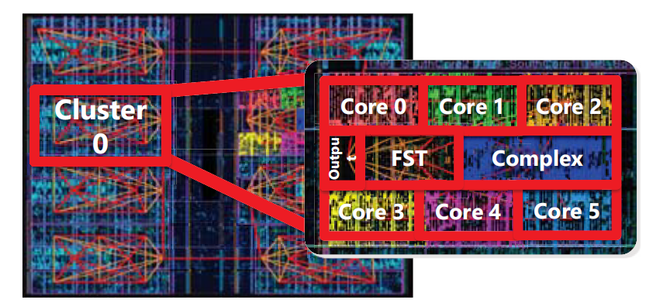
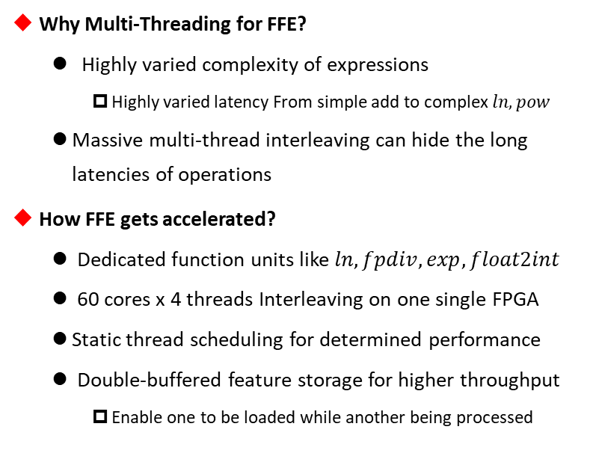
Catapult v1 — Accelerate FFE with Thread-Interleaving
Why Multi-Threading for FFE?
Highly varied complexity of expressions
Highly varied latency From simple add to complex $ln, pow$
Massive multi-thread interleaving can hide the long latencies of operations
How FFE gets accelerated?
Dedicated function units like $ln, fpdiv,exp, float2int$
60 cores x 4 threads Interleaving on one single FPGA
Static thread scheduling for determined performance
Double-buffered feature storage for higher throughput
Enable one to be loaded while another being processed
Fig 10. FFE Placed-and-Routed on FPGA

Slide 17
Catapult v1 — Putting it All Together
How FPGA Succeed in Accelerating Ranking Service
Reconfigure Different Architecture for Different Tasks
Dedicated function units for complex operations
Dedicated secondary network between FPGAs
Problems on Secondary Network
Expensive and complicated secondary network, hard to maintain
One node failure in torus network affects the neighbor nodes and requires re-routing
Dedicated secondary network is hard to scale for more FPGAs inter-connected
Back-end Cloud Architecture limits the functionality of other areas like networking and storage
Fig 11. 2D 6 x 8 Torus Network Failure

Slide 18
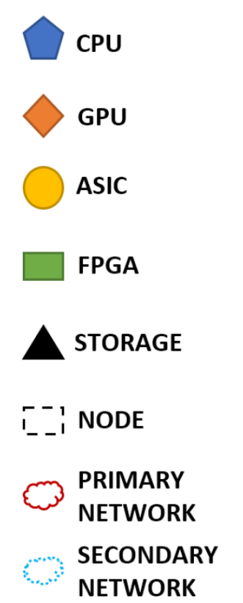
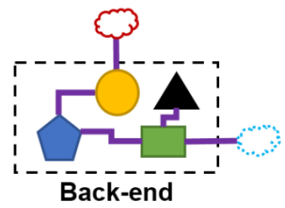
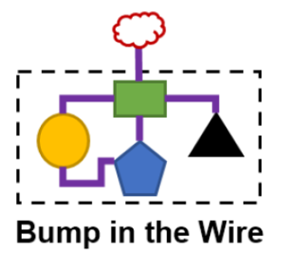
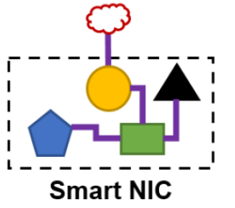
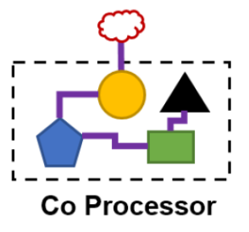
Break — Review of Cloud Acceleration Architectures
Four Types of Cloud Acceleration Architectures Mentioned in this Survey
Co-Processor (Catapult v0): Local Compute Acceleration
Back-End (Catapult v1): ultra-low latency, rack-scale FPGA-FPGA Connection
Bump-in-the-Wire (Catapult v2 & Brainwave): large scale compute (local and remote), network, and storage acceleration
Smart NICs (Azure NSDI’18): SDN & local network acceleration
Fig 12. Four Cloud Acceleration Architectures in this Survey

Slide 19
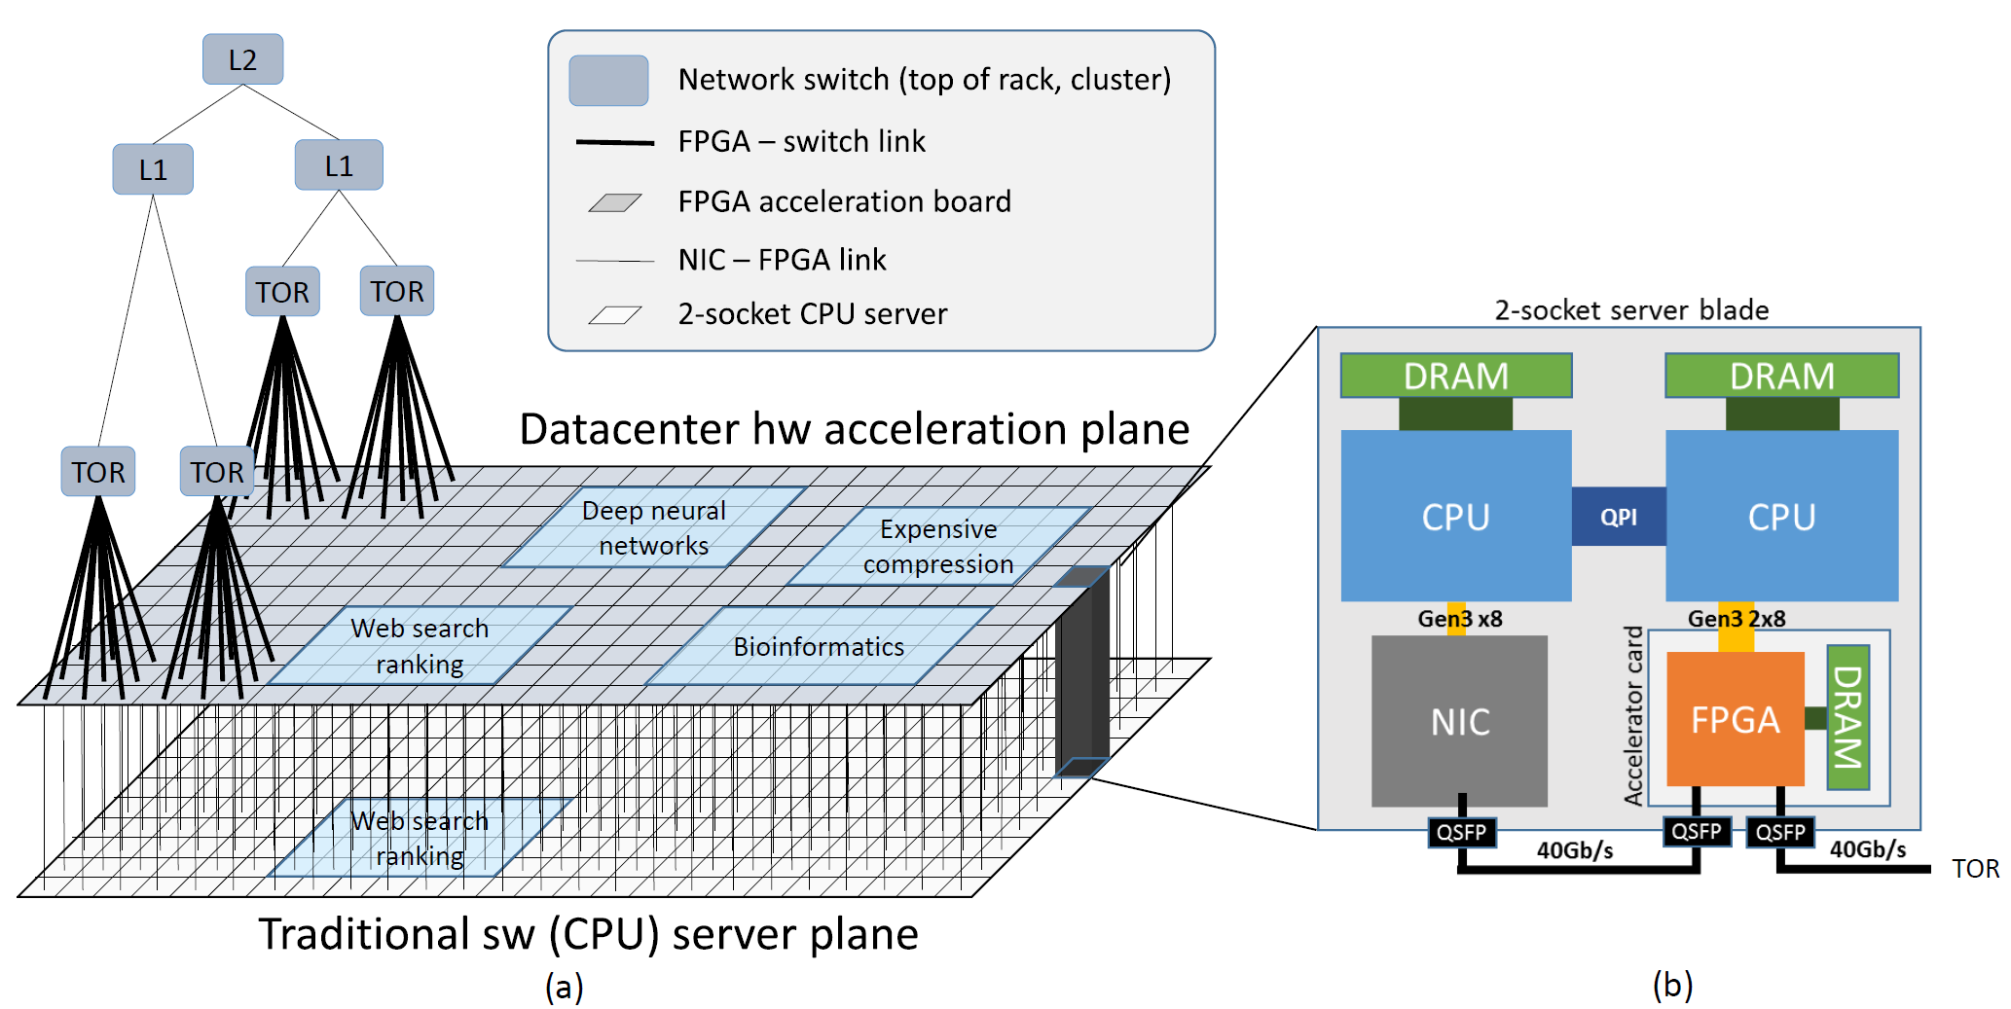
Catapult v2 — Bump-in-the-Wire Cloud Architecture
Motivation
Enable FPGAs to accelerate more tasks
Local & Remote Compute Acceleration
SDN and Network Crypto
More Scalable and Resilient to Failure
Hardware Plane & Design
FPGA as a layer between server’s NIC and the Ethernet network switches
FPGAs can generate and consume their own network flow independent of the host CPU (Pure FPGA-FPGA Connection)
Fig 13. (a) Decoupled Programmable Hardware Plane
(b) Server + FPGA Schematic

Slide 20
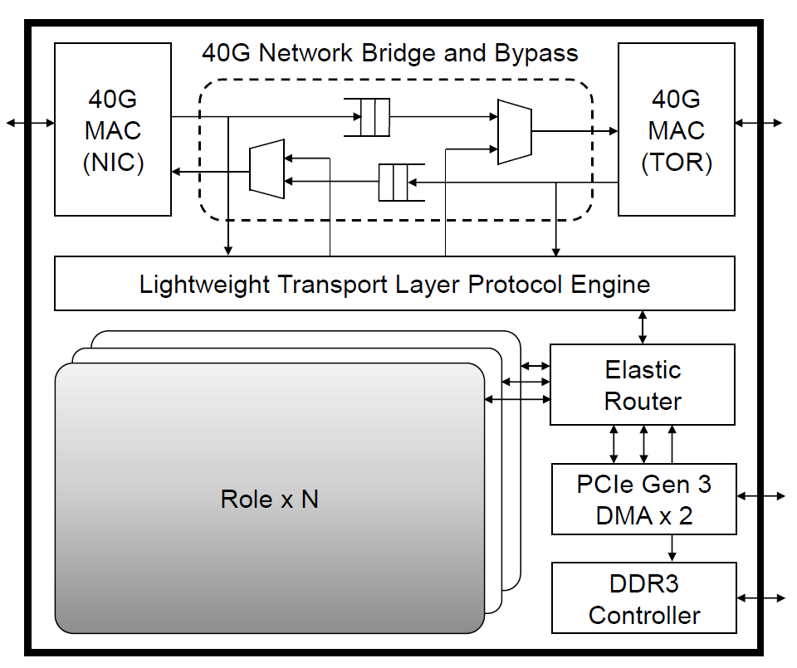
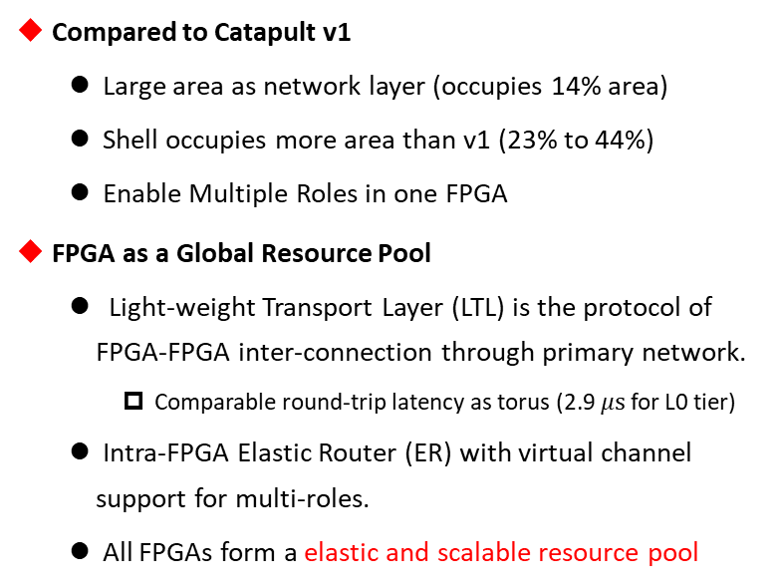
Catapult v2 — New Shell & Role Architecture
Compared to Catapult v1
Large area as network layer (occupies 14% area)
Shell occupies more area than v1 (23% to 44%)
Enable Multiple Roles in one FPGA
FPGA as a Global Resource Pool
Light-weight Transport Layer (LTL) is the protocol of FPGA-FPGA inter-connection through primary network.
Comparable round-trip latency as torus (2.9 $μs$ for L0 tier)
Intra-FPGA Elastic Router (ER) with virtual channel support for multi-roles.
All FPGAs form a elastic and scalable resource pool
Fig 14. Shell & Role Architecture on Catapult v2

Slide 21
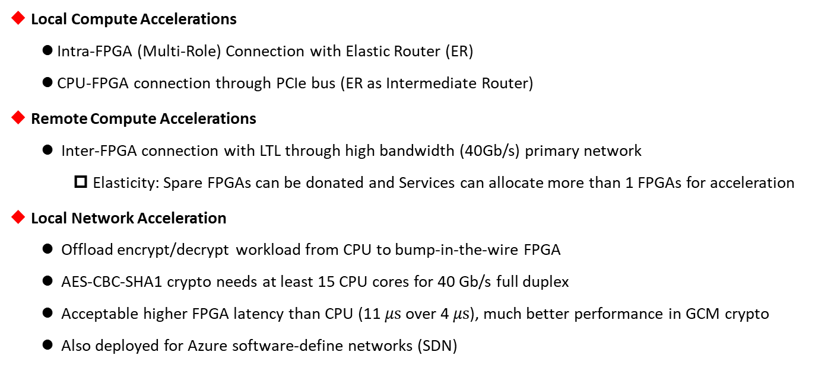
Catapult v2 — New Acceleration Possibilities
Local Compute Accelerations
Intra-FPGA (Multi-Role) Connection with Elastic Router (ER)
CPU-FPGA connection through PCIe bus (ER as Intermediate Router)
Remote Compute Accelerations
Inter-FPGA connection with LTL through high bandwidth (40Gb/s) primary network
Elasticity: Spare FPGAs can be donated and Services can allocate more than 1 FPGAs for acceleration
Local Network Acceleration
Offload encrypt/decrypt workload from CPU to bump-in-the-wire FPGA
AES-CBC-SHA1 crypto needs at least 15 CPU cores for 40 Gb/s full duplex
Acceptable higher FPGA latency than CPU (11 $μs$ over 4 $μs$), much better performance in GCM crypto
Also deployed for Azure software-define networks (SDN)

Slide 22
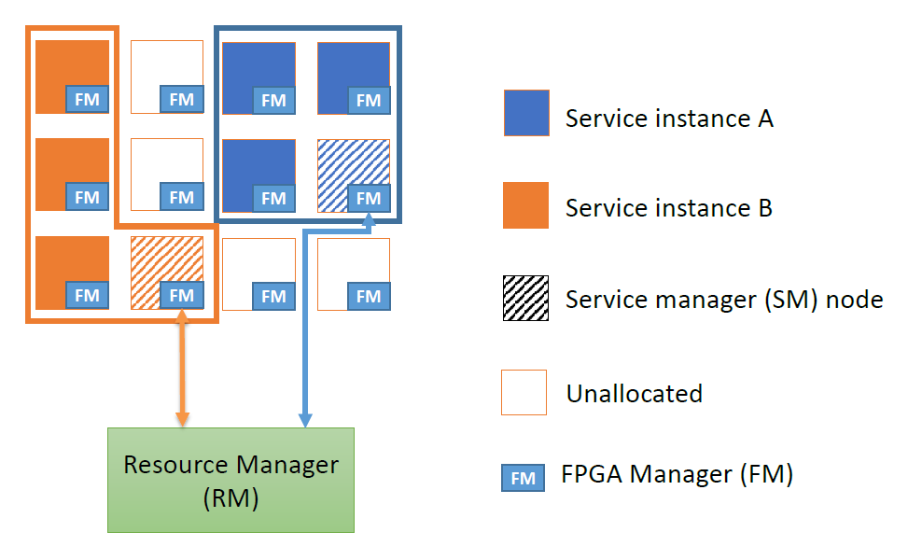
Catapult v2 — Hardware-as-a-Service (HaaS)
Multi-Level Resource Manager
From top to bottom
Resource Manager (RM)
Service Manager (SM) as one of FM nodes in a service
FPGA Manager (FM)
Go from Data Center to Cloud
Catapult v1 (ISCA’14): A Reconfigurable Fabric for Accelerating Large-Scale Datacenter Services
Catapult v2 (MICRO’16): A Cloud-Scale Acceleration Architecture
More elastic, scalable, failure resilience, and easy-to-share
Fig 15. Two HaaS-Enabled Accelerator Services

Slide 23
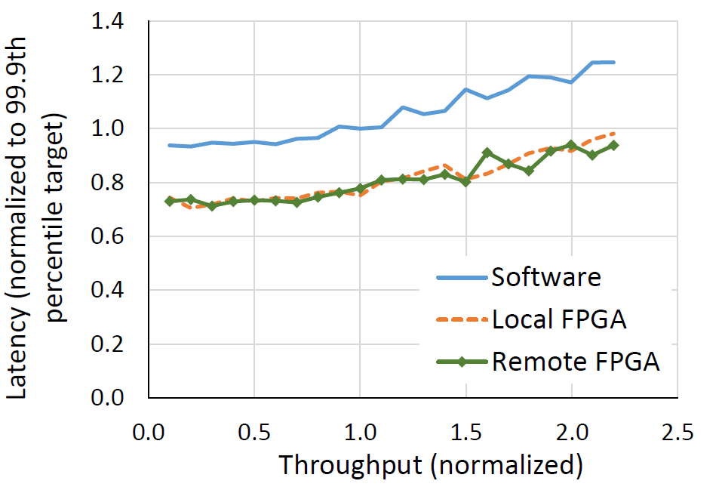
Catapult v2 — Putting it All Together
Features over Catapult v1
Bump-in-the-wire instead of back-end architecture
Able to take and accelerate more workloads
inter/intra FPGA connection without secondary network
Cloud-Scale elastic, scalable and easy-to-share solution
Better Performance over Software Solution
2.25x more throughput
20% tail latency drop in both local & remote acceleration
Problems
Too much FPGA area occupied by shell
Lack of multi-tenant resource sharing as a cloud service provider
Fig 16. Latency and Throughput for Catapult v2

Slide 24
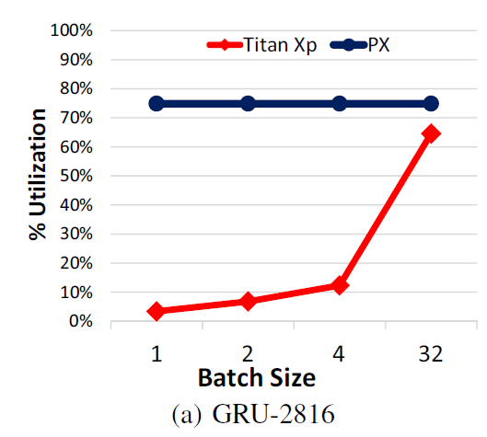
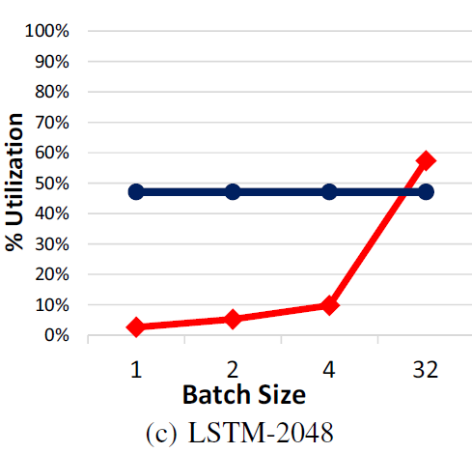
GPU
FPGA
Catapult to Brainwave — AI Acceleration
Background & Motivation
Accelerate NN inference based on Catapult v2 FPGA infrastructure
GPUs have excellent performance with batching but long latency
parallelism within and across request
under-utilization and long latency for online mode, when requests come one by one
Exploit parallelism within single request for real-time, low-latency AI
Trade-Off: Faster Clock Rate vs. Higher Utilization
Increasing clock rate improves performance, but reduce efficiency
Increased pipeline bubbles
FPGAs have lower clock rate than GPU and ASIC due to the overhead of reconfigurable logic (from performance-dominant to efficiency-dominant)
Fig 17. Utilization scaling with
increasing batch size

Slide 25
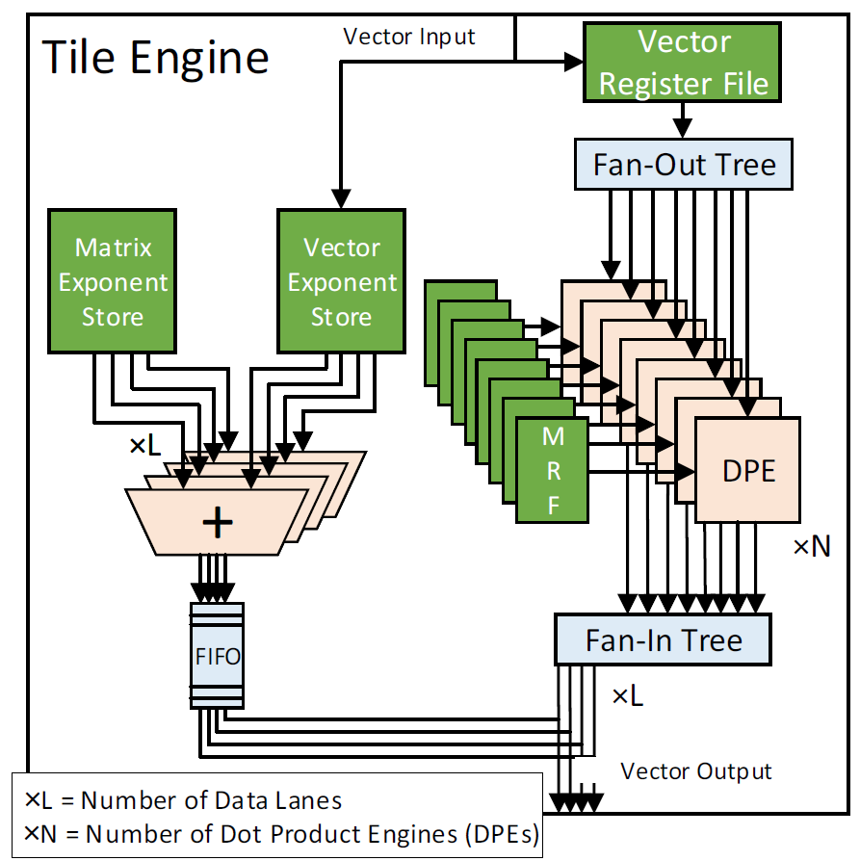
Brainwave — NPU + FPGA Architecture
Single-Thread SIMD Microarchitecture
Only one technique is tied to FPGA while others could stay in NPU
Focus on parallelizing matrix-vector multiplication
Chaining of Dependent Instructions
Pass values directly from one operation to the next
Avoid complex dependency check and multi-port register file
Mega-SIMD with 2D Tiled Matrix
Configurable NPU ISA with Compact and Simple Abstraction
Variable data types (precision, fp8, fp16, fp32, etc)
Variable vector size & matrix-vector tile size
Evaluation
35 TFLOPS on large RNN benchmarks without batching
10-90x lower latency than GPGPU for large models
Fig 18. Overview of Matrix-Vector Tile Engine

Slide 26

Catapult — Summary
Analysis on the 5 Guidelines of DSA proposed by our Textbook
Use dedicated memories to minimize the distance over which data is moved
There are on-chip memory in FPGA, that can be customized for application use
Invest the resources saved from dropping advanced microarchitectural optimizations into more arithmetic units or bigger memory
One Altera V FPGA has 3926 18-bit ALUs. Also, the 60 cores can be created on one FPGA for FFE acceleration
Use the easiest form of parallelism that matches the domain
MISD for FE Acceleration and multi-thread interleaving for FFE acceleration
Reduce data size and type to the simplest needed for the domain
Brainwave NPU supports various data types, like fp8, fp16, fp32, etc.
Use a domain-specific programming language to port code to the DSA
Microsoft still uses Verilog HDL to implement its FPGA accelerator

Slide 27
03
Challenges of FPGAs in the Cloud
Quick Review of Related Area and Works
PART

Slide 28
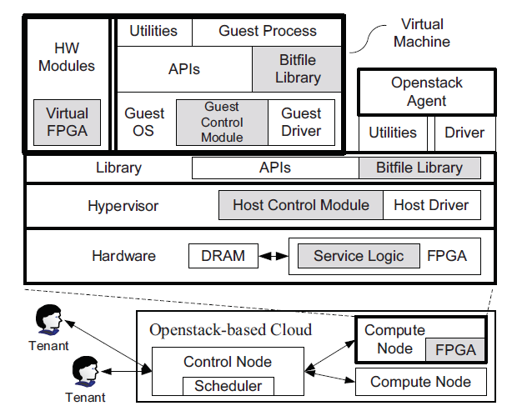
Enabling FPGAs in the Cloud
Like VMs, FPGA cloud service providers must allow multi-tenant applications running on the same FPGA with the following constraints
Resource Abstraction
FPGAs as programmable resource pool (PRP)
Abstracted into resources of registers, LUTs, memory, etc
Need HW manufacturer to support HW-independent bitfiles
FPGA Sharing
virtualization and isolation among tenants applications
AmorphOS and Coyate OS Abstraction working on this topic
Compatibility
Unified Software-Hardware Interfaces
Security
Prevent one application crashing the whole system
Prevent applications to steal or pollute other’s memory data
Fig 17. FPGA Framework in a Cloud

Slide 29
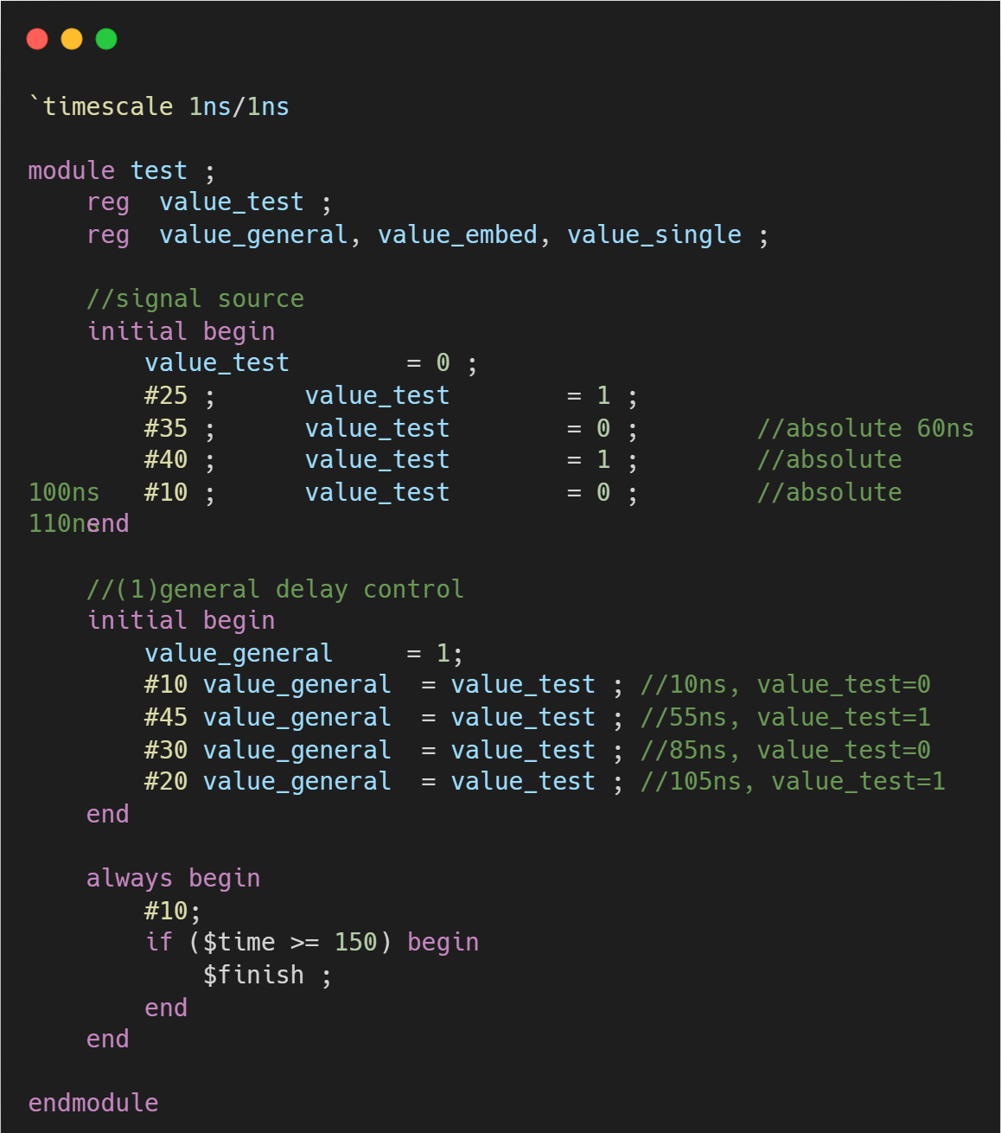
Techniques to Simplify FPGA Programming
Why FPGA is so hard to program?
Register Transfer Level (RTL) programming
completely different programming paradigm with SW languages
Compiler Support
Intel High-Level Synthesis (HLS) compiler
Takes untimed C++ codes and generates production-quality RTL code optimized for Intel FPGA. Accelerate the verification time over RTL.
Common Compiler Backend
Optimize Abstract Syntax Tree (AST) and generate suitable C++ for HLS
Automated Binary Translation from SW to HW
Translate ARMv8, RISC-V32imaf ISAs to HDL
Fig 18. A Verilog Code Snippet

Slide 30
Conclusion
Great Potential of Reconfigurable Accelerator in Data Center and Cloud
Development of domain-specific architecture as another way than general-purpose architecture
Trend of accelerating all kinds of applications with cloud infrastructure (Alibaba Damo Academy)
Host the most suitable DSA for the specific application (web search ranking, network, DNN, etc)
Comparable performance with lower memory consumption and better resource utilization
Challenges & Opportunities
Resource abstraction & sharing for multi-tenant applications on the same FPGA like VM
Complexity of HDL Programming (HLS compiler support, binary translation)
Interesting Trade-Offs
homogeneous vs. heterogeneous and specialization
high clock rate vs. high resource utilization (fewer pipeline bubbles)

Slide 31
References
Putnam, Andrew, et al. "A reconfigurable fabric for accelerating large-scale datacenter services." 2014 ACM/IEEE 41st International Symposium on Computer Architecture (ISCA). IEEE Computer Society, 2014.
Caulfield, Adrian M., et al. "A cloud-scale acceleration architecture." 2016 49th Annual IEEE/ACM international symposium on microarchitecture (MICRO). IEEE, 2016.
Fowers, Jeremy, et al. "A configurable cloud-scale DNN processor for real-time AI." 2018 ACM/IEEE 45th Annual International Symposium on Computer Architecture (ISCA). IEEE, 2018.
Firestone, Daniel, et al. "Azure Accelerated Networking:{SmartNICs} in the Public Cloud." 15th USENIX Symposium on Networked Systems Design and Implementation (NSDI 18). 2018.
Hennessy, John L., and David A. Patterson. Computer architecture: a quantitative approach. Elsevier, 2011.
Shahzad, Hafsah, Ahmed Sanaullah, and Martin Herbordt. "Survey and future trends for FPGA cloud architectures." 2021 IEEE High Performance Extreme Computing Conference (HPEC). IEEE, 2021.
Ovtcharov, Kalin, et al. "Accelerating deep convolutional neural networks using specialized hardware." Microsoft Research Whitepaper 2.11 (2015): 1-4.
Skliarova, Iouliia, and Valery Sklyarov. FPGA-BASED hardware accelerators. Springer International Publishing, 2019.

Slide 32
References
Chen, Fei, et al. "Enabling FPGAs in the cloud." Proceedings of the 11th ACM Conference on Computing Frontiers. 2014.
Rankin, Dylan, et al. "FPGAs-as-a-service toolkit (FaaST)." 2020 IEEE/ACM International Workshop on Heterogeneous High-performance Reconfigurable Computing (H2RC). IEEE, 2020.
Khawaja, Ahmed, et al. "Sharing, Protection, and Compatibility for Reconfigurable Fabric with {AmorphOS}." 13th USENIX Symposium on Operating Systems Design and Implementation (OSDI 18). 2018.
Korolija, Dario, Timothy Roscoe, and Gustavo Alonso. "Do {OS} abstractions make sense on {FPGAs}?." 14th USENIX Symposium on Operating Systems Design and Implementation (OSDI 20). 2020.
Cong, Jason, et al. "FPGA HLS today: Successes, challenges, and opportunities." ACM Transactions on Reconfigurable Technology and Systems (TRETS) 15.4 (2022): 1-42.
Del Sozzo, Emanuele, et al. "A common backend for hardware acceleration on FPGA." 2017 IEEE International Conference on Computer Design (ICCD). IEEE, 2017.
Paulino, Nuno, et al. "A Binary Translation Framework for Automated Hardware Generation." IEEE Micro 41.4 (2021): 15-23.

Slide 33
Q&A Session
Thanks for Listening!

