Slide 1
Efficient Scheduling Policies for Microsecond-Scale Tasks 2024.04.18
Liu Yuxuan
School of Data Science
Chinese University of Hong Kong, Shenzhen

Slide 2
Outline
Introduction
Related Work
Preliminaries
Proposed Methods
Performance Evaluation
Conclusions

Slide 3

Scheduling $μs$-SCALE TASKS
Introduction
Related Work
Preliminaries
Proposed Methods
Performance Evaluation
Conclusions

Slide 4
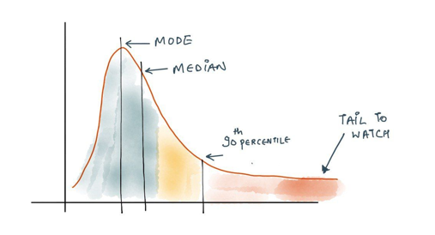
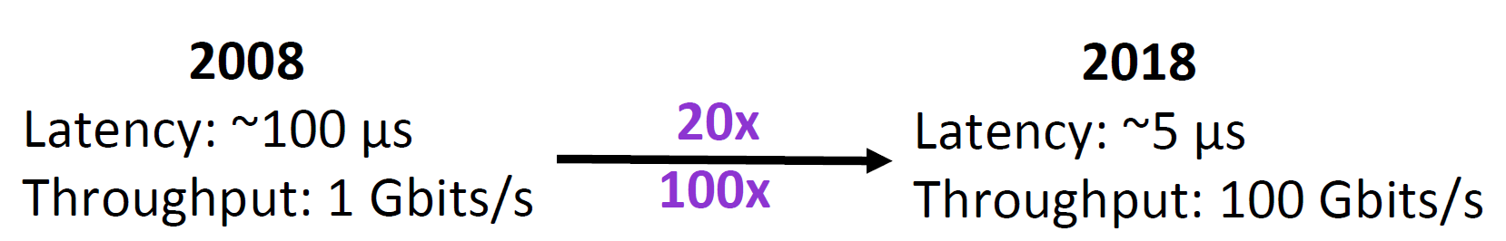
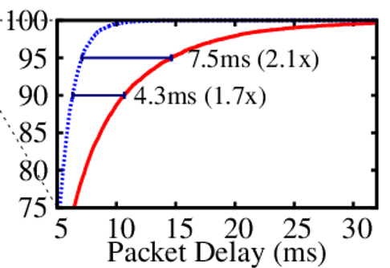

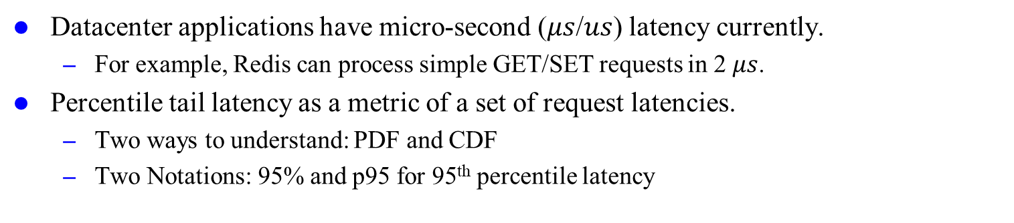
Latency
Datacenter applications have micro-second ($μs$/$us$) latency currently.
For example, Redis can process simple GET/SET requests in 2 $μs$.
Percentile tail latency as a metric of a set of request latencies.
Two ways to understand: PDF and CDF
Two Notations: 95% and p95 for 95th percentile latency
Much shorter latency and larger throughput
Sources:
Shenango Slides: https://www.usenix.org/sites/default/files/conference/protected-files/nsdi19_slides_ousterhout_amy.pdf
https://last9.io/blog/latency-slo/

Slide 5


Tail Latency Matters
Microservices fan out user requests to multiple servers.
Latency is up to the slowest responding service.
Tail latency matters as an important SLOs (Service-Level Objectives).
R
R
R
R
R
Sources:
Concord Slides: https://rishabh246.github.io/files/concord-slides.pptx

Slide 6
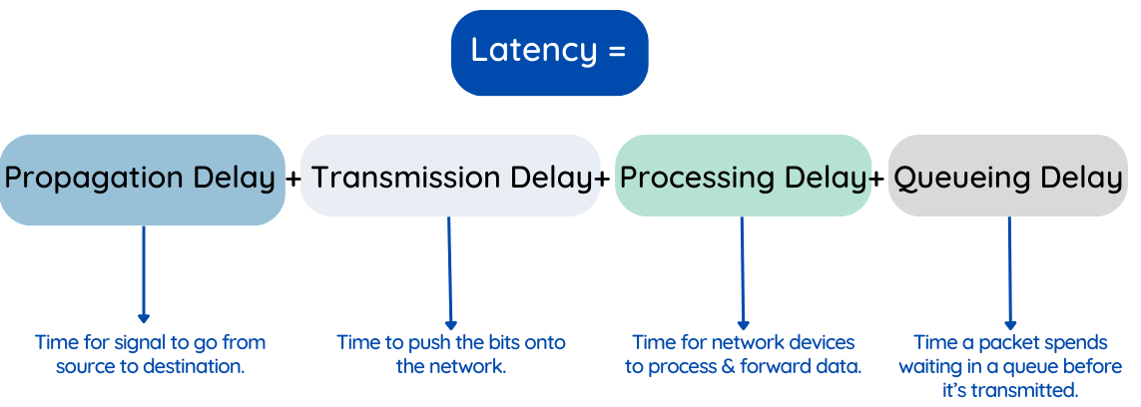
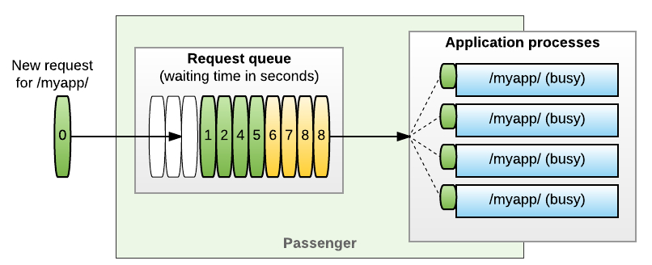
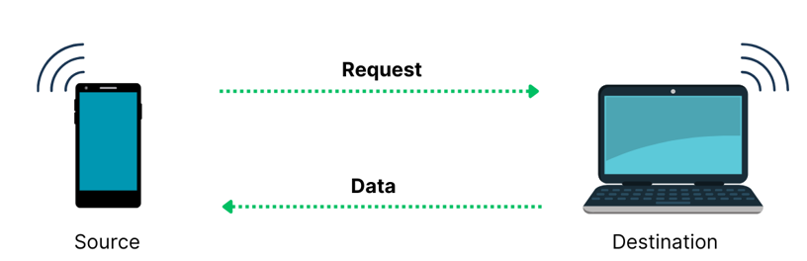
Sources of Latency
Sources of Images:
https://obkio.com/blog/voip-latency/high-voip-latency.png
https://encrypted-tbn0.gstatic.com/images?q=tbn:ANd9GcRFvmId86ykSbeeZmHcCWRXqfuO9EqKKllHHQ&s
https://blog.phusion.nl/content/images/2017/12/blog3.jpg

Slide 7
Latency Optimization
Propagation Delay
More powerful NIC (network interface cards), e.g, Infiniband
Transmission Delay
Reduce the large OS overheads
Processing Delay
Request-level parallelism
Thread-level parallelism
Queueing Delay
Optimize CPU scheduling policy
Reduce requests’ queueing time
Sources of Images:
https://encrypted-tbn0.gstatic.com/images?q=tbn:ANd9GcRFvmId86ykSbeeZmHcCWRXqfuO9EqKKllHHQ&s

Slide 8
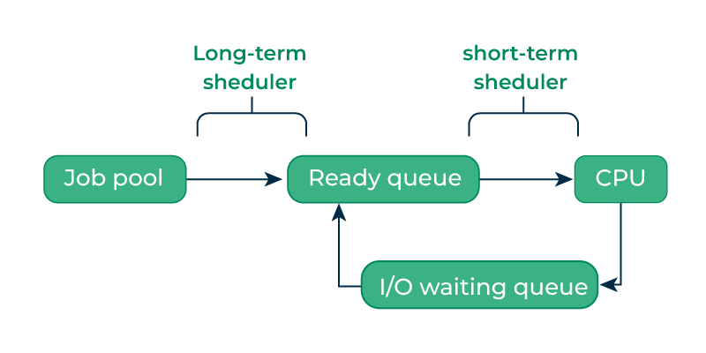
Scheduling
Definition
The action of assigning resources to perform tasks
What Resource to Schedule?
Short-Term CPU Scheduling (Mainly talk about)
Network Flow (Briefly cover)
Problems of Existing Scheduling Policies
Designed for millisecond-scale tasks
High OS kernel overhead
Sources of Images:
https://www.geeksforgeeks.org/process-schedulers-in-operating-system/

Slide 9
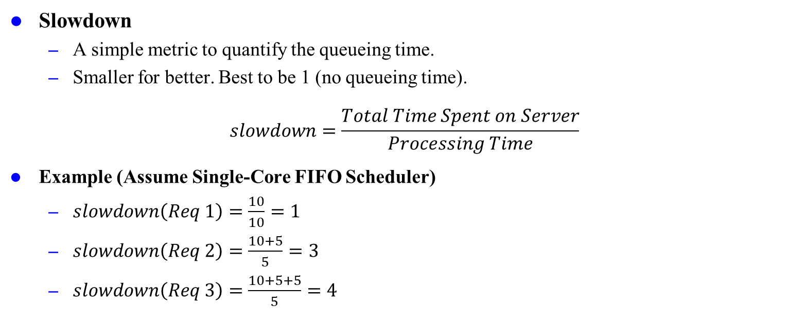
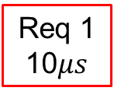
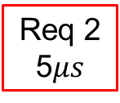

Slowdown
Slowdown
A simple metric to quantify the queueing time.
Smaller for better. Best to be 1 (no queueing time).
$$slowdown=\frac{Total Time Spent on Server}{Processing Time}$$
Example (Assume Single-Core FIFO Scheduler)
$slowdown\left(Req 1\right)=\frac{10}{10}=1$
$slowdown\left(Req 2\right)=\frac{10+5}{5}=3$
$slowdown\left(Req 3\right)=\frac{10+5+5}{5}=4$
Client
Req 3
5$μs$
Req 2
5$μs$
Req 1
10$μs$
Server

Slide 10
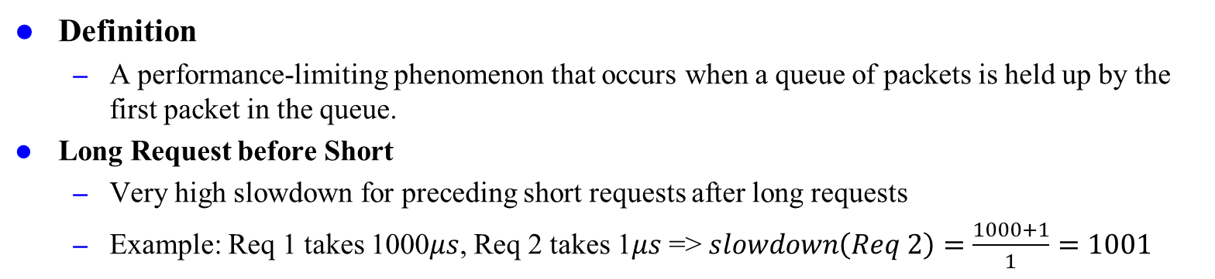
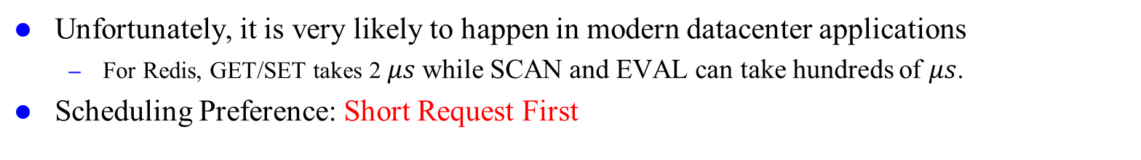
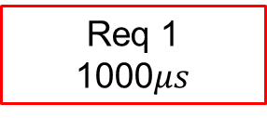
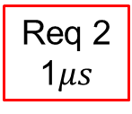
Head-of-Line (HOL) Blocking
Definition
A performance-limiting phenomenon that occurs when a queue of packets is held up by the first packet in the queue.
Long Request before Short
Very high slowdown for preceding short requests after long requests
Example: Req 1 takes 1000$μs$, Req 2 takes 1$μs$ => $slowdown\left(Req 2\right)=\frac{1000+1}{1}=1001$
Req 2
1$μs$
Req 1
1000$μs$
Unfortunately, it is very likely to happen in modern datacenter applications
For Redis, GET/SET takes 2 $μs$ while SCAN and EVAL can take hundreds of $μs$.
Scheduling Preference: Short Request First

Slide 11
Problem Formulation
We want a scheduling policy that
Performs short-term CPU or network flow schedule
Prevents HOL blocking (short requests first)
Reduces tail latency (queueing delay)
Low scheduling overheads
With acceptable throughput decrease
Easy to implement on multithreaded system
Works for different types of workloads
for microsecond-scale requests

Slide 12
Scheduling $μs$-SCALE TASKS
Introduction
Related Work
Preliminaries
Proposed Methods
Performance Evaluation
Conclusions

Slide 13
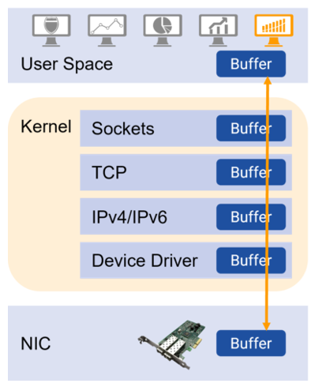
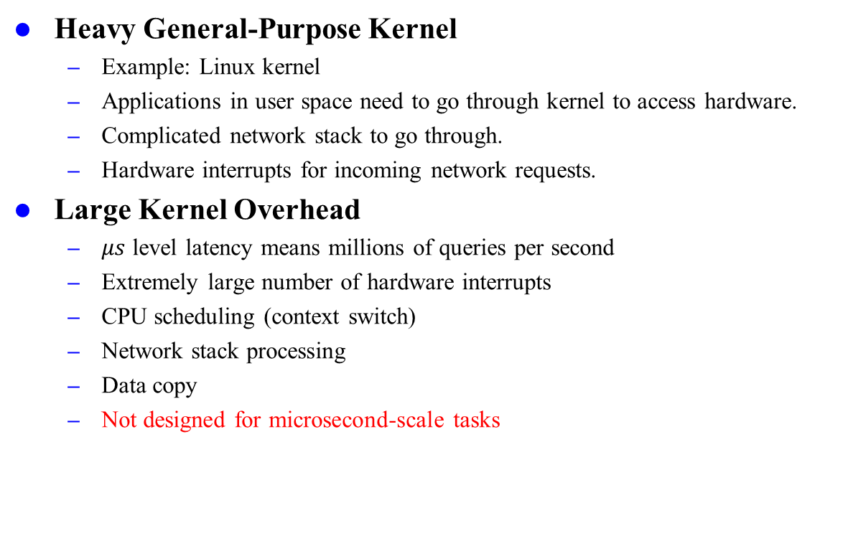
Traditional OS Approach
Heavy General-Purpose Kernel
Example: Linux kernel
Applications in user space need to go through kernel to access hardware.
Complicated network stack to go through.
Hardware interrupts for incoming network requests.
Large Kernel Overhead
$μs$ level latency means millions of queries per second
Extremely large number of hardware interrupts
CPU scheduling (context switch)
Network stack processing
Data copy
Not designed for microsecond-scale tasks
Sources of Images:
https://asterfusion.com/blog20220830/

Slide 14
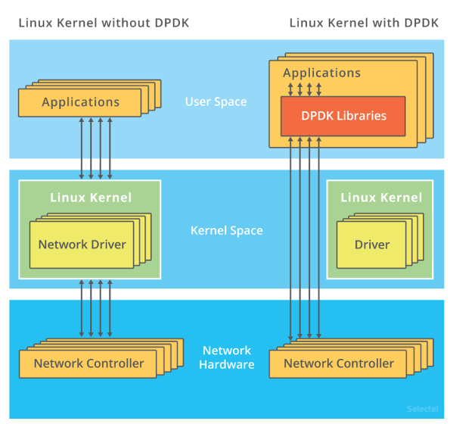
Kernel Bypass
User-space control
Allow application to directly access network hardware
User-space network stack processing
User-space CPU scheduling
Poll Mode Driver
Avoid extremely frequent interrupt processing
Busy looping with one dedicated CPU core
Usage:
Implement light-weight necessary OS functionalities
Deployed on top of a virtualization layer
Examples
DPDK (Data-plane Development Kit)
All proposed methods are kernel bypass scheduler
Figure. DPDK Architecture
Sources of Images:
https://aws.amazon.com/cn/blogs/china/building-cefi-high-frequency-trading-system-on-aws/

Slide 15
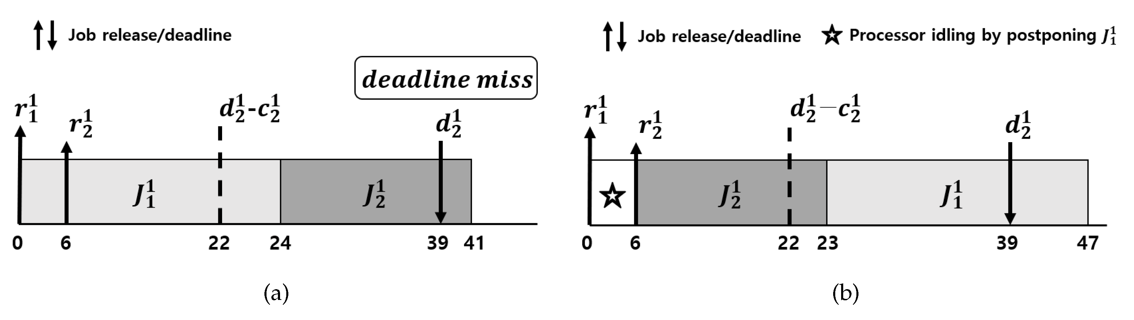
CPU Scheduling
Non-Preemptive (Cooperative)
The process holds the CPU until it terminates or voluntarily frees the CPU.
Pros: few context switches & largest throughput
Cons: high latency due to queueing time
Preemptive
The allocated CPU can be taken away by other processes during execution, and resume later.
Pros: low latency, fast response
Cons: frequent context switches & smaller throughput
Sources of Images:
https://www.mdpi.com/symmetry/symmetry-12-00172/article_deploy/html/images/symmetry-12-00172-g001.png
Notes:
when it reaches a waiting state (blocking I/O).
Modern OSes are mostly preemptive

Slide 16
CPU Scheduling
Work-Conserving
Scheduler always keep processors busy if there are jobs ready to be scheduled.
Generally considered as a better scheduling policy unless for special reasons.
Pros: high throughput (processor always busy)
Cons: inappropriate for special scenarios
Non-Work Conserving
Scheduler may leave some processors idle even with jobs ready to be scheduled.
Usually occurs when load is imbalance, but sometimes worthwhile
Pros: enhance predictability
Cons: lower throughput

Slide 17
Scheduling $μs$-SCALE TASKS
Introduction
Related Work
Preliminaries
Proposed Methods
Performance Evaluation
Conclusions

Slide 18
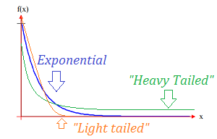
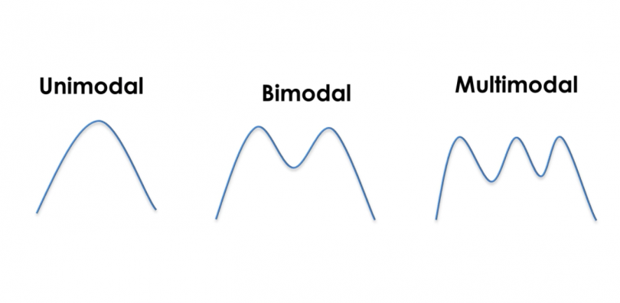
Service Time Distribution
Heavy-Tailed Distribution
Example: log-normal distribution
Light-Tailed Distribution
Example: exponential distribution
Bi-modal Distribution
Example: in-memory KVS (Redis)
Simple get/put and complex range query
Multi-modal Distribution
Example: MySQL
Multiple types of queries with highly different latencies
Sources:
https://www.statisticshowto.com/heavy-tailed-distribution/
https://towardsdatascience.com/learning-from-multimodal-target-5d3d2ea0d4c5
Notes:
Heavy-Tailed & Light-Tailed Distribution
Dispersion of Distribution
Bi-Modal and Multi-Modal Distributions
Burst Distribution
Diurnal Distribution

Slide 19
Scheduling $μs$-SCALE TASKS
Introduction
Related Work
Preliminaries
Proposed Methods
Performance Evaluation
Conclusions

Slide 20
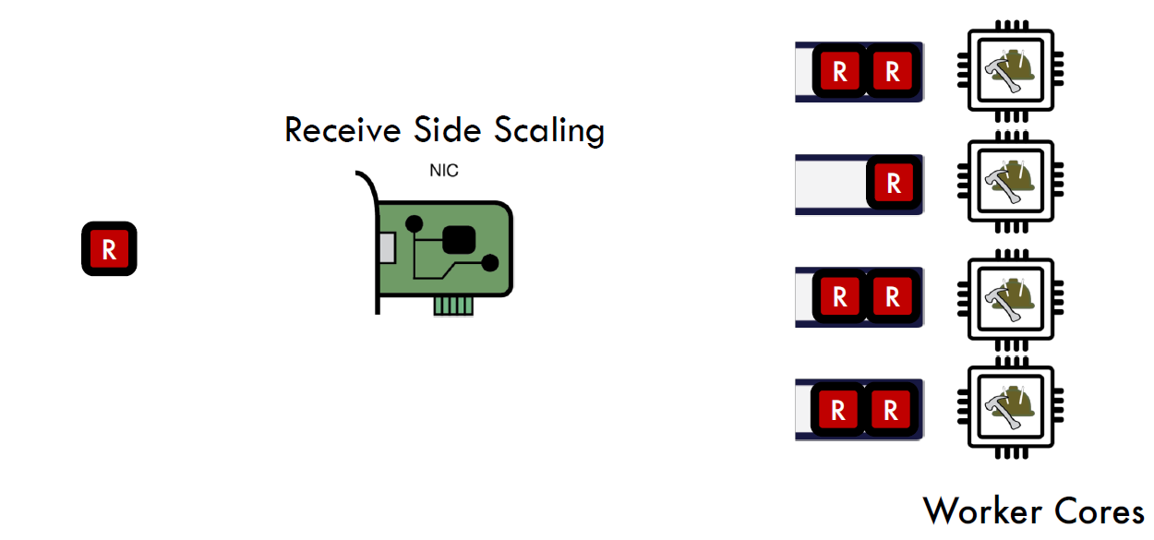
d-FCFS
Distributed Queues with First-Come-First-Server Scheduling
Relies on Receiver-Side Scaling (RSS) to evenly distribute requests to multiple worker cores
RSS is done in Network Interface Cards (NIC)
Non-preemptive scheduling with FCFS
Example: IX OS
[OSDI’14] IX: a protected dataplane operating system for high throughput and low latency by Stanford and EPFL
Sources:
Shinjuku Slides: https://www.usenix.org/sites/default/files/conference/protected-files/nsdi19_slides_kaffes.pdf

Slide 21
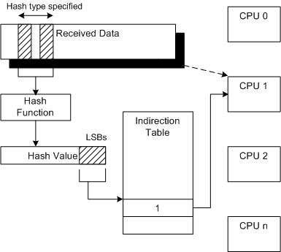
RSS
Developed in 2008 by Windows OS
Without RSS, only one core is used for packet processing.
Hashing-based Distribution
Hash functions
Simple XOR
Toeplitz
Indirection table assigns CPU by LSBs of hash value
Configurable hash settings
Benefits
Distributed processing to use multiple CPUs
Dynamic load balancing by changing indirection table
Sources:
https://learn.microsoft.com/en-us/windows-hardware/drivers/network/introduction-to-receive-side-scaling

Slide 22
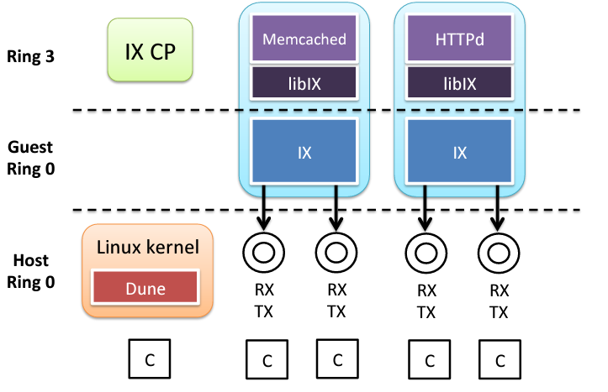
IX OS: Design
Split control plane and data plane
Control plane establishes mappings for RSS flow groups to queues for traffic balance.
Each data plane runs an application in single address space.
Each thread as a queue handles disjoint network flows with few synchronization overheads.
Implemented on DPDK and Dune hardware virtualization to host protected OS.
User Space
(Control Plane)
Kernel Space
(Data Plane)
Sources:
IX Slides: https://www.usenix.org/sites/default/files/conference/protected-files/osdi14_slides_belay.pdf
Notes:
Dune virtualization in OS kernel for light-weight isolation and security

Slide 23
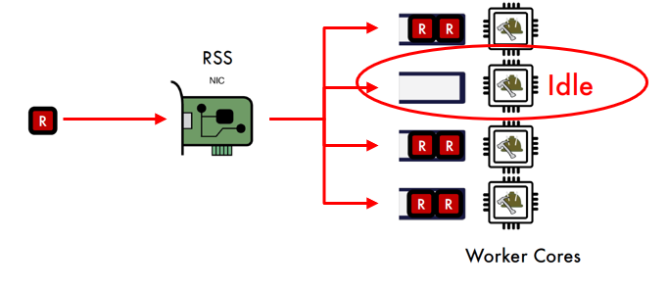
d-FCFS: Analysis
Pros
Easy to implement (Non-Preemptive)
Most modern NICs support RSS
Low scheduling overhead
Good for light-tailed distributions
Cons
Poor for heavy-tailed distributions due to HOL blocking
Load imbalance since RSS does not know service time
Low throughput due to possible non-work conserving
Usually serve as the baseline scheduling policy
Sources:
Shinjuku Slides: https://www.usenix.org/sites/default/files/conference/protected-files/nsdi19_slides_kaffes.pdf

Slide 24
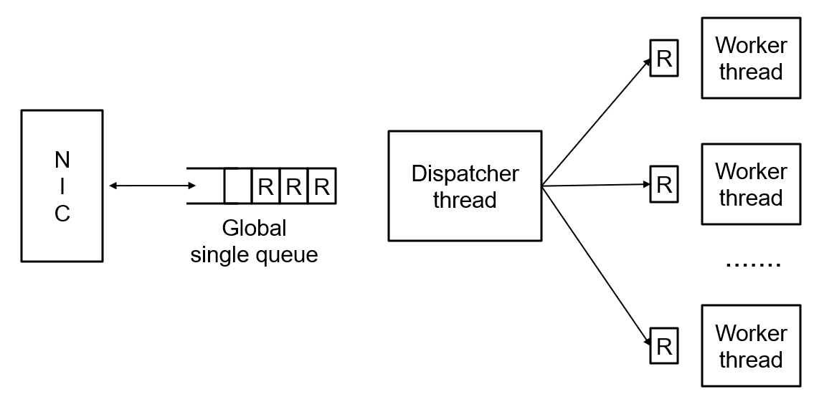
c-FCFS
Centralized Queue with First-Come-First Server Scheduling
Implemented on top of IX (Non-Preemptive)
c-FCFS = d-FCFS + work stealing
Basic idea: steal works from other processors
Approximate there is a central queue
Fetch Work from Dispatcher
Example: ZygOS
[SOSP’17] ZygOS: Achieving low tail latency for microsecond-scale networked tasks by EPFL
Sources:
Concord Slides: https://rishabh246.github.io/files/concord-slides.pptx

Slide 25
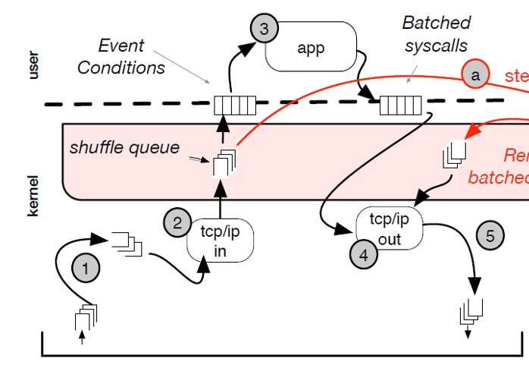
ZygOS: Design
Three Layers of Queues
Hardware Queue
NIC network packets with RSS distribution
Software Queue
packets go through network stack (TCP/IP)
Shuffle Queue
ready connection requests after network stack
Where work stealing happens
Three Layers of Execution Stack
Application Execution Layer (User-space App)
Shuffle Layer (Control Plane)
Networking Layer (Data Plane)
Sources:
ZygOS Paper: https://dl.acm.org/doi/pdf/10.1145/3132747.3132780

Slide 26
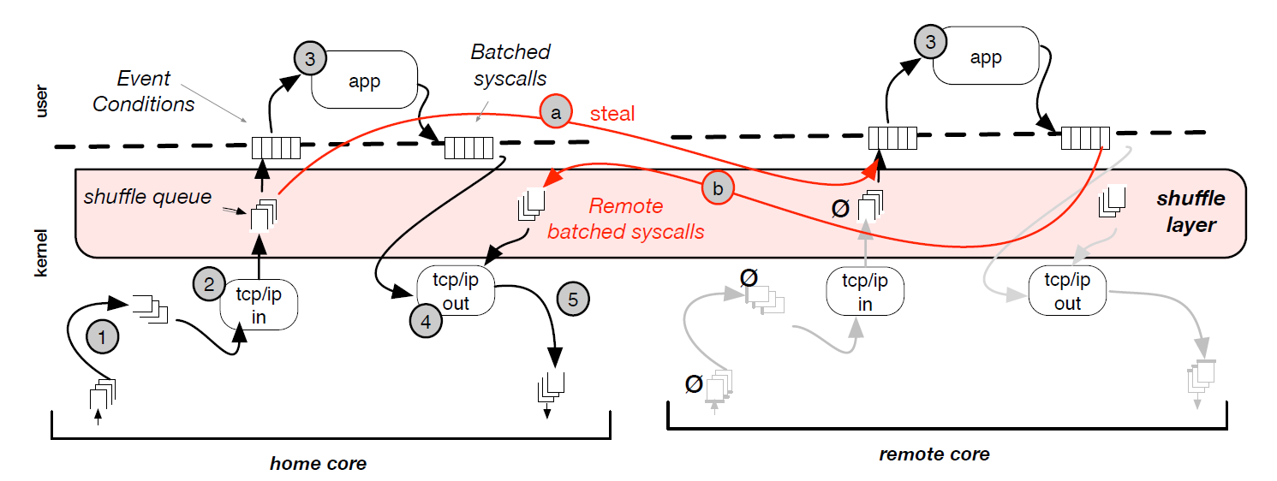
Work Stealing
Shuffle Queue
Single-producer, multiple-consumer data structure
Home core produces requests, and both home core and remote cores can consume them
Resulting batched syscalls returns to home core for coherence-free manner
Sources:
ZygOS Paper: https://dl.acm.org/doi/pdf/10.1145/3132747.3132780

Slide 27
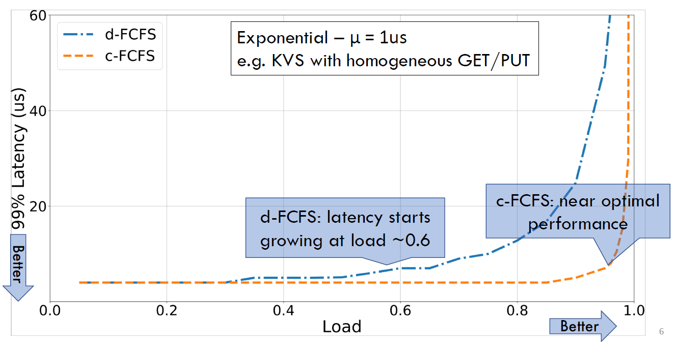
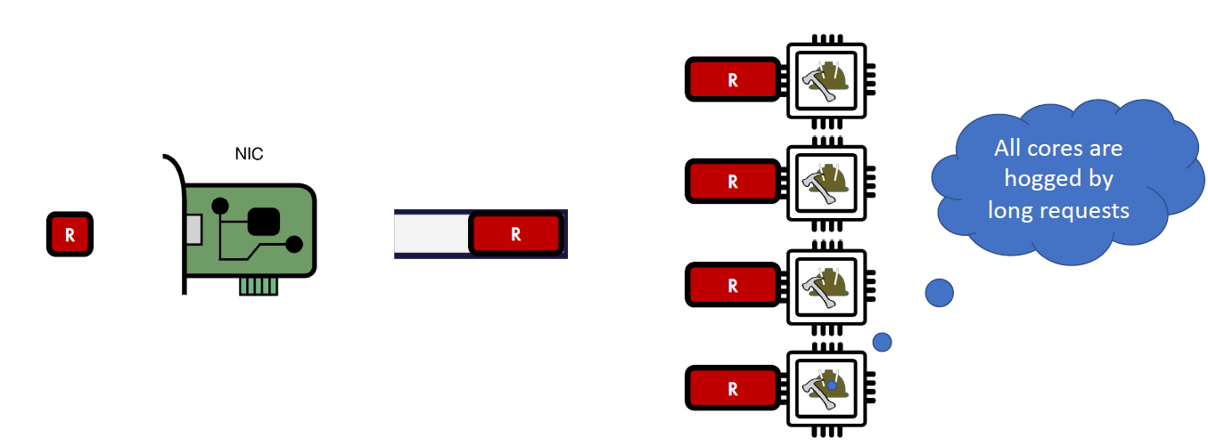
c-FCFS: Analysis
Pros
Dynamic load balancing by work stealing
Work-conserving
Low scheduling overhead
Cons
HOL blocking is still possible for heavy-tailed / bi-modal distributions
Usually serve as a standard approach
Sources:
Shinjuku Slides: https://www.usenix.org/sites/default/files/conference/protected-files/nsdi19_slides_kaffes.pdf

Slide 28
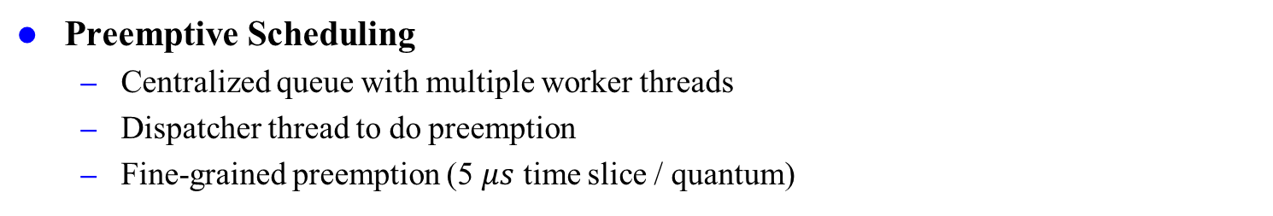
Processor Sharing (PS)
Preemptive Scheduling
Centralized queue with multiple worker threads
Dispatcher thread to do preemption
Fine-grained preemption (5 $μs$ time slice / quantum)
Preempt Interrupt to Worker
Example: Shinjuku OS (新宿駅)
[NSDI’19] : Shinjuku: Preemptive Scheduling for μsecond-scale Tail Latency by Stanford and MIT
Sources:
Concord Slides: https://rishabh246.github.io/files/concord-slides.pptx

Slide 29
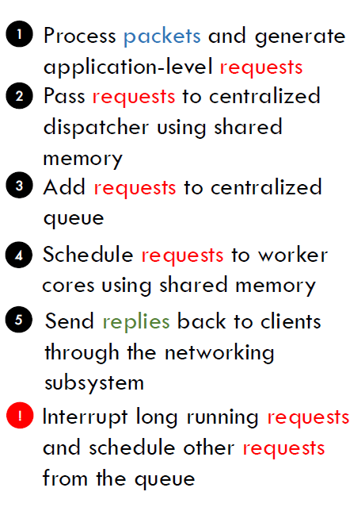
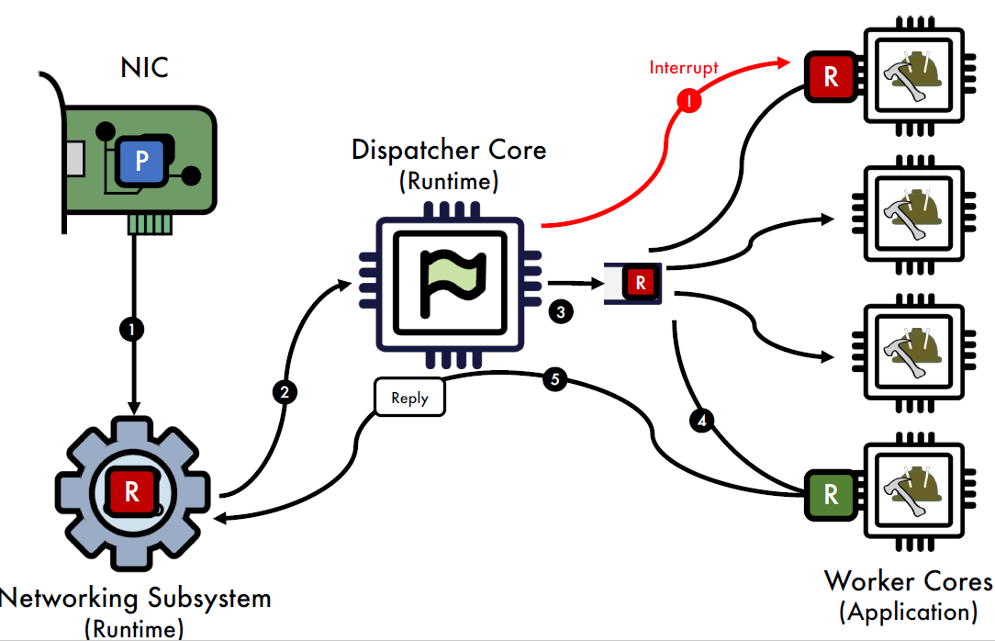
Shinjuku: Design
Main Idea: Preempt long requests by short requests
User space CPU scheduling, no need for RSS of NIC
Sources:
Shinjuku Slides: https://www.usenix.org/sites/default/files/conference/protected-files/nsdi19_slides_kaffes.pdf

Slide 30
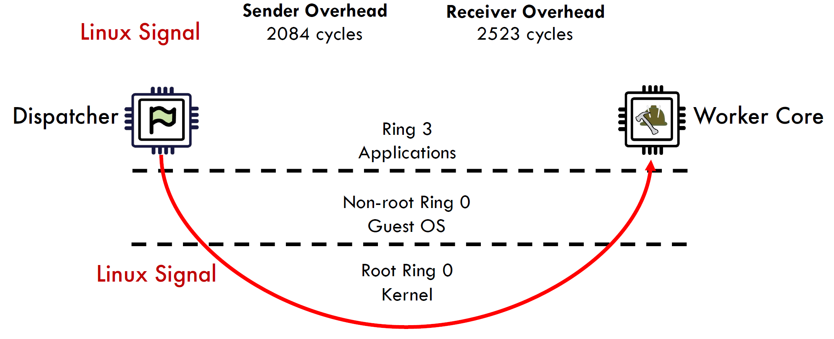
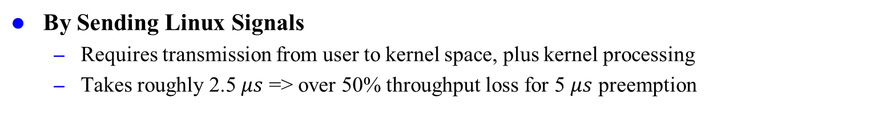
Traditional Preemption
By Sending Linux Signals
Requires transmission from user to kernel space, plus kernel processing
Takes roughly 2.5 $μs$ => over 50% throughput loss for 5 $μs$ preemption
Sender
Receiver
Sources:
Shinjuku Slides: https://www.usenix.org/sites/default/files/conference/protected-files/nsdi19_slides_kaffes.pdf

Slide 31
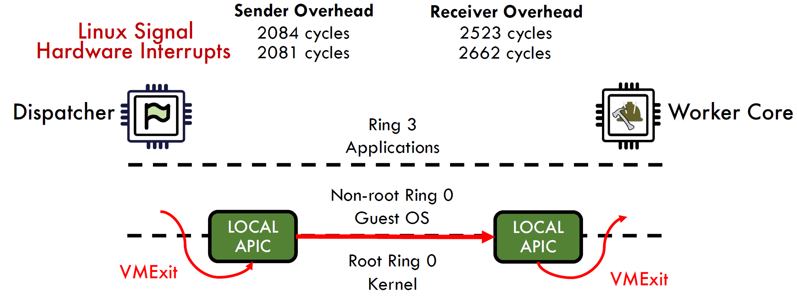
Traditional Preemption
By Hardware Interrupts
Inter-Process Interrupts (IPI) by Advanced Programmable Interrupt Controller (APIC)
Local APIC for each core and I/O APIC attached to system bus
Dune virtualization of local APIC causes VM exit for physical APIC interrupt sending.
Sources:
Shinjuku Slides: https://www.usenix.org/sites/default/files/conference/protected-files/nsdi19_slides_kaffes.pdf

Slide 32
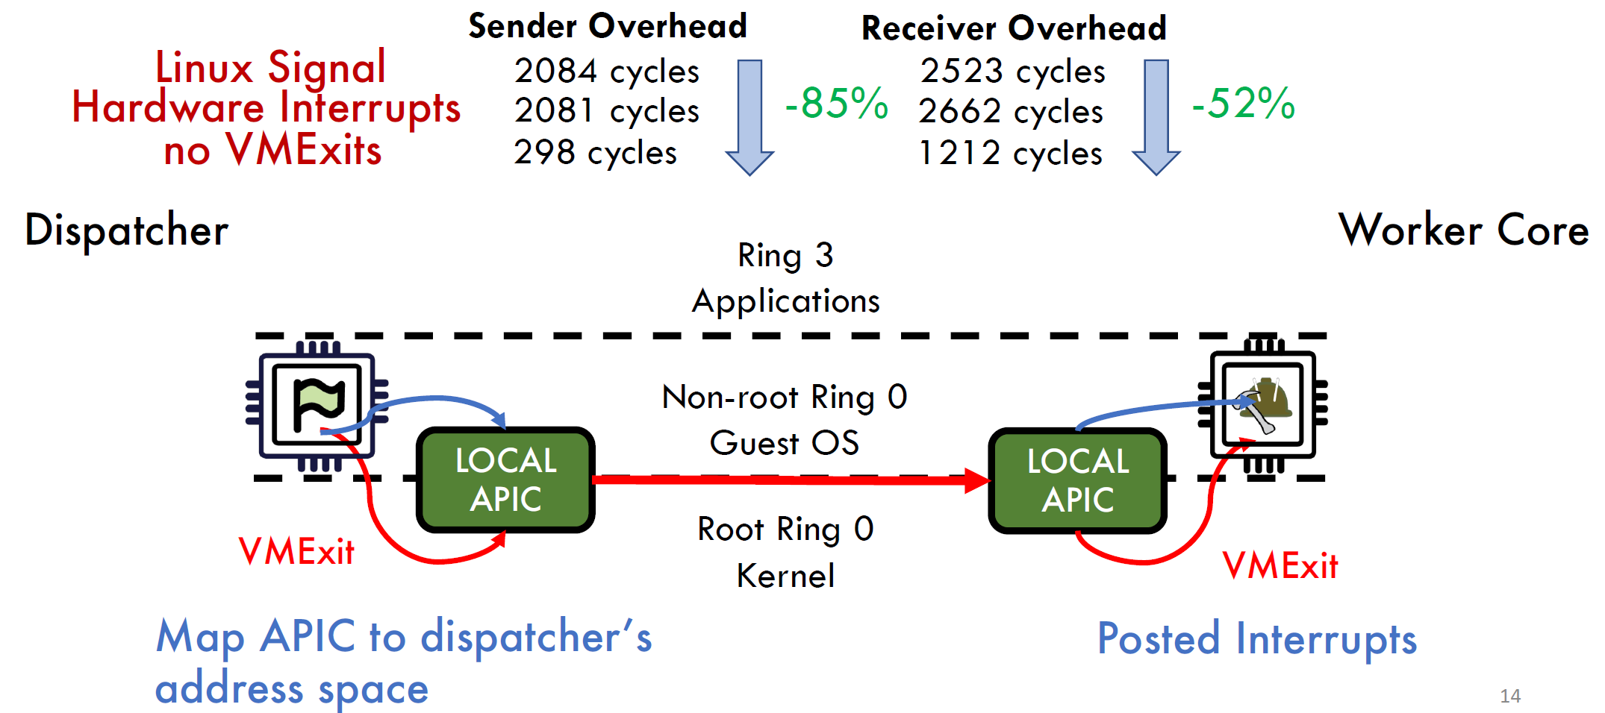
Shinjuku: Fast Preemption
Avoid VM Exits in Both Sender/Receiver
Receiver: sender directly writes interrupt number in receiver’s posted interrupt descriptor
Sender: allow direct access to real APIC without Dune virtualization
System insecurity due to direct access to APIC registers
Sources:
Shinjuku Slides: https://www.usenix.org/sites/default/files/conference/protected-files/nsdi19_slides_kaffes.pdf

Slide 33
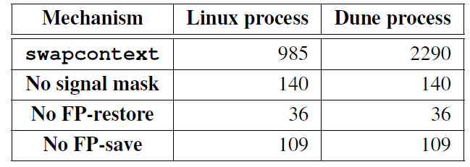
Fast Context Switch
Linux Approach
swapcontext
Shinjuku’s Optimization
Skips setting signal masks in context switch to avoid VM exit
Cost: tasks belonging to the same application must share the same signal masks
Skips save and restore of FP registers
Cost: only request context can use FP instructions, while main worker context cannot
Sources:
Shinjuku Paper: https://www.usenix.org/system/files/nsdi19-kaffes.pdf

Slide 34
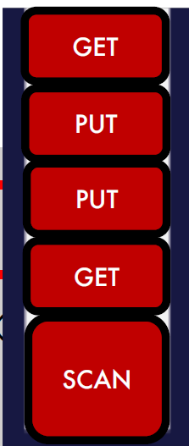

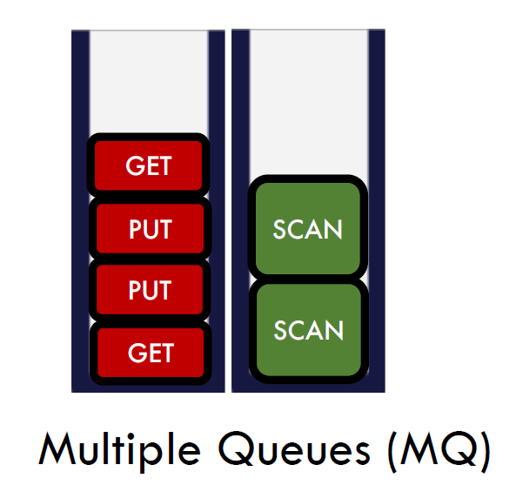
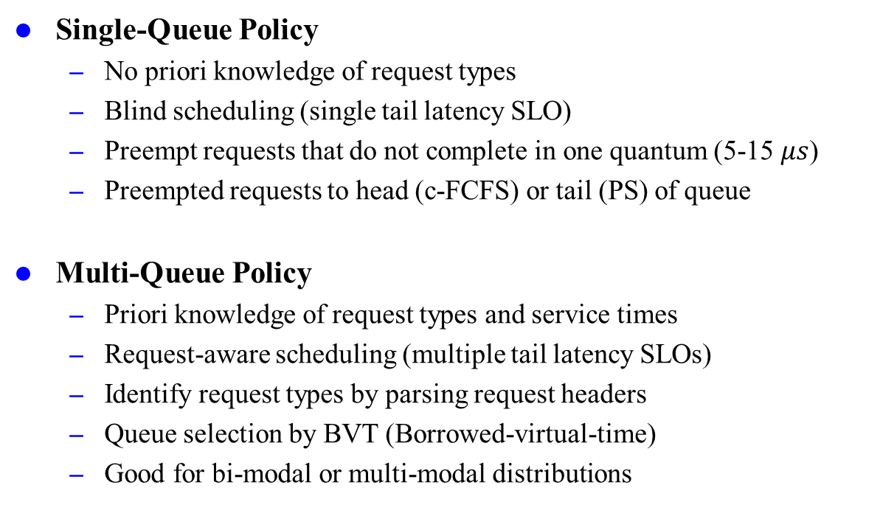
Request-Aware Scheduling
Single-Queue Policy
No priori knowledge of request types
Blind scheduling (single tail latency SLO)
Preempt requests that do not complete in one quantum (5-15 $μs$)
Preempted requests to head (c-FCFS) or tail (PS) of queue
Multi-Queue Policy
Priori knowledge of request types and service times
Request-aware scheduling (multiple tail latency SLOs)
Identify request types by parsing request headers
Queue selection by BVT (Borrowed-virtual-time)
Good for bi-modal or multi-modal distributions
Sources:
Shinjuku Slides: https://www.usenix.org/sites/default/files/conference/protected-files/nsdi19_slides_kaffes.pdf

Slide 35
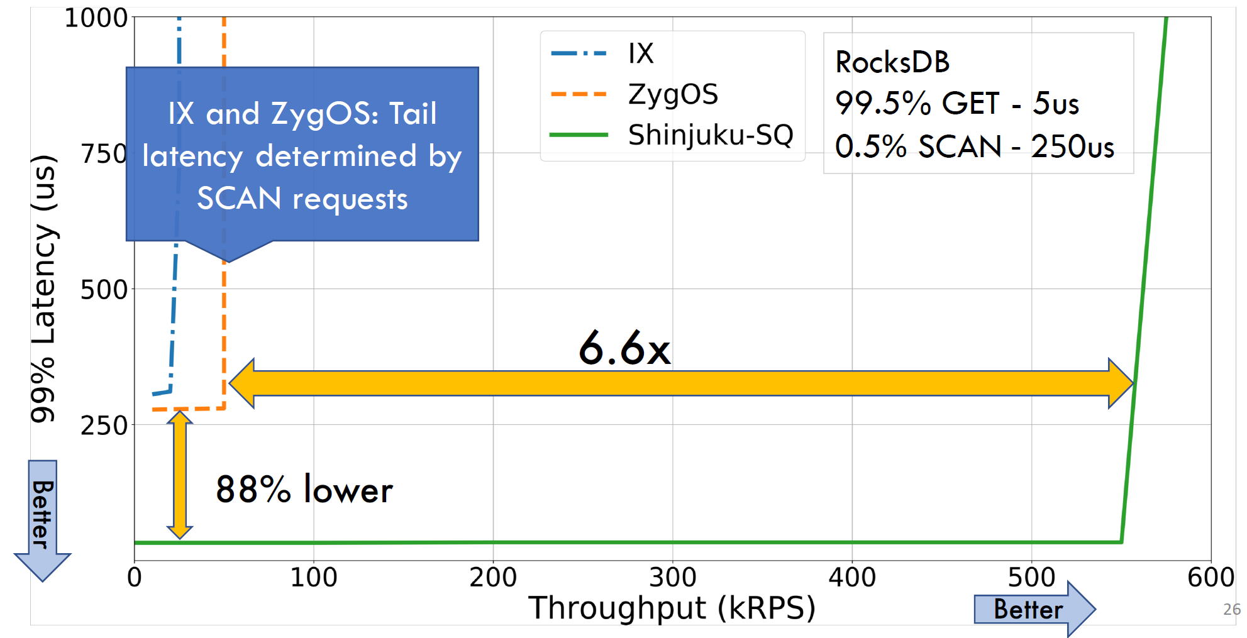
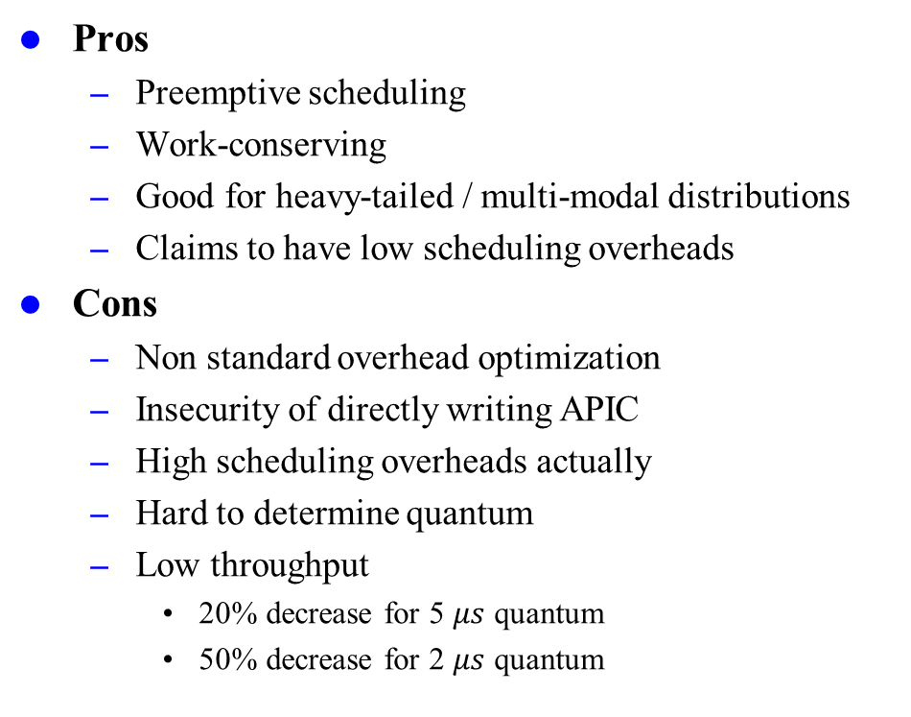
Shinjuku: Analysis
Pros
Preemptive scheduling
Work-conserving
Good for heavy-tailed / multi-modal distributions
Claims to have low scheduling overheads
Cons
Non standard overhead optimization
Insecurity of directly writing APIC
High scheduling overheads actually
Hard to determine quantum
Low throughput
20% decrease for 5 $μs$ quantum
50% decrease for 2 $μs$ quantum
Sources:
Shinjuku Slides: https://www.usenix.org/sites/default/files/conference/protected-files/nsdi19_slides_kaffes.pdf
Notes:
Actually, there is a trade-off of determining the quantum. Too small quantum leads to over-frequent preemption and context switches, causing too much overheads. However, too long quantum cannot execute short requests on time, resulting in still high tail latency.

Slide 36
DARC
Dynamic Application-aware Reserved Cores (DARC)
Motivation: unacceptable overhead for preemptive scheduling
Main Idea: non-preemptive with ideal cores for short requests
Lower latency by over-provisioning
Fetch Work from Dispatcher
Idle for Short Requests
Implementation: Persephone
[SOSP’21] : When Idling is Ideal: Optimizing Tail-Latency for Highly-Dispersed Datacenter Workloads with Persephone by University of Pennsylvania
Sources:
Concord Slides: https://rishabh246.github.io/files/concord-slides.pptx

Slide 37
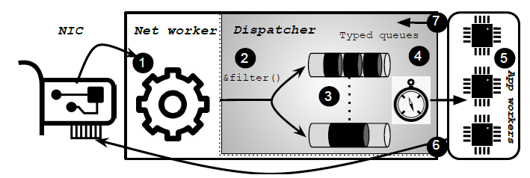
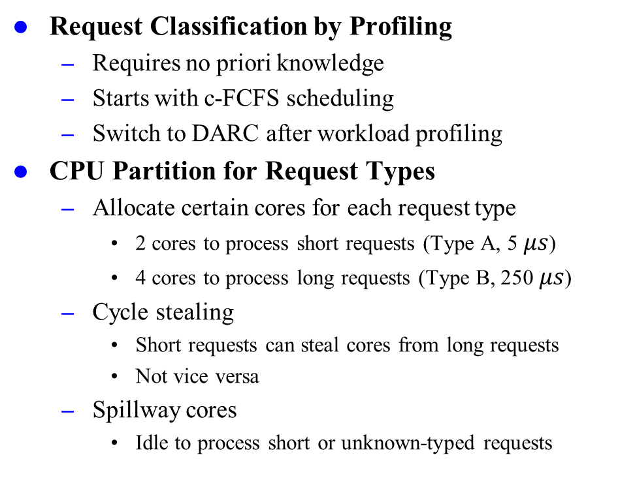
Request-Aware Scheduling
Request Classification by Profiling
Requires no priori knowledge
Starts with c-FCFS scheduling
Switch to DARC after workload profiling
CPU Partition for Request Types
Allocate certain cores for each request type
2 cores to process short requests (Type A, 5 $μs$)
4 cores to process long requests (Type B, 250 $μs$)
Cycle stealing
Short requests can steal cores from long requests
Not vice versa
Spillway cores
Idle to process short or unknown-typed requests
Sources:
DARC Paper: https://par.nsf.gov/servlets/purl/10354122
Notes:
Cycle stealing is pretty similar to work stealing

Slide 38
DARC: Analysis
Pros
Low scheduling overhead
Low queueing delay for short requests
Good for heavy-tailed / multi-modal distributions
Cons
Non-work conserving
Works only for requests with disjoint types and service times
Loses some generality
Waste of throughput (low CPU efficiency)

Slide 39
Concord
Enhanced Version of Shinjuku (PS)
Avoid non-standard use and improve generality
Reduce scheduling overheads
Sources of Shinjuku’s Overheads
Preemption
Large overhead for interrupts (IPI)
Long worker stalls
worker completes → dispatcher knows → sends new request to worker
Two cache coherence misses for sync inter-thread communication (400 cycles wasted)
Dispatcher does not contribute to request processing
Unimportant, ignore it here
Paper:
[SOSP’23] : Achieving Microsecond-Scale Tail Latency Efficiently with Approximate Optimal Scheduling by EPFL

Slide 40
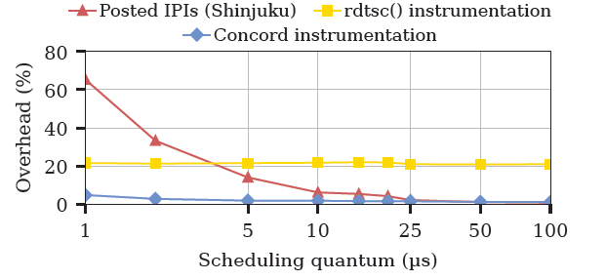
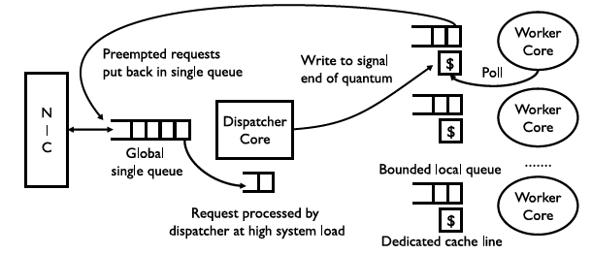
Concord: Preemption
Compiler Instrumentation
Compiler injects bookkeeping probes to the application codes
Standard way: injects rdtsc() instructions
Concord’s way: async communication through shared cache line
From interrupt to frequent polling
Implemented as 2 LLVM passes
Figure. Overhead of preemption mechanisms
to the scheduling quantum
Sources:
Concord Paper: https://dslab.epfl.ch/pubs/concord.pdf

Slide 41
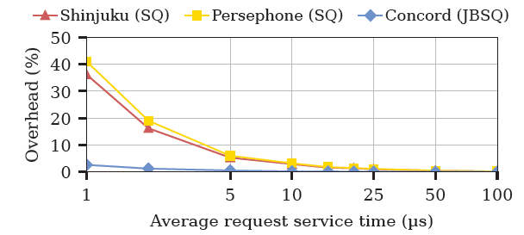
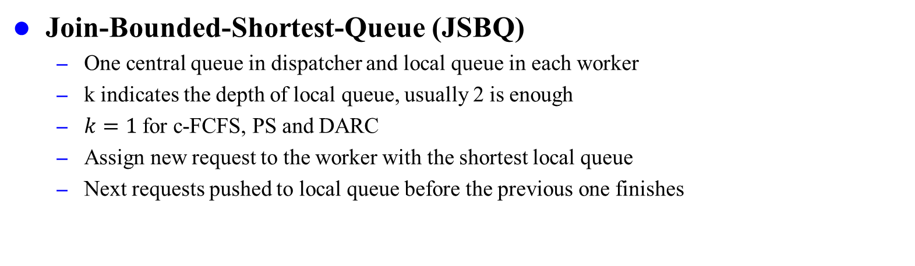
Concord: JSBQ(k)
Join-Bounded-Shortest-Queue (JSBQ)
One central queue in dispatcher and local queue in each worker
k indicates the depth of local queue, usually 2 is enough
$k=1$ for c-FCFS, PS and DARC
Assign new request to the worker with the shortest local queue
Next requests pushed to local queue before the previous one finishes
Figure. Time spent idle by a worker thread awaiting the next
request in Single Queue (SQ) and JBSQ systems.
Sources:
Concord Paper: https://dslab.epfl.ch/pubs/concord.pdf

Slide 42
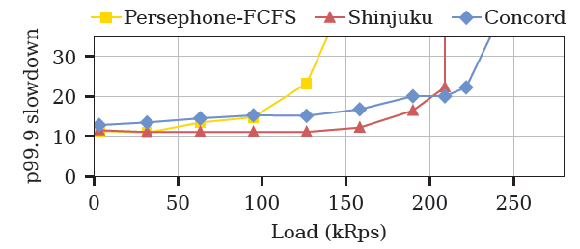
Concord: Analysis
Pros
Reduce scheduling overhead
Preemptive scheduling & Work-Conserving
High CPU utilization
Standard approach to deploy
Cons
Slightly increased tail latency
Hard to determine k for blind scheduling
Hard to implement dispatcher that schedules and processes
Sometimes, it even causes worse performance
Sources:
Concord Paper: https://dslab.epfl.ch/pubs/concord.pdf

Slide 43
Summary of Proposed Methods
Each scheduling policy is designed for certain types of workload.
No optimized policy for all types of workloads.
 | Preemptive | Work-Conserving | Prevents HOL | Scheduling Overhead | Tail Latency | Throughput | Ideal Workload
d-FCFS |  |  |  | low | very high | very large | light-tailed
c-FCFS |  |  |  | low | high | large | light-tailed
Shinjuku |  |  |  | very high | low | small | heavy-tailed
DARC |  |  |  | medium | low | large | multi-modal
Concord |  |  |  | medium | medium | large | heavy-tailed

Slide 44
Scheduling $μs$-SCALE TASKS
Introduction
Related Work
Preliminaries
Proposed Methods
Performance Evaluation
Conclusions

Slide 45

Workloads
High Bimodal
50%-50% service time distribution
Light-tailed bimodal
Extreme Bimodal
99.5%-0.5% service time distribution
Heavy-tailed bimodal
Sources:
DARC Paper: https://par.nsf.gov/servlets/purl/10354122

Slide 46


Short Request First
Preventing HOL blocking largely reduces tail latency of short requests
Comes with the scarify of slightly longer latency for long requests
Figure. Evaluating DARC on High Bimodal (50.0:1.0 – 50.0:100.0)
within Perséphone.
Sources:
DARC Paper: https://par.nsf.gov/servlets/purl/10354122

Slide 47






Throughput
Shinjuku reduces tail latency but leads to smaller throughput
DARC uses non-preemptive scheduling to earn more throughput
Figure. Evaluating on High Bimodal (50.0:1.0 – 50.0:100.0) workload.
Sources:
DARC Paper: https://par.nsf.gov/servlets/purl/10354122

Slide 48


Tail Latency
Preemptive scheduling produces lower tail latency
Tail latency varies largely with service time distribution
Evenly distributed bimodal: DARC shows comparable performance
Extremely distributed (heavy-tailed) bimodal: preemptive performs much better
Figure. Evaluating on High Bimodal (50%-50%, left)
and Extreme Bimodal (99.5%-0.5%, right).
Sources:
Concord Paper: https://dslab.epfl.ch/pubs/concord.pdf

Slide 49

Problem Found
Inconsistent Data for the Same Workload
DARC (Persephone) performs better than Shinjuku in DARC paper but worse in Concord paper.
Exactly the same hardware (CloudLab c6420 node), number of workers (14)
Reason: they use different load generator for workload simulation
Figure. Evaluation Results for High Bimodal Workload
(DARC left, Concord right).
Sources:
DARC Paper: https://par.nsf.gov/servlets/purl/10354122
Concord Paper: https://dslab.epfl.ch/pubs/concord.pdf

Slide 50

Lack of General Load Generator
Load Generator is a system, which is used to simulate load for performance testing.
It generates requests for the target service time distribution to simulate.
It sends out requests by establishing multiple client connections to server.
It collects latencies (service times) and output percentile tail latency (p99.9).
Highly varied in its configuration and data collection details
Sources:
https://flylib.com/books/1/396/1/html/2/files/09fig06.gif

Slide 51
Scheduling $μs$-SCALE TASKS
Introduction
Related Work
Preliminaries
Proposed Methods
Performance Evaluation
Conclusions

Slide 52
Trade-Off Analysis
Latency vs. Throughput
Preemption reduces tail latency but leads to smaller throughput
Non-preemption indicates larger throughput but higher latency
Latency vs. CPU Efficiency
Overprovision (non-work conserving) reduces latency but leads to lower CPU efficiency
Work-conserving is CPU efficient but hard to reduce latency
Performance vs. Generality
Standard and general-purpose design usually has poor performance
Domain-specific optimization largely improve performance, but hard to deploy as a non-standard approach
Goal
balance every objective, reaching pareto frontier
Notes:
Cannot make all objectives good, but someone make all objectives bad, and we can improve on it

Slide 53

New Era of OS
Era of Kernel Bypass
Increasingly higher demand for better performance
Modern datacenter applications bypass OS kernel for better I/O performance.
Rise of domain-specific OS, just like domain-specific architecture.
Traditional OS is dying? Not Necessary
Computer still needs high-level abstraction
Demi-Kernel
defines a new kernel-bypass I/O abstraction and customizes library OSes
Sources:
Demikernel (HotOS’19) Paper: http://www.schemeprincess.com/papers/demikernel-hotos19.pdf

Slide 54


Demi-Kernel
Split Control and Data Planes
Kernel (Control Plane): resource allocation & scheduling, memory & file systems
LibOS (Data Plane): handles I/O, read & write to storage and network devices
Provides high-level I/O abstraction for implementing kernel bypass OS
Figure: Demi kernel Architecture
Sources:
Demikernel (HotOS’19) Paper: http://www.schemeprincess.com/papers/demikernel-hotos19.pdf
Demikernel (SOSP’21) Paper: https://irenezhang.net/papers/demikernel-sosp21.pdf

Slide 55
References
Proposed Methods
Belay, Adam, et al. "{IX}: a protected dataplane operating system for high throughput and low latency." 11th USENIX Symposium on Operating Systems Design and Implementation (OSDI 14). 2014.
Prekas, George, Marios Kogias, and Edouard Bugnion. "Zygos: Achieving low tail latency for microsecond-scale networked tasks." Proceedings of the 26th Symposium on Operating Systems Principles (SOSP 17). 2017.
Kaffes, Kostis, et al. "Shinjuku: Preemptive Scheduling for {μsecond-scale} Tail Latency." 16th USENIX Symposium on Networked Systems Design and Implementation (NSDI 19). 2019.
Demoulin, Henri Maxime, et al. "When idling is ideal: Optimizing tail-latency for heavy-tailed datacenter workloads with perséphone." Proceedings of the ACM SIGOPS 28th Symposium on Operating Systems Principles (SOSP 21). 2021.
Iyer, Rishabh, et al. "Achieving Microsecond-Scale Tail Latency Efficiently with Approximate Optimal Scheduling." Proceedings of the 29th Symposium on Operating Systems Principles (SOSP 23). 2023.
References
Ousterhout, Amy, et al. "Shenango: Achieving high {CPU} efficiency for latency-sensitive datacenter workloads." 16th USENIX Symposium on Networked Systems Design and Implementation (NSDI 19). 2019.
McClure, Sarah, et al. "Efficient scheduling policies for {Microsecond-Scale} tasks." 19th USENIX Symposium on Networked Systems Design and Implementation (NSDI 22). 2022.
Seyedroudbari, Hamed, Srikar Vanavasam, and Alexandros Daglis. "Turbo: Smartnic-enabled dynamic load balancing of µs-scale rpcs." 2023 IEEE International Symposium on High-Performance Computer Architecture (HPCA 23). IEEE, 2023.
Humphries, Jack Tigar, et al. "ghost: Fast & flexible user-space delegation of linux scheduling." Proceedings of the ACM SIGOPS 28th Symposium on Operating Systems Principles (SOSP 21). 2021.
Zhang, Irene, et al. "I'm not dead yet! the role of the operating system in a kernel-bypass era." Proceedings of the Workshop on Hot Topics in Operating Systems (HotOS 19). 2019.
Zhang, Irene, et al. "The demikernel datapath os architecture for microsecond-scale datacenter systems." Proceedings of the ACM SIGOPS 28th Symposium on Operating Systems Principles (SOSP 21). 2021.
Fried, Joshua, et al. "Caladan: Mitigating interference at microsecond timescales." 14th USENIX Symposium on Operating Systems Design and Implementation (OSDI 20). 2020.

