Slide 1
Evaluating Fuzz Testing 2024.04.29
Liu Yuxuan & Ma Haotian
School of Data Science
Chinese University of Hong Kong, Shenzhen

Slide 2
Outline
Introduction
Preliminaries
Methodology
Experiments
Conclusions

Slide 3
Evaluating fuzz testing
Introduction
Preliminaries
Methodology
Experiments
Conclusions

Slide 4
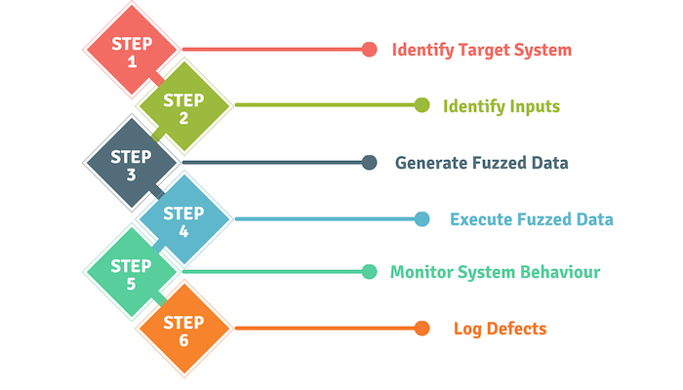
Fuzzing
A widely-used dynamic technique to discover bug or vulnerability
Fuzzers generate inputs that crash the program under test (PUT)
Industry: Google has found tens of thousands bugs by different fuzzers
Academia: Several thousand published papers since 2014
Categories of Fuzzing
Based on knowledge of PUT: grammar, semantics, input format, structure
Black-Box: blind fuzz with no knowledge with mutation
White-Box: highly targeted fuzz with full knowledge by program analysis
Gray-Box: targeted fuzz with partial knowledge by instrumentation
Highly Stochastic Nature
Highly random input generation
How to evaluate the performance of fuzzers?
Figure 1: Fuzz Testing Steps
Sources:
https://www.synopsys.com/glossary/what-is-fuzz-testing.html
Figure: https://cyberhoot.com/cybrary/application-fuzzing/

Slide 5
Evaluating Fuzzers (1)
Components of Fuzzing Evaluation
Compelling/Baseline Fuzzers
Target Programs
Performance Metric
Number of crashes
Number of (unique) bugs
Meaning Fuzzing Configuration
Timeout
Seed Corpus
Lack of Trustworthy Evaluation
Initially proposed by Klee (CCS’18) by analyzing 32 top papers
Found a new field of study: fuzz testing evaluation
Existing papers give wrong and misleading evaluation conclusions
Sources:
Klees, George, et al. "Evaluating fuzz testing." Proceedings of the 2018 ACM SIGSAC conference on computer and communications security (CCS’18). 2018.
Notes:
This argument does not come from nowhere. Instead, the author has carried out over 50000 CPU hours of comprehensive experiments.

Slide 6
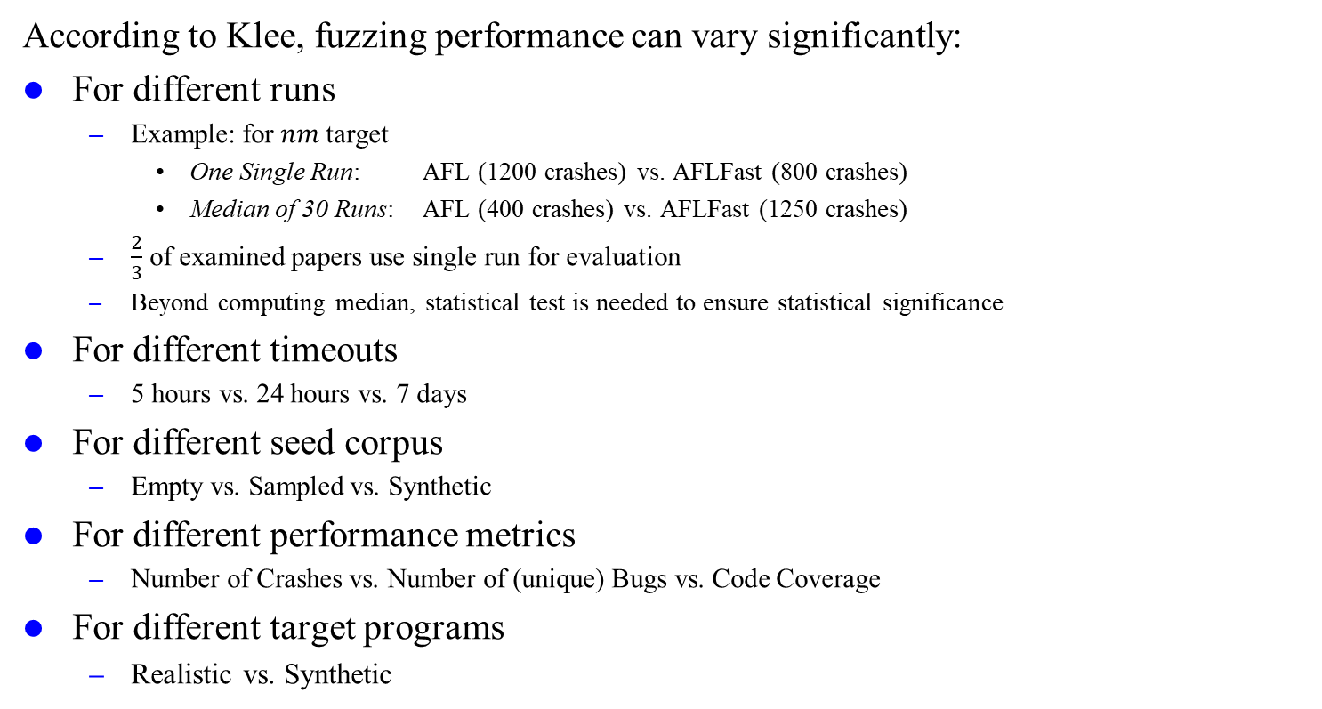
Evaluating Fuzzers (2)
According to Klee, fuzzing performance can vary significantly:
For different runs
Example: for $nm$ target
One Single Run: AFL (1200 crashes) vs. AFLFast (800 crashes)
Median of 30 Runs: AFL (400 crashes) vs. AFLFast (1250 crashes)
$\frac{2}{3}$ of examined papers use single run for evaluation
Beyond computing median, statistical test is needed to ensure statistical significance
For different timeouts
5 hours vs. 24 hours vs. 7 days
For different seed corpus
Empty vs. Sampled vs. Synthetic
For different performance metrics
Number of Crashes vs. Number of (unique) Bugs vs. Code Coverage
For different target programs
Realistic vs. Synthetic

Slide 7
Evaluating fuzz testing
Introduction
Preliminaries
Methodology
Experiments
Conclusions

Slide 8
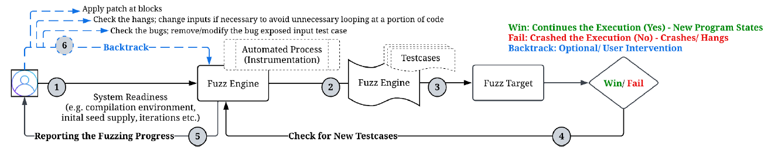
Unique Bugs
De-Duplicate Crashes to Unique Bugs
Multiple crashes may have root cause of the same bug
Number of unique bugs serve as the ultimate performance metric
Common de-duplication techniques
Ground-truth bug indication (adopted by LAVA and Magma)
Stack hash
AFL Coverage profile
Sources:

Slide 9
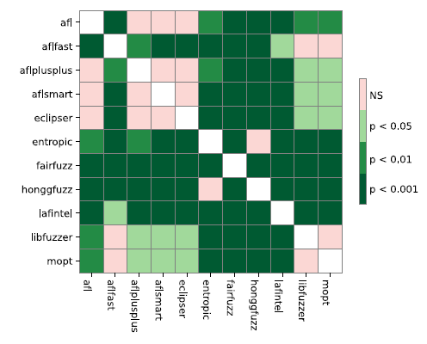
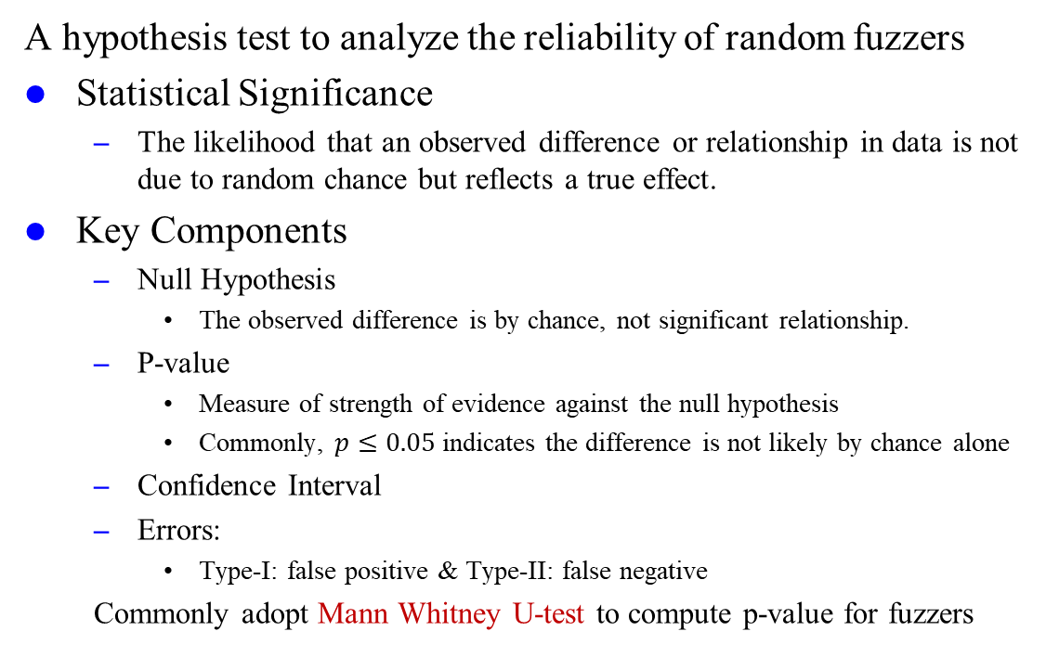
Statistical Test
A hypothesis test to analyze the reliability of random fuzzers
Statistical Significance
The likelihood that an observed difference or relationship in data is not due to random chance but reflects a true effect.
Key Components
Null Hypothesis
The observed difference is by chance, not significant relationship.
P-value
Measure of strength of evidence against the null hypothesis
Commonly, $p≤0.05$ indicates the difference is not likely by chance alone
Confidence Interval
Errors:
Type-I: false positive & Type-II: false negative
Commonly adopt Mann Whitney U-test to compute p-value for fuzzers
Figure 2: Mann-Whitney U-test result for libxml in fuzzbench MainExperiment
Sources:
Metzman, Jonathan, et al. "Fuzzbench: an open fuzzer benchmarking platform and service." Proceedings of the 29th ACM joint meeting on European software engineering conference and symposium on the foundations of software engineering. 2021.

Slide 10
Problem Formulation
Klee’s guidelines for fuzz testing evaluation:
Large Enough Target Programs
With clear bug indicator to avoid overcounting and duplication
Prefer real target programs than synthetic programs due to ecological validity
Meaningful Fuzzing Configurations
Run fuzzers for multiple trials
Various well documented seed choices (including empty seed)
Timeout of at least 24 hours for each trial
Performance Metrics
Measure performance of number of known unique bugs found
Use statistical test to distinguish distribution
Usability
Easy-to-deploy environment
Fast execution

Slide 11
Evaluating fuzz testing
Introduction
Preliminaries
Methodology
Experiments
Conclusions

Slide 12
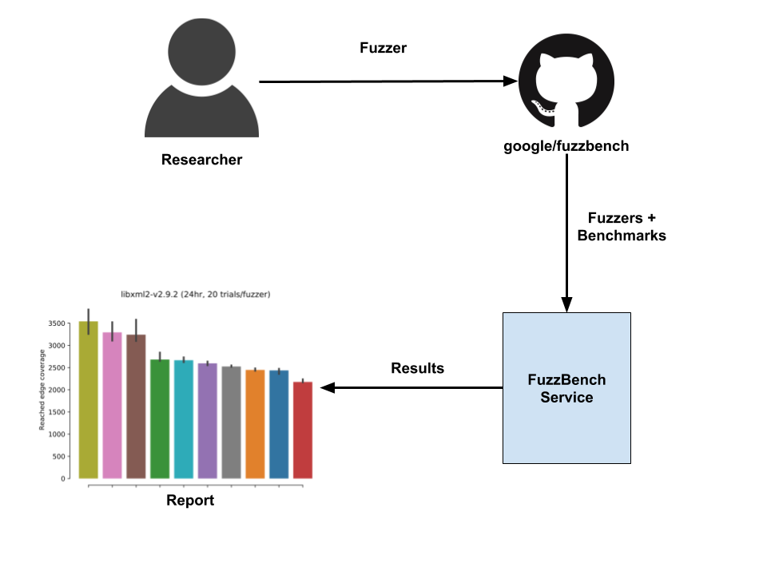
FuzzBench: Overview
Developed by Google in 2020
Successor of Google’s fuzzer test suite
Still updating until now, compared to benchmarks from academia
The first fuzzer-benchmark-as-a-service platform
Fuzzer developers can integrate and evaluate fuzzer online
Integrates 11 commonly used fuzzers like AFL, AFLFast
Integrates 22 real-work benchmark programs in C/C++
Produces comprehensive and trustworthy reports and statistics
Highly parallelized and free benchmark in 1-2 days
Successful Outcome
Dozens of researcher users from academia and industry
More than 150 benchmark experiments publicly and privately
(Data reported by its paper released in 2021, still growing)
Figure 3: Overview of FuzzBench
Sources:
Figure 3: https://github.com/google/fuzzbench/raw/master/docs/images/FuzzBench-service.png

Slide 13
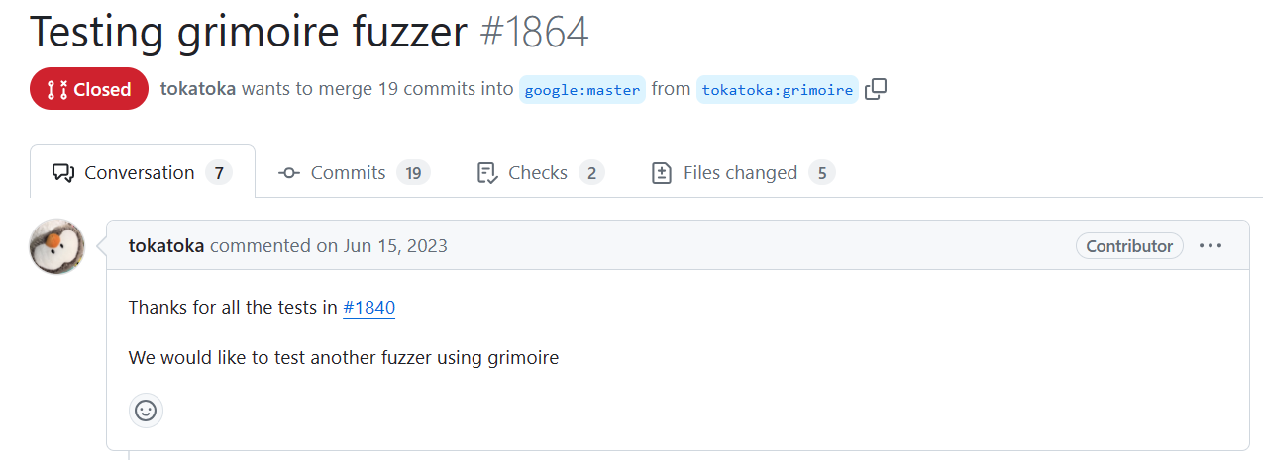

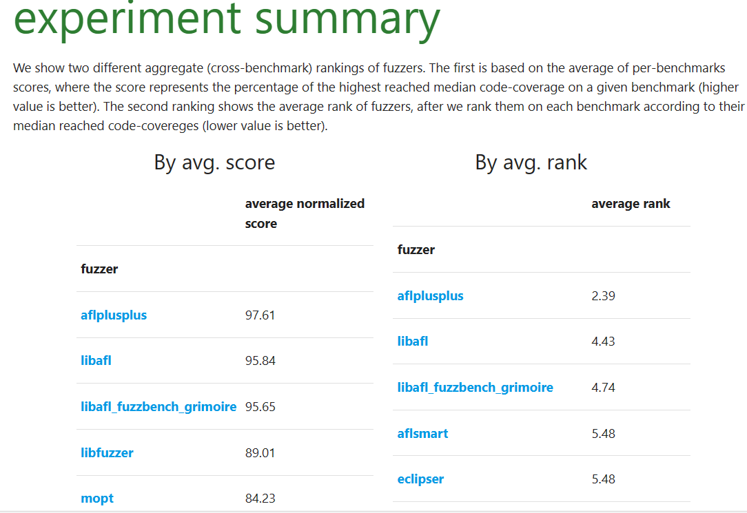
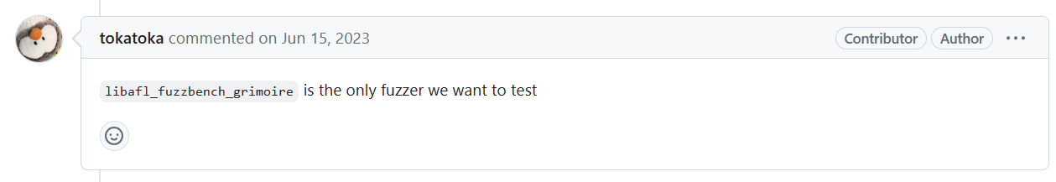
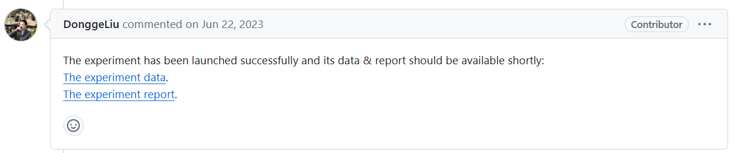
FuzzBench: How to Use?
Submit self-implemented fuzzers and a pull request to fuzzbench
Fuzzer Developer
The fuzzer under evaluation
Maintainer from Google
Sources:
GitHub PR: https://github.com/google/fuzzbench/pull/1864
FuzzBench Report: https://storage.googleapis.com/www.fuzzbench.com/reports/experimental/2023-06-22-libafl/index.html
Notes:
As we said just now, fuzzbench also supports private evaluation that the reports are invisible to public visitors

Slide 14
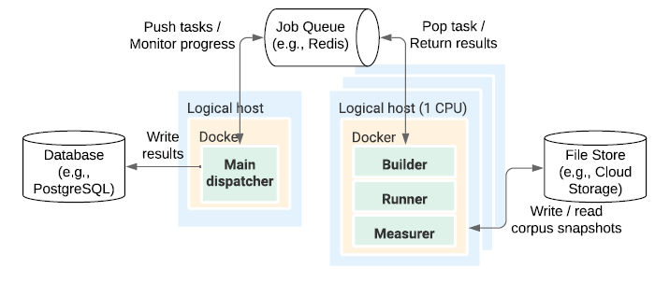
FuzzBench: Design
Frontend
Easy-to-use interface to integrate both benchmark programs and fuzzers
Backend
Builder: Dispatcher spawns jobs to build docker image for each fuzzer-benchmark pair
Runner: Tens of thousands of instances run trials in parallel, completing 13 CPU years’ work within 1-2 days
Measurer: Periodical snapshot of coverage information
Execute on Google Compute Engine with Google Cloud Storage
Figure 4: FuzzBench’s High-Level Architecture
Sources:
Metzman, Jonathan, et al. "Fuzzbench: an open fuzzer benchmarking platform and service." Proceedings of the 29th ACM joint meeting on European software engineering conference and symposium on the foundations of software engineering. 2021.

Slide 15
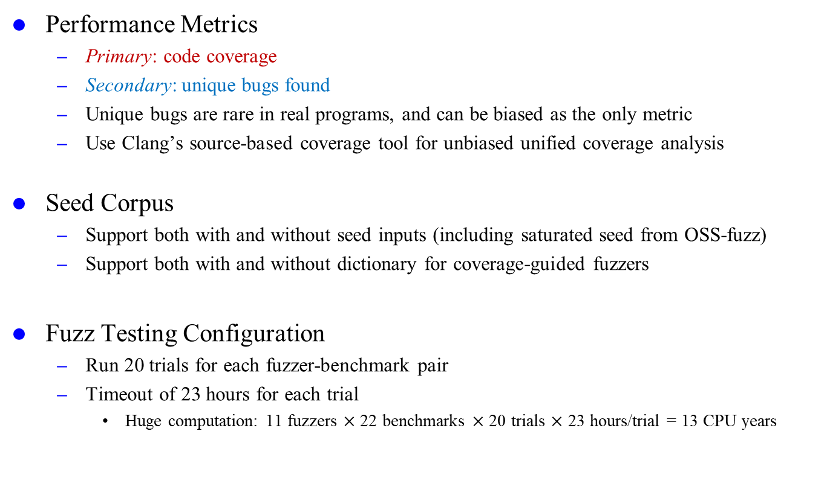
FuzzBench: Evaluation
Performance Metrics
Primary: code coverage
Secondary: unique bugs found
Unique bugs are rare in real programs, and can be biased as the only metric
Use Clang’s source-based coverage tool for unbiased unified coverage analysis
Seed Corpus
Support both with and without seed inputs (including saturated seed from OSS-fuzz)
Support both with and without dictionary for coverage-guided fuzzers
Fuzz Testing Configuration
Run 20 trials for each fuzzer-benchmark pair
Timeout of 23 hours for each trial
Huge computation: 11 fuzzers $×$ 22 benchmarks $×$ 20 trials $×$ 23 hours/trial = 13 CPU years
Notes:
Fuzzbench counts on code coverage as performance metric and it did not support bug counting when it was initially released in 2020
After criticized by some other papers and maybe also users, it added this feature later

Slide 16
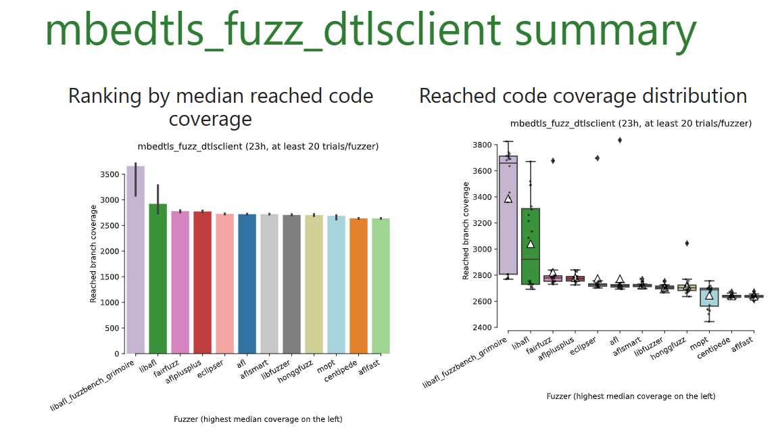
FuzzBench: Results
Benchmark-Level Results
Code/bug coverage information and profile
Differential code coverage analysis of fuzzers
Two-tailed Mann-Whitney U-test
Experiment-Level Results
Score: % of the highest reached median code coverage
Rank: by median of reached code coverage
Critical-difference diagram
Sources:
FuzzBench Report: https://storage.googleapis.com/www.fuzzbench.com/reports/experimental/2023-06-22-libafl/index.html
Notes:
Mbedtls is an open-source library for TLS and encryption

Slide 17
Evaluating fuzz testing
Introduction
Preliminaries
Methodology
Experiments
Conclusions

Slide 18
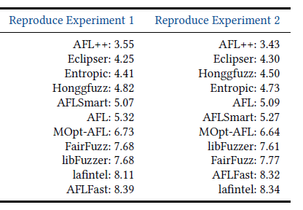
FuzzBench: Experiments (1)
Reproducibility
1

Slide 19
FuzzBench: Experiments (1)
Both code coverage and bug coverage report
List some findings and reasoning

Slide 20
FuzzBench: Experiments (2)
Help Improve Fuzzers
Differential code coverage report

Slide 21
Evaluating fuzz testing
Introduction
Preliminaries
Methodology
Experiments
Conclusions

Slide 22
Google’s Fuzzing Toolchain
Fuzzer
AFL (American fuzzy lop) (2014): classical security-oriented fuzzer
Gofuzz (2014): fuzzer for Go language
Honggfuzz (2015): feedback-driven fuzzing based on code coverage
ClusterFuzz (2019): scalable fuzzing infrastructure
Fuzzing Framework
OSS-fuzz (2016): continuous fuzzing for open-source projects
FuzzTest (2022): internal C++ testing framework in Google
Fuzzing Evaluation (What we focus on today)
Fuzzer Test Suite (2016): set of benchmark programs for fuzzer
FuzzBench (2020): fuzzer benchmark as a service
AI-powered Fuzzing
OSS-fuzz-gen (2023): LLM powered fuzzing via OSS-fuzz

Slide 23
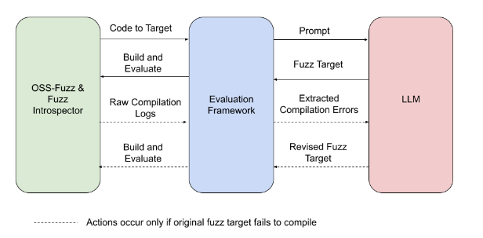
LLM-aided Fuzzing
Main Idea
Apply the generative power of LLMs to improve fuzzing
Scale security improvements across fuzzed projects
Remove barrier to adopt fuzzing in future projects
Ultimate Goal: fully automated fuzzing
Hey LLM, fuzz this project for me
Automatically writing fuzz targets by prompts
Currently support models like OpenAI GPT-3.5/4.0
Evaluation Metrics
Compilability
Runtime crashes (covered today)
Runtime coverage (covered today)
Runtime line coverage diff against existing human-written fuzz targets in OSS-fuzz
Figure x: Overview of OSS-fuzz-gen

Slide 24
References
Klees, George, et al. "Evaluating fuzz testing." Proceedings of the 2018 ACM SIGSAC conference on computer and communications security (CCS’18). 2018.
Metzman, Jonathan, et al. "Fuzzbench: an open fuzzer benchmarking platform and service." Proceedings of the 29th ACM joint meeting on European software engineering conference and symposium on the foundations of software engineering (ESEC/FSE’21). 2021.
Hazimeh, Ahmad, Adrian Herrera, and Mathias Payer. "Magma: A ground-truth fuzzing benchmark." Proceedings of the ACM on Measurement and Analysis of Computing Systems 4.3 (MACS’20) (2020): 1-29.
Dolan-Gavitt, Brendan, et al. "Lava: Large-scale automated vulnerability addition." 2016 IEEE symposium on security and privacy (SP’16). IEEE, 2016.
Li, Yuwei, et al. "{UNIFUZZ}: A holistic and pragmatic {Metrics-Driven} platform for evaluating fuzzers." 30th USENIX Security Symposium (USENIX Security’21). 2021.
Arcuri, Andrea, and Lionel Briand. "A practical guide for using statistical tests to assess randomized algorithms in software engineering." Proceedings of the 33rd international conference on software engineering (ICSE’11). 2011.
Mallissery, Sanoop, and Yu-Sung Wu. "Demystify the fuzzing methods: A comprehensive survey." ACM Computing Surveys 56.3 (2023): 1-38.
Manès, Valentin JM, et al. "The art, science, and engineering of fuzzing: A survey." IEEE Transactions on Software Engineering (TSE’19) 47.11 (2019): 2312-2331.
Google. [n.d.]. FuzzBench. https://google.github.io/fuzzbench/ . Accessed: 2020-05-02.
Google. [n.d.]. Fuzzer Test Suite. https://github.com/google/fuzzer-test-suite . Accessed: 2019-09-06.
Google. [n.d.]. Oss-fuzz-gen. https://github.com/google/oss-fuzz-gen . Accessed: 2024-04-28.

