Slide 1


Slide 2

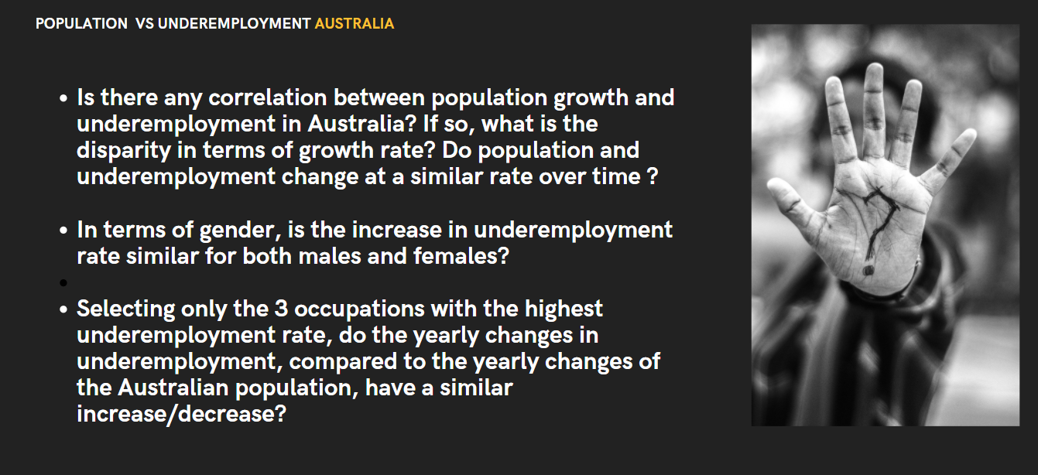
We have a lot of charts to show the results, however to save time we only present few of them, all others refer to results holder

Slide 3
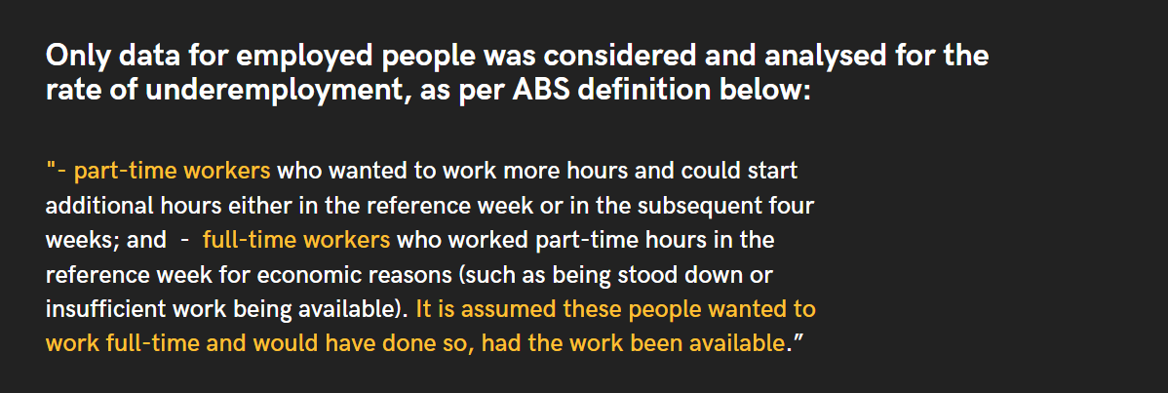
We have a lot of charts to show the results, however to save time we only present few of them, all others refer to results holder

Slide 4
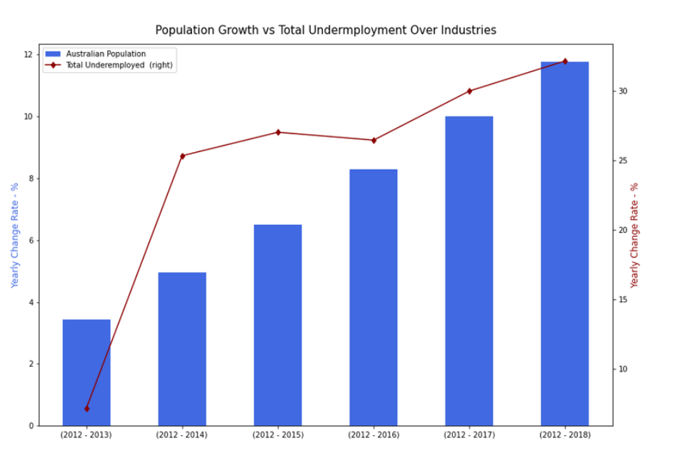
We have a lot of charts to show the results, however to save time we only present few of them, all others refer to results holder

Slide 5
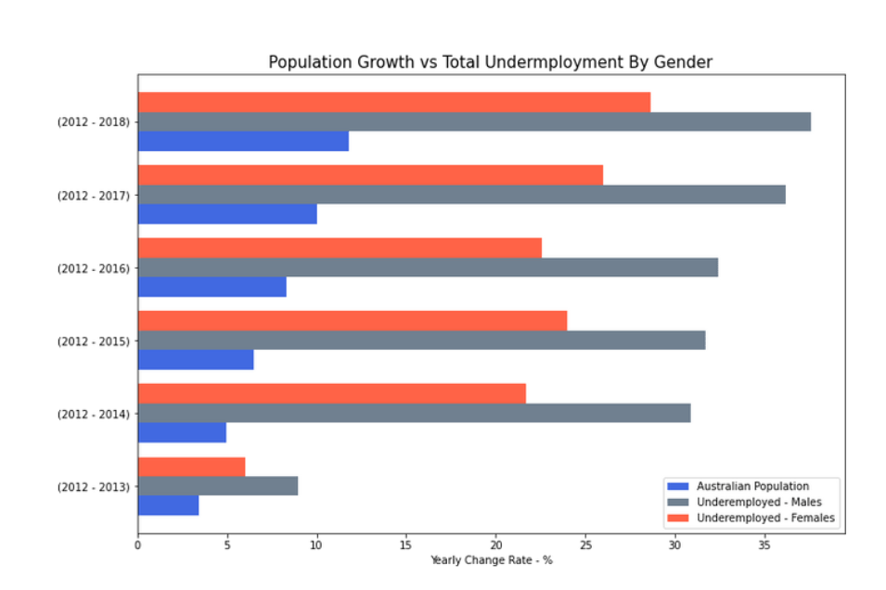
We have a lot of charts to show the results, however to save time we only present few of them, all others refer to results holder

Slide 6
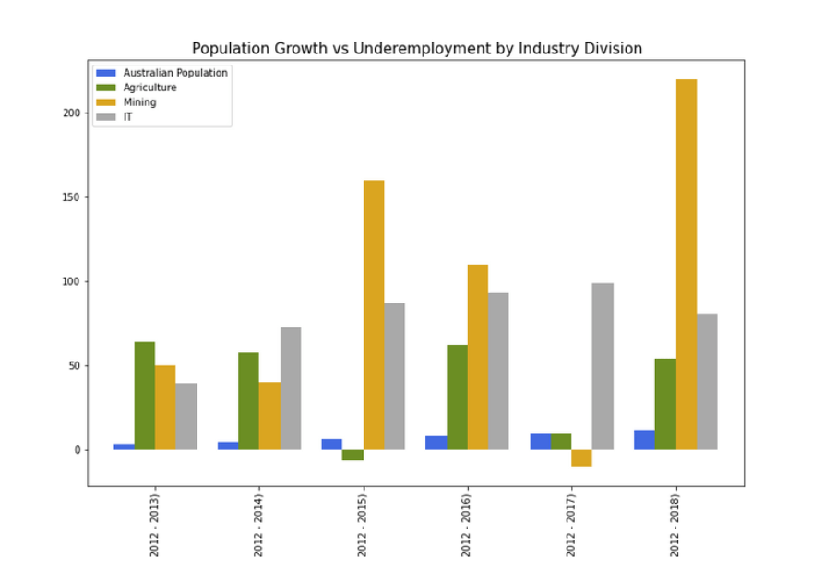
We have a lot of charts to show the results, however to save time we only present few of them, all others refer to results holder

Slide 7
Conclusions
Pearson’s correlation is 0.812, showing positive correlation between population growth and Underemployment.
Over the period of 2012 -2014, the underemployment showed a significant increase over population growth (4.96% and 25.36%) compared with 2012 -2014 (3.44% and 7.17%).
Males have consistently represented the greater share of underemployed workers.
In terms of underemployment over the total industry/ocupation listed, agriculture, mining and IT had the highest increase. From 2015 onwards mining had the highest increase overall.

