Slide 1

Population vs Employment AUS
Adventure Team 06/02/21

Slide 2

Why & How
Queries about AUS population vs employment/Unemployment relationship and data availability from ABS.
01
Cleaning and filter data mainly in the process of prepare CSV’s in EXCel
Bigest File Size reduced from 99M to several Ks.
02

Slide 3

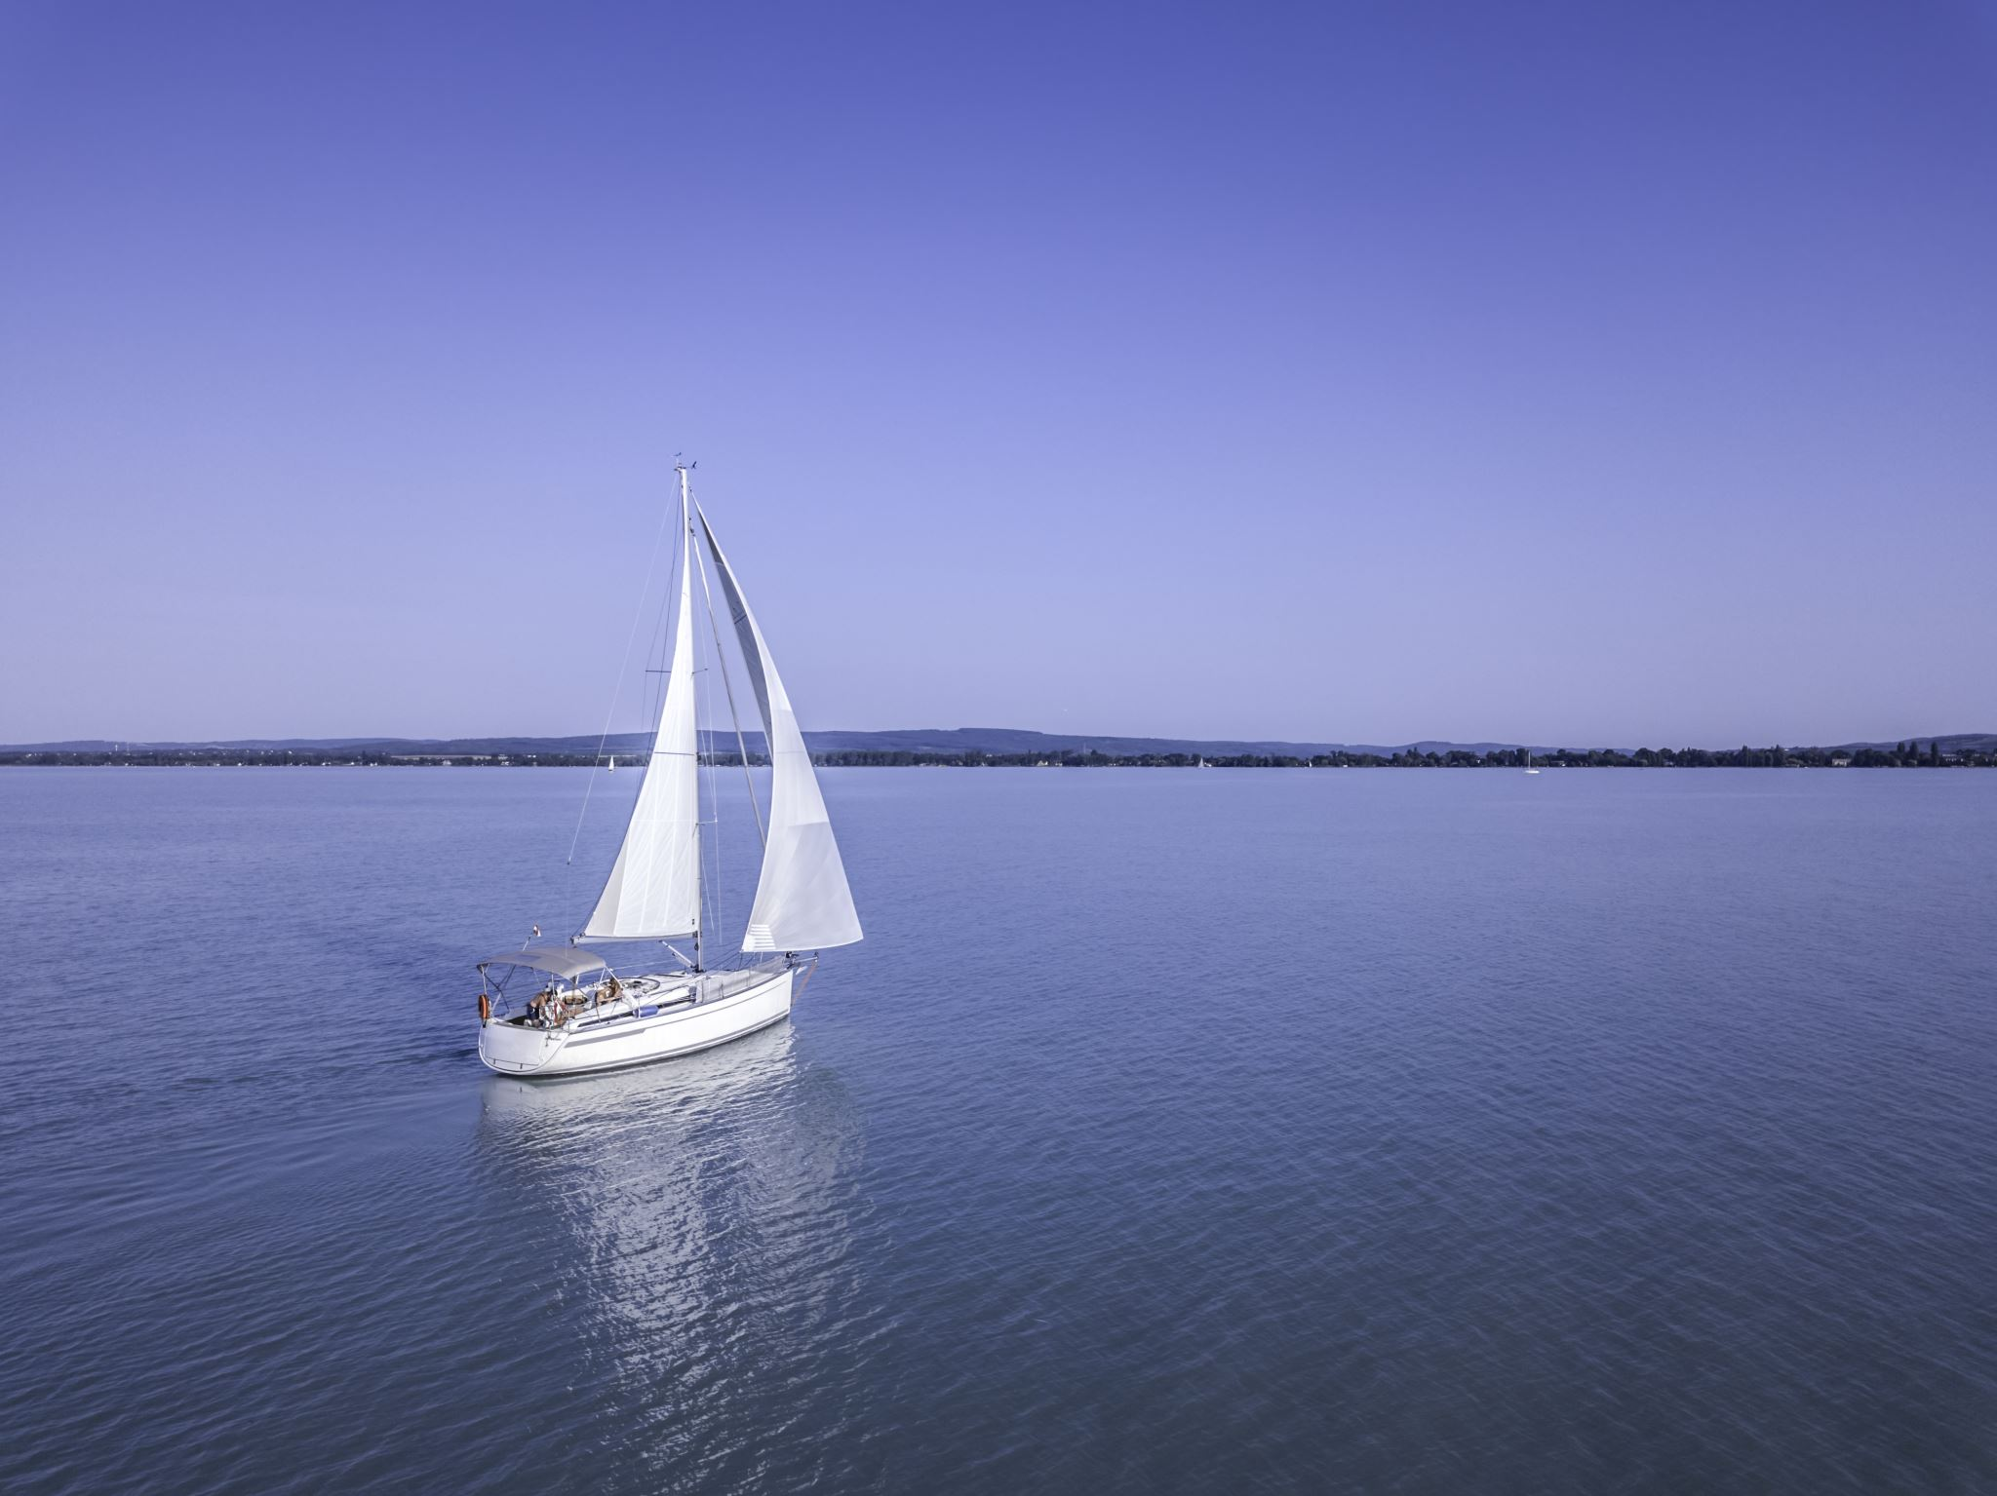
Scope & Definition
Our scope covers population vs employment and unemployment over national states, age & gender groups, working hours and industries.
Our employment, unemployment definition as ABS’
Employment = full_ time plus part_time jobs.
Yearly change % take 2012
as our base year.

Slide 4
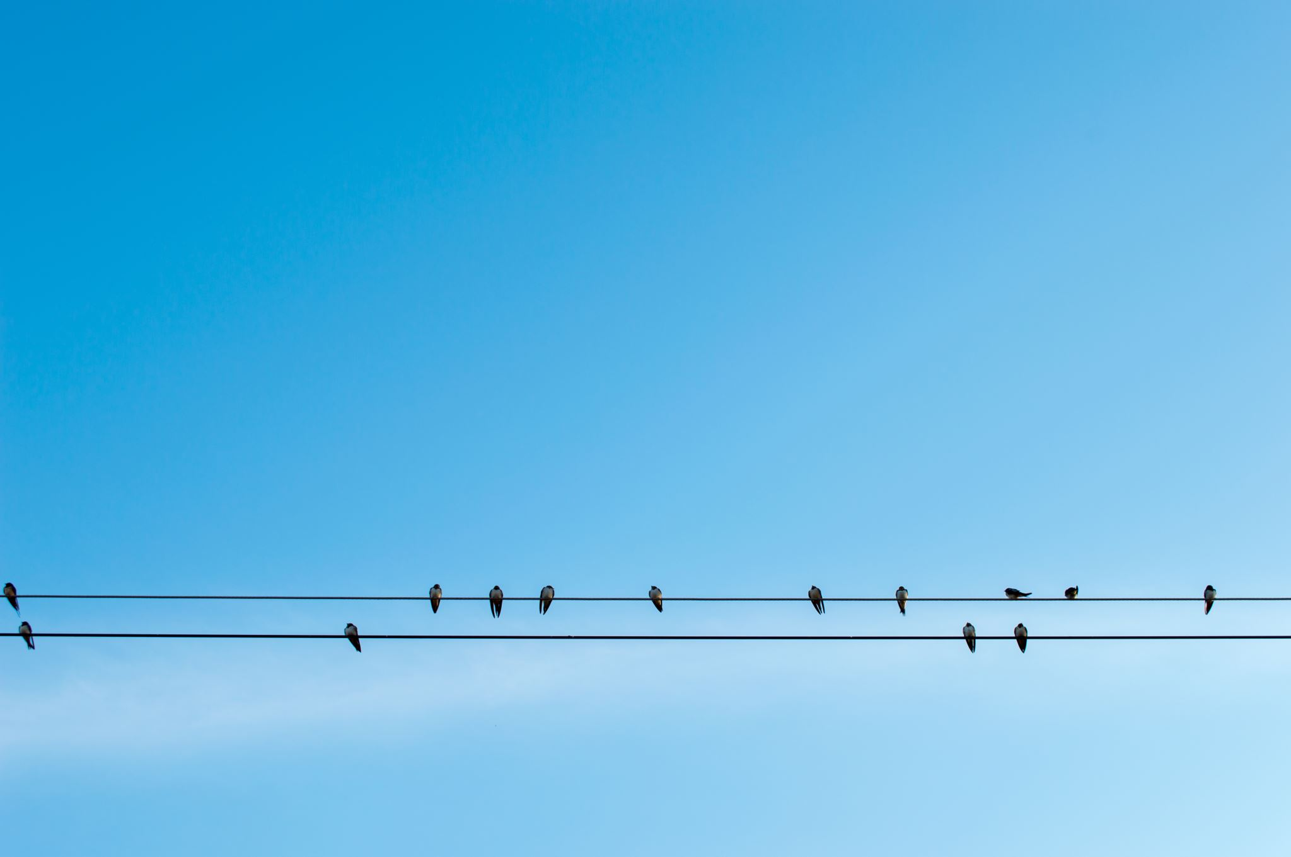
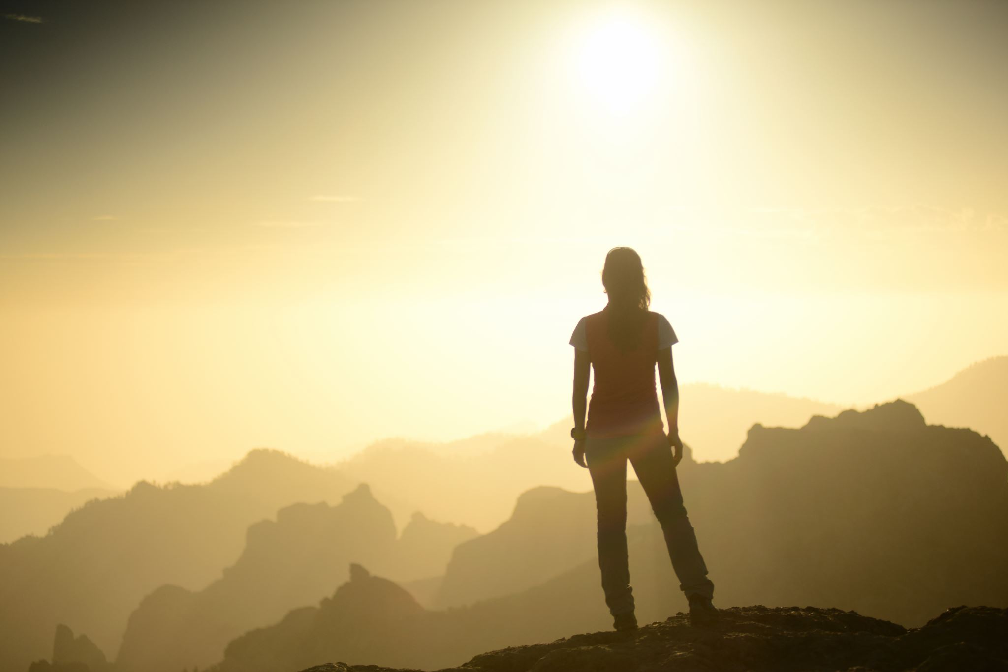
Charts & Experiences
For teamwork, environment very important.
Feeling the name of Variables/DataFrame etc have better has a established rules.
How & when to merge into main, should also have some regulations too.
We have a lot of charts to show the results, however to save time we only present few of them, all others refer to results holder

Slide 5
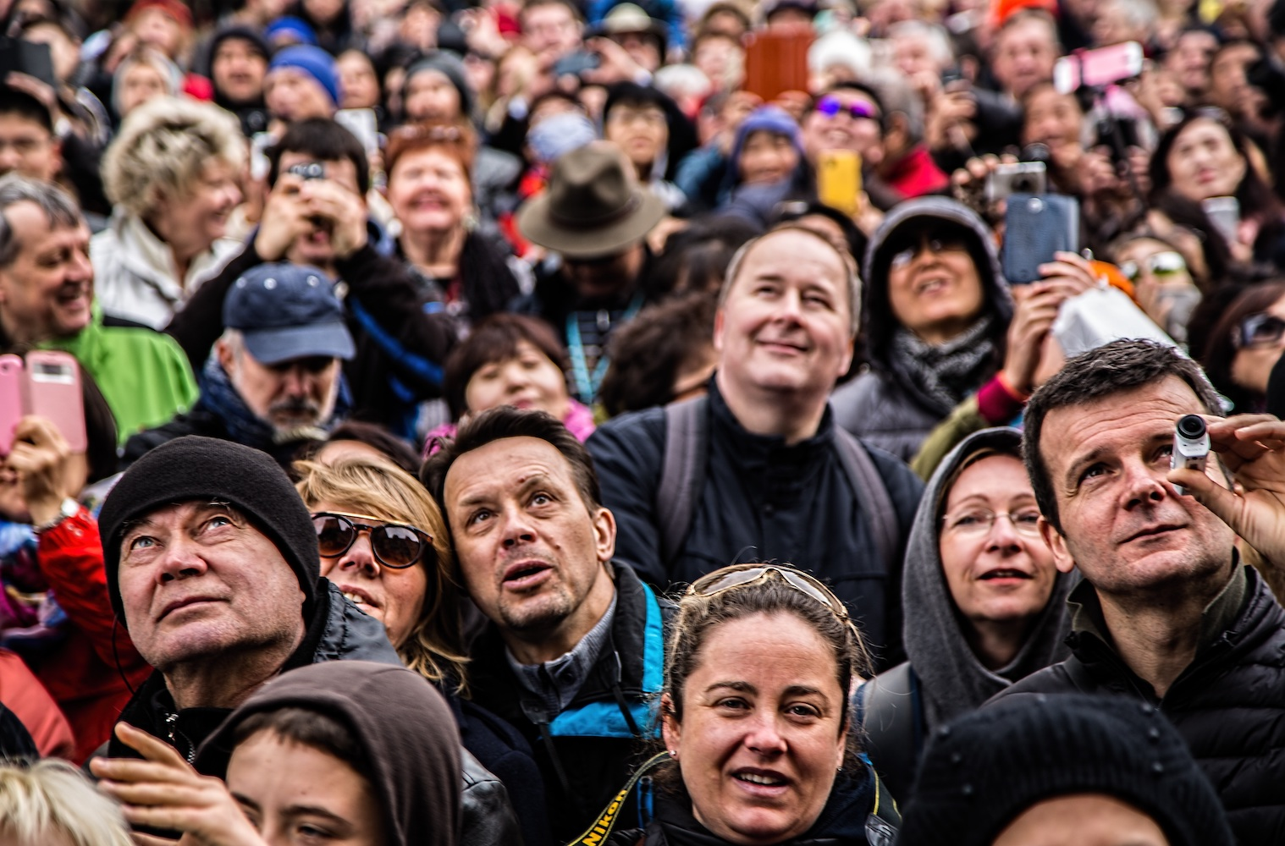
Population vs Employment over National/States/Territories
This Photo by Unknown Author is licensed under CC BY

Slide 6
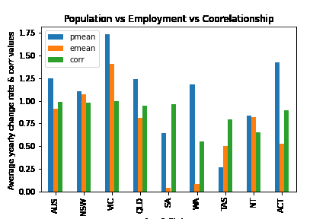
Period 2012 -2018

Slide 7
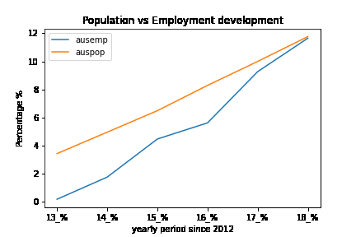
Additional Charts for each state/territory available on request. Can be in any combination.

Slide 8
Conclusions for pop/emp over National/States
National and every states/territories population average yearly positive increasing, with national level at 1.25%, max Vic at 1.74%, and min Tas at 0.27%. Within the whole country, population yearly average increase rate overpass that of employment.
2. Employment increasing every year in the whole country, the national level at 0.9%, max Vic at about 1.4%, min SA at 0.04%.
3. From population vs employment correlation coefficient point of view, every states shown a very strong correlation effect (corr = 0.8 - 0.99), except WA and NT with coefficient values at 0.55 and 0.65 respectively.
Contrary to any other state, TAS’s average employment change rate 50% higher than its population increase rate, means where easy to find job? The reasons need to be further investigated.

Slide 9


Slide 10
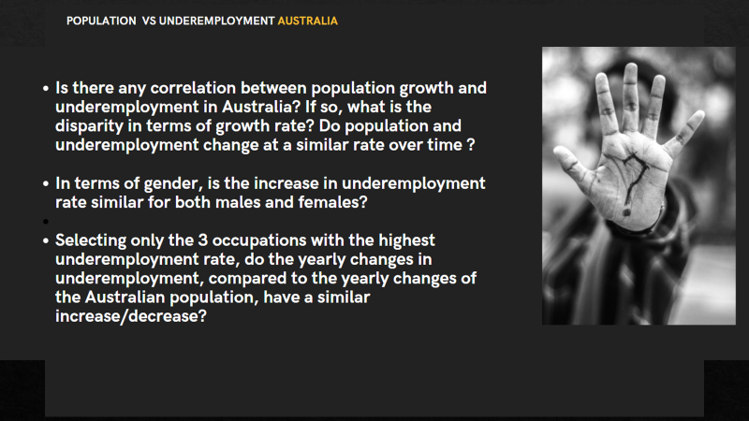

Slide 11
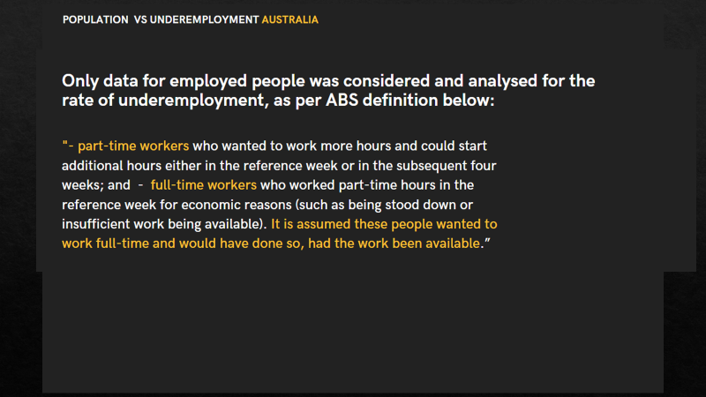

Slide 12
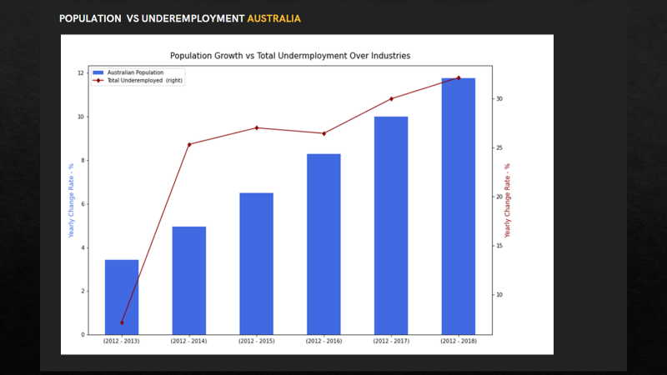

Slide 13
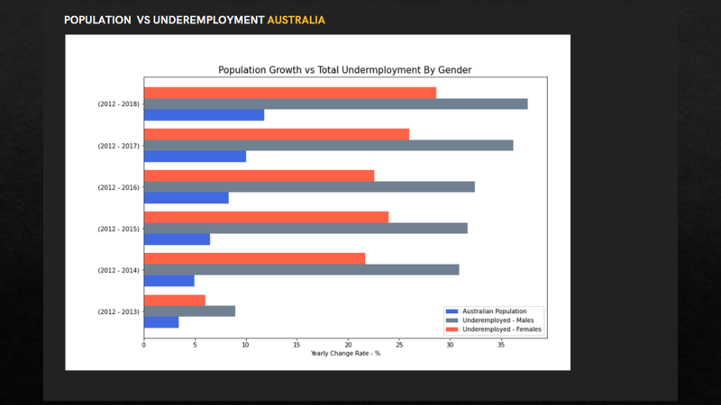

Slide 14
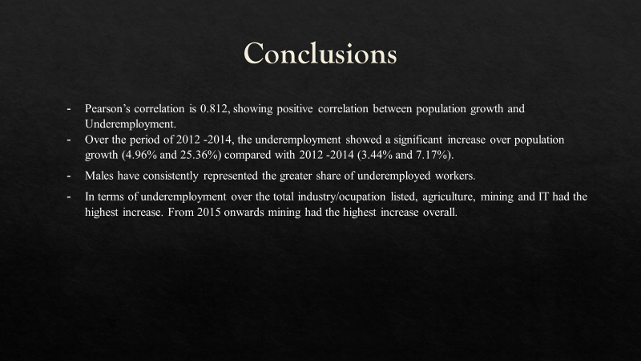

Slide 15

This Photo by Unknown Author is licensed under CC BY-SA-NC

