Slide 1





Project 1 Team: Adventure
Tony
Nooshin
Aroosa
Adeniyi
Mara
Title: Employment and Unemployment – Australian Bureau of statistics
(Employment & unemployment overview, trends, status, age/gender, state and territory)

Slide 2

About the Project
This project studies the employment statistics in Australia from Year 2012-2018.
The data is collected from website “Australian bureau of statistics”. The URL is below: https://www.abs.gov.au/statistics/labour/employment-and-unemployment/labour-force-australia/latest-release
Questions addressed- How has Australia’s employment rate changed over the years 2012-2018 for the population aged 15-64. Furthermore, the correlation between participation rate, employment to population ratio, and labor force is studied.
Additionally, the relationship between employment to population ratio and participation rate is studied , as it directly affects Australia’s economic growth potential. Three key factors that impact the economic growth, often referred to as the three P’s, are population, participation (or labour supply) and productivity .

Slide 3
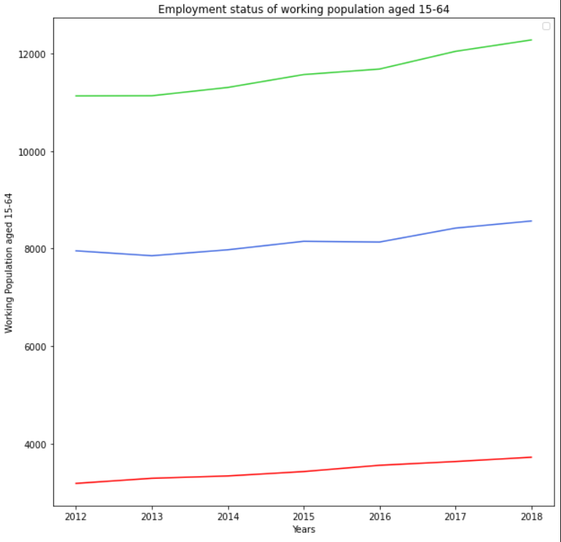
Employment Status of working Population aged 15-64
Employed Total
This line graph represents the number of persons employed part time and full-time, which we can see is increasing over the years.
Full -time and Part time employment are both increasing over the span of time 2012-2018.
Employed Full-time
Employed Part-time

Slide 4
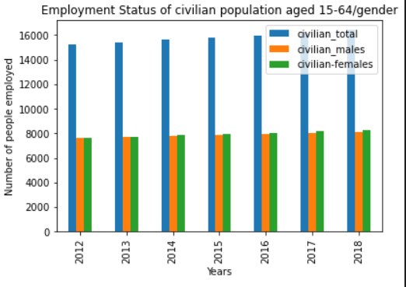
Civilian population aged 15-64/Gender
The bar graph shows the number of males and females in civilian population aged 15-64.
In 2012-2013 the employment status remains the same for both males and females. From 2014-2018 there is a slight increase in the female employment .

Slide 5
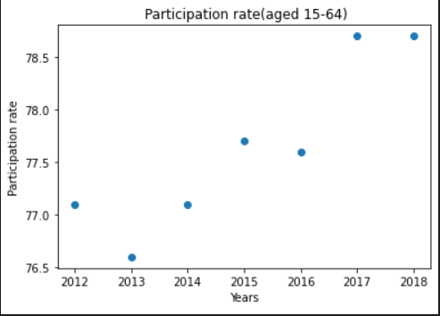
Participation rate (aged 15-64)
Workforce participation refers to the share of the working age population who are either in a job or actively looking for one. It ‘matters’ because it affects Australia’s economic growth potential.
The Correlation between participation rate over the years is 0.91 which indicates a positive relationship.

Slide 6
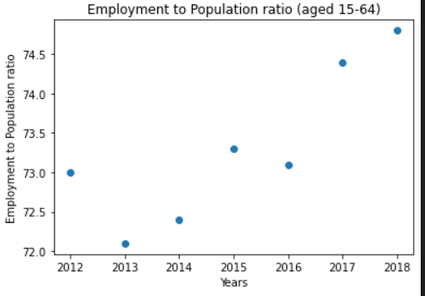
Employment to population ratio (aged 15-64)
Employment to population ratio is the proportion of a country's population that is employed. Ages 15 and older are generally considered the working-age population.
Why is employment to population ratio important?
To determine the economic strength of a country
To employ most of the population that helps reduce poverty
Track the pace of job creation
In general, a high ratio is considered to be above 70 percent of the working-age population whereas a ratio below 50 percent is considered to be low.

Slide 7
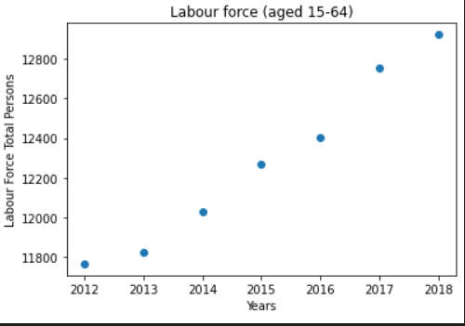
Labor force (aged 15-64)
The labor force comprises all persons who fulfil the requirements for inclusion among the employed (civilian employment plus the armed forces) or the unemployed.
The unemployed are defined as people without work but actively seeking employment and currently available to start work.
Correlation is 0.99

Slide 8
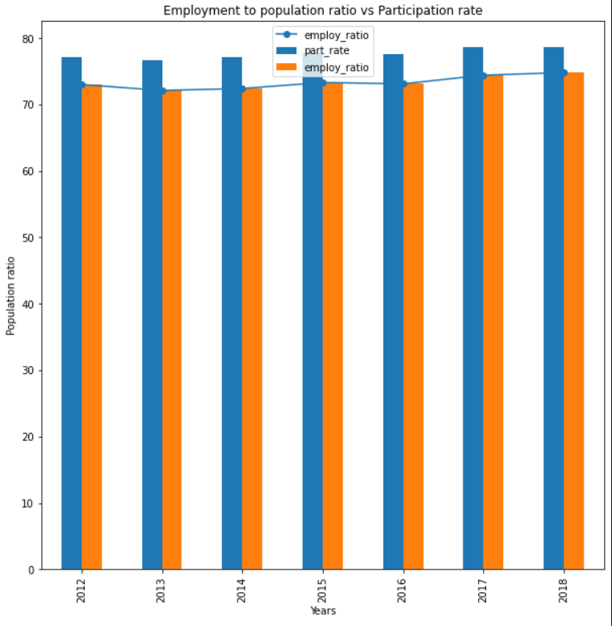
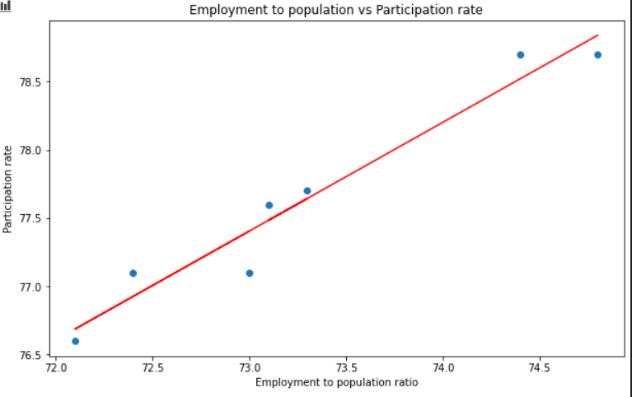
Employment to population ratio vs Participation rate (aged 15-64)
The regression line represents the mean of y at every given point of x.
That is to say: the central tendency of y depends on x.
R² = 0.949269
R² = 0.949269

Slide 9

Thank you

