Slide 1
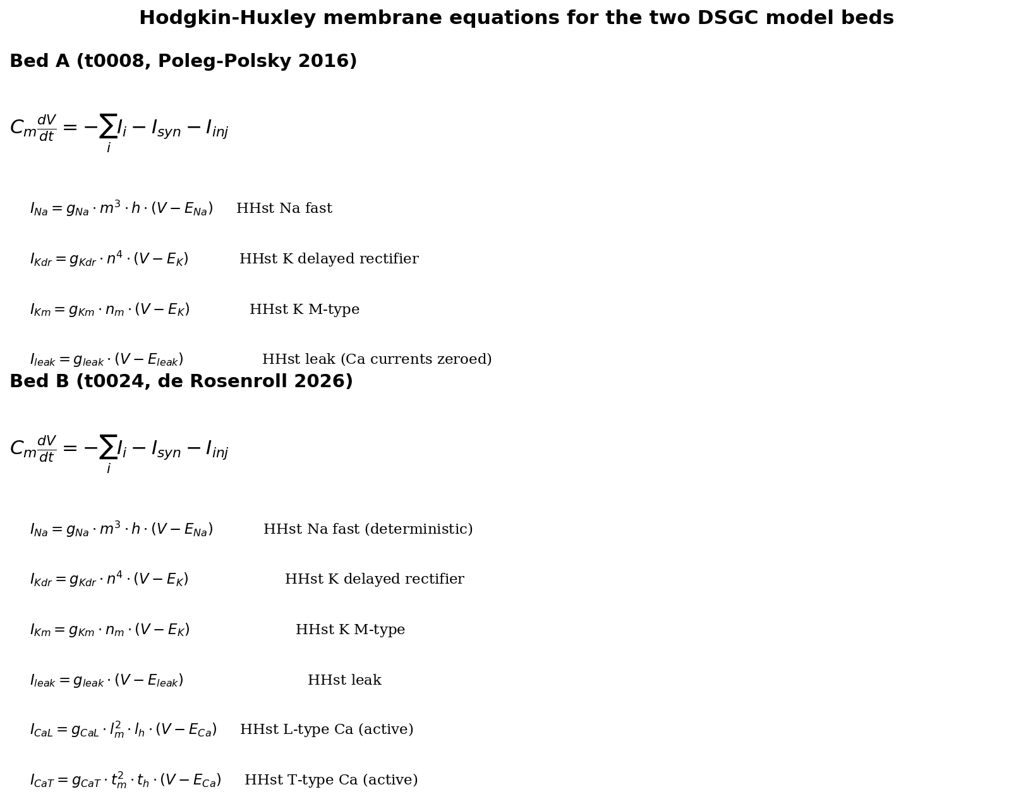
Figure 1 -- Hodgkin-Huxley membrane equations (Bed A and Bed B)
Canonical HH equation plus per-channel current decompositions.
Notes:
Source: tasks/t0070_writeup_two_model_beds/results/results_detailed.md lines 120-134 (Bed A) and 405-415 (Bed B). Rendered fresh via matplotlib mathtext.

Slide 2
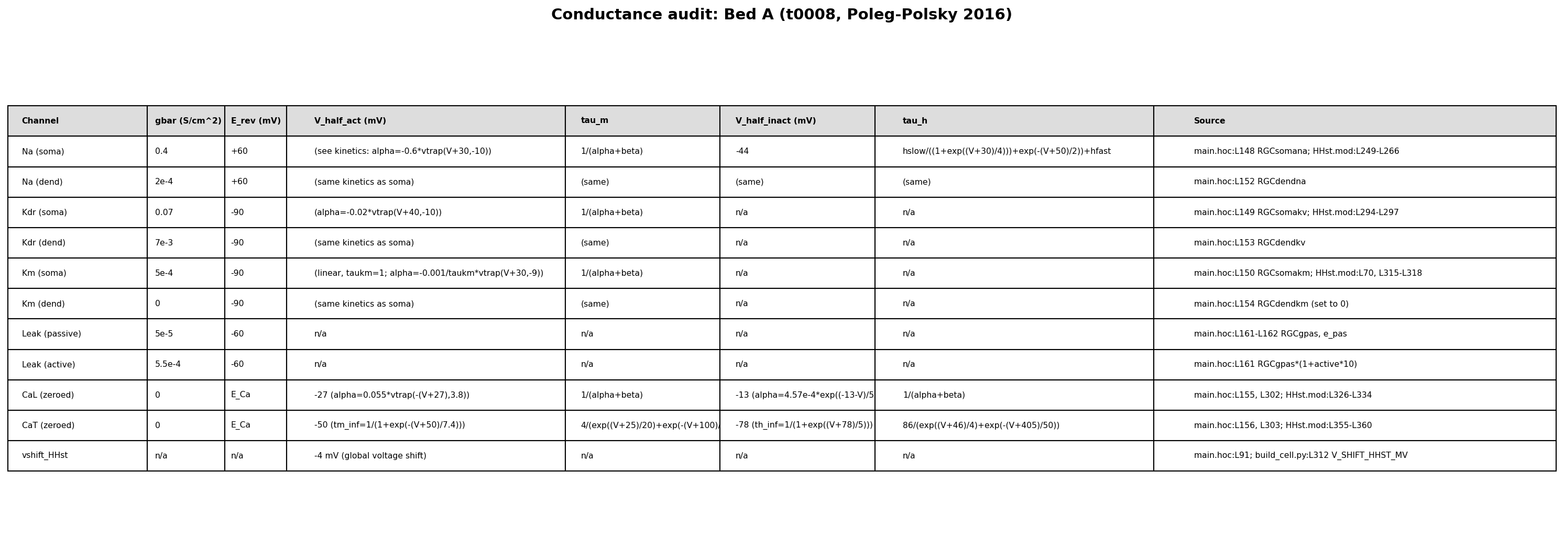
Figure 2a -- Bed A conductance audit (11 rows)
Per-channel gbar, E_rev, V_half_act, tau_m, V_half_inact, tau_h with code:line provenance.
Notes:
Source: tasks/t0070_writeup_two_model_beds/results/results_detailed.md lines 158-169. Bed A driver: t0008 ModelDB 189347.

Slide 3
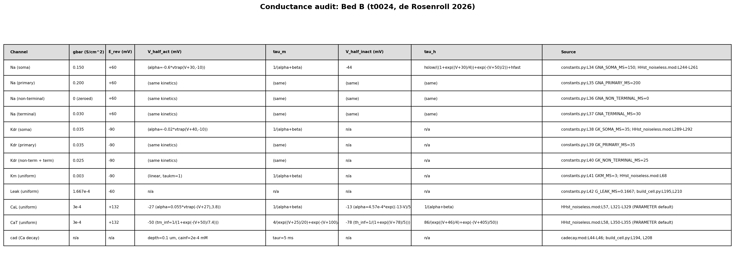
Figure 2b -- Bed B conductance audit (12 rows)
Bed B per-tier conductances (soma / primary / non-terminal / terminal) plus cad calcium-decay shell.
Notes:
Source: tasks/t0070_writeup_two_model_beds/results/results_detailed.md lines 452-465. Bed B driver: t0024 de Rosenroll 2026 port.

Slide 4
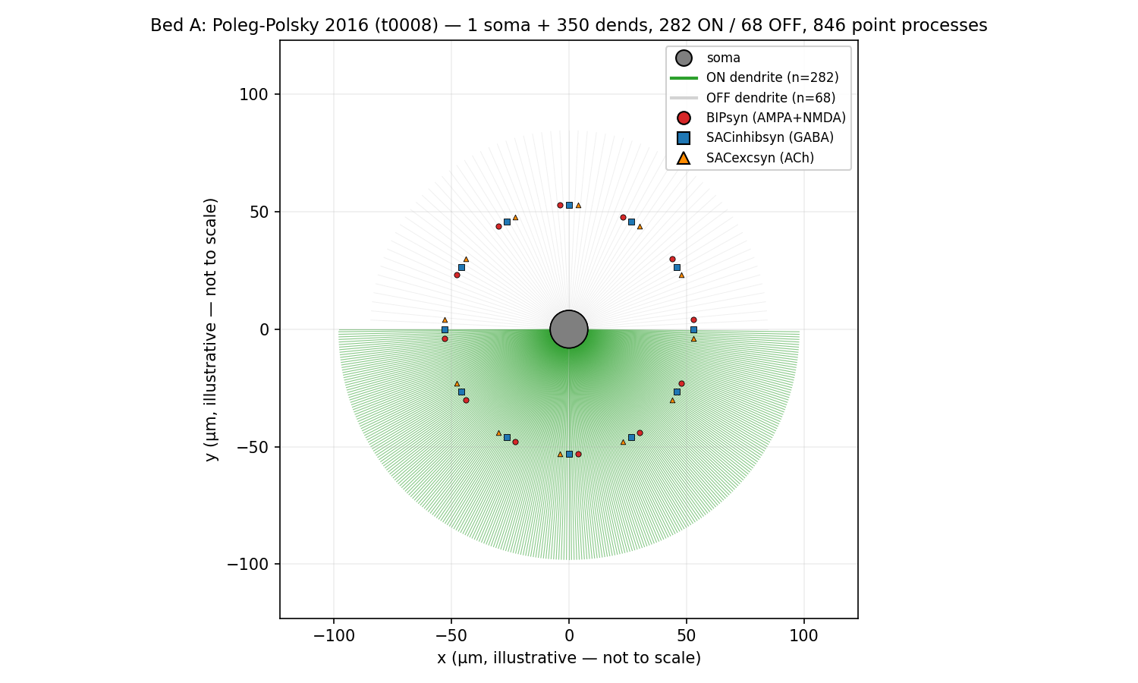
Figure 3a -- Bed A morphology
Bed A radial-fan dendritic schematic (illustrative).
Notes:
Source: copied verbatim from tasks/t0070_writeup_two_model_beds/results/images/bed_a_morphology.png.

Slide 5
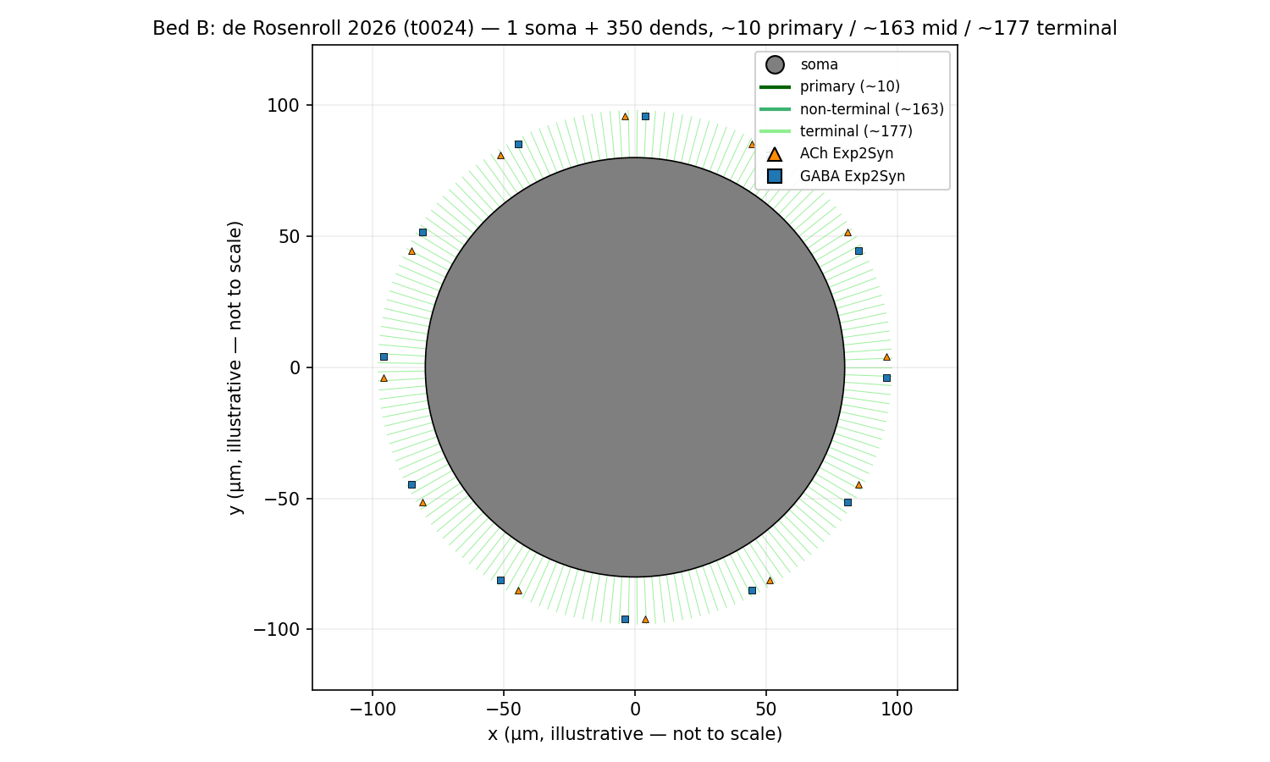
Figure 3b -- Bed B morphology
Bed B radial-fan dendritic schematic (illustrative).
Notes:
Source: copied verbatim from tasks/t0070_writeup_two_model_beds/results/images/bed_b_morphology.png.

Slide 6
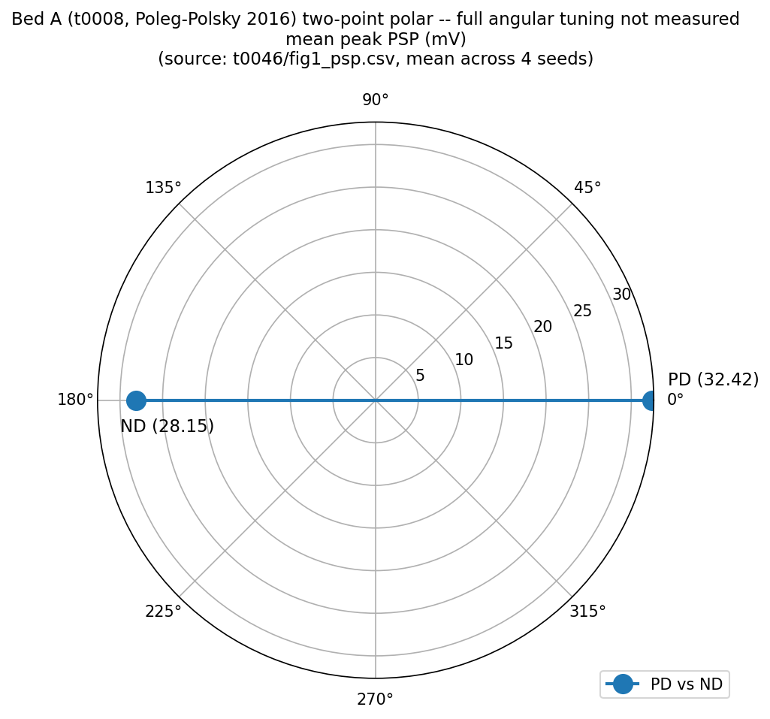
Figure 4a -- Bed A two-point polar synaptic (PD vs ND)
Two-point polar of mean peak PSP (mV). Full angular tuning was not measured for either bed.
Notes:
Source: tasks/t0046_reproduce_poleg_polsky_2016_exact/results/data/fig1_psp.csv; mean peak_psp_mv across 4 trial seeds, gnmda_ns=0.5.

Slide 7
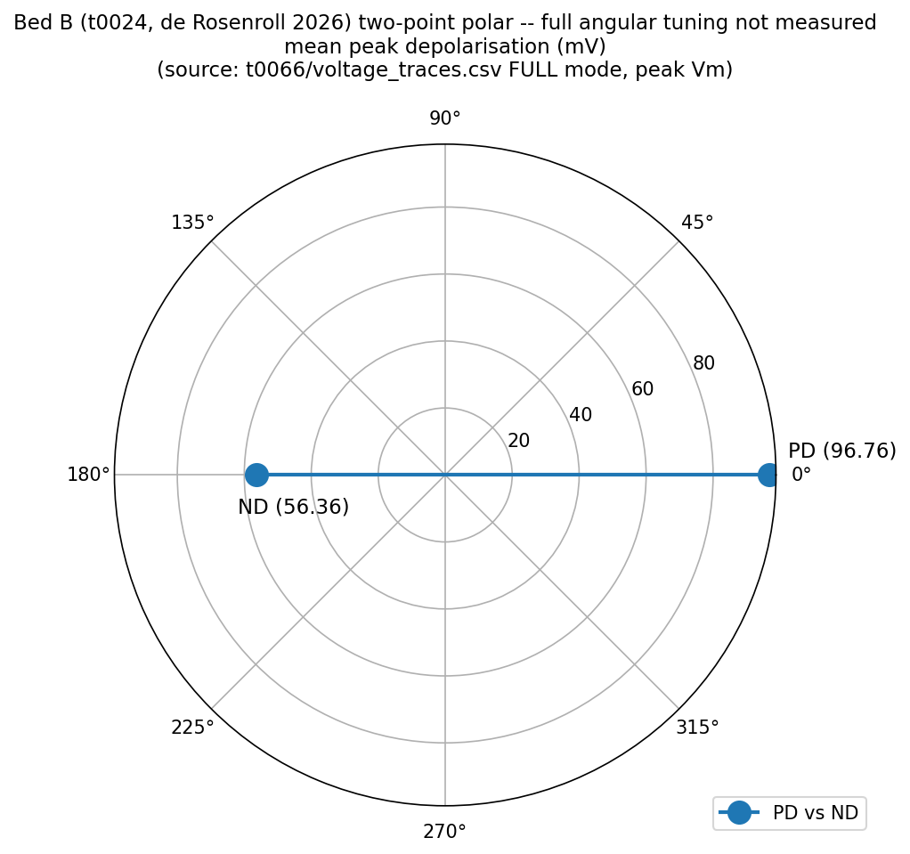
Figure 4b -- Bed B two-point polar synaptic (PD vs ND)
Two-point polar of mean peak depolarisation (FULL mode). Two-point treatment because no per-angle CSV exists.
Notes:
Source: tasks/t0066_t0024_epsp_ipsp_vm_protocol/data/voltage_traces.csv; peak Vm of FULL-mode traces, mean across trials.

Slide 8
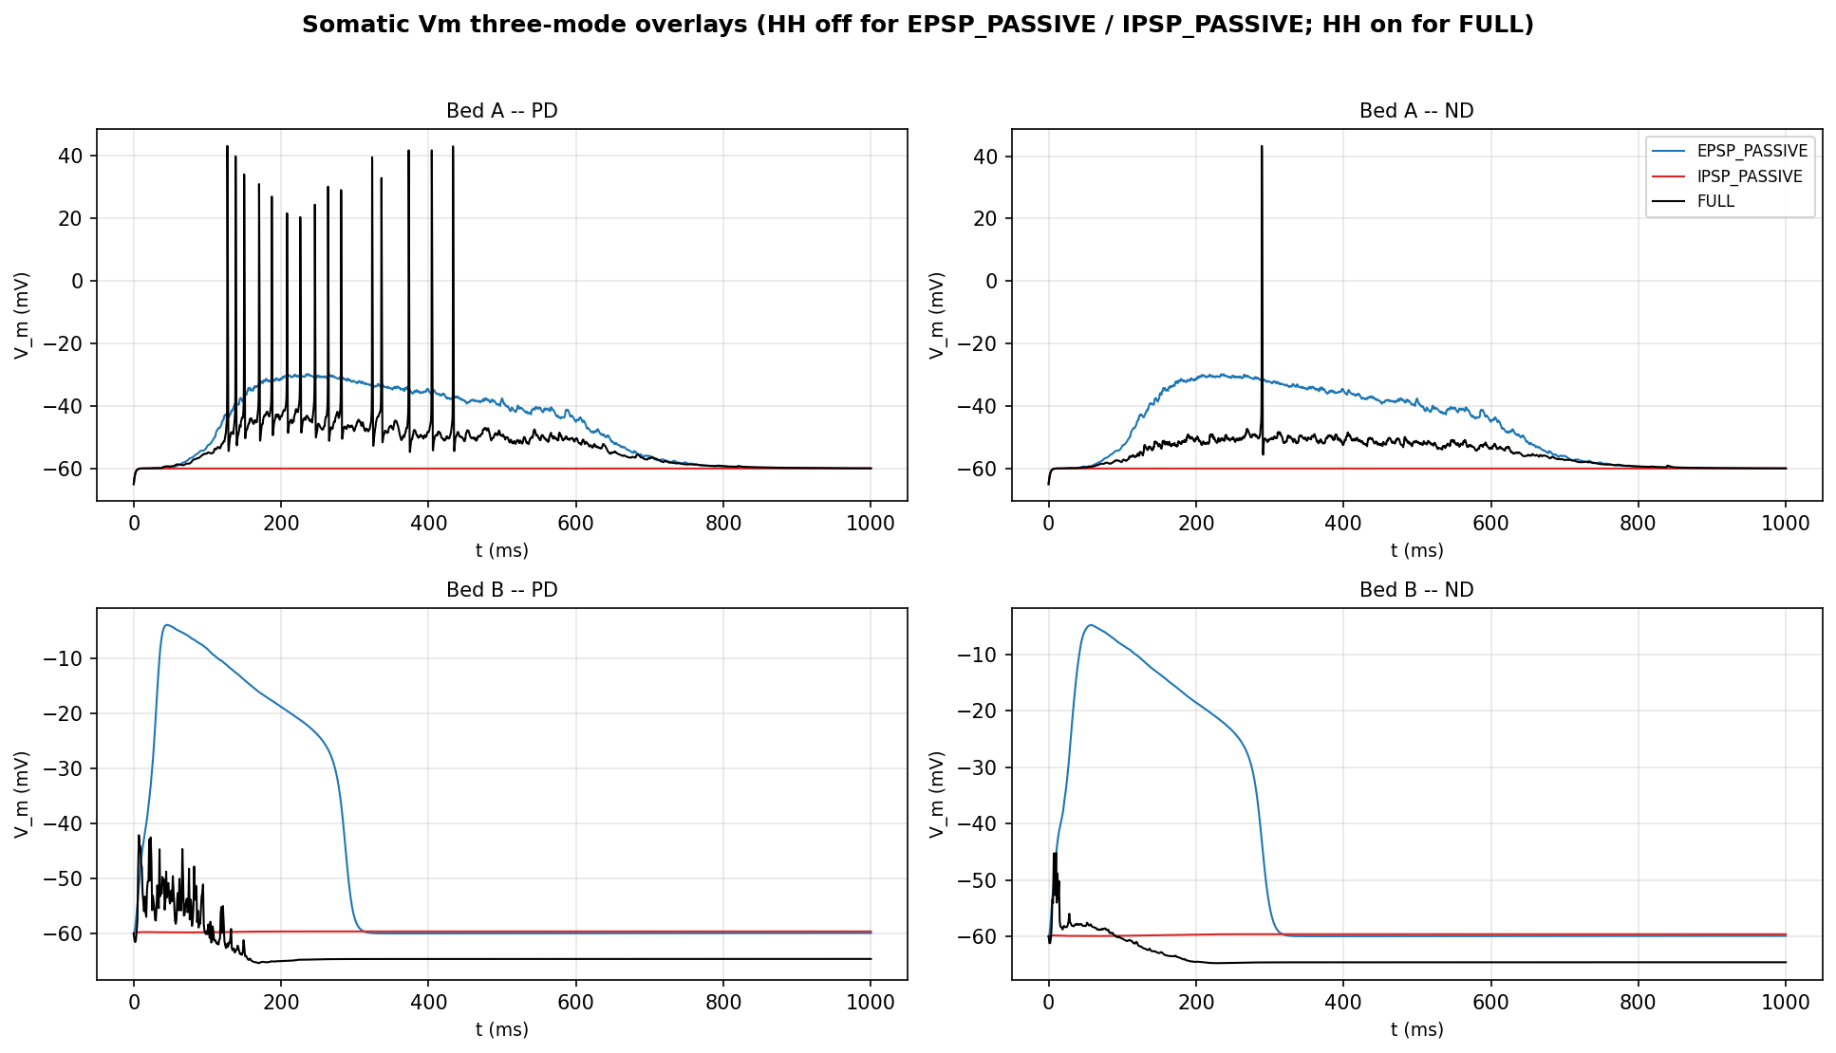
Figure 5 -- Somatic Vm three-mode overlays (2x2 bed x direction)
EPSP_PASSIVE, IPSP_PASSIVE (HH off) and FULL (HH on) overlaid for {Bed A, Bed B} x {PD, ND}.
Notes:
Source: tasks/t0065_t0020_epsp_ipsp_vm_protocol/data/voltage_traces.csv (Bed A) and tasks/t0066_t0024_epsp_ipsp_vm_protocol/data/voltage_traces.csv (Bed B). Recomposed from raw CSV for unified axes.

Slide 9
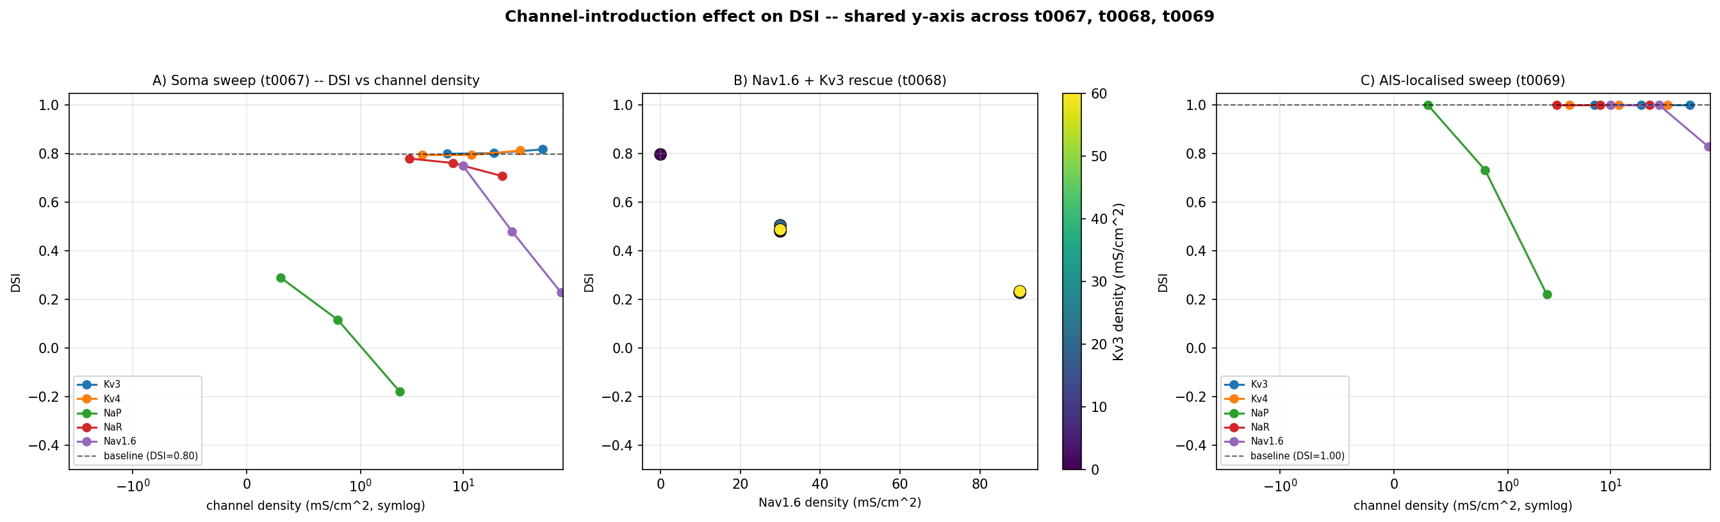
Figure 6 -- Channel-introduction effect on DSI
Unified panel combining t0067 soma sweep, t0068 Nav1.6+Kv3 rescue, and t0069 AIS-localised sweep, shared y-axis.
Notes:
Sources: tasks/t0067_t0065_soma_channel_addition_sweep/data/dsi_by_condition.json (16 conditions); tasks/t0068_t0067_nav16_kv3_coexpression_rescue/data/dsi_by_condition.json (9 conditions); tasks/t0069_t0067_ais_localised_channel_sweep/data/dsi_by_condition.json (16 conditions).

Slide 10
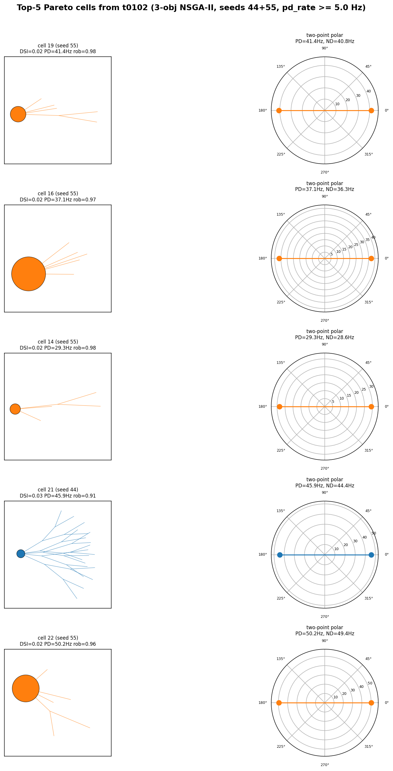
Figure 7 -- Top-5 Pareto cells (3-obj NSGA-II, t0102)
Top-5 cells by joint rank on (DSI, PD-rate, robustness) after pd_rate_hz >= 5 Hz filter; morphology + two-point polar per cell.
Notes:
Source: tasks/t0102_seedscale_n4_gen20/results/data/pareto_front_seed{44,55}.json (60 cells total). Morphology slice uses vector_68d[54:] per t0100 correction. Polar uses pd_rate_hz as PD radius and pd_rate_hz*(1-dsi) as ND radius (two-point).

Slide 11
Figure 7b -- DSI + PD 2-obj Pareto (DEFERRED)
Deferred until t0104_nsga2_2obj_dsi_pdrate_3seeds completes. A follow-up suggestion will be recorded for this panel.
Notes:
Reason for deferral: t0104 is still in_progress. The follow-up suggestion is captured in the orchestrator-written results/suggestions.json. No source data available yet.

