Slide 1

Algorithms 2018

Slide 2
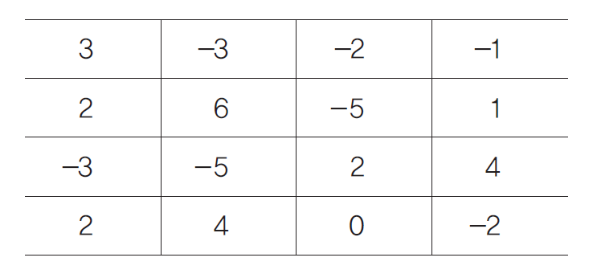
Homework #2
Consider the following 4 x 4 array.
0 1 2 3
0
1
2
3

Slide 3
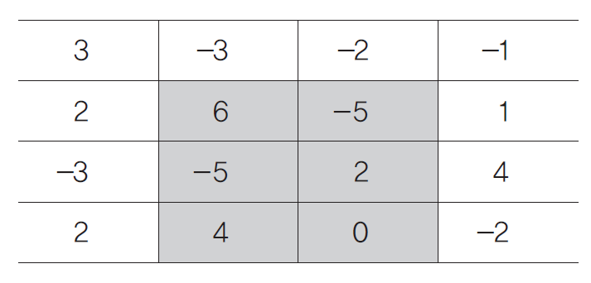
Homework #2
The sum of numbers in the following gray rectangle becomes 2 (=6-5-5+2+4+0).

Slide 4
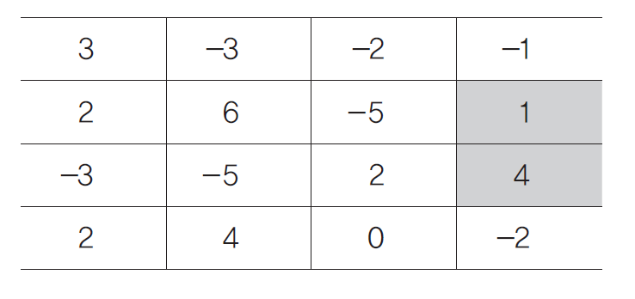
Homework #2
The sum of numbers in the following gray rectangle becomes 5 (=1+4).

Slide 5
Homework #2
The sum of numbers in the following gray rectangle becomes 8 (=2+6).

Slide 6
Homework #2
The sum of numbers in the following gray rectangle becomes -8 (=-3-5).

Slide 7
Homework #2
가장커지거나 작아지는 것을
구하시오
Given an n x n integer array, your program should find a rectangle such that the sum of numbers in the rectangle is maximized/minimized.
Your program should output the maximum/minimum summation value in the first line, and in the next line, the top-left and bottom-right positions of the rectangle that gives the maximum/minimum summation value.
Note that n is less than or equal to 1,000.

Slide 8
Homework #2
Top-left position
(i₁, j₁)
Bottom-right
position
(i₂, j₂)

Slide 9
Examples (1/4)
Input (standard/console input)
5 n
15 -3 -66 78 39 n x n input array
3 -55 1 -91 6
-65 37 -84 52 -99
37 -50 -8 9 -22
13 66 -23 58 10
Output (standard/console output)
124 Maximum summation value
(4,0) (4,4) A rectangle
… Minimum summation value
(…) (…) A rectangle

Slide 10
Examples (2/4)
Input (standard/console input)
  testcase100.txt
Output (standard/console output)
8821 Maximum summation value
(…) (…) A rectangle
… Minimum summation value
(…) (…) A rectangle

Slide 11
Examples (3/4)
Input (standard/console input)
  testcase500.txt
Output (standard/console output)
34329 Maximum summation value
(…) (…) A rectangle
… Minimum summation value
(…) (…) A rectangle

Slide 12
Examples (4/4)
Input (standard/console input)
  testcase1000.txt
Output (standard/console output)
93472 Maximum summation value
(…) (…) A rectangle
… Minimum summation value
(…) (…) A rectangle

Slide 13
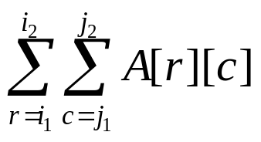
Naïve Method
O(n⁶)-time algorithm
(i₁, j₁)
(i₂, j₂)
A[ ][ ]

Slide 14
Better Method
O(n⁴)-time algorithm
(i₁, j₁)
구하고나서
위에꺼 빼고
왼쪽꺼 빼고
중복된거 더하면
저값이다
(i₂, j₂)
A[ ][ ]

Slide 15
Your Method
Design O(n³)-time algorithm
  Dynamic Programming
Cf. Section 2.6 and Problem 2.f of the auxiliary textbook.

Slide 16
Due Date
Soft deadline: May 13, 2018
Hard deadline: May 20, 2018
  But, will be deducted 10% per one day from your original score
Submission Date | Deduction Rate
May 14 | 10%
May 15 | 20%
May 16 | 30%
May 17 | 40%
May 18 | 50%
May 19 | 60%
May 20 | 70%
May 21 | 100%

Slide 17
Notice (cont’d)
You should observe the format of input & output exactly.
You should submit a compressed file (HW2_your-ID.zip) containing the following three files to the “u-campus” web-site (http://info.kw.ac.kr).
  HW2_your-ID.hwp/doc // report document
  HW2_your-ID.cpp/cc (or .java) // source code
  HW2_your-ID.exe // executable file

Slide 18
Notice (cont’d)
Source code
  It should be compiled in
    C/C++ Language: Visual Studio 2010 or higher, or g++
    Java Language: not restricted
    You should note your environment in your report.
  Your name and student ID should be noted at the top of your source files in the form of comment.
Report
  Free format.
  But, it must include several examples for testing your program and your own discussion.
  It will be an important factor for getting a good score.
  Mention your programming language together with compiler.

