Slide 1
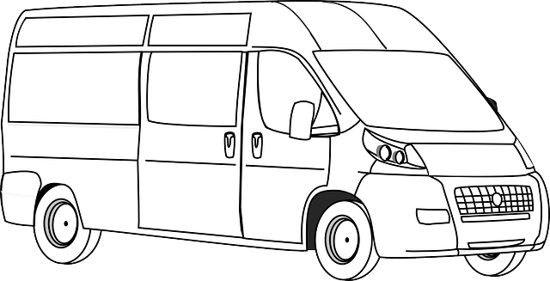
Terrestrial
Cellular
Communications
Satellite
Communications
& Navigation
Terrestrial
“Land-Line”
Communications
Terrestrial
Power
Connections

