Slide 1
Web Designing (WIT – 303) Unit -1
Mohd Vasim Ahmad
Computer Engineering Section
University Women’s Polytechnic
Aligarh Muslim University

Slide 2
Introduction to HTML
HyperText Markup Language (HTML) is the standard markup language for creating web pages and web applications.
Hypertext refers to the way in which Web pages (HTML documents) are linked together.
HTML "marks-up" a text document with tags that tells a Web browser how to structure it to display.
Originally, HTML was developed with the intent of defining the structure of documents like headings, paragraphs, lists, and so forth to facilitate the sharing of scientific information between researchers.
Now, HTML is being widely used to format web pages with the help of different tags available in HTML language.
HTML was created by Berners-Lee in late 1991 but "HTML 2.0" was the first standard HTML specification which was published in 1995.
HTML 4.01 was a major version of HTML and it was published in late 1999.
Though HTML 4.01 version is widely used but currently we are having HTML-5 version which is an extension to HTML 4.01, and this version was published in 2012.

Slide 3
Introduction to HTML
HyperText
Hypertext is the text on the screen that has references to other text on different web pages that the reader can immediately go to by just clicking on this text. These references are termed as hyperlinks.
Markup language
Markup means to structure the text in a specific format.
Markup language is a set of markup tags. HTML uses markup tags to describe web pages.
Markup language is a text-formatting language designed to transform raw text into structured documents, by inserting markup into the raw text.
Markup is what HTML do to the text inside them. They mark it as a certain type of text(like bold, italic, underline etc).
HTML is a language as it has its own code words like any other language.
Due to these reasons HTML is calles Markup language.

Slide 4
Introduction to HTML
HTML is a markup language and makes use of various tags to format the content.
These tags are enclosed within angle braces <Tag Name>.
Except few tags, most of the tags have their corresponding closing tags.
For example <html> has its closing tag </html> and <body> tag has its closing tag </body> tag etc.
<!DOCTYPE html>
<html>
<head>
<title>This is document title</title>
</head>
<body>
<h1>This is a heading</h1>
<p>Document content goes here.....</p>
</body>
</html>

Slide 5
Introduction to HTML
<!DOCTYPE...>
This tag defines the document type and HTML version.
<html>
This is the tag which defines that the document is html. This tag encloses the complete HTML document and mainly comprises of document header which is represented by <head>...</head> and document body which is represented by <body>...</body> tags.
<head>
This tag represents the document's header which can keep other HTML tags like <title>, <link>, <script>, <style>, <meta> etc.
<title>
The <title> tag is used inside the <head> tag to mention the document title. The title will be displayed on the left top corner of the browser page.
<body>
This tag represents the document's body which keeps other HTML tags like <h1>, <div>, <p> etc. Any thing we type inside the body tag will be displayed in the browser page.
<h1>
This tag represents the heading.
<p>
This tag represents a paragraph.

Slide 6
Basics of HTML
HTML stands for Hyper Text Markup Language
An HTML file is a text file containing small markup tags
The markup tags tell the Web browser how to display the page
An HTML file must have an .htm or .html file extension
All HTML documents must start with a document type declaration: <!DOCTYPE html>.
The HTML document itself begins with <html> and ends with </html>.
The visible part of the HTML document is between <body> and </body>.
HTML Headings (e.g. <h1> A Heading </h1>)
You can use different sizes for your headings. HTML also has six levels of headings, which use the elements <h1>, <h2>, <h3>, <h4>, <h5>, and <h6>.
While displaying any heading, browser adds one line before and one line after that heading.
<h1> defines the most important heading. <h6> defines the least important heading.
HTML Paragraphs (e.g. <p> Some text </p>)
The <p> tag offers a way to structure your text into different paragraphs. Each paragraph of text should go in between an opening <p> and a closing </p> tag

Slide 7
Basics of HTML
HTML Links (e.g. <a href="home.html"> My homepage </a>)
HTML links are defined with the <a> tag. The link's destination is specified in the href attribute.
HTML Images (e.g. <img src="photo.jpg">)
HTML images are defined with the <img> tag.
The source file (src), alternative text (alt), width, and height are provided as attributes.
Line Break
Whenever you use the <br /> element, anything following it starts from the next line. This tag is an example of an empty element, where you do not need opening and closing tags, as there is nothing to go in between them.
The <br /> tag has a space between the characters br and the forward slash. If you omit this space, older browsers will have trouble rendering the line break, while if you miss the forward slash character and just use <br> it is not valid in XHTML.

Slide 8
Basics of HTML
Example:
<p>Hello<br />
You delivered your assignment on time.<br />
Thanks<br />
John</p>
Centering Content
You can use <center> tag to put any content in the center of the page or any table cell.
Example:
<center>
<p>This text is in the center.</p>
</center>

Slide 9
Some Other Important Tags of HTML
Horizontal Lines
Horizontal lines are used to visually break-up sections of a document. The <hr> tag creates a line from the current position in the document to the right margin and breaks the line accordingly.
<body>
<p>This is paragraph one and should be on top</p>
<hr />
<p>This is paragraph two and should be at bottom</p>
</body>
HTML <b> Tag
The HTML <b> tag specifies bold text.
HTML <big> Tag
The HTML <big> tag increases the font size. This tag is not supported in HTML5.

Slide 10
Some Other Important Tags of HTML
HTML <div> Tag
The HTML <div> tag is used for defining a section of your document. With the div tag, you can group large sections of HTML elements together and format them with CSS.
<body>
<p>This is some text.</p>
<div style="color:#0000FF">
<h3>This is a heading in a div element</h3>
<p>This is some text in a div element.</p>
</div>
<p>This is some text.</p>
</body>

Slide 11
Some Other Important Tags of HTML
HTML <i> Tag
The HTML <i> tag is used to display the content in italic.
<body>
<p>HTML is a <i>Markup</i> language</p>
</body>
HTML <pre> Tag
The <pre> tag defines preformatted text.
Text in a <pre> element is displayed in a fixed-width font, and it preserves both spaces and line breaks.
<pre> Text in a pre element is displayed in a fixed-width font, and it preserves both spaces and line breaks </pre>

Slide 12
Tag Attributes
An HTML attribute is a modifier of an HTML element type. An attribute either modifies the default functionality of an element type or provides functionality to certain element types unable to function correctly without them. In HTML syntax, an attribute is added to an HTML start tag.
An attribute is used to define the characteristics of an HTML element and is placed inside the element's opening tag. All attributes are made up of two parts: a name and a value.
The name is the property you want to set. For example, the paragraph <p> element in the example carries an attribute whose name is align, which you can use to indicate the alignment of paragraph on the page.
The value is what you want the value of the property to be set and always put within quotations. The following example shows three possible values of align attribute: left, center and right.
<body>
<p align="left">This is left aligned</p>
<p align="center">This is center aligned</p>
<p align="right">This is right aligned</p>
</body>
The <tag> tells the browser to do something, while the attribute tells the browser how to do it.
For instance, if we add the bgcolor attribute, we can tell the browser that the background color of your page should be blue, like this: <body bgcolor="blue">.

Slide 13
Core Attributes
There are four core attributes that can be used on the majority of HTML elements :
id
title
class
style
Id attribute
The id attribute of an HTML tag can be used to uniquely identify any element within an HTML page.
<p id="html">This para explains what is HTML</p>
<p id="css">This para explains what is Cascading Style Sheet</p>
Title attribute
The title attribute gives a suggested title for the element. They syntax for the title attribute is similar as explained for id attribute:
<h3 title="Hello HTML!">Titled Heading Tag Example</h3>

Slide 14
Core Attributes
Class attribute
The class attribute is used to associate an element with a style sheet, and specifies the class of element.
Style attribute
The style attribute allows you to specify Cascading Style Sheet (CSS) rules within the element.
<body>
<p style="font‐family:arial; color:#FF0000;">Some text...</p>
</body>

Slide 15
Container & Empty Tags
Container Tags
Most HTML elements or components are containers, meaning they have a start tag and an end tag.
The text enclosed within the tags follows the tag's instructions.
In the following example, the <i> container tags make the enclosed text italic:
The weather is <i>gorgeous</i> today.
<html> is the opening tag, </html> is the closing tag
<a href=""> is the opening tag, </a> is the closing tag (closing is required)
Empty ("Standalone") Tags
The tags that don’t need to be closed with </> command is called an empty tag.
For example <img src=“”>, <br>, <hr> are the empty tags they don’t need to be closed with </ > command.

Slide 16
Logical & Physical Tags
A tag that is applied to an individual character is known as a character tag. A character tag can be grouped into two categories: physical and logical.
Physical Tags
Physical tags provide specific instructions on how to display the text they enclose. Examples of physical tags include:
<b> : Makes the text bold.
<big> : Makes the text usually one size bigger than what's around it.
<font> : Used to apply a font-face (like Arial or Helvetica) and font-color.
<i> : Makes text italic.
<small>: Defines small text
<sup> : Defines superscripted text
<sub> : Defines subscripted text
Physical tags are more straightforward; <i> makes the text italic, <b> makes text bold and <font> is used to set the font face and color for the text.

Slide 17
Logical & Physical Tags
Logical Tags
Logical tags are designed to describe (to the browser) the enclosed text's meaning.
An example of a logical tag is the <strong> </strong> tag.
By placing text in between these tags you are telling the browser that the text has some greater importance.
By default all browsers make the text appear bold when in between the <strong> and </strong> tags, but the point to take away from this is that the strong tag implies that importance of that text.
This has impact with search engines like Google who look for such tags to help figure out what the page is about.
<strong> : Defines strong text
<em> : Defines emphasized text

Slide 18
Block Level & Text Level (Inline) Elements
Block Level Elements
Block level elements format blocks of text. They take up 100% of the available width, with line breaks before and after each element.
Block level elements can be introduced into other block level elements, but they cannot be introduced into inline elements without causing a disturbance.
Block level elements are most commonly used to create headings, paragraphs, page divisions, lists and tables, but are not limited to these choices.
By default, block level elements begin on new lines and create larger structures (than inline elements).
Examples
p
h1, h2, h3, h4, h5, h6
ol, ul
pre
div
form
table

Slide 19
Block Level & Text Level (Inline) Elements
Inline Elements
In contrast to a block level element, an inline element can:
Begin within a line
Does not start a new line
Its width only extends as far as it is defined by its tags
It can contain data and other inline elements.
Inline elements create shorter structures (than block level elements).
An example of an inline element is the <strong> tag, which makes the font of the text content contained within boldface.
Examples
<b> </b>
<big> </big>
<i> </i>
<small> </small>

Slide 20
Grouping HTML Elements
There are two important tags which we use very frequently to group various other HTML tags
<div> tag
<span> tag
The <div> tag
This is the very important block level tag which plays a big role in grouping various other HTML tags and applying CSS on group of elements.
Even <div> tag can be used to create webpage layout where we define different parts ( Left, Right, Top etc) of the page using <div> tag.
This tag does not provide any visual change on the block but this has more meaning when it is used with CSS.
The <span> tag
The HTML <span> is an inline element and it can be used to group inline elements in an HTML document. This tag also does not provide any visual change on the block but has more meaning when it is used with CSS.
The difference between the <span> tag and the <div> tag is that the <span> tag is used with inline elements where as the <div> tag is used with block level elements.

Slide 21
Example: <div> tag
<body>
<div style="color:red">
<h4>This is first group</h4>
<p>Following is a list of vegetables</p>
<ul>
<li>Beetroot</li>
<li>Ginger</li>
</ul>
</div>
<div style="color:green">
<h4>This is second group</h4>
<p>Following is a list of fruits</p>
<ul>
<li>Apple</li>
<li>Banana</li>
</ul>
</div>
</body>

Slide 22
Example: <span> tag
<!DOCTYPE html>
<html>
<head>
<title>HTML span Tag</title>
</head>
<body>
<p>This is <span style="color:red">red</span> and this is <span style="color:green">green</span></p>
</body>
</html>

Slide 23
Emphasizing Text Implicitly and Explicitly
Explicit tags are also often called physical tags, since they very specifically tell the Web browser how you want the text to physically appear. The browser is given no choice in the matter.
The basic explicit tags are containers that let the user mark text as bold, italic, or underlined.
With these tags, the browser really has no choice, it must either display the text as defined or, if it can't do that, then it must add no emphasis to the text.
Implicit styles are often called logical styles, since they allow the browser some freedom in how it will display the text.

Slide 24
HTML Lists: Introduction
HTML Lists are used to group related pieces of information together, so they are clearly associated with each other and easy to read.
Lists are good from a structural point of view as they help create a well-structured, more accessible, easy-to-maintain document.
There are three types of list in HTML
Unordered List — Used to group a set of related items, in no particular order.
Ordered List — Used to group a set of related items, in a specific order.
Description List — This arranges your items in the same way as they are arranged in a dictionary.

Slide 25
HTML Lists: Unordered List
An unordered list is a collection of related items that have no special order or sequence.
Unordered lists should be used when rearranging the order of the list items would not create confusion or change the meaning of the information on the list.
The <ul> element opens and </ul>closes an unordered list.
The items on the list are contained between list item, <li> </li>, tags.
This will produce following result:
Beetroot
Ginger
Potato
Radish
<!DOCTYPE html>
<html>
<head>
<title>Unordered List</title>
</head>
<body>
<ul>
<li>Beetroot</li>
<li>Ginger</li>
<li>Potato</li>
<li>Radish</li>
</ul>
</body>
</html>

Slide 26
HTML Lists: Unordered List
You can use type attribute for <ul> tag to specify the type of bullet you like. By default it is a disc. Following are the possible options:
<ul type="square">
<ul type="disc">
<ul type="circle">
<!DOCTYPE html>
<html>
<head>
<title>HTML Unordered List</title>
</head>
<body>
<ul type="square">
<li>Beetroot</li>
<li>Ginger</li>
<li>Potato</li>
<li>Radish</li>
</ul>
</body>
</html>
This will produce following result:
Beetroot
Ginger
Potato
Radish

Slide 27
HTML Lists: Ordered List
If you are required to put your items in a numbered list instead of bulleted then HTML ordered list will be used. This list is created by using <ol> tag. The numbering starts at one and is incremented by one for each successive ordered list element tagged with <li>.
<!DOCTYPE html>
<html>
<head>
<title>HTML Ordered List</title>
</head>
<body>
<ol>
<li>Beetroot</li>
<li>Ginger</li>
<li>Potato</li>
<li>Radish</li>
</ol>
</body>
</html>
This will produce following result:
Beetroot
Ginger
Potato
Radish

Slide 28
HTML Lists: Ordered List
You can use type attribute for <ol> tag to specify the type of numbering you like. By default it is a number. Following are the possible options:
<ol type="1"> ‐ Default‐Case Numerals.
<ol type="I"> ‐ Upper‐Case Numerals.
<ol type="i"> ‐ Lower‐Case Numerals.
<ol type="a"> ‐ Lower‐Case Letters.
<ol type="A"> ‐ Upper‐Case Letters.
This will produce following result:
Beetroot
Ginger
Potato
Radish
<!DOCTYPE html>
<html>
<head>
<title>HTML Ordered List</title>
</head>
<body>
<ol type="I">
<li>Beetroot</li>
<li>Ginger</li>
<li>Potato</li>
<li>Radish</li>
</ol>
</body>
</html>

Slide 29
HTML Lists: Ordered List
You can use start attribute for <ol> tag to specify the starting point of numbering you need.
Following are the possible options:
<ol type="1" start="4"> ‐ Numerals starts with 4.
<ol type="I" start="4"> ‐ Numerals starts with IV.
<ol type="i" start="4"> ‐ Numerals starts with iv.
<ol type="a" start="4"> ‐ Letters starts with d.
<ol type="A" start="4"> ‐ Letters starts with D.
This will produce following result:
iv. Beetroot
v. Ginger
vi. Potato
vii. Radish
<!DOCTYPE html>
<html>
<head>
<title>HTML Ordered List</title>
</head>
<body>
<ol type=“i“ start=“4”>
<li>Beetroot</li>
<li>Ginger</li>
<li>Potato</li>
<li>Radish</li>
</ol>
</body>
</html>

Slide 30
HTML Lists: Definition/Description List
HTML support a list style which is called definition lists where entries are listed like in a dictionary. The definition list is the ideal way to present a glossary, list of terms, or other name/value list.
Definition List makes use of following three tags.
<dl> Defines the start of the list
<dt> A term
<dd> Term definition
</dl> Defines the end of the list
This will produce following result:
HTML
This stands for Hyper Text Markup Language
HTTP
This stands for Hyper Text Transfer Protocol
<!DOCTYPE html>
<html>
<head>
<title>HTML Definition List</title>
</head>
<body>
<dl>
<dt><b>HTML</b></dt>
<dd>This stands for Hyper Text Markup Language</dd>
<dt><b>HTTP</b></dt>
<dd>This stands for Hyper Text Transfer Protocol</dd>
</dl>
</body>
</html>

Slide 31
HTML Lists: Definition/Description List
HTML support a list style which is called definition lists where entries are listed like in a dictionary. The definition list is the ideal way to present a glossary, list of terms, or other name/value list.
Definition List makes use of following three tags.
<dl> Defines the start of the list
<dt> A term
<dd> Term definition
</dl> Defines the end of the list
This will produce following result:
HTML
This stands for Hyper Text Markup Language
HTTP
This stands for Hyper Text Transfer Protocol
<!DOCTYPE html>
<html>
<head>
<title>HTML Definition List</title>
</head>
<body>
<dl>
<dt><b>HTML</b></dt>
<dd>This stands for Hyper Text Markup Language</dd>
<dt><b>HTTP</b></dt>
<dd>This stands for Hyper Text Transfer Protocol</dd>
</dl>
</body>
</html>

Slide 32
HTML Lists: Nested List
A list item can contain another entire list — this is known as "nesting" a list. It is useful for things like tables of contents.
One feature that makes lists extremely powerful is their ability to be nested. Every list may be placed within another list; they can be nested continually.
This will produce following result:
1. Chapter One
1. Section One
2. Section Two
3. Section Three
2. Chapter Two
3. Chapter Three
<ol>
<li>Chapter One
<ol>
<li>Section One</li>
<li>Section Two </li>
<li>Section Three </li>
</ol>
</li>
<li>Chapter Two</li>
<li>Chapter Three </li>
</ol>

Slide 33
HTML Lists: Menu List
The HTML <menu> tag is used for creating a menu list. This tag has been deprecated in HTML and redefined in HTML5.
<menu>
<li>ol - ordered list</li>
<li>ul - unordered list</li>
<li>dir - directory list</li>
<li>menu - menu list</li>
</menu>
This will produce following result:
ol - ordered list
ul - unordered list
dir - directory list
menu - menu list

Slide 34
HTML Lists: Directory List
The HTML <dir> tag is used for specifying a directory list. This is very similar to <ul> tag but now this is deprecated.
<dir>
<li>dir</li>
<li>menu</li>
<li>ul</li>
</dir>
This will produce following result:
dir
menu
ul

Slide 35
Graphics for Web Pages
The Web is about more than text and information, it is also a medium for expressing creativity, data visualization, and optimizing the presentation of information with different needs and expectations.
Web graphics are visual representations used on a Web site to enhance the representation of information in graphics format.
Examples of graphics include maps, photographs, designs and patterns, diagrams, bar charts and pie charts, line art, flowcharts, and many other image forms.
Graphics are used for everything from enhancing the appearance of Web pages to serving as the presentation for full-fledged Web Applications.

Slide 36
How to add graphics to a web page?
Different use cases for graphics demand different solutions, thus there are several different technologies available.
Using <img> Tag (GIF Image)
Using <marquee> Tag
Using <img> Tag
Graphics can be placed on web pages using the <img> element. Note that the <img> element is an empty element, i.e. no content appears between the start and end tags, and hence <img >only requires a start tag.
The 'content‘ is your graphic file, the name of which is used as a value in the src attribute.
The most fundamental syntax for adding a graphic in a web page uses the <img> element with just the src attribute: <img src="filename.ext">

Slide 37
Using <img> Tag (GIF Image)
GIF (Graphic Interchange Format)
The CompuServe Information Service popularized the Graphic Interchange Format (GIF) in the 1980s as an efficient means to transmit images across data networks.
In the early 1990s the original designers of the World Wide Web adopted GIF for its efficiency and widespread familiarity.
Many images on the web are in GIF format, and virtually all web browsers that support graphics can display GIF files.
GIF files incorporate a “lossless” compression scheme to keep file sizes at a minimum without compromising quality. However, GIF files are 8-bit graphics and thus can only accommodate 256 colors.

Slide 38
Using <marquee> Tag
An HTML marquee is a scrolling piece of text or image displayed either horizontally across or vertically down a webpage, depending on the settings.
This kind of graphics can be created by using HTML <marquees> tag.
The HTML <marquee> tag may not be supported by various browsers so its not recommended to rely on this tag, instead you can use JavaScript and CSS to create such effects.

Slide 39
Using <marquee> Tag : Example
Upside Text Scrolling
<marquee behavior="scroll" direction="up">Upside Text Scrolling</marquee>
Marquee Text Scrolling Speed
<marquee behavior="scroll" direction="left" scrollamount="3">Slow Speed scroll speed</marquee>
<marquee behavior="scroll" direction=“right" scrollamount="10">Medium Speed scroll speed</marquee>
<marquee behavior="scroll" direction=“down" scrollamount="17">Fast Speed scroll speed</marquee>
Side Touch Margin Bounce Text
<marquee behavior="alternate" direction="left">Side Touch Margin Bounce Text</marquee>

Slide 40
Using <marquee> Tag : Example
Upside Image Scrolling
<marquee behavior="scroll" direction="up"><img src="../jix/img_nat.png" width="120“ height="80" alt="Natural" /></marquee>
Click to Stop Marquee
<marquee behavior="scroll" direction="left" onmousedown="this.stop();“ onmouseup="this.start();">Click Here and hold the mouse marquee stop</marquee>

Slide 41
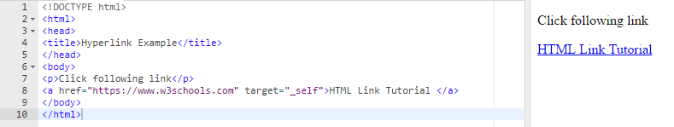
HTML Links
A webpage can contain various links that take you directly to other pages and even specific parts of a given page. These links are known as hyperlinks.
Hyperlinks allow visitors to navigate between Web sites by clicking on words, phrases, and images. Thus you can create hyperlinks using text or images available on a webpage.
A link is specified using HTML tag <a> </a>.
This tag is called anchor tag and anything between the opening <a> tag and the closing </a> tag becomes part of the link and a user can click that part to reach to the linked document.
Following is the simple syntax to use <a> tag.

Slide 42
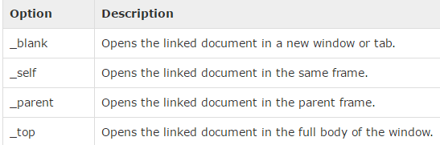
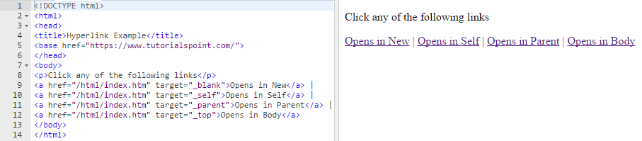
HTML Links
The target attribute is used to specify the location where linked document is opened.
Following are possible options:

Slide 43
HTML Links: Absolute & Relative URLs
Every document on the Web has a unique address. This address is known as Uniform Resource Locator (URL).
A URL is made of up several parts, each of which offers information to the web browser to help find the page.
It is easier to learn the parts of a URL, there are three key parts: the scheme, the host address, and the file path.
The scheme identifies the type of protocol and URL you are linking to.
For example, most web browsers use Hypertext Transfer Protocol (HTTP) to pass information to communicate with the web servers and this is the reason a URL starts with http:// or https://.
The host address is where a website can be found, either the IP address (for example 68.178.157.132 ) or more commonly the domain name for a site such as www.amu.ac.in
The file-path always begins with a forward slash character, and may consist of one or more directory or folder names. Each directory name is separated by forward slash characters and the file-path may end with a filename at the end. For example, www.amu.ac.in/about.php

Slide 44
HTML Links: Absolute & Relative URLs
You may address a URL in one of the following two ways:
Absolute URL
An absolute URL is the complete address of a resource.
For example, https://www.amu.ac.in.com/html/html_text_links.htm
Relative URL
A relative URL indicates where the resource is in relation to the current page. Given URL is added with the <base> element to form a complete URL. For example /html/html_text_links.htm

Slide 45
HTML Tables
The HTML table allows web designers to arrange data ( text, preformatted text, images, links, forms, form fields, other tables, etc. ) into rows and columns of cells.
The HTML tables are created using the <table> tag in which the <tr> tag is used to create table rows and <td> tag is used to create data cells.
A table header is defined with the <th> tag. By default, table headings are bold and centered.
<table style="width:100%">
<tr>
<th>Firstname</th>
<th>Lastname</th>
</tr>
<tr>
<td>Jill</td>
<td>Smith</td>
</tr>
<tr>
<td>Eve</td>
<td>Jackson</td>
</tr>
</table>

Slide 46
HTML Table - Adding a Border
If you do not specify a border for the table, it will be displayed without borders. A border is set using the CSS border property:
<head>
<style>
table, th, td {
border: 1px solid black;
}
</style>
</head>
If you want the borders to collapse into one border, add the CSS border-collapse property:
table, th, td {
border: 1px solid black;
border-collapse: collapse;
}

Slide 47
HTML Table – Colspan and Rowspan Attributes
You will use colspan attribute if you want to merge two or more columns into a single column. Similar way you will use rowspan if you want to merge two or more rows.

Slide 48
HTML Table – Cell Padding & Cell Spacing
There are two attributes called cellpadding and cellspacing which you will use to adjust the white space in your table cells. The cellpadding is used to set extra space which is used to separate cell walls from their contents. But in contrast cellspacing is used to set space between cells.

Slide 49
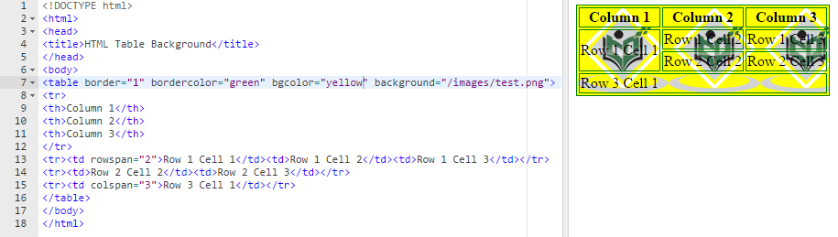
HTML Table – Backgrounds
You can set table background using one of the following two ways:
bgcolor attribute You can set background color for whole table or just for one cell.
background attribute You can set background image for whole table or just for one cell.
You can also set border color also using bordercolor attribute.

Slide 50
HTML Frames
HTML frames are used to divide your browser window into multiple sections where each section can load a separate HTML document.
A collection of frames in the browser window is known as a frameset.
The window is divided into frames in a similar way the tables are organized: into rows and columns.
To use frames on a page we use <frameset> tag instead of <body> tag.
The <frameset> tag defines how to divide the window into frames.
The rows attribute of <frameset> tag defines horizontal frames and cols attribute defines vertical frames.
Each frame is indicated by <frame> tag and it defines which HTML document shall open into the frame.

Slide 51
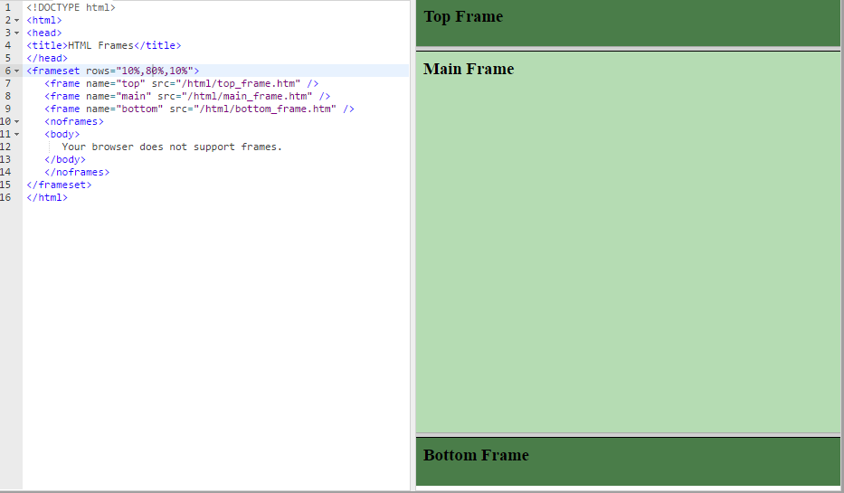
HTML Frames: Example (Horizontal Frames)

Slide 52
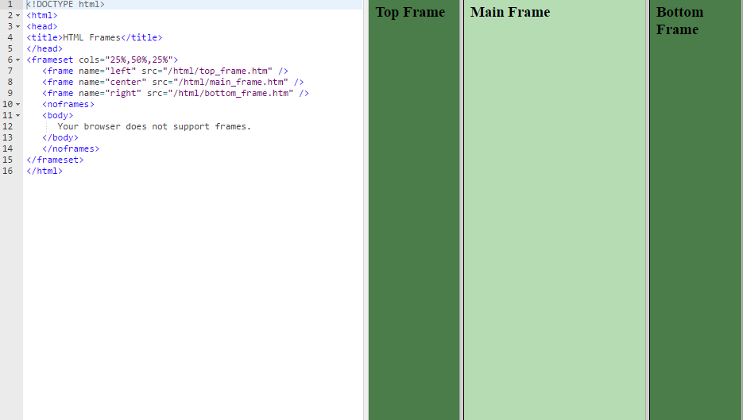
HTML Frames: Example (Vertical Frames)

Slide 53
HTML Frames : <frameset> Tag Attributes

Slide 54
HTML Frames : <frame> Tag Attributes

Slide 55
HTML Forms
HTML Forms are required, when you want to collect some data from the website user. For example, during user registration you would like to collect information such as name, email address, credit card, etc.
A form will take input from the user and then will post it to a back-end application such as PHP script. The back-end application will perform required processing on the passed data based on defined business logic inside the application.
There are various form elements available like text fields, text-area fields, drop-down menus, radio buttons, checkboxes, etc.
The HTML <form> tag is used to create an HTML form and it has following syntax:
<form action="Script URL" method="GET|POST">
form elements like input, text-area etc.
</form>

Slide 56
HTML Form Attributes
Attribute | Description
Action | Specifies a URI/URL of the backend script that will process the form inputs
method | Specifies the HTTP method to use when the form is submitted. Possible values: GET (the form data is appended to the URL when submitted) POST (the form data is not appended to the URL)
enctype | You can use the enctype attribute to specify how the browser encodes the data before it sends it to the server. Possible values are: application/x-www-form-urlencoded - This is the standard method most forms use in simple scenarios. mutlipart/form-data - This is used when you want to upload binary data in the form of files like image, word file etc.

Slide 57
HTML Form Controls
There are different types of form controls that you can use to collect data using HTML form:
Text Input Controls
Checkboxes Controls
Radio Box Controls
Select Box Controls
Clickable Buttons
Submit and Reset Button

Slide 58
HTML Form Controls: Text Input Controls
There are three types of text input used on forms:
Single-line text input controls
This control is used for items that require only one line of user input, such as search boxes or names. They are created using HTML <input> tag.
Password input controls
This is also a single-line text input but it masks the character (replace characters by *) as soon as a user enters it. They are also created using HTMl <input> tag.
Multi-line text input controls
This is used when the user is required to give details that may be longer than a single sentence. Multi-line input controls are created using HTML <textarea> tag.
Example 1 (Single Line text input controls) :
<body>
<form >
First name: <input type="text" name="first_name" />
<br>
Last name: <input type="text" name="last_name" />
</form>
</body>

Slide 59
HTML Form Controls: Text Input Controls
Example 2 (Password input controls)
<body>
<form >
User ID : <input type="text" name="user_id" />
<br>
Password: <input type="password" name="password" />
</form>
</body>
Attribute | Description
type | Indicates the type of input control and for text/password input control it will be set to text/password.
name | Used to give a name to the control which is sent to the server to be recognized and get the value.
value | This can be used to provide an initial value inside the control.
size | Allows to specify the width of the text-input control in terms of characters.
maxlength | Allows to specify the maximum number of characters a user can enter into the text box.

Slide 60
HTML Form Controls: Text Input Controls
Example 3 (Multiline input controls)
<body>
<form>
Description: <br />
<textarea rows="5" cols="50" name="description"> Enter description here... </textarea>
</form>
</body>
Attribute | Description
name | Used to give a name to the control which is sent to the server to be recognized and get the value.
rows | Indicates the number of rows of text area box.
cols | Indicates the number of columns of text area box.

Slide 61
HTML Form Controls: Checkbox Controls
Checkboxes are used when more than one option is required to be selected. They are also created using HTML <input> tag but type attribute is set to checkbox.
Example
<body>
<form>
<input type="checkbox" name="maths" value="on"> Maths
<input type="checkbox" name="physics" value="on"> Physics
</form>
</body>
Attribute | Description
type | Indicates the type of input control and for checkbox input control it will be set to checkbox.
name | Used to give a name to the control which is sent to the server to be recognized and get the value.
value | The value that will be used if the checkbox is selected.
checked | Set to checked if you want to select it by default.

Slide 62
HTML Form Controls: Radio Button Controls
Radio buttons are used when out of many options, just one option is required to be selected. They are also created using HTML <input> tag but type attribute is set to radio.
Example
<body>
<form>
<input type="radio" name="subject" value="maths"> Maths
<input type="radio" name="subject" value="physics"> Physics
</form>
</body>
Attribute | Description
type | Indicates the type of input control and for radio button input control it will be set to radio.
name | Used to give a name to the control which is sent to the server to be recognized and get the value.
value | The value that will be used if the radio button is selected.
checked | Set to checked if you want to select it by default.

Slide 63
HTML Form Controls: Select Box Controls
A select box, also called drop down box which provides option to list down various options in the form of drop down list, from where a user can select one or more options.
Example
<form>
<select name="dropdown">
<option value="Maths" selected>Maths</option>
<option value="Physics">Physics</option>
</select>
</form>
Attribute | Description
name | Used to give a name to the control which is sent to the server to be recognized and get the value.
multiple | If set to "multiple" then allows a user to select multiple items from the menu.
value | The value that will be used if an option in the select box is selected.
selected | Specifies that this option should be the initially selected value when the page loads.

Slide 64
HTML Form Controls: Button Controls
There are various ways in HTML to create clickable buttons. You can also create a clickable button using <input> tag by setting its type attribute to button.
Example
<form>
<input type="submit" name="submit" value="Submit" />
<input type="reset" name="reset" value="Reset" />
<input type="button" name="ok" value="OK" />
<input type="image" name="imagebutton" src="/html/images/logo.png" />
</form>
Type | Description
submit | This creates a button that automatically submits a form.
reset | This creates a button that automatically resets form controls to their initial values.
button | This creates a button that is used to trigger a client-side script when the user clicks that button.
image | This creates a clickable button but we can use an image as background of the button.

