Slide 1




























Culture Day 2015
C U @ Culture Day
26. 6. 2015

Slide 2
Klasseneinteilung:
 | 8:50-9:40 | 9:50-10:40 | 10:40-11:30 | 11:40-12:30
1AFEL |  |  | Breakfast 11 Foto 0 / Quiz 0 / Tanzen 9 | Breakfast 9 Foto 7 / Quiz 4
2AFEL | Foto 3 / Quiz 10 | Breakfast 13
3AFEL | Foto 6 / Quiz 13 | Breakfast 19
1AHEL | Breakfast 30 | Foto 0 / Quiz 11 / Tanzen 19
1BHEL |  |  | Breakfast 28 Foto 0 / Quiz 0 / Tanzen 2 | Breakfast 2 Foto 9 / Quiz 19
2AHEL | Foto 4 / Quiz 5 | Breakfast 9
2BHEL |  |  | Foto 1 / Quiz 9 / Tanzen 1 | Breakfast 11
3AHEL | Foto 6 / Quiz 7 | Breakfast 13
3BHEL |  |  | Foto 5 / Quiz 3 / Tanzen 1 | Breakfast 9
4AHEL |  |  | Foto 0 / Quiz 12 / Tanzen 2 | Breakfast 14
4BHEL | Breakfast 14 | Foto 3 / Quiz 11
4AKELI | Breakfast 9 | Foto 4 / Quiz 5

Slide 3
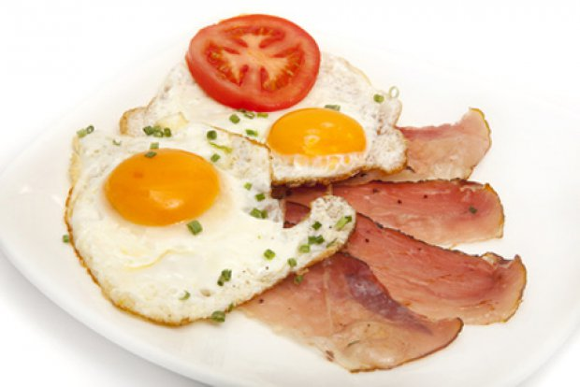
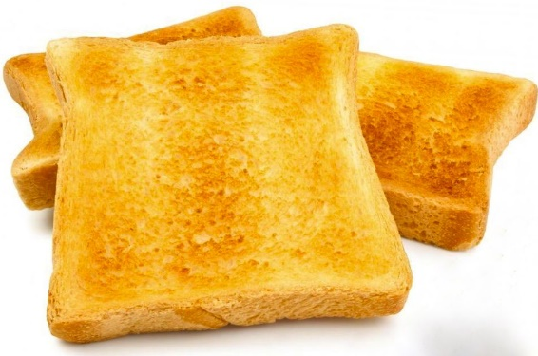
Culture Day 2015
Raum 019
English Breakfast

Slide 4
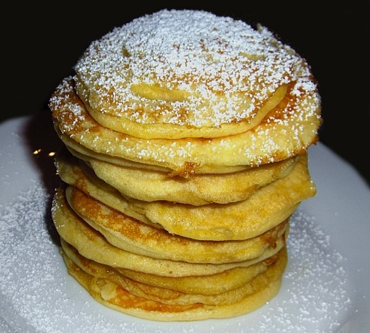

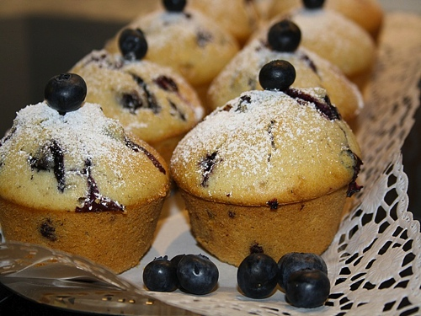
Culture Day 2015
Raum 018
American Breakfast

Slide 5


Culture Day 2015
Raum 013
Fotowettbewerb
und
Quizrallye

Slide 6
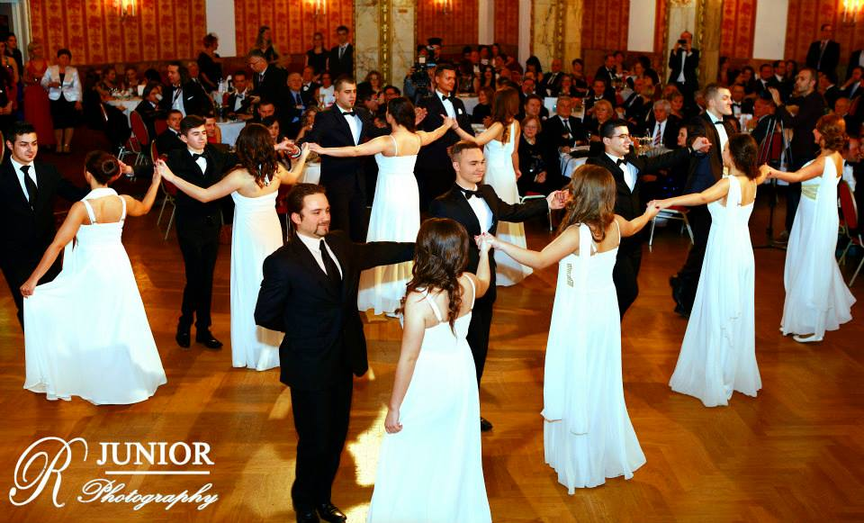
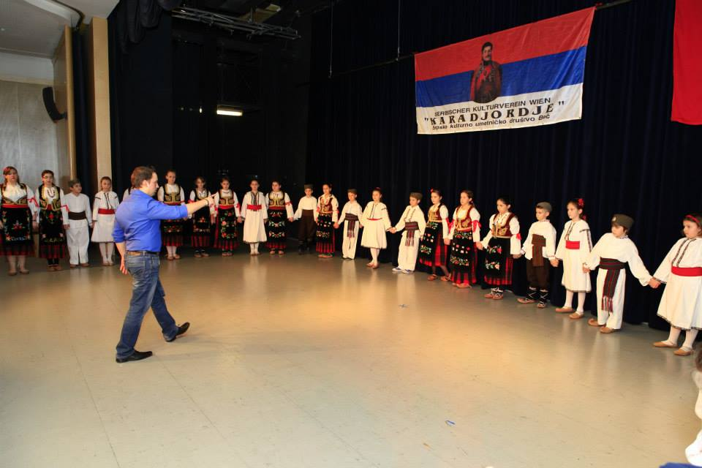
Culture Day 2015
Raum 017
Tanz – Workshop: Serbische Folklore

