Slide 1

BADMINTON
Presentation by Tobias Scharsching

Slide 2
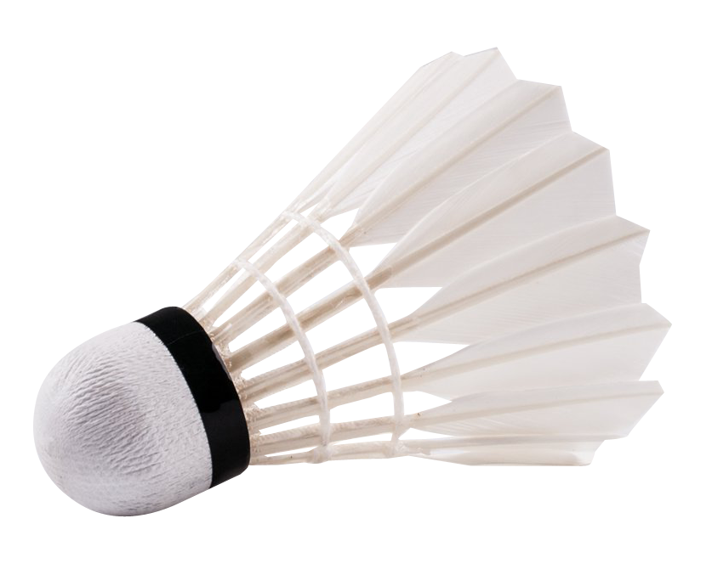
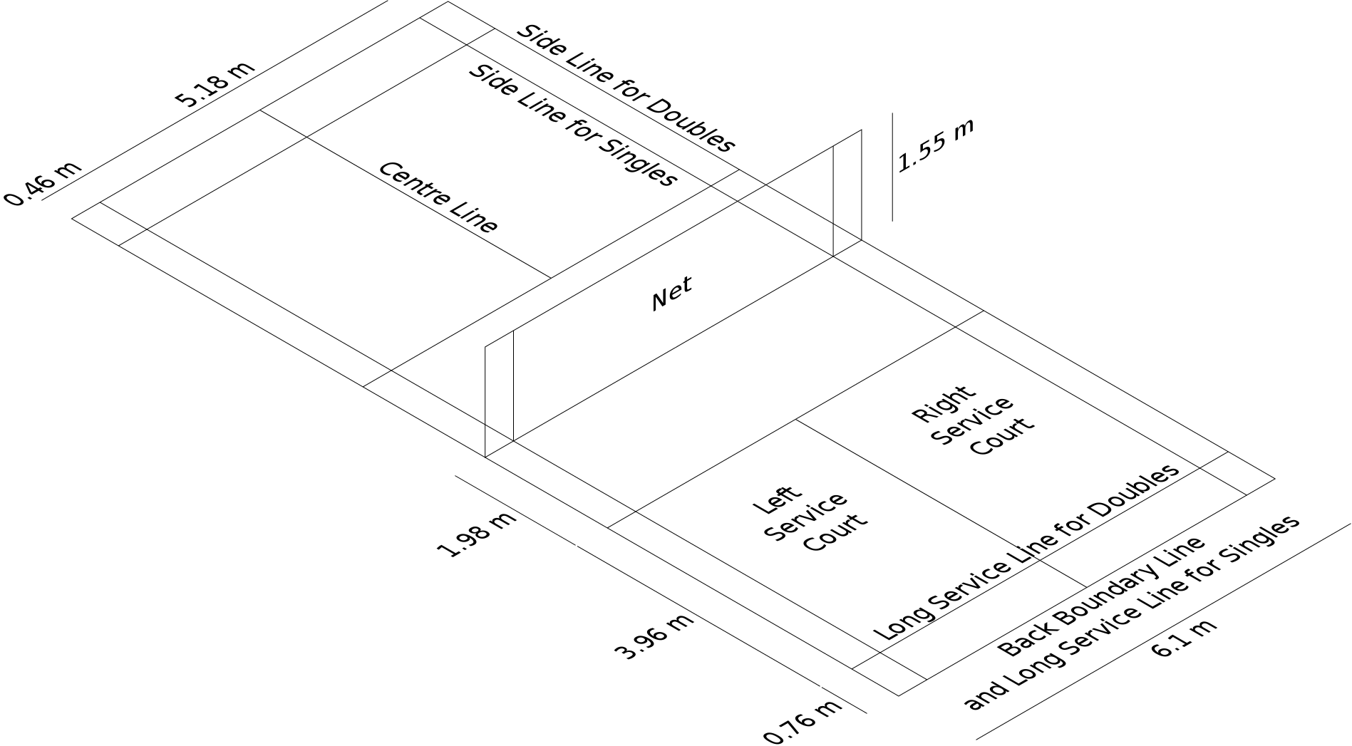
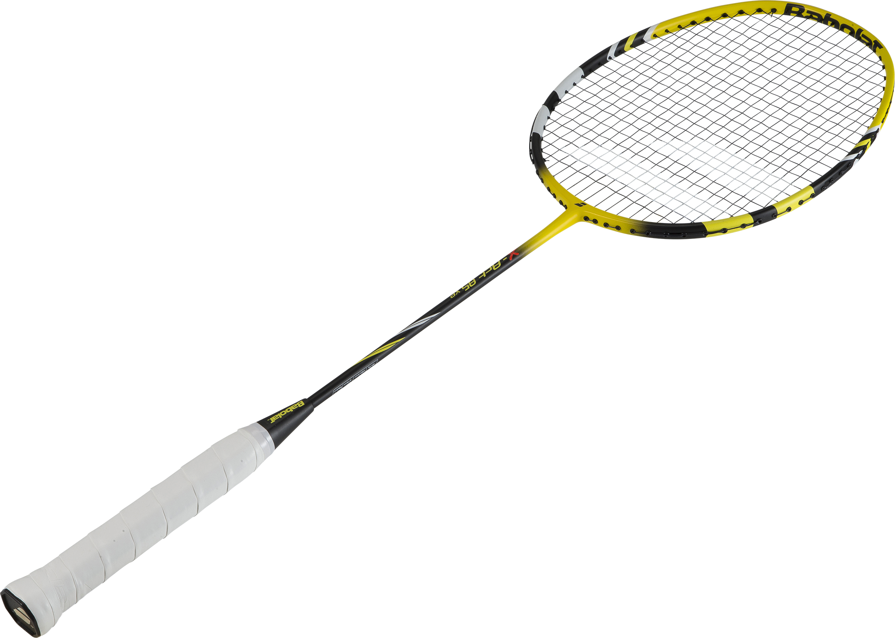
Equipment and Badminton Court
Shuttlecock
Racket

Slide 4
Score:
19:20
20:20
21:20
21:21
22:21
23:21
Ends at 21 points
Ends at 22 points
Ends at 22 points
Ends at 23 points
Ends at 23 points
Player with 23 points won

Slide 6

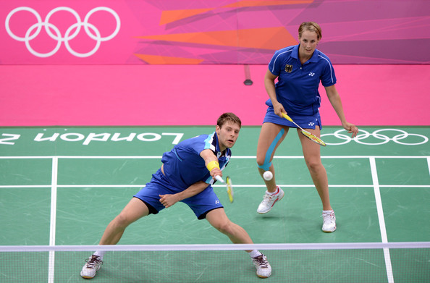
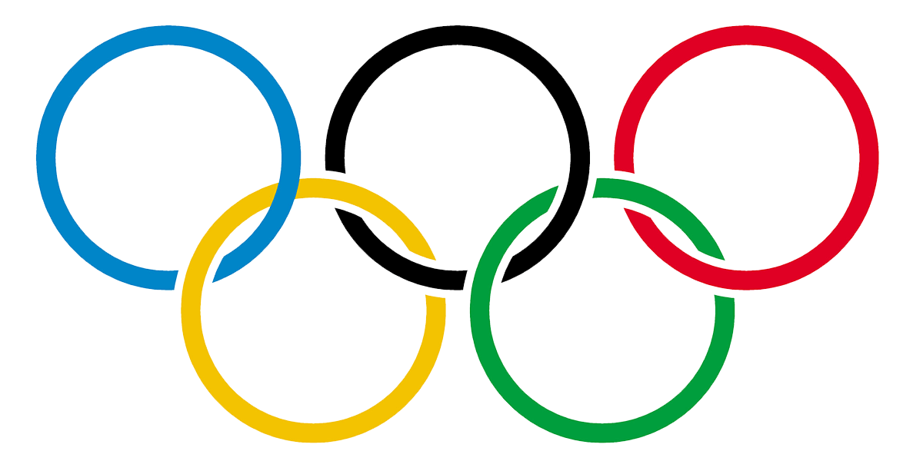
Leagues
Olympic games
Tournaments organized by the Badminton World Federation

Slide 7
Sources:
Wikipedia
https://en.wikipedia.org/wiki/Badminton
My Brain

