Slide 1
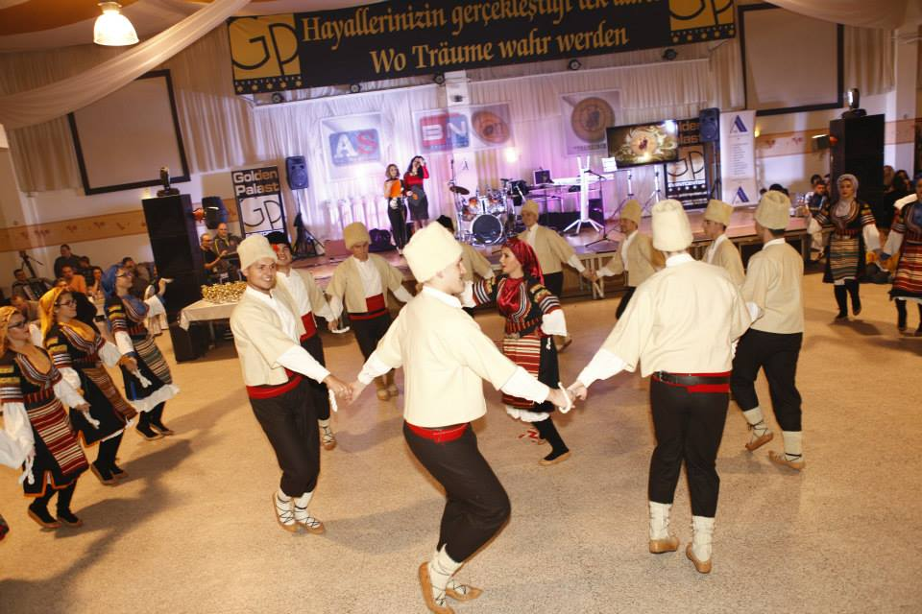
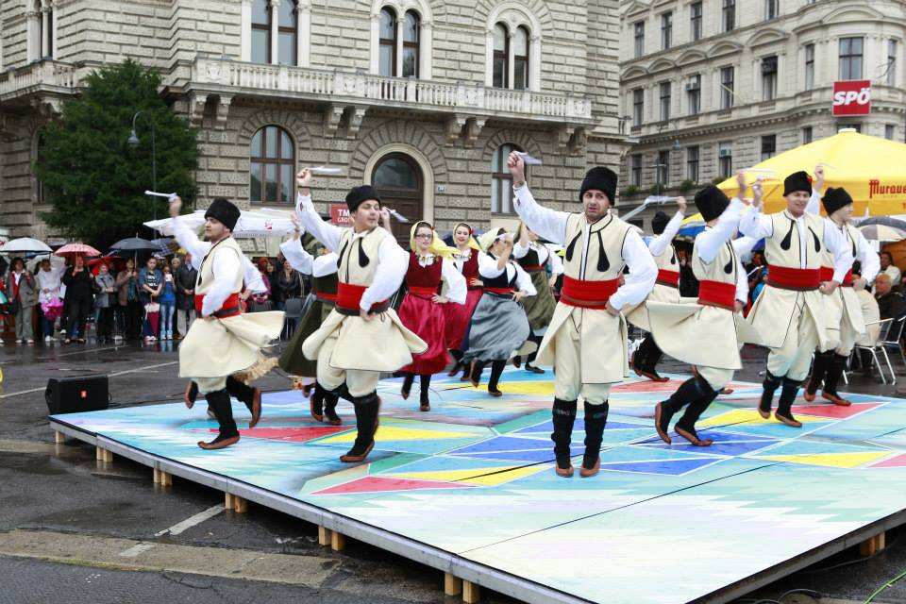
Culture Day 2015
Tanz – Workshop
Serbische
Folklore

Slide 2
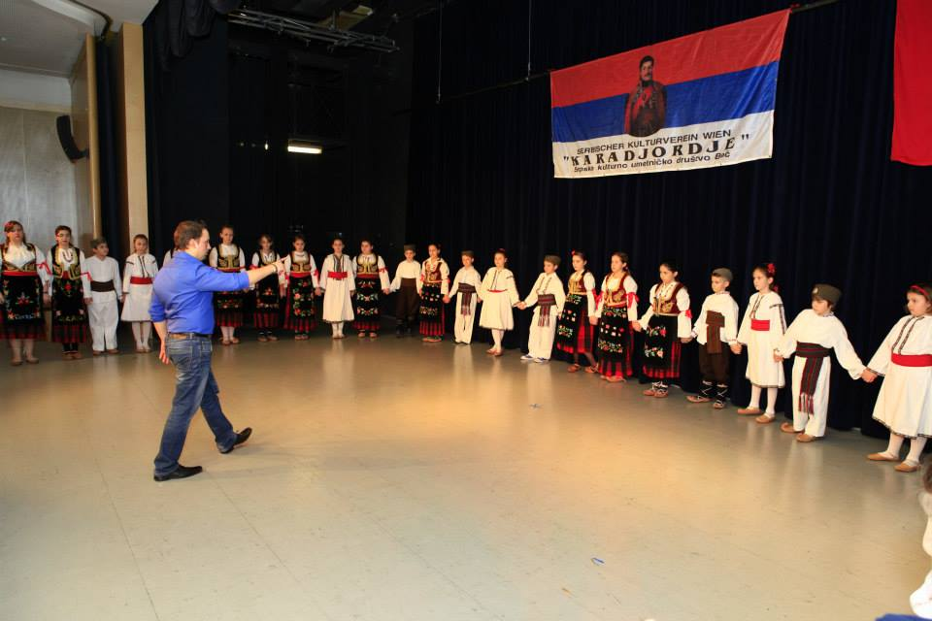
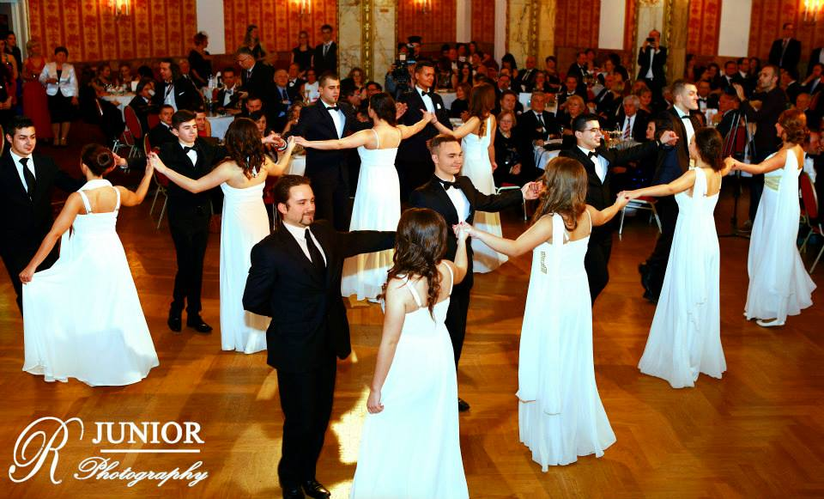
Culture Day 2015
Tanz – Workshop: Serbische Folklore

Slide 3
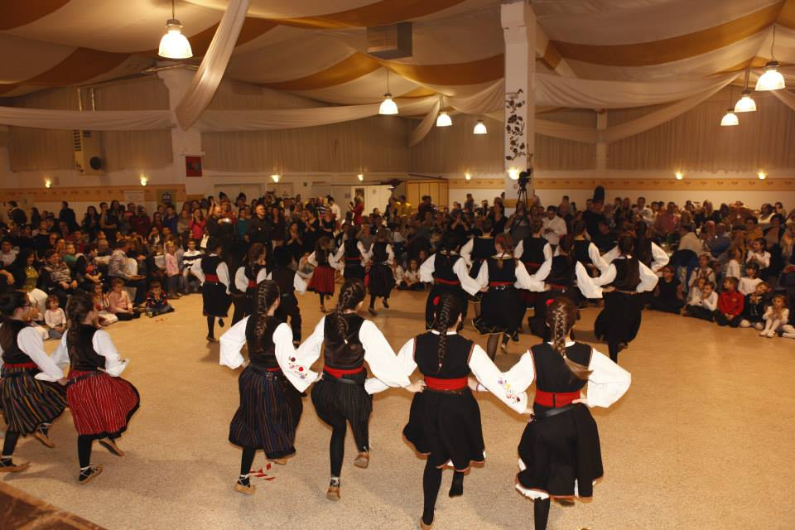
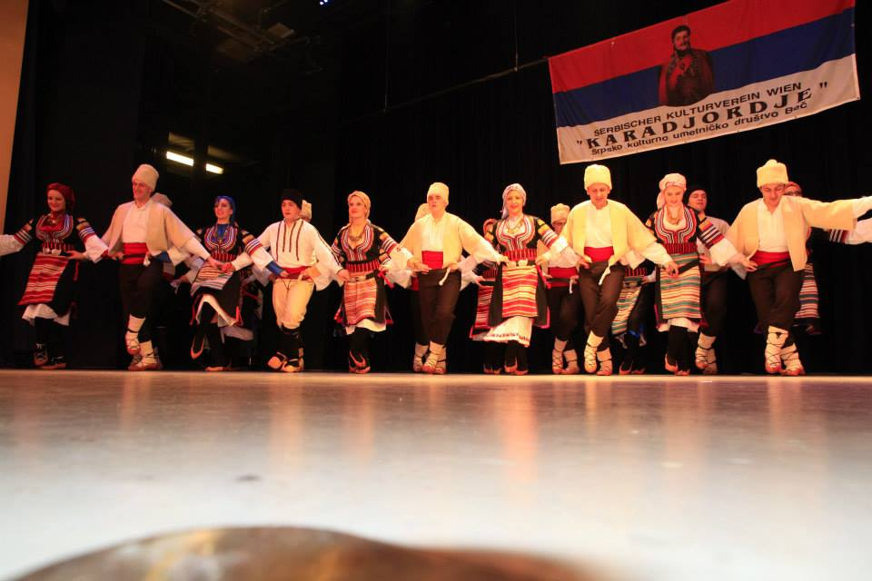
Culture Day 2015
Tanz – Workshop: Serbische Folklore

