Slide 1
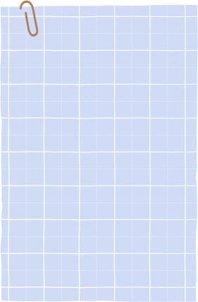
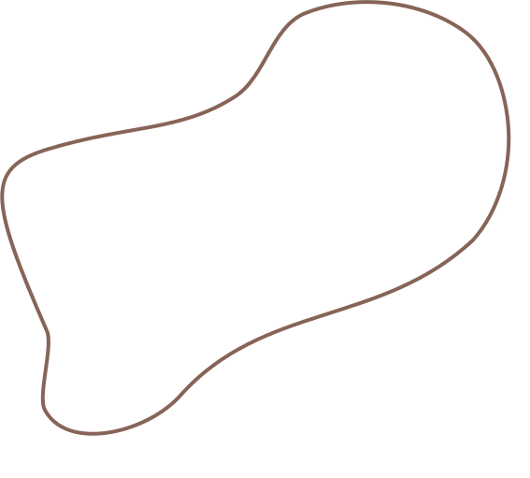
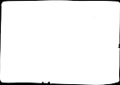


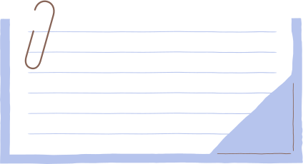

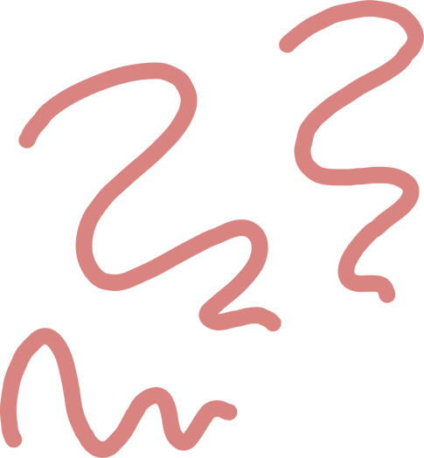
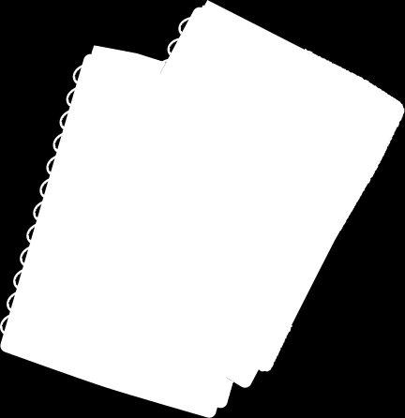

Group Members
Optimizing CIFAR-10 Classification: Residual Networks, Data Augmentation, and Regularization Techniques
Tooba Batool - bsse23067
Manal Rana- bsse23099
Umar Younas-bsse23043
AI Project Group 3

Slide 2
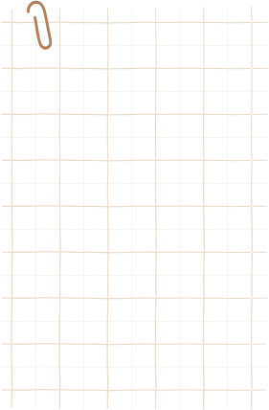
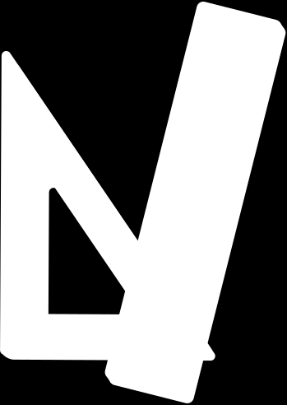



Goal & Motivation
Goal: To build a robust CNN model for CIFAR-10 image classification by exploring the Regularization and Data Augmentation paths.
Motivation: Solve the "Vanishing Gradient" problem using Residual Connections.
Compare how smart Weight Decay ( Regularization )vs. synthetic data variety (Augmentation) impacts performance in a fixed training window.

Slide 3
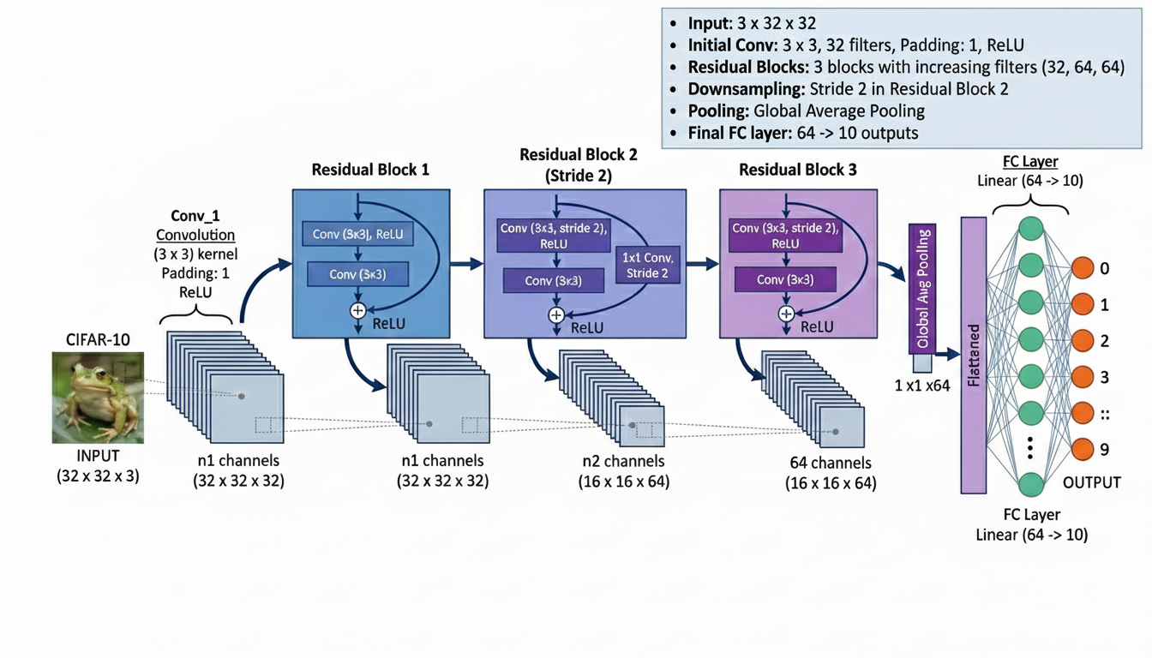
Model Architecture Diagram

Slide 4
Experiment 1: Regularization Path (Weight Decay)
Description:
Implementation of structural and weight-based penalties to enhance model generalization.
The Strategy:
L2 Weight Decay (1 X 10^-4) to control model complexity.
Results:
Peak Accuracy: 62.26% (at 5 epochs).
Insight: Regularization effectively prevented overfitting, ensuring the model learned generalized patterns rather than memorizing specific training noise.

Slide 5
Experiment 2: Data Augmentation Path
Description:
Implemented RandomHorizontalFlip during training.
Rationale:
To prevent overfitting by forcing the model to recognize objects regardless of their orientation or slight shifts.
Results:
Final Accuracy: 63.81%.
Insight: While accuracy was slightly lower than the optimization run within 5 epochs, the model showed more consistent loss reduction, indicating higher robustness for real-world data.

Slide 6
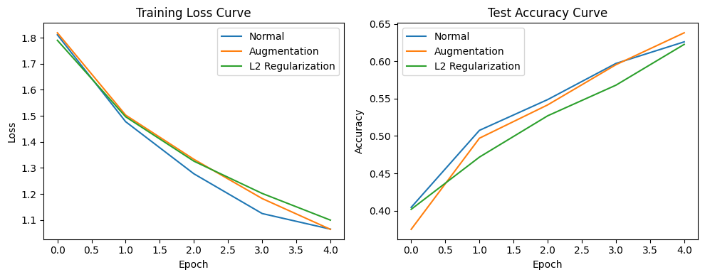
Evaluation
Training Loss & Accuracy Curve

Slide 7
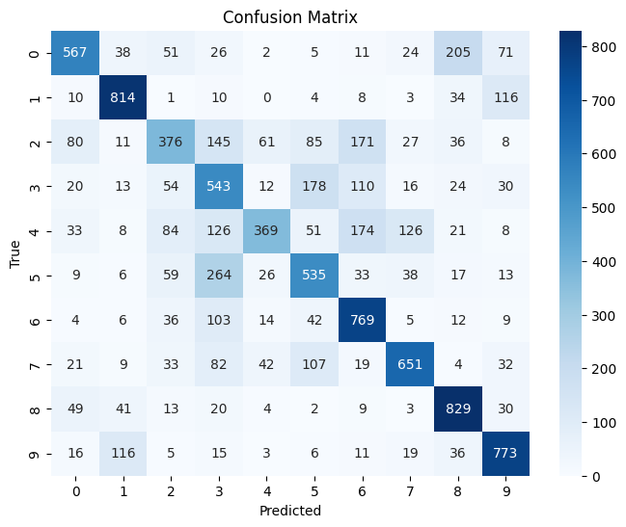
Evaluation
Confusion Matrix

Slide 8
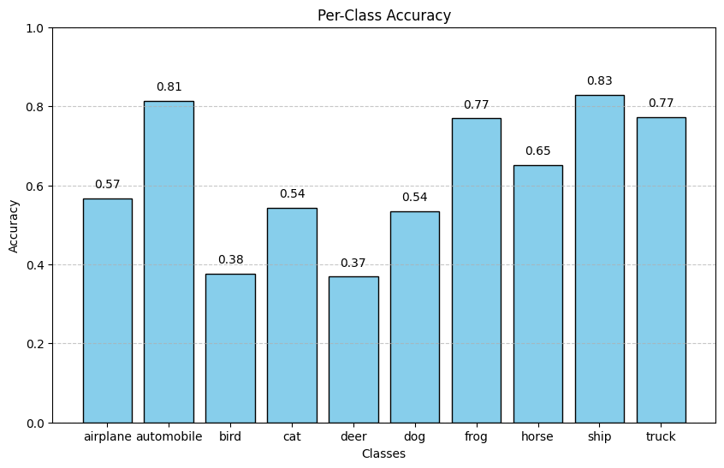
Evaluation
Per Class Accuracy

Slide 9
Conclusion & Best Accuracy & Insights
Best Test Accuracy: 62.00% (Achieved via Data Augmentation path)
Key Insights:
Residual blocks are critical for stable training in CIFAR-10.
Regularization Path: Effectively controlled overfitting and stabilized the learning process.
Augmentation Path: Essential for generalization; likely to outperform in longer training runs.
Class Performance: The model excelled at identifying 'Ship' and 'Automobile' but faced challenges with 'Cat' vs 'Dog' confusion.

Slide 10
Contributions
Manal Rana
Tooba Batool
Model Architecture design
PPT
Report
ResNet implementation.
Regularization path development (Dropout & Weight Decay integration).
Data Augmentation logic and Regularization experiments.
Umar Younas
Final evaluation pipeline, including Training Curves, Confusion Matrix, and Per-class accuracy visualization.

Slide 11


Thank
You!

