Slide 1
Public Space Utilization
Where do people sit outside?
Ethan & Marcel

Slide 2
Sampling Frame
UC campus, 4 tables
Hour per day for 3 days
Distance from walkway and entry point
Temperature and shade status
Table occupancy?

Slide 3
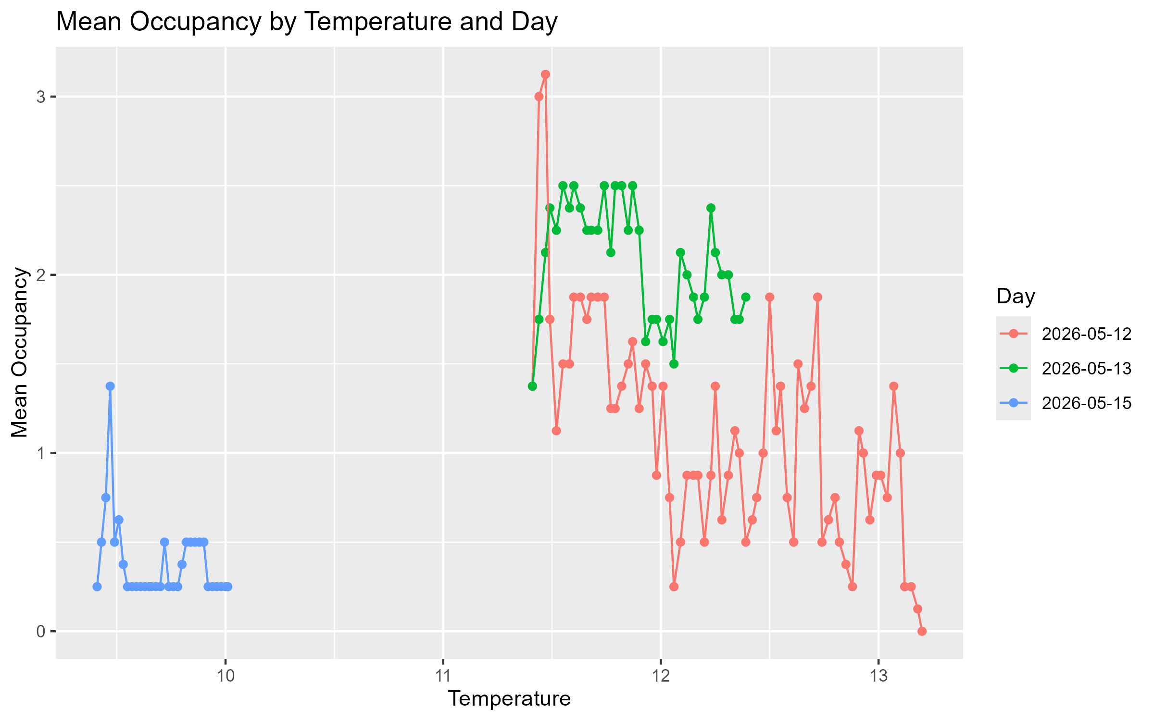

Slide 4
