Slide 1

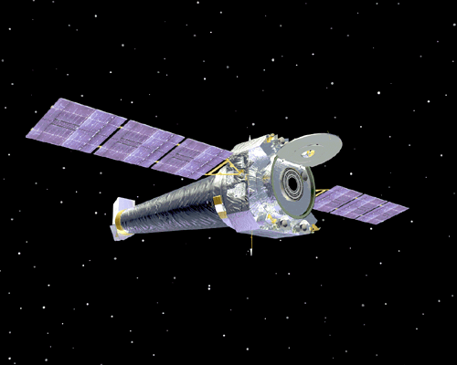
Chandra X-ray Observatory
Spacecraft in Flight
CXC

