Slide 1
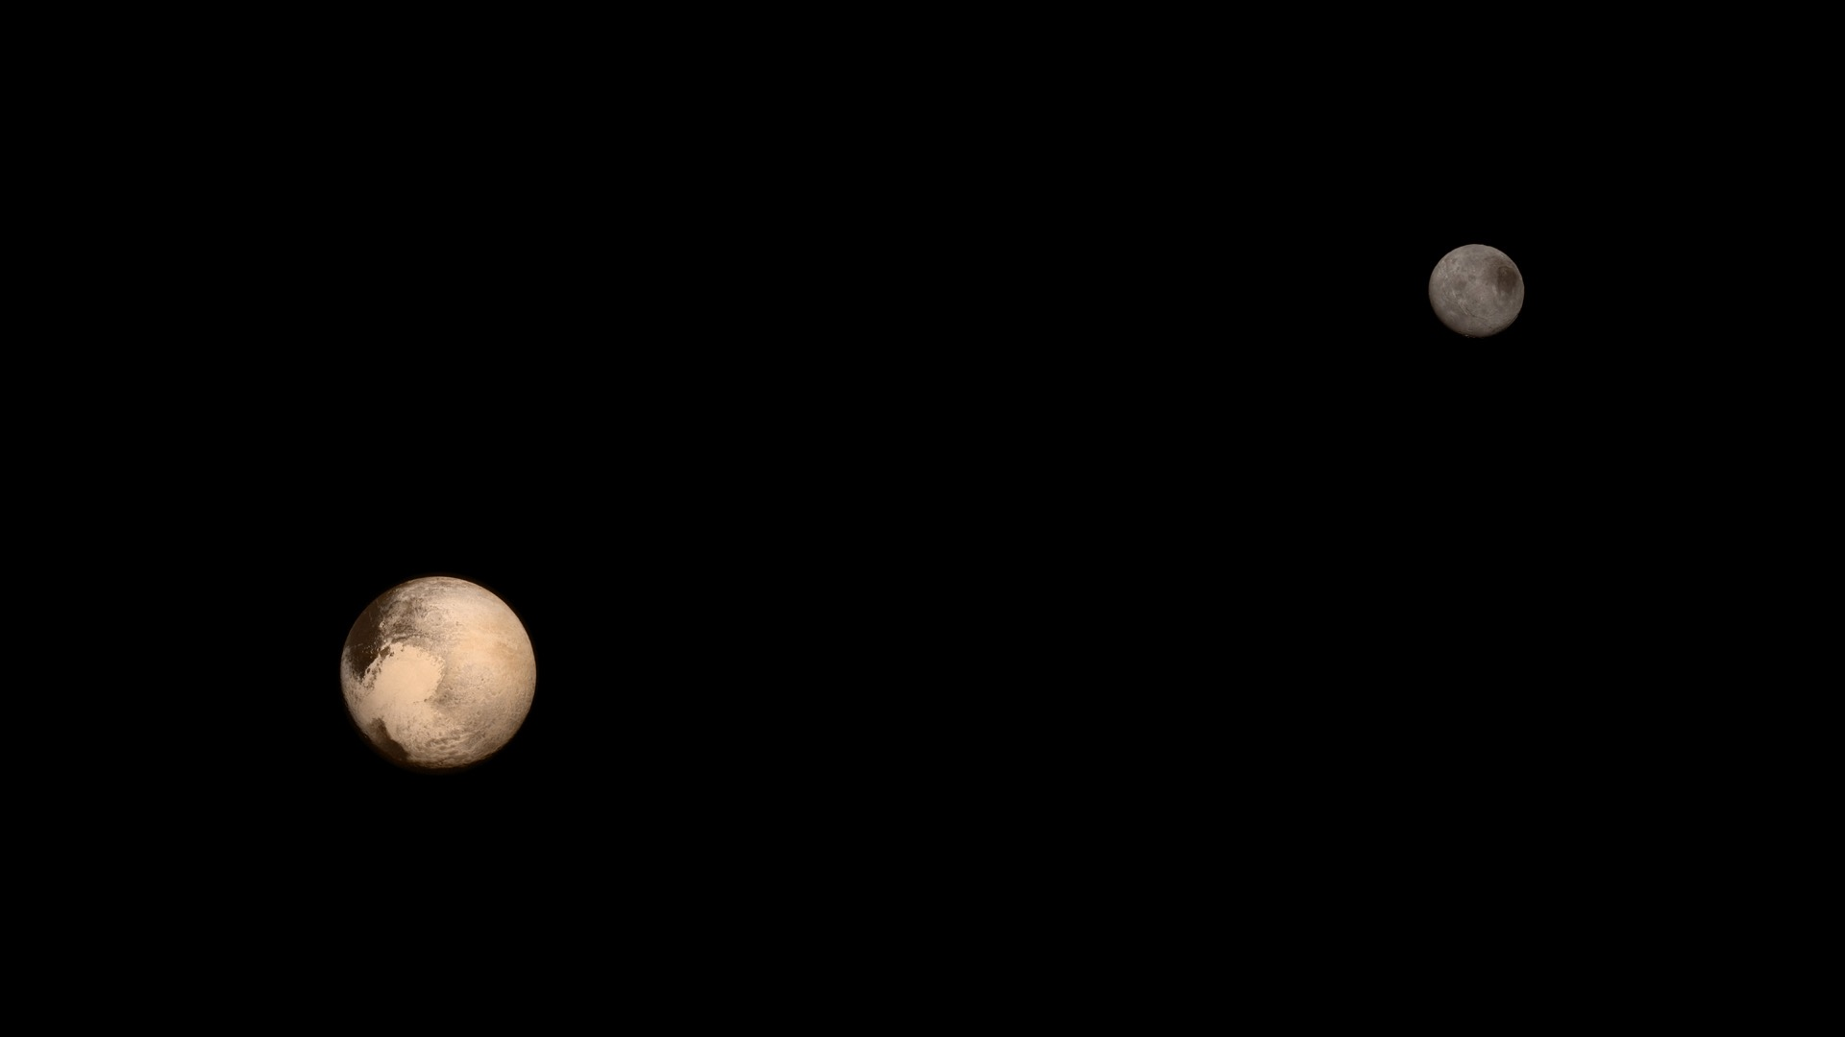
Notes:
Pluto and Charon
Pluto and Charon are shown in a composite of natural-color images from New Horizons. Images from the Long Range Reconnaissance Imager (LORRI) were combined with color data from the Ralph instrument to produce these views, which portray Pluto and Charon as an observer riding on the spacecraft would see them. The images were acquired on July 13 and 14, 2015
For more information, see:
pluto.jhuapl.edu

