Slide 1
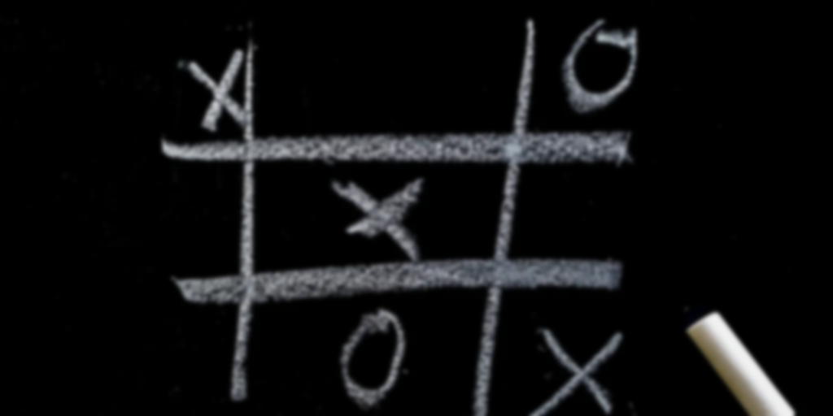
ufdhdijskjdhfi
TIC TAC TOE
Submitted To:-
Mr. Shairy

Slide 2
ufdhdijskjdhfi
Objectives
-- An Implementation of The Famous Game Tic Tac Toe Programmed so that you can play it with your friends in your leisure time.
-- The game is very popular & fairly simple by itself.
-- The goal of this tic tac toe is to be one of the players to get three same symbols in a row – horizontally , vertically or diagonally on a 3x3 grid.
-- opponent can prevent a win by blocking the completion of the opponent’s line.

Slide 3
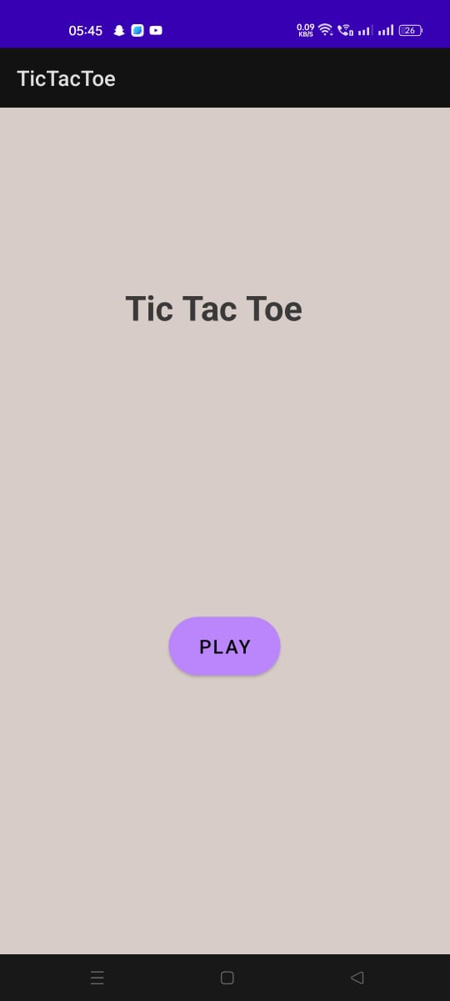
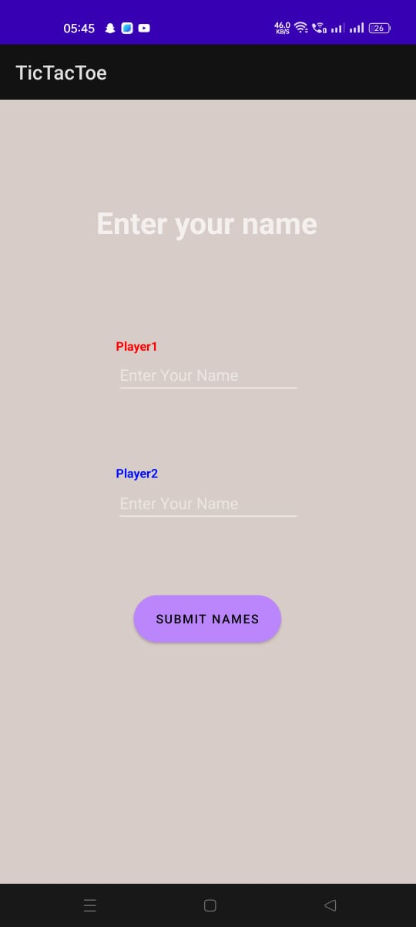
ufdhdijskjdhfi
1st page
launch activity
(play button)
2nd page
(enter names)

Slide 4
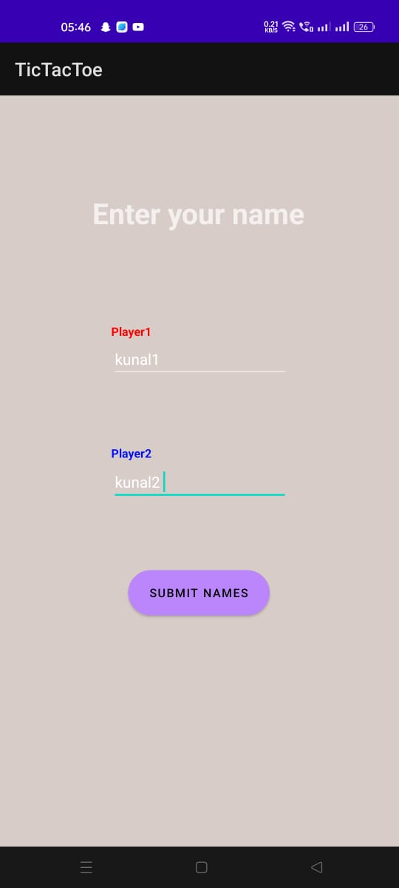
ufdhdijskjdhfi

Slide 5
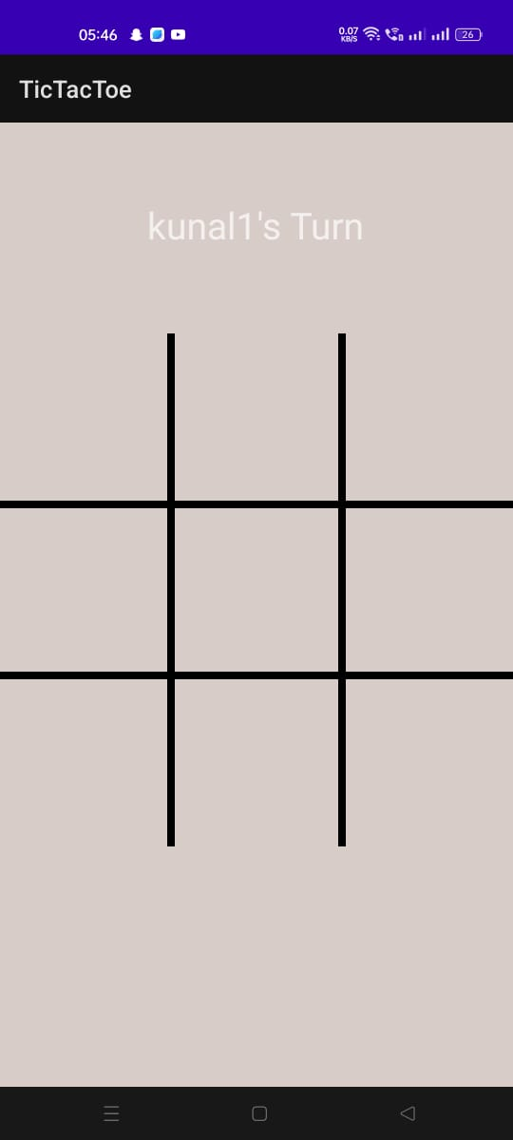
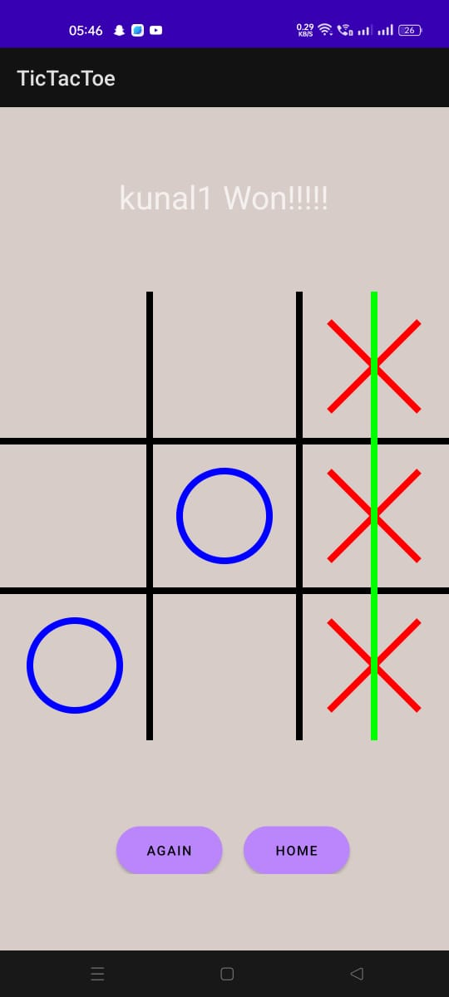
ufdhdijskjdhfi

Slide 6
ufdhdijskjdhfi
Thankyou!

Slide 7
ufdhdijskjdhfi

