Slide 1
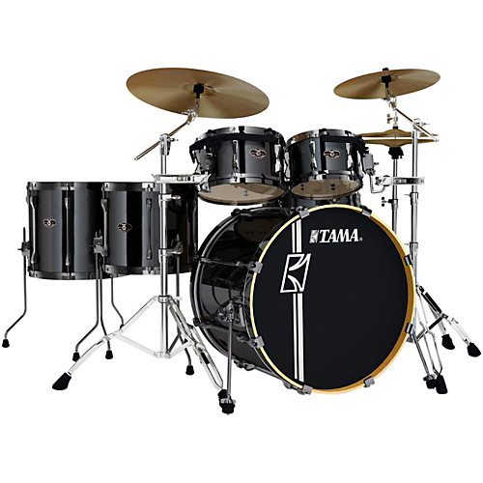
Music
Drums

Slide 2
History
Percussion in the early 19th century
Late 19th: combining drums together (foot pedal)
Early 20th: Ludwig patent bass drum pedal
1920’s: Drums becomes more & more common thanks to jazz.
Not a lot of change since then

Slide 3
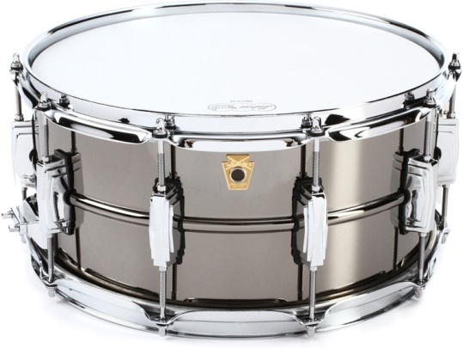
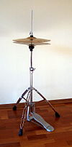
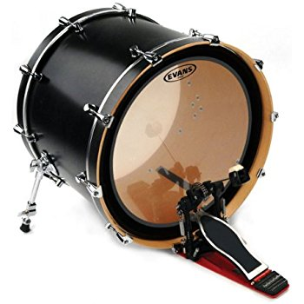
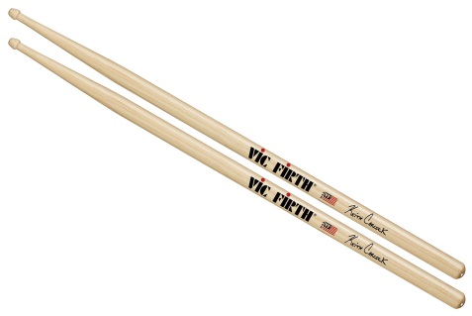
Components
Three main components: Bass drum, snare drum and hi-hat
Tom-tom drums
Stick
Stands

Slide 4
Let off steam
Powerfull
Enjoyement

