Slide 1

Rockbuster Stealth How to Lunch an Online Video Rental Service
Toomaj Foroud
May 2022

Slide 2
The Main Business Questions of Rockbuster Stealth Management Board
What was the average rental duration for all videos?
Do sales figures vary between geographic regions?
Which countries are Rockbuster customers based in?
Where are customers with a high lifetime value based?
Which movies contributed the most/least to revenue gain?
Objective
planning to use existing movie licenses to
launch an online video rental service in order to stay competitive

Slide 3
What was the average rental duration for all videos?
General Statistics of Current Movies
Number of Movies | Modal Release Year | Modal Language | Modal Rating
1000 | 2006 | English | PG-13
 | MIN | MAX | AVERAGE
Rental Duration (Days) | 3 | 7 | 5
Rental Rate ($) | 0.99 | 4.99 | 2.98
Movie Length (Minutes) | 46 | 185 | 115
Replacement Cost ($) | 9.99 | 29.99 | 19.99
Average rental Duration

Slide 4
Which movies contributed the most/least to revenue gain?
Top 10 Movies with Highest Revenue
Rank | Movie Title | Movie Total Revenue $
1 | Telegraph Voyage | 215.75
2 | Zorro Ark | 199.72
3 | Wife Turn | 198.73
4 | Innocent Usual | 191.74
5 | Hustler Party | 190.78
6 | Saturday Lambs | 190.74
7 | Titans Jerk | 186.73
8 | Harry Idaho | 177.73
9 | Torque Bound | 169.76
10 | Dogma Family | 168.72
Top 10 Movies with Lowest Revenue
Rank | Movie Title | Movie Total Revenue $
1 | Duffel Apocalypse | 5.94
2 | Oklahoma Jumanji | 5.94
3 | Texas Watch | 5.94
4 | Freedom Cleopatra | 5.95
5 | Rebel Airport | 6.93
6 | Young Language | 6.93
7 | Treatment Jekyll | 6.94
8 | Cruelty Unforgiven | 6.94
9 | Lights Deer | 7.93
10 | Stallion Sundance | 7.94

Slide 5
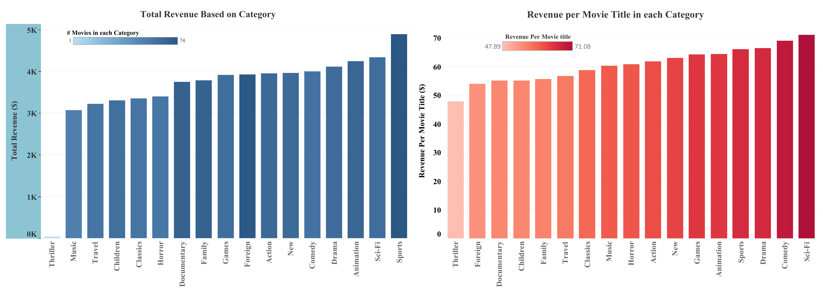
Which movies contributed the most/least to revenue gain?
SPORT, Sci-Fi & Animation have the Highest Total Revenue
while Thriller has the Lowest Movie number and Total Revenue
Sci-Fi, Comedy & Drama have the Highest Revenue per Movie Title

Slide 6
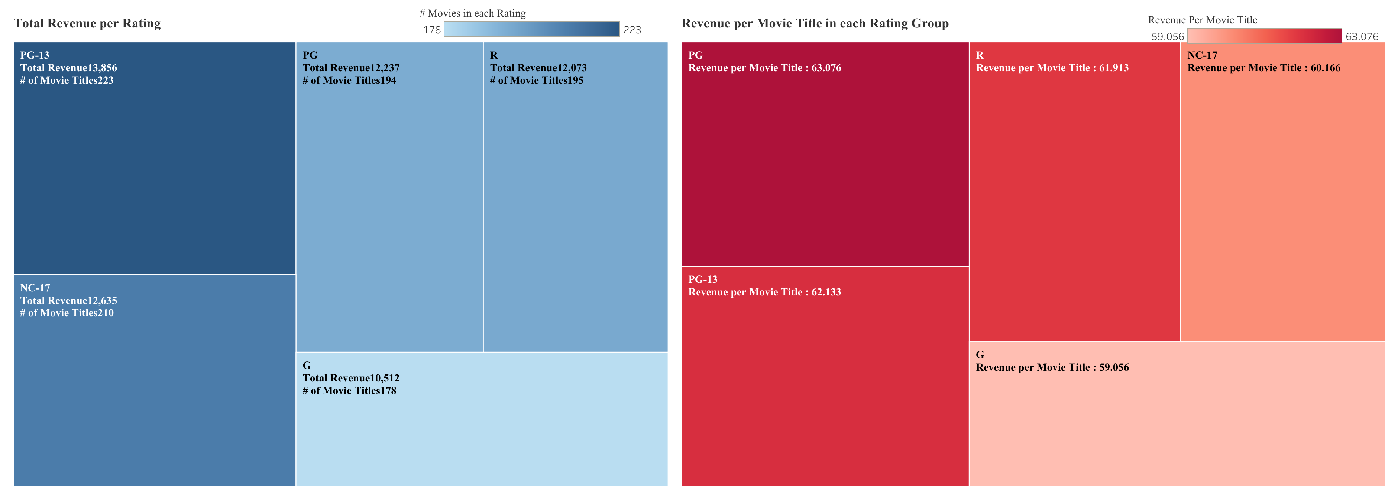
Which movies contributed the most/least to revenue gain?
Ratings PG-13 & NC-17 have the Highest Total Revenue and Highest Movie Number
while G has the Lowest Revenue
Ratings PG & PG-13 have the Highest Revenue per Movie Title
while G has the Lowest Revenue per Title

Slide 7
Where are customers with a high lifetime value based?
Which countries are Rockbuster customers based in?
Top 10 Customers
First Name | Last Name | Country | Total Payment $
Eleanor | Hunt | Runion | 211.55
Karl | Seal | United States | 208.58
Marion | Snyder | Brazil | 194.61
Rhonda | Kennedy | Netherlands | 191.62
Clara | Shaw | Belarus | 189.6
Tommy | Collazo | Iran | 183.63
Ana | Bradley | United States | 167.67
Curtis | Irby | Canada | 167.62
Marcia | Dean | Philippines | 166.61
Mike | Way | India | 162.67
Top 10 Countries
Country | Number of Transaction | Total Revenue $
India | 1422 | 6034.78
China | 1297 | 5251.03
United States | 869 | 3685.31
Japan | 749 | 3122.51
Mexico | 718 | 2984.82
Brazil | 681 | 2919.19
Russian Federation | 638 | 2765.62
Philippines | 530 | 2219.7
Turkey | 351 | 1498.49
Indonesia | 331 | 1352.69

Slide 8
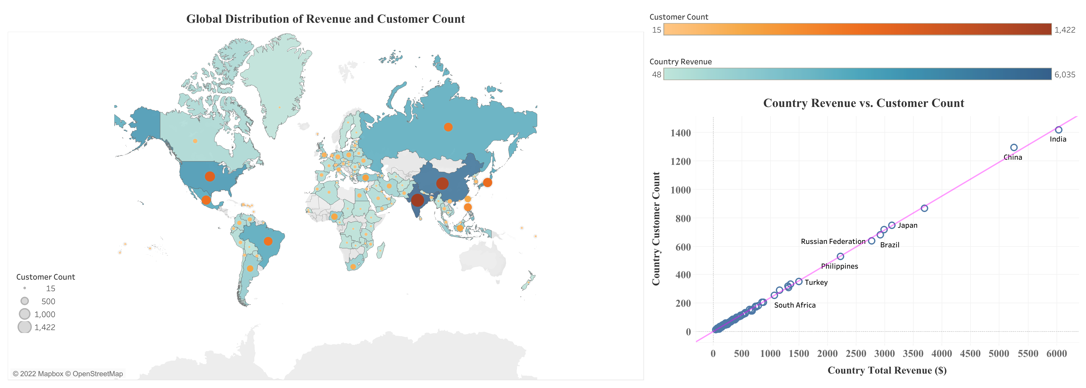
Do sales figures vary between geographic regions?

Slide 9
Insights and Recommendations
Movie Classifications:
Special Categories and Ratings are more popular than others (SCI-FI , COMEDY & DRAMA are top categories and PG-13 & PG are the ratings with highest revenue per movie title). Rockbuster can focus on these categories and ratings to expand its inventory.
Global Distribution:
While Rockbuster customers are distributed all over the world, some countries provide more profits than others like: India, China, United States, Japan and Mexico. These are also the countries with highest number of customers. There is a positive strong relation between Total Revenue and Number of Customers in each country. So, if the company wants to start new online activities, these countries can be the promising targets.
Top Customers:
There is no obvious connection between Top customers with highest payment and Top countries. As Top customers are in countries like Runion, US, Brazil, Netherland and Belarus which are not among top countries (Except US). As a result, the company can consider some especial programs and bonus plans for top customers to keep them loyal to the Rockbuster services and also encourage others to be as Top Customer.

Slide 10
Thank You for Your Attention
Link for Visualizations:
https://public.tableau.com/app/profile/toomaj.foroud/viz/RockbusterVisualization/Rating?publish=yes

