Slide 1
Edge-Based Cloud Computing as a Feasible Network Paradigm
Joe Elizondo and Sam Palmer

Slide 2
Introduction
  Edge-based cloud computing: new computing paradigm!
  Combination of two ideas
    Edge Computing – massively distributed grid computing, public resource computing (e.g. SETI@Home, Folding@Home)
    Cloud Computing – virtualized resources, scalable, dynamically allocated

Slide 3
Motivation
  Inexpensive computation
    High performance per dollar ratio
    Leverage available idle CPU cycles and internet bandwidth (potentially free to use, no existing cost model)
  Existing Infrastructure
    Every host on the Internet could potentially participate
    Access an edge cloud from anywhere in the world
Notes:
Access from anywhere in the world. Envision a system where you can connect to the internet run a script that schedules jobs on available machines based on constraints perhaps bandwidth, latency, CPU speed, etc.

Slide 4
Our Work
Is an edge-based cloud computing paradigm feasible?
- Find answer through simulation
High level Approach
  Model the Internet
    Build a cloud
      Simulate MapReduce jobs
        Evaluate performance
Notes:
Ignoring certain factors such as privacy and security, and just focusing on the system performance.

Slide 5
Our Work
Is an edge-based cloud computing paradigm feasible?
- Find answer through simulation
High level Approach
  Model the Internet
    Build a cloud
      Simulate MapReduce jobs
        Evaluate performance
Notes:
Ignoring certain factors such as privacy and security, and just focusing on the system performance.

Slide 6
Model the Internet (1/3)
Hand-coding thousands of routers and nodes has obvious disadvantages.
Why not use a topology generator?
  GT-ITM - Georgia Tech Internetwork Topology Models
  BRITE - Boston university Representative Internet Topology gEnerator
Sacrifice realistic results in simulation.
Notes:
We decided to use ns-2 for our network simulator. We needed to give ns-2 a topology that was representative of the internet

Slide 7
Model the Internet (2/3)
Measure link speeds and latency for every backbone router of every major ISP in the world?
  Realistic topology with accurate simulation results
  Challenging?
Notes:
The best way to build a realistic topology would be to collect real information about link speeds and latencies between routers for the thousands or routers that make up the majority of internet
The more realistic the topology the more accurate our simulation results

Slide 8

Model the Internet (3/3)
University of Washington's Rocketfuel Project
  Rocketfuel - ISP toplogy mapping engine
  Data -
  Used Rocketfuel's data to build our topology
10+ Tier 1 ISPs
50,000 IP addresses
45,000 routers
537 POPs
80,000 links

Slide 9
Our Work
Is an edge-based cloud computing paradigm feasible?
- Find answer through simulation
High level Approach
  Model the Internet
    Build a cloud
      Simulate MapReduce jobs
        Evaluate performance

Slide 10



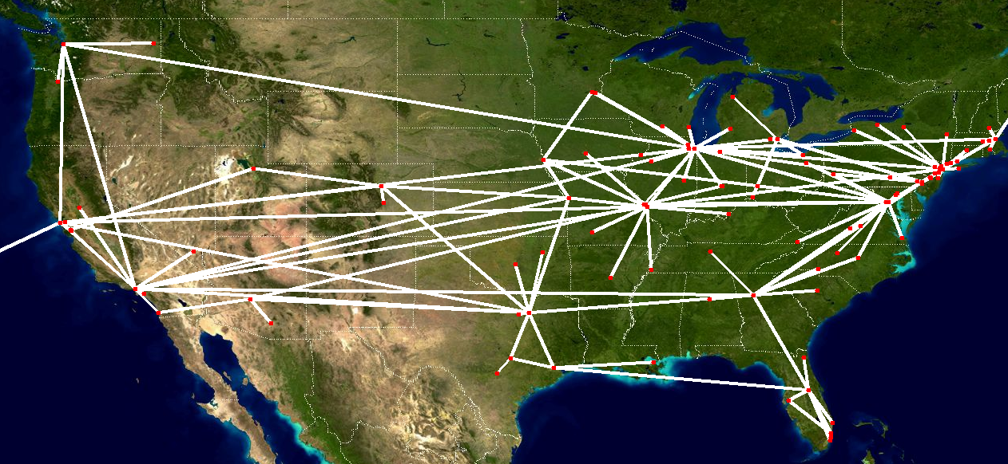


Build a Cloud (1/3)
Python script attaches heterogeneous end hosts to the network topology in our simulation.
Rocketfuel data for one AS(7018) plotted on a Visible Earth satellite image from NASA
Notes:
end hosts are attached to mapped backbone routers

Slide 11
Build a Cloud (2/3)
Heterogeneity accomplished by assigning end host resources from the following choices.
CPU speed (GHz) | 1.5, 1.6, 1.8, 2.0, 2.3, 2.4, 2.5, 3.0, 3.2
Number of CPUs | 1, 2
Number of cores per CPU | 1, 2, 4
Number of disks | 1, 2
Disk capacity (GB) | 40, 60, 80, 100, 120, 160, 180, 200, 250, 300, 400, 450, 500, 550, 600, 650, 700, 750, 800, 850, 900, 950, 1000
Disk read bandwidth (MB/s) | 250, 260, 270, 280
Disk write bandwidth (MB/s) | 60, 65, 70, 75
NIC capacity | 100Mbps, 1Gbps
Memory capacity (GB) | 0.5, 1, 2, 3, 4, 5, 6
End Host Link Speeds
Last hop link speeds are assigned a bandwidth and latency based on a normal distribution given a mean and a standard deviation.

Slide 12
Build a Cloud (3/3)
Final Step: Output files for use in our simulation
  Python script outputs ns-2 readable TCL files containing our internet topology
  Python script outputs end host information to an XML file that we pass into our simulation
# TCL code to create two backbone routers
# 101:2914
if { [info exists n("101:Seattle,WA")] == 0 } {
set n("101:Seattle,WA") [$ns node] }
if { [info exists n("2914:Seattle,WA")] == 0 } {
set n("2914:Seattle,WA") [$ns node] }
# TCL code to create link
# 101:Seattle, WA ->11608:Seattle,WA 0
#101:Seattle, WA -> 101:Sunnyvale, CA 5.68752395038991
$ns duplex-link $n("101:Seattle,WA") $n("101:Sunnyvale,CA") 10.0Gb 5.68752395038991ms DropTail
<machine_type>
<name>EndHost1667</name>
<disk><type>drive3</type><capa>250</capa><num>1</num></disk>
<cpu><type>1.6Ghz</type><number_of_cores>1</number_of_cores><num>1</num></cpu>
<mem><type>ECC</type><capa>1024</capa></mem>
<nic><type>100Mbps</type><num>1</num></nic>
</machine_type>

Slide 13
Our Work
Is an edge-based cloud computing paradigm feasible?
- Find answer through simulation
High level Approach
  Model the Internet
    Build a cloud
      Simulate MapReduce jobs
        Evaluate performance

Slide 14
Simulate MapReduce Jobs (1/4)
Why MapReduce?
  MapReduce operations model the high level of coordination and communication that takes place between machines in a cloud computing cluster.
We use MRPerf (Viginia Tech, IBM Almaden)
  MRPerf merges MapReduce and network simulation to achieve a seamless simulation environment.
  Claims to predict simulation performance within 5.22% of actual measurements for map and 12.83% for reduce for a double rack cluster with 16 to 128 cores.

Slide 15
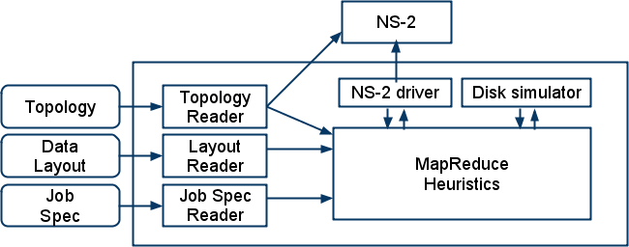
Simulate MapReduce Jobs (2/4)
MRPerf - Simulation tool for evaluating MapReduce performance on large clusters.
MRPerf simulates Hadoop's implementation of MapReduce using ns-2
MRPerf Original Architecture

Slide 16
Simulate MapReduce Jobs (3/4)
MRPerf is designed to model performance on a data center infrastructure.
Key Differences
MRPerf Default (Data Center) | Edge-based cloud
Homogeneous Nodes Racks with several nodes and several CPUs per node Connected using switches Connect via Gbps links Other nodes are generally close together (1 hop) Data locality - usually rack or node local | Heterogeneous Nodes One node with at most 4 CPUs Connected to Internet via router or gateway Connect via Mbps links Other nodes are many hops away Data is always remote
Implications
  Chunk size, data replication, node bandwidth, mappers/reducers per node, scheduling, etc.

Slide 17
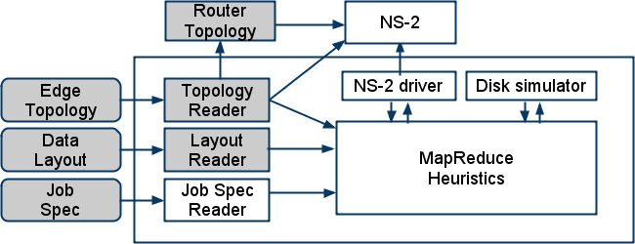
Simulate MapReduce Jobs (4/4)
Our work requires modifications to architecture and parameters to measure performance of edge-based cloud.
MRPerf Architecture after modifications (in grey)

Slide 18
Our Work
Is an edge-based cloud computing paradigm feasible?
- Find answer through simulation
High level Approach
  Model the Internet
    Build a cloud
      Simulate MapReduce jobs
        Evaluate performance

Slide 19
Simulation Setup
  Simulations were run over a three week period on a combination of UT's Condor Cluster and TACC's Sun Constellation Linux Cluster (Ranger)
  All simulations sort 1GB of data
  Variables
    End host link bandwidth
    Chunk size
      Data center
      Mapped Internet
    Total number of hosts
      Data center
      Mapped Internet
      Single AS (United States)
    Map and reduce slots per node

Slide 20
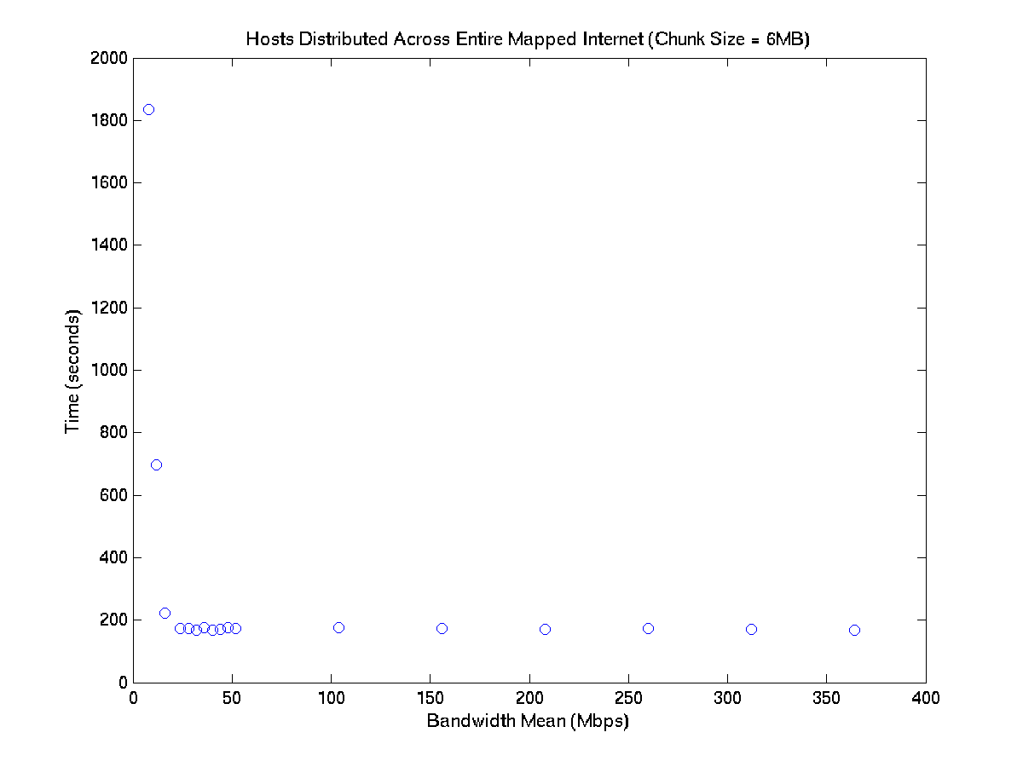
Notes:
50 Mbps topology
Bandwidth does not limit run time after about 20Mbps
Therefore since the rest of our tests use 16Mbps mean and 8Mbps std dev.
for normally distributed random end host links,
the node’s bandwidth is one factor in the variation of run times

Slide 21
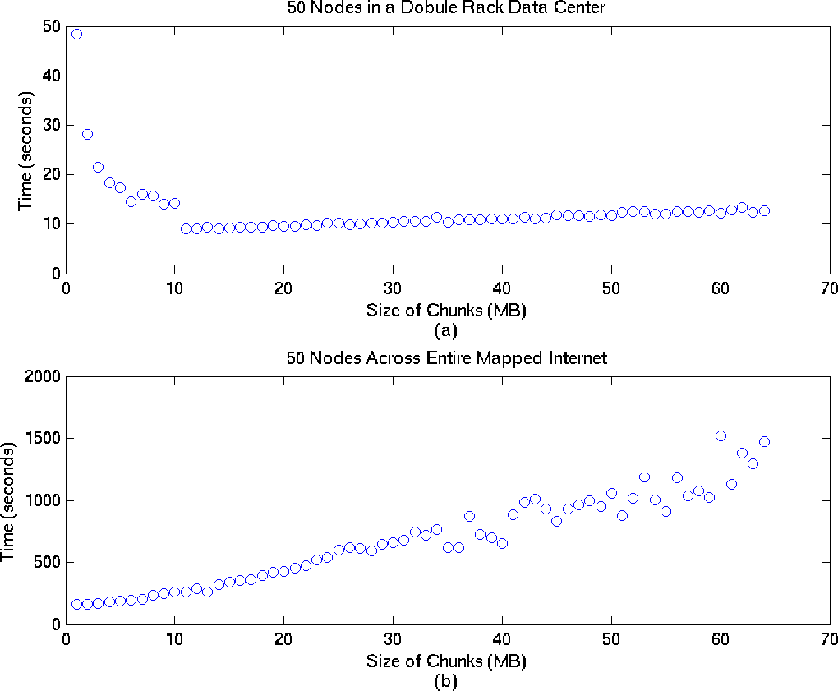
Notes:
Edge topology does better with smaller chunk sizes
Inverse of data center plot which tends to do better as chunk sizes increase
up to about 11MB chunks

Slide 22
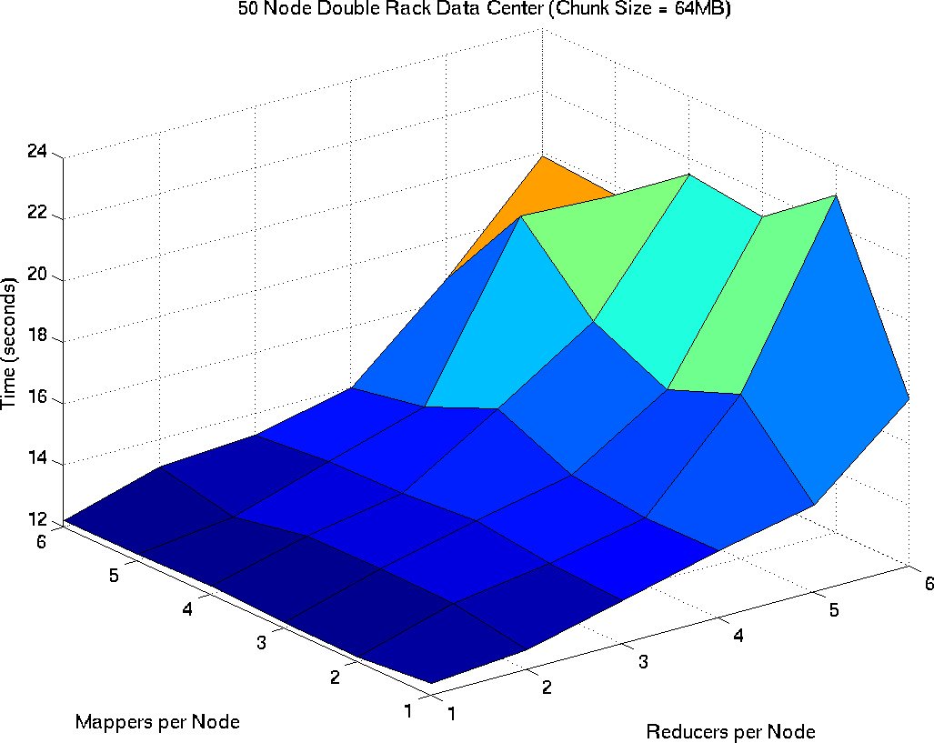
Notes:
Increasing number of reducers per node increases run time
increasing number of mappers has little effect

Slide 23
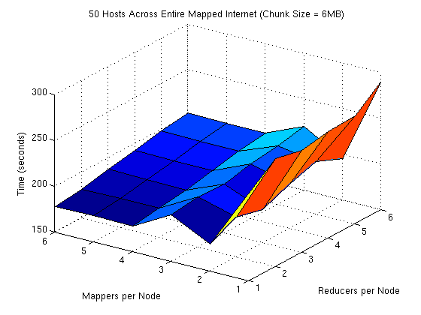
Notes:
Increasing number of map slots decreases run time
Increasing reduce slots does not necessarily decrease run time

Slide 24
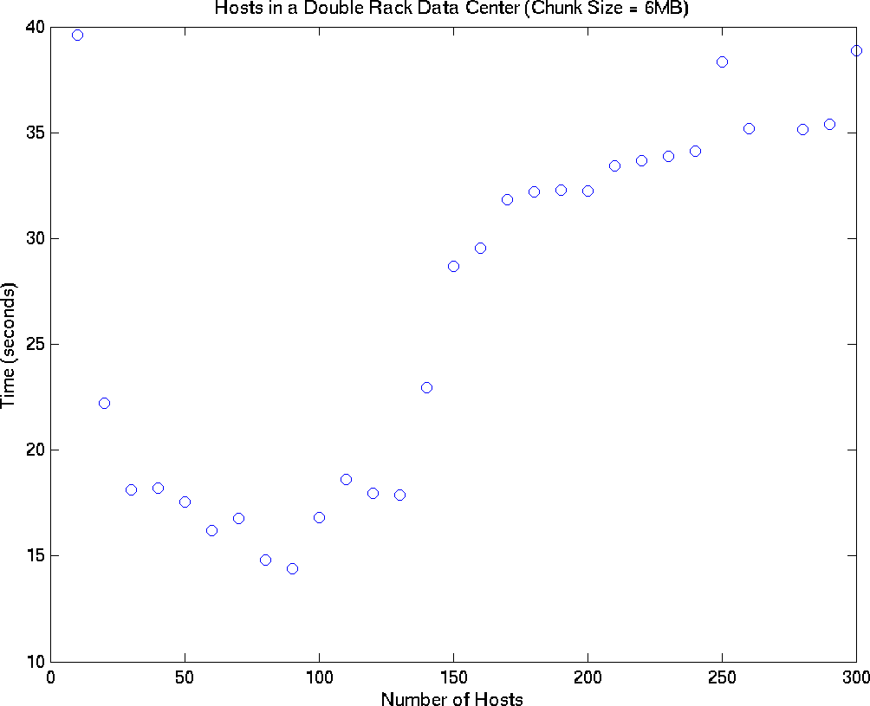
Notes:
In double rack topology communication with additional nodes causes performance degredation

Slide 25
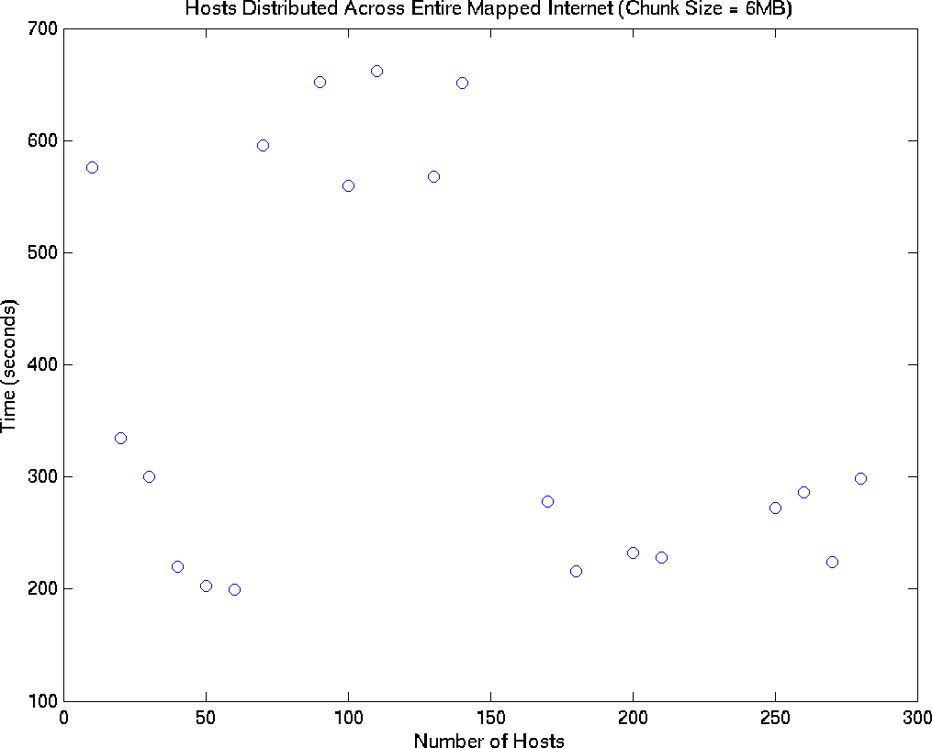
Notes:
No clear trend
Scheduler was not modified
Addition of one extra slow node on other side of the world would be scheduled the same as near fast node

Slide 26
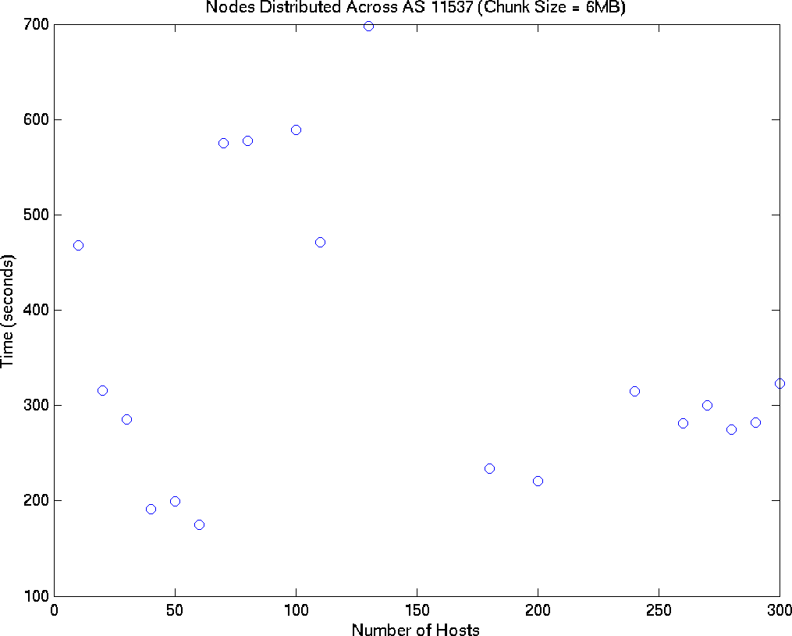
Notes:
United States and southern Canada

Slide 27
Future Work
  Verify simulation results
  Investigate effects of node churn
  Develop a new MapReduce scheduler optimized for a WAN
  Evaluate other cloud-based services in an edge environment

