Slide 1
Joe’s intro to GPL slides

Slide 2
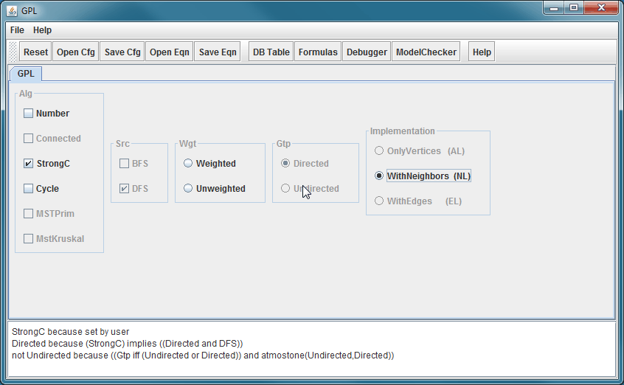
Demo GuiDsl

Slide 3
WebGuiDsl Goals
Present GuiDsl functionality through a web interface
This semester’s progress is specific to GPL interface
Run on CS web servers
Limited us to PHP or CGI
No Java servlets
Temporary files must be created in a world writable directory ☹

Slide 4
Technologies Leveraged
Python CGI
jQuery JavaScript library
Easily navigate and modify DOM
Helps with Ajax requests and event handling
BlockUI jQuery plugin
Simulate synchronous Ajax behavior without locking the browser
http://jquery.malsup.com/block/
Google-gson
Serialize Java Objects into JSON Objects
http://code.google.com/p/google-gson/

Slide 5
WebGuiDsl for GPL Contents
New GuiDsl feature – WebTool
Provides programmatic interface like existing Tool feature
Provides a method that calls SAT solver for a given number of set variables and returns a JSON 2D array consisting of variable values (set/not set) and reasons for the values

Slide 6
WebGuiDsl for GPL Contents
Python CGI scripts
webguidsl.cgi
compose.cgi
HTML page – gpl.html
Nothing special, just a form with <input> tags
JavaScript – webguidsl.js
Initializes event handlers
Updates DOM

Slide 7
WebGuiDsl for GPL
Client
Server
webguidsl.js
WebGuiDsl
(Java Program)
Set features and reasons
webguidsl.cgi
(Python CGI script)
User selected
features
GuiDsl
(new WebTool feature and SAT solver)
Action:
Validate model
Action:
DOM is updated
Action:
user wants to compose GPL
Action:
Action:
User Interface Blocks until response
(BlockUI jQuery plugin)
Action:
user selects GPL feature
composer
jak2java
All selected
features
compose.cgi
(Python CGI script)
Zip of all output
javac
xhtml2html

Slide 8
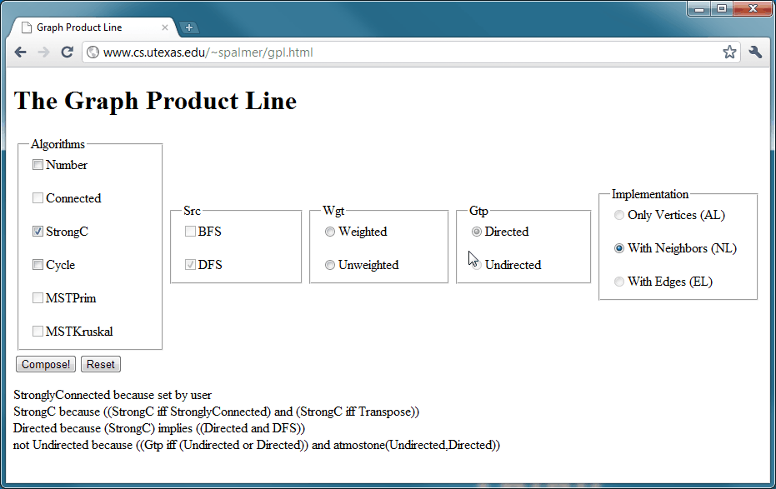
Demo WebGuiDsl

Slide 9
Joe’s slides on other packages and benchmarking methods

Slide 10
Results

Slide 11
Future Work
WebGuiDsl for GPL can be generalized for any feature model
Only client code would change
Currently webguidsl.js has GPL specific code
Currently
Non-Existent
Tool
mymodel.html
mymodel.m
validatemymodel.js
Notes:
Currently WebGuiDsl is specific to GPL. This, however, does not mean that it was built without a larger picture in mind. The validation function in webguidsl.js is the only one that is specific to GPL. The server-side portion of this application is completely independent of GPL.
While outside of the scope of this semester’s project, we envision a tool that can read a model file (e.g. mymodel.m) and produce the corresponding HTML document and validation JavaScript. This JavaScript file can then be used in conjunction with the model independent JavaScript code.
Another option would be to move validation to the server.

