Slide 1
Joe’s intro to GPL slides

Slide 2
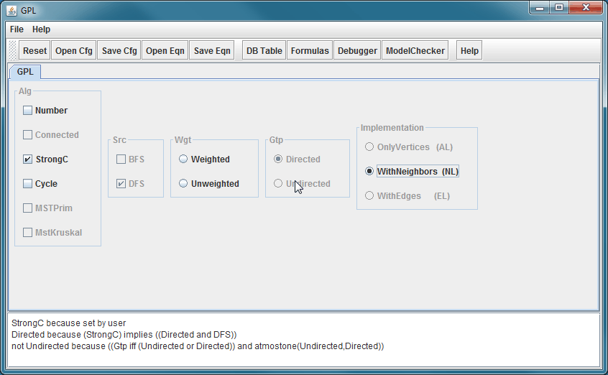
Demo GuiDsl

Slide 3
WebGuiDsl Goals
Present GuiDsl functionality through a web interface
This semester’s progress is specific to GPL interface
Run on CS web servers
Limited us to PHP or CGI
No Java servlets
Temporary files must be created in a world writable directory ☹

Slide 4
Technologies Leveraged
Python CGI
jQuery JavaScript library
Easily navigate and modify DOM
Helps with Ajax requests
BlockUI jQuery plugin
Simulate synchronous Ajax behavior without locking the browser
http://jquery.malsup.com/block/

Slide 5
WebGuiDsl
Client
Server
webguidsl.js
WebGuidsl
(Java Program)
Set features and reasons
gpl.cgi
(Python CGI script)
User selected
features
GuiDsl
(new WebTool feature and SAT solver)
Action:
DOM is updated
Action:
user wants to compose GPL
Action:
Action:
user selects GPL feature
composer
jak2java
All selected
features
compose.cgi
(Python CGI script)
Zip of all output
javac
xhtml2html

Slide 6
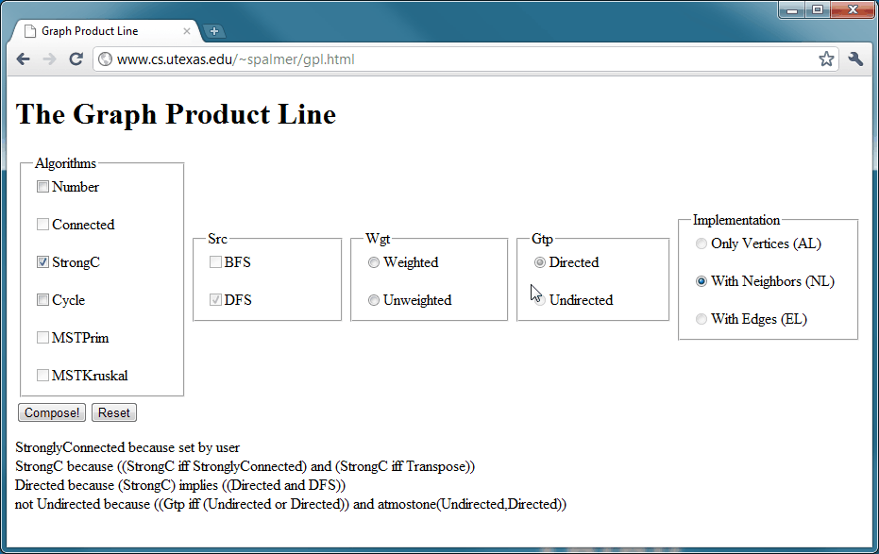
Demo WebGuiDsl

Slide 7
Joe’s slides on other packages and benchmarking methods

Slide 8
Results

Slide 9
Future Work

