Slide 1
GUIDSL for GPL
Web

Slide 2
Graph Product Line
Review of GPL
Demo GUIDSL
Introduce Web GUIDSL
Introduce Algorithms
Java Packages
Experiments
Results
Future Work

Slide 3
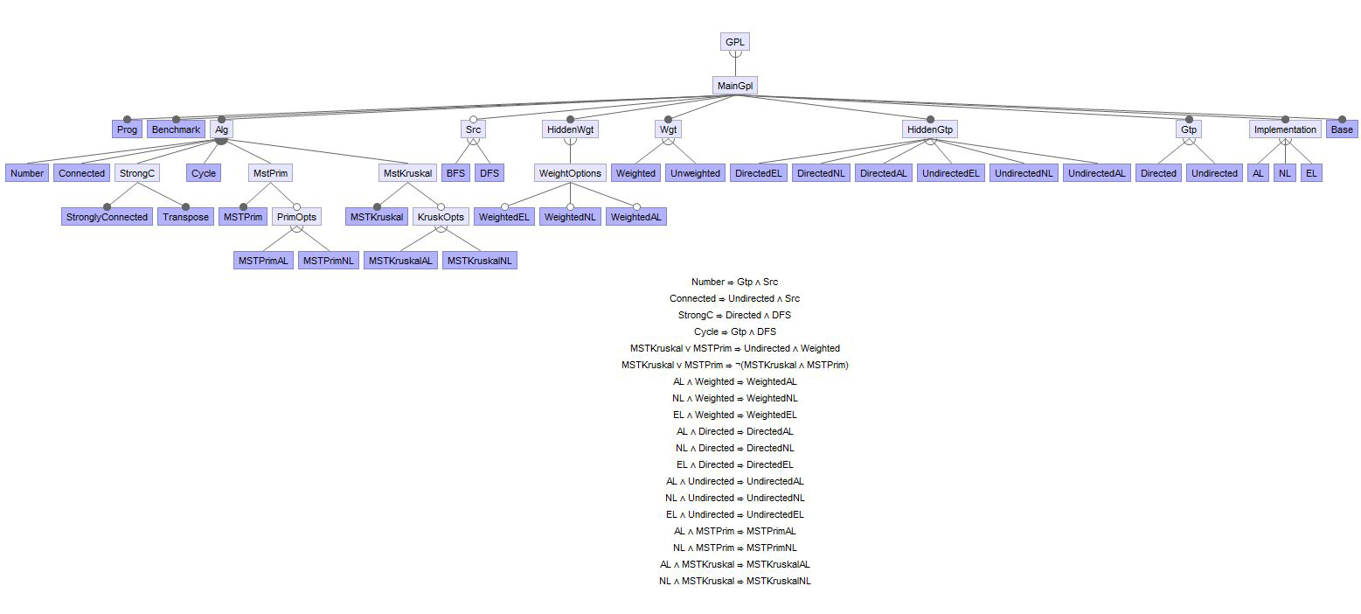
GPL as an example of a feature model

Slide 4
Compose an algorithm given certain constraints
©
Again ignore AL, NL, EL for now
(top-most)
ordering
unimportant (commutative)
MSTPrim
Number
MSTKruskal
Algorithm
Cycle
Connected
StrongC
Search
BFS
DFS
Constraints
Edge Weight
Weighted
UnWeighted
Constraints
Graph Type
Directed
Undirected
(bottom-most)
Notes:
By selecting valid feature combinations the users builds a program that executes a customized graph algorithm. Feature tree and additional cross-tree constraints are propagated as features are selected. This prevents users from making mistakes and having to backtrack on their selections. GPL is a software product line, it is a family of related programs that are built by transformations or increments in functionality.

Slide 5
Introduce Different Graph Implementations
Graph Type
Graph Weight
Type of Search
Algorithm
One more feature set…
Graph Data Representation
Directed
Undirected
Weighted
UnWeighted
BFS
DFS
Number
StrongC
MSTPrim
Cycle
Connected
MSTKruskal
Adjacency List
Neighbor List
Edge List
Notes:
We’ve seen the following features make up the Graph Product line (graph type, graph weight, type of search, and graph algorithm) but GPL has one more feature set and that is the different way the Graph itself is implemented and how it stores data. The three ways are Adjacency Lists, Neighbor Lists, and Edge Lists.

Slide 6
Adjacency Lists Representation (AL)
Graph Object
9
V1
9
V1
V1
V3
V3
V3
Vertices List
V1
V2
V3
V1
7
7
11
Vertex Object (V1)
V2
V2
V2
Adjacent
Vertices
V2
V3
Weights List
7
9
Graph Example
2 classes: Graph, Vertex
Pros
simple, matched legacy design of earlier work
Cons
edges must be computed from adjacency lists
a parallel list for each edge annotation (weight), a hack
complicates algorithms that manipulate explicit edges
Next Design Update
Eliminate parallel lists
Notes:
An adjacency list represents a graph in the following way that this animation attempts to explain clearly. There is a graph object that holds a list of vertices. There is a vertex object, for each vertex in the graph it holds a list of the vertices adjacent to that vertex. For a graph with weighted edges another “parallel” list is required to hold the weights. So there are two classes, graph and vertex. This is a simple design but it is limited because some graph algorithms require explicit edge manipulation which cannot be done with an adjacency list because there are no explicit edges. The next implementation takes care of the parallel list problem.

Slide 7
Neighbor List Representation (NL)
Graph Object
9
V1
9
V1
V3
V3
Vertices List
V1
V1
V2
V3
7
7
11
Vertex V1
V2
V2
List of Neighbors
V2
V3
Vertex
Object
Graph Example
Integer
Weight
Neighbor Object
7
9
3 classes: Graph, Vertex, Neighbor
Pros
list accesses to obtain annotations are reduced
simplified design of some features
Cons
algorithms that manipulate edges explicitly still must compute them from Neighbors list
redundancy in edge annotations
some algorithms need to sort edges by the weights
Next Design Update
represent edges explicitly
Notes:
The neighbor list for the most part is the same as the adjacency list. The graph object still holds a list of vertices. The vertex object still exists but instead of a list of adjacent vertices it holds Neighbor objects. A new neighbor class holds both a vertex and an integer weight value. For each vertex a neighbor object is created for the vertices adjacent to it and these neighbor objects are then stored in a list. So now an algorithm only has to access one list to get the neighbor and respective edge weight, but it doesn’t solve the problem of handling edges explicitly. There is redundancy and there is no way to sort by edge weight.

Slide 8
Edge List Representation (EL)
Graph Object
9
Edges List
9
V3
Vertices List
V1
V3
V1
V3
V1
V1
V1
V1
V2
V3
E1
E2
E3
11
7
11
7
11
7
List of Neighbors
V2
V2
V2
Vertex Object (V1)
V2
V3
Graph Example
Neighbor
Object
E1
E2
Edge Object (E1)
E1
Edge E2
E2
Edge E3
E3
V1
V2
7
V1
V3
9
V2
V3
11
4 classes: Graph, Vertex, Neighbor, Edge
Pros
supports algorithms that manipulate edges explicitly
easier to add new algorithms – lift out of textbooks
algorithm specifications cleaner
less redundancy
Cons
equating conceptual objects with physical objects may simplify source code, but is this efficient?
is premature design optimization essential for performance?
Notes:
This representation is the most common for graphs and how almost all graph algorithms expect the data to be stored. The Graph object still contains a vertex list and the vertex object still exists, but now there is a new edge class. We build explicit edge objects. We still have neighbor objects and they are contained within a list in each vertex object. But now instead of an integer weight the neighbor object contains an edge object. We also add an edge list to the graph object.

Slide 9
GPL as an example of Kubes
AL, NL, and EL represent different encodings of graphs
Implementations of other features are effected by the choice of AL, NL, or EL
Connected Number Cycle DFS BFS Weighted Directed Undirected
AL
Connected_{AL} | Number_{AL} | Cycle_{AL} | DFS_{AL} | BFS_{AL} | Weighted_{AL} | Directed_{AL} | Undirected_{AL}
Connected_{NL} | Number_{NL} | Cycle_{NL} | DFS_{NL} | BFS_{NL} | Weighted_{NL} | Directed_{NL} | Undirected_{NL}
Connected_{EL} | Number_{EL} | Cycle_{EL} | DFS_{EL} | BFS_{EL} | Weighted_{EL} | Directed_{EL} | Undirected_{EL}
NL
EL
array
program_{NL} = Cycle_{NL} ⋅ Connected_{NL} ⋅ DFS_{NL} ⋅ UnWeighted_{NL} ⋅ Undirected_{NL}
program_{AL} = Cycle_{AL} ⋅ Connected_{AL} ⋅ DFS_{AL} ⋅ UnWeighted_{AL} ⋅ Undirected_{AL}
Notes:
Adding different encodings of graphs produces a product line of product lines or a 2D Kube. We saw GPL used as an example of Kubes during the semester. A program could be constructed by valid composition of features from any one of the three rows. As an example this slide shows two possible programs one using the neighbor list implementation and the other using the adjacency list.

Slide 10
Remember this Slide?
Project away unneeded columns
Project away unneeded rows
Contract the array to produce the feature expression for the desired program
Connected Number Cycle DFS BFS Weighted Directed Undirected
Common
Connected | Number | Cycle | DFS | BFS | Weighted_{C} | Directed_{C} | Undirected_{C}
 |  |  |  |  | Weighted’_{AL} | Directed’_{AL} | Undirected’_{AL}
 |  |  |  |  | Weighted’_{NL} | Directed’_{NL} | Undirected’_{NL}
 |  |  |  |  | Weighted’_{EL} | Directed’_{EL} | Undirected_{C}
Connected | Number | Cycle | DFS | BFS | Weighted_{C} | Directed_{C} | Undirected_{C}
 |  |  |  |  | Weighted’_{AL} | Directed’_{AL} | Undirected’_{AL}
 |  |  |  |  | Weighted’_{NL} | Directed’_{NL} | Undirected’_{NL}
 |  |  |  |  | Weighted’_{EL} | Directed’_{EL} | Undirected’_{EL}
Connected | Number | Cycle | DFS | BFS | Weighted_{C} | Directed_{C} | Undirected_{C}
 |  |  |  |  | Weighted’_{AL} | Directed’_{AL} | Undirected’_{AL}
 |  |  |  |  | Weighted’_{NL} | Directed’_{NL} | Undirected’_{NL}
 |  |  |  |  | Weighted’_{EL} | Directed’_{EL} | Undirected_{C}
AL
NL
EL
Cycle DFS Directed
Common
Cycle | DFS | Directed_{C}
 |  | Directed’_{EL}
Cycle ⋅ DFS ⋅ Directed’_{EL} ⋅ Directed_{C}
EL
Notes:
Our last review slide shows an improvement to the design of the previous slide. This slide adds a row for commonalities is to solve the problem of code redundancy in the previous slide and the blank cells can be viewed as the identity transformation. We can build a program by a composition of transformations projecting away unneeded columns and rows and the folding or contracting the kubes to produce our program. (The composition is still under feature model tree and cross-tree constraints)

Slide 11
Cycles
Directed Graph
A path of length 2 or more that connects a vertex to itself
Undirected Graph
A path of length 3 or more that connects a vertex to itself

Slide 12
Cycles
CycleChecker
Set Flag
DFS
Return True
Done?
Return Flag
Throw Exception
Set Flag
Yes
No
Cycle?
No
Yes
Runs in O(|E|) time.

Slide 13
Connected Graph
GPL uses either BFS or DFS to find connected components
b
f
b
f
h
h
a
a
c
e
c
c
g
g
d
d
This method works in O(|V||E|) time
Notes:
Real cost comes from having to (potentially) run a search on every vertex. No extra cost from choosing BFS over DFS because they both run in linear time.

Slide 14
Strongly Connected Graph
GPL uses Kosaraju's algorithm
3. Depth first search on transposed graph
2. Reverse all Edges
4
3
4
3
4
3
a
b
a
a
b
b
a
a
b
b
1. Depth First Search to number vertices
d
c
d
c
c
d
c
d
d
c
1
2
1
2
1
2
Can be completed in O(|V|+|E|) time
Notes:
Majority of the cost is in building a graph with reversed edges, as we back out of recursion we number the vertices, on the second DFS we start from the vertex with the highest number.

Slide 15
Minimum Spanning Tree
Prim’s Algorithm
Loop while U ≠ V, where U and V are sets of vertices
Follow lowest cost edge in U
1
1
6
5
2
2
4
1
4
V = {1,2,3,4,5,6}
5
3
3
5
U = {1,3,6,4,2}
U = {1,3,6,4,2,5}
U = {1}
U = {1,3,6}
U = {1,3}
U = {1,3,6,4}
3
6
4
2
5
5
6
6
6
Prim’s algorithm runs in O(n²) time

Slide 16
Minimum Spanning Tree
Kruskals Algorithm
Sort edges and add the lowest cost edges in different
connected components.
Stop when all vertices are in one connected
component.
1
1
6
5
2
2
4
1
4
5
3
3
5
{1,3} = 1 {4,6} = 2
{2,5} = 3
{3,6} = 4
{1,4},{2,3},{3,4} = 5
{1,3} = 1 {4,6} = 2
{2,5} = 3
{3,6} = 4
{2,3} = 5
{1,3} = 1 {4,6} = 2
{2,5} = 3
{1,3} = 1 {4,6} = 2
{2,5} = 3
{3,6} = 4
{1,3} = 1 {4,6} = 2
{1,3} = 1
{1,3} = 1 {4,6} = 2
{2,5} = 3
{3,6} = 4
{1,4},{2,3},{3,4} = 5
{1,2},{3,5},{3,6} = 6
3
6
4
2
5
5
6
6
6
Kruskal’s algorithm runs in O(|E| log |E|) time
For a graph where |E| < V² we prefer Kruskal otherwise Prim
Notes:
Time complexity comes from sorting the edges.

