Slide 1
Joe’s intro to GPL slides

Slide 2
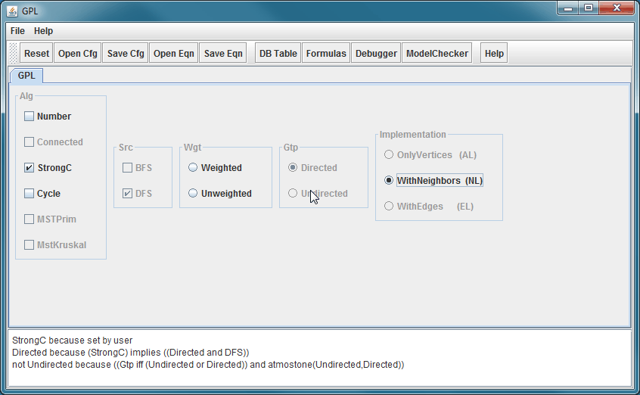
Demo GuiDsl
Notes:
At this point we demo the out-of-the-box GuiDsl that comes with the ATS.

Slide 3
WebGuiDsl Goals
Present GuiDsl functionality through a web interface
This semester’s progress is specific to GPL interface
Run on CS web servers
Limited us to PHP or CGI
No Java servlets
Temporary files must be created in a world writable directory ☹
Notes:
The first goal of WebGuiDsl is to present the functionality of GuiDsl in a web interface. Currently, the only working WebGuiDsl feature model is GPL but the design of WebGuiDsl should allow rapid development for future feature models. Only client-side code must be altered (see Future Work slide).
The second goal was to implement this functionality in a manner that is compatible with the UTCS web server. That is we needed to be able to deploy the application without any special privileges. The obvious choice of languages for WebGuiDsl was Java and Java’s native web application technology, servlets, since the AHEAD Tool Suite is written in Java. This was not an option, however, since the CS web servers limited us to running PHP or CGI for dynamic content. Additionally, all PHP and CGI content is run as a restricted user named “www”. This forced us to create a world-writable directory to create temporary files in.

Slide 4
Technologies Leveraged
Python CGI
jQuery JavaScript library
Easily navigate and modify DOM
Helps with Ajax requests and event handling
BlockUI jQuery plugin
Simulate synchronous Ajax behavior without locking the browser
http://jquery.malsup.com/block/
Google-gson
Serialize Java Objects into JSON Objects
http://code.google.com/p/google-gson/
Notes:
We chose to write our CGI scripts using Python because it contains modules that handle temporary directories and zip files with ease.
We chose to use the jQuery JavaScript library for its powerful ability to select and modify DOM elements and its support for handling Ajax requests. Additionally, we chose to use the BlockUI jQuery plugin availible at http://jquery.malsup.com/block/. This plugin allows us to simulate synchronous Ajax behavior without locking the browser which is the default behavior in many browsers if you send an Ajax request with the synchronous flag.
The final piece of technology that we leveraged is the Google-gson library. This Java library provides methods to serialize Java Objects from the Java programs running on the server into JavaScript Object Notation (JSON) objects which can be understood by JavaScript engines.

Slide 5
WebGuiDsl for GPL Contents
New GuiDsl feature – WebTool
Provides programmatic interface like existing Tool feature
Provides a method that calls SAT solver for a given number of set variables and returns a 2D JSON array consisting of variable values (set/not set) and reasons for the values
Java program – WebGuiDsl
Interacts with WebTool
Notes:
The first part of our implementation involved creating a new feature in GuiDsl called WebTool. The WebTool feature is similar to the existing Tool interface in GuiDsl in that it provides another programming interface to GuiDsl. WebTool exposes a method that takes in a list of features that the user wants to select. The method then calls the SAT solver available in GuiDsl to determine the values for other variables. The method returns the values for all the variables and the reasons that they have the values.
A simple Java program named WebGuiDsl is required to interact with the WebTool feature in GuiDsl.

Slide 6
WebGuiDsl for GPL Contents
Python CGI scripts
webguidsl.cgi
compose.cgi
HTML page – gpl.html
Nothing special, just a form with <input> tags
JavaScript – webguidsl.js
Initializes event handlers
Updates DOM
Notes:
WebGuiDsl contains two CGI scripts. webguidsl.cgi responds to requests as the user makes selections and compose.cgi composes the desired product from the GPL and zips the files.
gpl.html defines the presentation to the user as a form with the appropriate <input> tags.
webguidsl.js handles all the client-side logic. It creates all the event handlers, send Ajax requests, and updates the user interface when the server responds to an Ajax request.

Slide 7
WebGuiDsl for GPL
Client
Server
webguidsl.js
WebGuiDsl
(Java Program)
Set features and reasons
webguidsl.cgi
(Python CGI script)
User selected
features
GuiDsl
(new WebTool feature and SAT solver)
Action:
Validate model
Action:
DOM is updated
Action:
user wants to compose GPL
Action:
Action:
User Interface Blocks until response
(BlockUI jQuery plugin)
Action:
user selects GPL feature
composer
jak2java
All selected
features
compose.cgi
(Python CGI script)
Zip of all output
javac
xhtml2html
Notes:
Let’s look at a use case for WebGuiDsl:
Suppose the user selects an available feature by clicking on it in the interface. The following sequence of events will occur:
An Ajax request is sent to the server with a list of all the features that the user has selected. The client’s user interface will block until it gets a reply from the server.
webguidsl.cgi will handle the Ajax request. It passes the list of user selected features to a Java program called WebGuiDsl which uses the new WebTool feature of GuiDsl to determine the values for all variables and the reason for each value. WebGuiDsl then writes a JSON array to standard out which webguidsl.cgi captures and sends back to the client.
webguidsl.js will then update the DOM appropriately to reflect the results generated by the SAT solver.
Now suppose that the user wants to compose a specific product. The following sequence of events will occur:
webguidsl.js will attempt to validate that all required selections have been made. If they have not an error message is displayed.
All features to compose are sent to compose.cgi.
compose.cgi calls composer with all requested features, jak2java, javac, and xhtml2html.

Slide 8
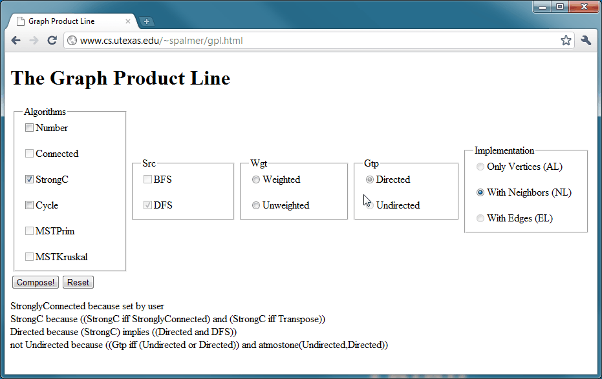
Demo WebGuiDsl
Notes:
At this point we demo a live version of WebGuiDsl for GPL actually running on the CS server!

Slide 9
Joe’s slides on other packages and benchmarking methods

Slide 10
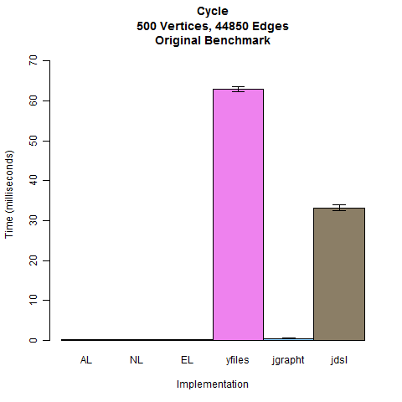
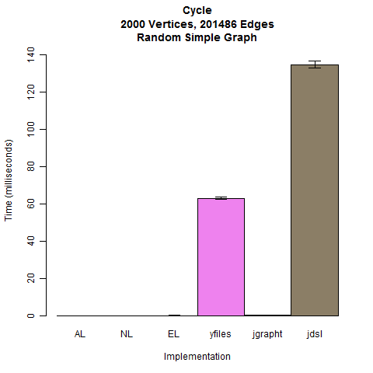
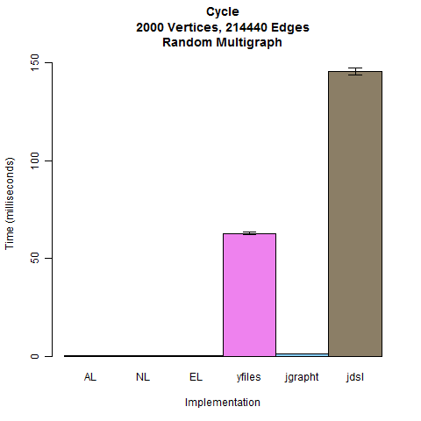
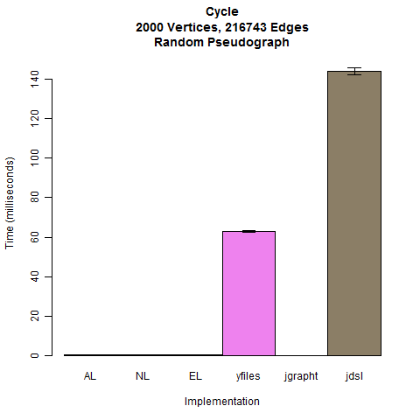
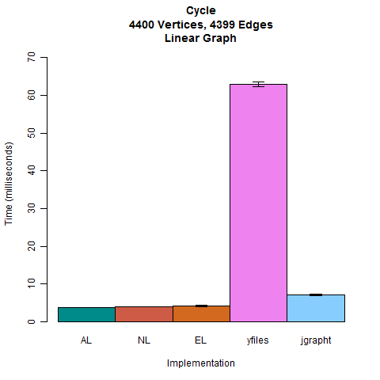

Slide 11
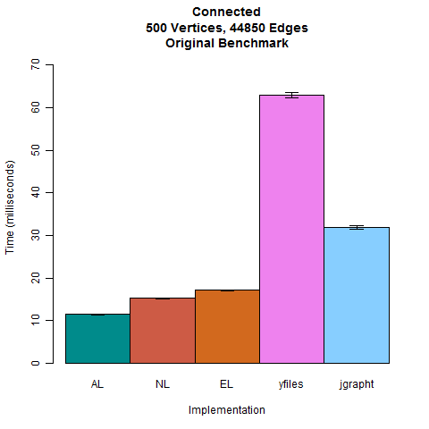
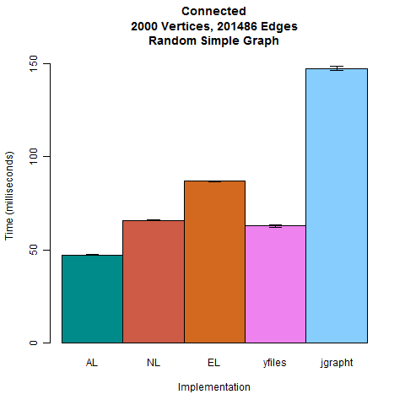
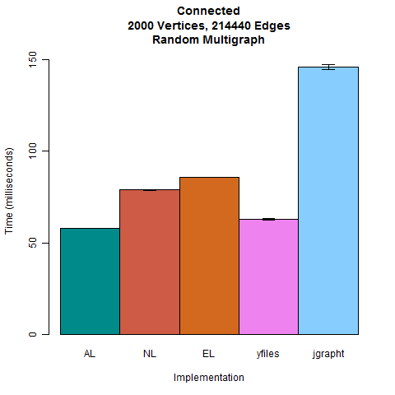
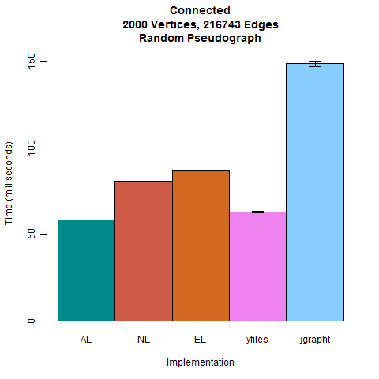
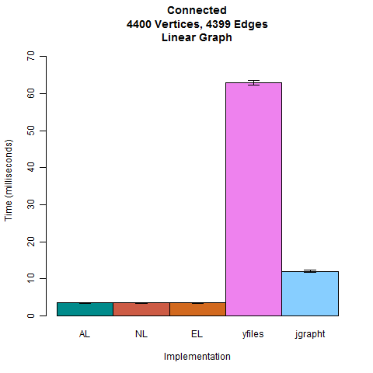

Slide 12
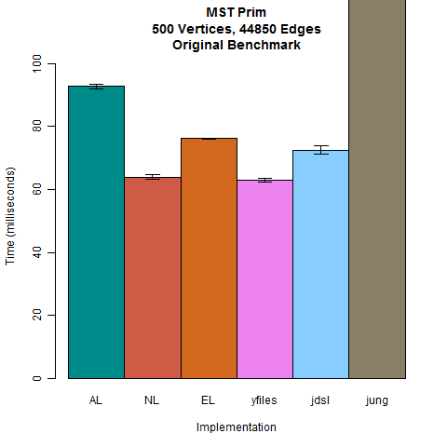
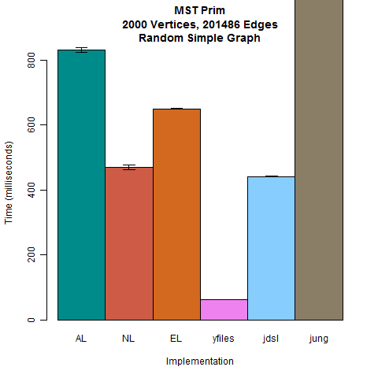
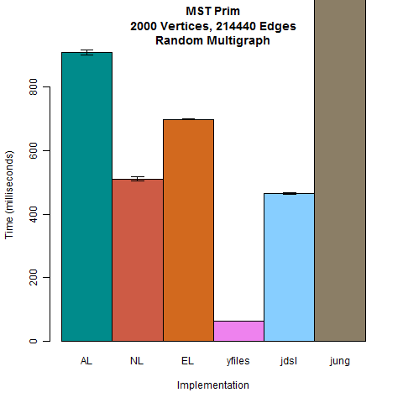
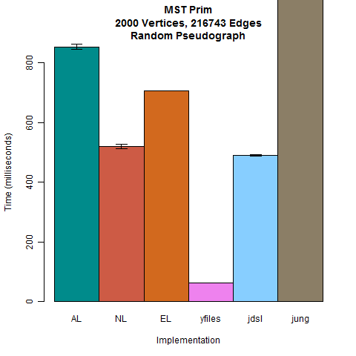
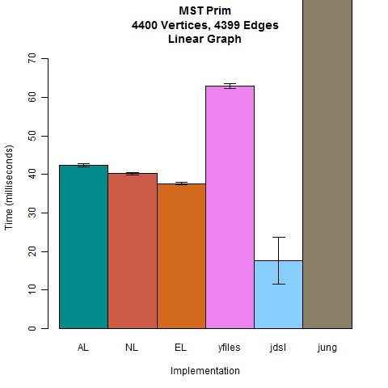

Slide 13
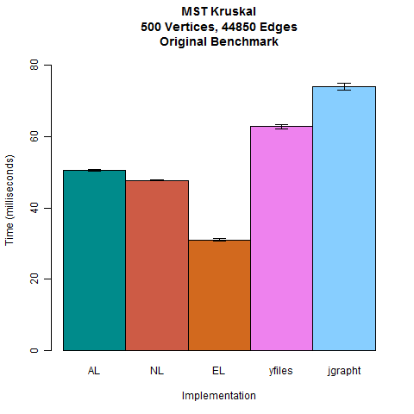
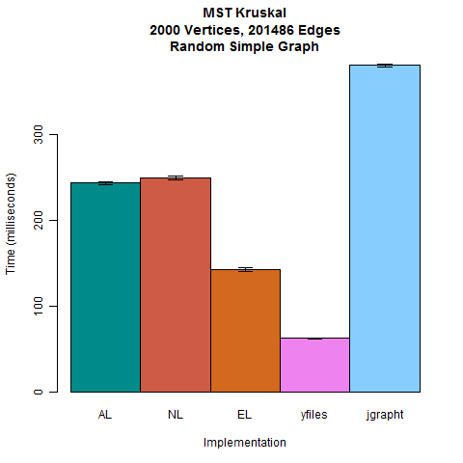
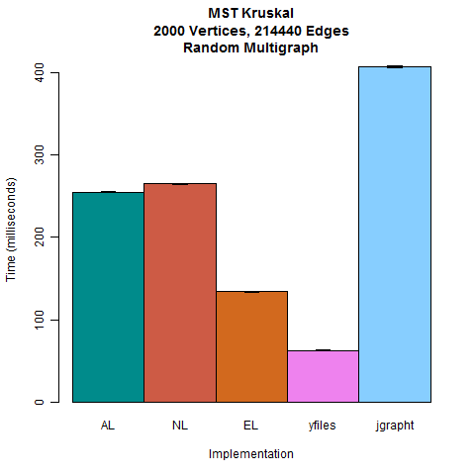

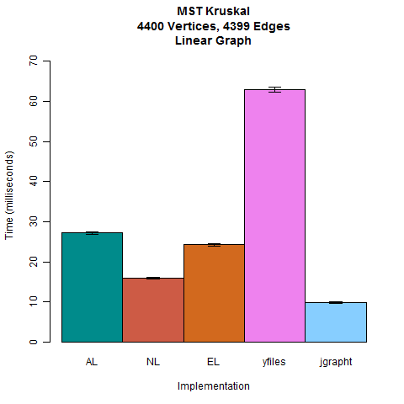

Slide 14
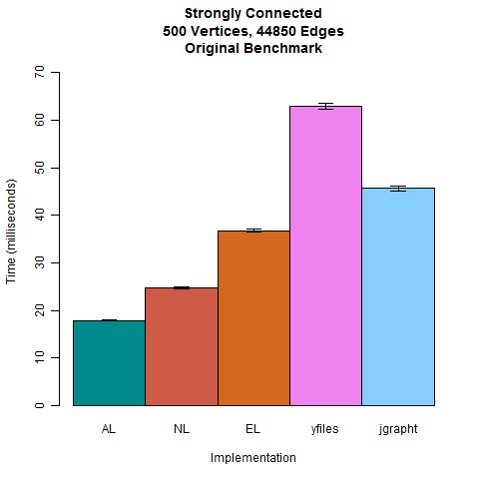
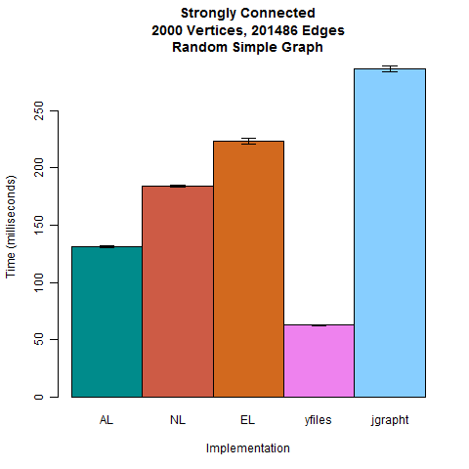
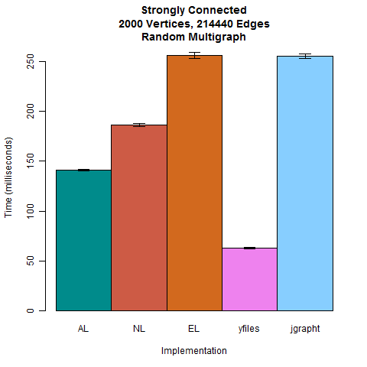
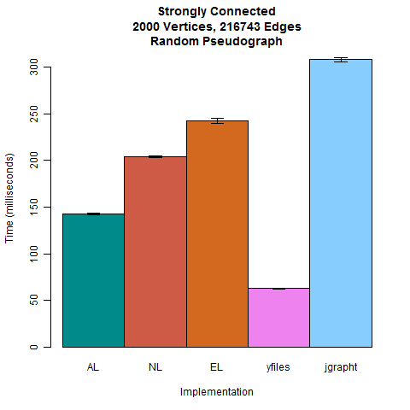

Slide 15
Conclusions
GPL is at least as fast as the other implementations with the provided 500 verticy graph
Maybe you get what you pay for
yFiles seems faster with arbitrary graphs
For the price of $2,700 + $810 annual subscription (single developer price)
$18,000 + $5,400 annual subscription to peek at the source code
Be thankful for 30-day trials

Slide 16
Future Work
WebGuiDsl for GPL can be generalized for any feature model
Only client code would change
Currently webguidsl.js has GPL specific code
Currently
Non-Existent
Tool
mymodel.html
mymodel.m
validatemymodel.js
Notes:
Currently WebGuiDsl is specific to GPL. This, however, does not mean that it was built without a larger picture in mind. The validation function in webguidsl.js is the only one that is specific to GPL. The server-side portion of this application is completely independent of GPL.
While outside of the scope of this semester’s project, we envision a tool that can read a model file (e.g. mymodel.m) and produce the corresponding HTML document and validation JavaScript. This JavaScript file can then be used in conjunction with the model independent JavaScript code.
Another option would be to move validation to the server.

