Slide 1
Joe’s intro to GPL slides

Slide 2
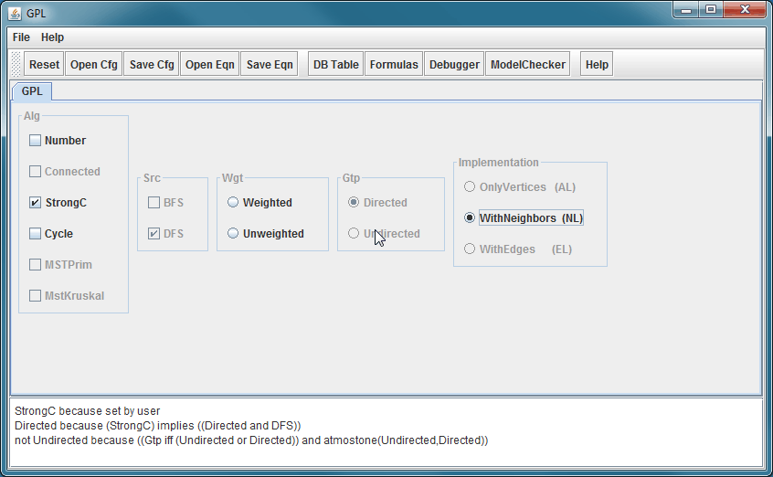
Demo GuiDsl

Slide 3
WebGuiDsl Goals
Present GuiDsl functionality through a web interface
This semester’s progress is specific to GPL interface
Run on CS web servers
Limited us to PHP or CGI
No Java servlets
Temporary files must be created in a world writable directory ☹

Slide 4
Technologies Leveraged
Python CGI
jQuery JavaScript library
Easily navigate and modify DOM
Helps with Ajax requests and event handling
BlockUI jQuery plugin
Simulate synchronous Ajax behavior without locking the browser
http://jquery.malsup.com/block/
Google-gson
Serialize Java Objects into JSON Objects
http://code.google.com/p/google-gson/

Slide 5
WebGuiDsl
Client
Server
webguidsl.js
WebGuidsl
(Java Program)
Set features and reasons
gpl.cgi
(Python CGI script)
User selected
features
GuiDsl
(new WebTool feature and SAT solver)
Action:
DOM is updated
Action:
user wants to compose GPL
Action:
Action:
user selects GPL feature
composer
jak2java
All selected
features
compose.cgi
(Python CGI script)
Zip of all output
javac
xhtml2html

Slide 6
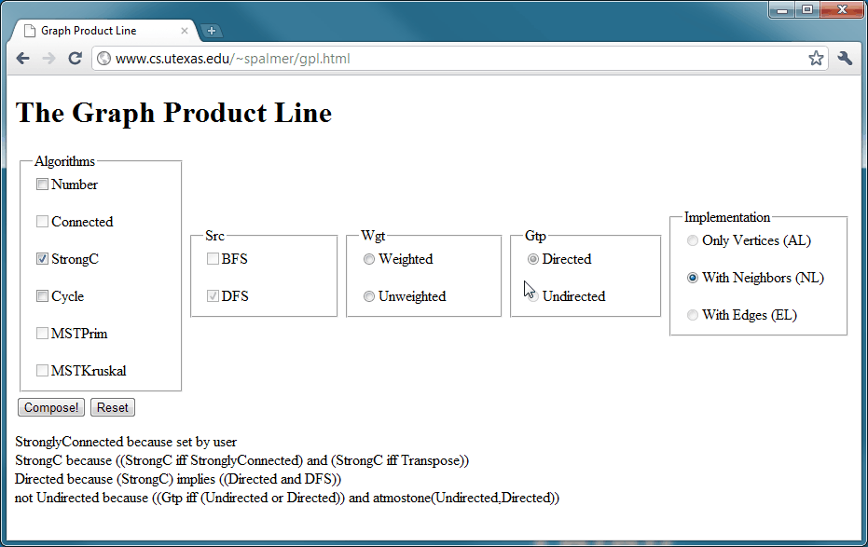
Demo WebGuiDsl

Slide 7
Joe’s slides on other packages and benchmarking methods

Slide 8
Results

Slide 9
Future Work

