Slide 1
GuiDsl for GPL
Web
Samuel Palmer
Joe Elizondo
Notes:
We are going to present to you our project, a web application for GUIDSL and GPL. We call it [click mouse] Web GUIDSL for GPL. Our two main goals for this project were:
to create a web application for GuiDsl and,
to see how the GPL programs that are generated compare to other available java graph algorithm packages.

Slide 2
Graph Product Line
Review of GPL
Demo GuiDsl
Introduce WebGuiDsl
Introduce Algorithms
Java Packages
Experiments
Results
Future Work
Notes:
Here is an outline of where we are going, we start with a review of GPL and talk about how we’ve seen it used throughout the semester. We will also demo the existing GUIDSL as a refresher. After that we introduce WebGUIDSL. Then the algorithms that GPL makes available. We then talk about the java packages for graph algorithms that we tested GPL against, we discuss some details of our experiments and their results and we close with future work.

Slide 3
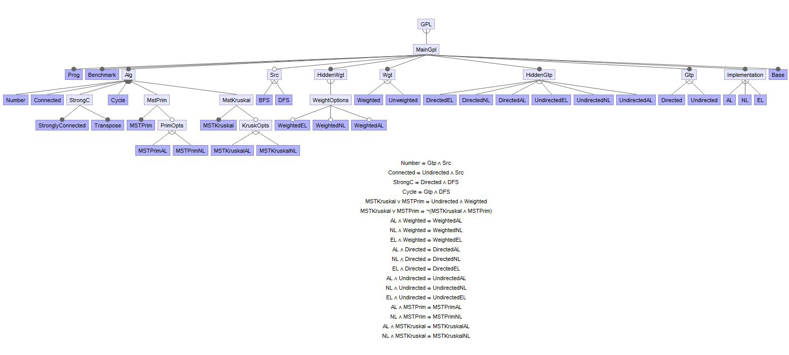
GPL as an example of a feature model
Notes:
One place we saw GPL this semester was during out discussion of feature models. GPL is a feature model with a feature tree and cross tree constraints.

Slide 4
Compose an algorithm given certain constraints
©
Again ignore AL, NL, EL for now
(top-most)
ordering
unimportant (commutative)
MSTPrim
Number
MSTKruskal
Algorithm
Cycle
Connected
StrongC
Search
BFS
DFS
Constraints
Edge Weight
Weighted
UnWeighted
Constraints
Graph Type
Directed
Undirected
(bottom-most)
Notes:
By selecting valid feature combinations the users builds a program that executes a customized graph algorithm. Feature tree and additional cross-tree constraints are propagated as features are selected. This prevents users from making mistakes and having to backtrack on their selections. GPL is a software product line, it is a family of related programs that are built by transformations or increments in functionality.

Slide 5
Graph Representations
Graph Type
Graph Weight
Type of Search
Algorithm
One more feature set…
Graph Data Representation
Directed
Undirected
Weighted
UnWeighted
BFS
DFS
Number
StrongC
MSTPrim
Cycle
Connected
MSTKruskal
Adjacency List
Neighbor List
Edge List
Notes:
We’ve seen the following features make up the Graph Product line (graph type, graph weight, type of search, and graph algorithm) but GPL has one more feature set and that is the different way the Graph itself is implemented and how it stores data. The three ways are Adjacency Lists, Neighbor Lists, and Edge Lists.

Slide 6
Adjacency Lists Representation (AL)
Graph Object
9
V1
9
V1
V1
V3
V3
V3
Vertices List
V1
V2
V3
V1
7
7
11
Vertex Object (V1)
V2
V2
V2
Adjacent
Vertices
V2
V3
Weights List
7
9
Graph Example
2 classes: Graph, Vertex
Pros
simple, matched legacy design of earlier work
Cons
edges must be computed from adjacency lists
a parallel list for each edge annotation (weight), a hack
complicates algorithms that manipulate explicit edges
Next Design Update
Eliminate parallel lists
Notes:
An adjacency list represents a graph in the following way that this animation attempts to explain clearly. There is a graph object that holds a list of vertices. There is a vertex object, for each vertex in the graph it holds a list of the vertices adjacent to that vertex. For a graph with weighted edges another “parallel” list is required to hold the weights. So there are two classes, graph and vertex. This is a simple design but it is limited because some graph algorithms require explicit edge manipulation which cannot be done with an adjacency list because there are no explicit edges. The next implementation takes care of the parallel list problem.

Slide 7
Neighbor List Representation (NL)
Graph Object
9
V1
9
V1
V3
V3
Vertices List
V1
V1
V2
V3
7
7
11
Vertex V1
V2
V2
List of Neighbors
V2
V3
Vertex
Object
Graph Example
Integer
Weight
Neighbor Object
7
9
3 classes: Graph, Vertex, Neighbor
Pros
list accesses to obtain annotations are reduced
simplified design of some features
Cons
algorithms that manipulate edges explicitly still must compute them from Neighbors list
redundancy in edge annotations
some algorithms need to sort edges by the weights
Next Design Update
represent edges explicitly
Notes:
The neighbor list for the most part is the same as the adjacency list. The graph object still holds a list of vertices. The vertex object still exists but instead of a list of adjacent vertices it holds Neighbor objects. A new neighbor class holds both a vertex and an integer weight value. For each vertex a neighbor object is created for the vertices adjacent to it and these neighbor objects are then stored in a list. So now an algorithm only has to access one list to get the neighbor and respective edge weight, but it doesn’t solve the problem of handling edges explicitly. There is redundancy and there is no way to sort by edge weight.

Slide 8
Edge List Representation (EL)
Graph Object
9
Edges List
9
V3
Vertices List
V1
V3
V1
V3
V1
V1
V1
V1
V2
V3
E1
E2
E3
11
7
11
7
11
7
List of Neighbors
V2
V2
V2
Vertex Object (V1)
V2
V3
Graph Example
Neighbor
Object
E1
E2
Edge Object (E1)
E1
Edge E2
E2
Edge E3
E3
V1
V2
7
V1
V3
9
V2
V3
11
4 classes: Graph, Vertex, Neighbor, Edge
Pros
supports algorithms that manipulate edges explicitly
easier to add new algorithms – lift out of textbooks
algorithm specifications cleaner
less redundancy
Cons
equating conceptual objects with physical objects may simplify source code, but is this efficient?
is premature design optimization essential for performance?
Notes:
This representation is the most common for graphs and how almost all graph algorithms expect the data to be stored. The Graph object still contains a vertex list and the vertex object still exists, but now there is a new edge class. We build explicit edge objects. We still have neighbor objects and they are contained within a list in each vertex object. But now instead of an integer weight the neighbor object contains an edge object. We also add an edge list to the graph object.

Slide 9
GPL as an example of Kubes
AL, NL, and EL represent different encodings of graphs
Implementations of other features are effected by the choice of AL, NL, or EL
Connected Number Cycle DFS BFS Weighted Directed Undirected
AL
Connected_{AL} | Number_{AL} | Cycle_{AL} | DFS_{AL} | BFS_{AL} | Weighted_{AL} | Directed_{AL} | Undirected_{AL}
Connected_{NL} | Number_{NL} | Cycle_{NL} | DFS_{NL} | BFS_{NL} | Weighted_{NL} | Directed_{NL} | Undirected_{NL}
Connected_{EL} | Number_{EL} | Cycle_{EL} | DFS_{EL} | BFS_{EL} | Weighted_{EL} | Directed_{EL} | Undirected_{EL}
NL
EL
array
program_{NL} = Cycle_{NL} ⋅ Connected_{NL} ⋅ DFS_{NL} ⋅ UnWeighted_{NL} ⋅ Undirected_{NL}
program_{AL} = Cycle_{AL} ⋅ Connected_{AL} ⋅ DFS_{AL} ⋅ UnWeighted_{AL} ⋅ Undirected_{AL}
Notes:
We also saw GPL used as an example of Kubes during the semester. Adding the different encodings of graphs that we just discussed produces a product line of product lines or a 2D Kube. A program could be constructed by valid composition of features from any one of the three rows. As an example this slide shows two possible programs one using the neighbor list implementation and the other using the adjacency list.

Slide 10
Remember this Slide?
Project away unneeded columns
Project away unneeded rows
Contract the array to produce the feature expression for the desired program
Connected Number Cycle DFS BFS Weighted Directed Undirected
Common
Connected | Number | Cycle | DFS | BFS | Weighted_{C} | Directed_{C} | Undirected_{C}
 |  |  |  |  | Weighted’_{AL} | Directed’_{AL} | Undirected’_{AL}
 |  |  |  |  | Weighted’_{NL} | Directed’_{NL} | Undirected’_{NL}
 |  |  |  |  | Weighted’_{EL} | Directed’_{EL} | Undirected_{C}
Connected | Number | Cycle | DFS | BFS | Weighted_{C} | Directed_{C} | Undirected_{C}
 |  |  |  |  | Weighted’_{AL} | Directed’_{AL} | Undirected’_{AL}
 |  |  |  |  | Weighted’_{NL} | Directed’_{NL} | Undirected’_{NL}
 |  |  |  |  | Weighted’_{EL} | Directed’_{EL} | Undirected’_{EL}
Connected | Number | Cycle | DFS | BFS | Weighted_{C} | Directed_{C} | Undirected_{C}
 |  |  |  |  | Weighted’_{AL} | Directed’_{AL} | Undirected’_{AL}
 |  |  |  |  | Weighted’_{NL} | Directed’_{NL} | Undirected’_{NL}
 |  |  |  |  | Weighted’_{EL} | Directed’_{EL} | Undirected_{C}
AL
NL
EL
Cycle DFS Directed
Common
Cycle | DFS | Directed_{C}
 |  | Directed’_{EL}
Cycle ⋅ DFS ⋅ Directed’_{EL} ⋅ Directed_{C}
EL
Notes:
Our last review slide shows an improvement to the design of the previous slide. This slide adds a row for commonalities is to solve the problem of code redundancy in the previous slide and the blank cells can be viewed as the identity transformation. We can build a program by a composition of transformations projecting away unneeded columns and rows and the folding or contracting the kubes to produce our program. (The composition is still under feature model tree and cross-tree constraints)

Slide 11
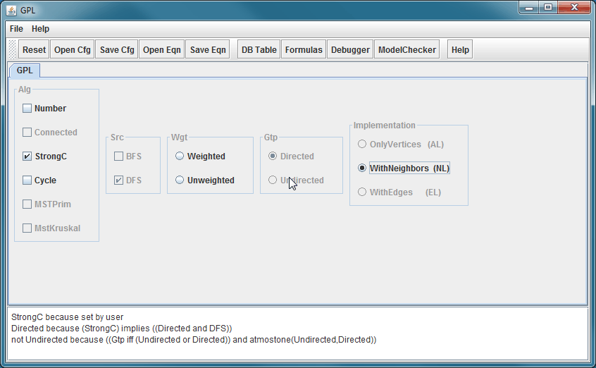
Demo GuiDsl
Notes:
At this point we demo the out-of-the-box GuiDsl that comes with the ATS.

Slide 12
WebGuiDsl Goals
Present GuiDsl functionality through a web interface
This semester’s progress is specific to GPL interface
Run on CS web servers
Limited us to PHP or CGI
No Java servlets
Temporary files must be created in a world writable directory ☹
Notes:
The first goal of WebGuiDsl is to present the functionality of GuiDsl in a web interface. Currently, the only working WebGuiDsl feature model is GPL but the design of WebGuiDsl should allow rapid development for future feature models. Only client-side code must be altered (see Future Work slide).
The second goal was to implement this functionality in a manner that is compatible with the UTCS web server. That is, we needed to be able to deploy the application without any special privileges. The obvious choice of languages for WebGuiDsl was Java and Java’s native web application technology, servlets, since the AHEAD Tool Suite is written in Java. This was not an option, however, since the CS web servers limited us to running PHP or CGI for dynamic content. Additionally, all PHP and CGI content is run as a restricted user named “www”. This forced us to create a world-writable directory to create temporary files in.

Slide 13
Technologies Leveraged
Client
Server
jQuery JavaScript library
Easily navigate and modify DOM
Helps with Ajax requests and event handling
Used by webguidsl.js for most UI functionality
BlockUI jQuery plugin
Simulate synchronous Ajax behavior without locking the browser
http://jquery.malsup.com/block/
Used by webguidsl.js to display a “please wait” message when making feature selections
Python CGI
Used for any client/server communication that happens in between the HTML form and the java program.
Passes information from the client to a java program on the server and vice versa.
Google-gson
Serialize Java Objects into JSON Objects
http://code.google.com/p/google-gson/
Notes:
We chose to write our CGI scripts using Python because it contains modules that handle temporary directories and zip files with ease.
We chose to use the jQuery JavaScript library for its powerful ability to select and modify DOM elements and its support for handling Ajax requests. Additionally, we chose to use the BlockUI jQuery plugin availible at http://jquery.malsup.com/block/. This plugin allows us to simulate synchronous Ajax behavior without locking the browser which is the default behavior in many browsers if you send an Ajax request with the synchronous flag.
The final piece of technology that we leveraged is the Google-gson library. This Java library provides methods to serialize Java Objects from the Java programs running on the server into JavaScript Object Notation (JSON) objects which can be understood by JavaScript engines.

Slide 14
WebGuiDsl for GPL Contents
New GuiDsl feature – WebTool
Provides programmatic interface like existing Tool feature
Provides a method that calls SAT solver for a given number of set variables and returns a 2D JSON array consisting of variable values (set/not set) and reasons for the values
Java program – WebGuiDsl
Interacts with WebTool
Notes:
The first part of our implementation involved creating a new feature in GuiDsl called WebTool. The WebTool feature is similar to the existing Tool interface in GuiDsl in that it provides another programming interface to GuiDsl. WebTool exposes a method that takes in a list of features that the user wants to select. The method then calls the SAT solver available in GuiDsl to determine the values for other variables. The method returns the values for all the variables and the reasons that they have the values.
A simple Java program named WebGuiDsl is required to interact with the WebTool feature in GuiDsl.

Slide 15
WebGuiDsl for GPL Contents
Python CGI scripts
webguidsl.cgi
compose.cgi
HTML page – gpl.html
Nothing special, just a form with <input> tags
JavaScript – webguidsl.js
Initializes event handlers
Updates DOM
Notes:
WebGuiDsl contains two CGI scripts. webguidsl.cgi responds to requests as the user makes selections and compose.cgi composes the desired product from the GPL and zips the files.
gpl.html defines the presentation to the user as a form with the appropriate <input> tags.
webguidsl.js handles all the client-side logic. It creates all the event handlers, send Ajax requests, and updates the user interface when the server responds to an Ajax request.

Slide 16
WebGuiDsl for GPL
Client
Server
webguidsl.js
WebGuiDsl
(Java Program)
Set features and reasons
webguidsl.cgi
(Python CGI script)
User selected
features
GuiDsl
(new WebTool feature and SAT solver)
Action:
Validate model
Action:
User wants to compose GPL
Action:
User Interface Blocks until response
(BlockUI jQuery plugin)
Action:
DOM is updated
Action:
Action:
User selects GPL feature
composer
jak2java
All selected
features
compose.cgi
(Python CGI script)
Zip of all output
javac
xhtml2html
Notes:
Let’s look at a use case for WebGuiDsl:
Suppose the user selects an available feature by clicking on it in the interface. The following sequence of events will occur:
An Ajax request is sent to the server with a list of all the features that the user has selected. The client’s user interface will block until it gets a reply from the server.
webguidsl.cgi will handle the Ajax request. It passes the list of user selected features to a Java program called WebGuiDsl which uses the new WebTool feature of GuiDsl to determine the values for all variables and the reason for each value. WebGuiDsl then writes a JSON array to standard out which webguidsl.cgi captures and sends back to the client.
webguidsl.js will then update the DOM appropriately to reflect the results generated by the SAT solver.
Now suppose that the user wants to compose a specific product. The following sequence of events will occur:
webguidsl.js will attempt to validate that all required selections have been made. If they have not an error message is displayed.
All features to compose are sent to compose.cgi.
compose.cgi calls composer with all requested features, jak2java, javac, and xhtml2html.
Compose.cgi zips the files created and delivers the zip file to the client

Slide 17
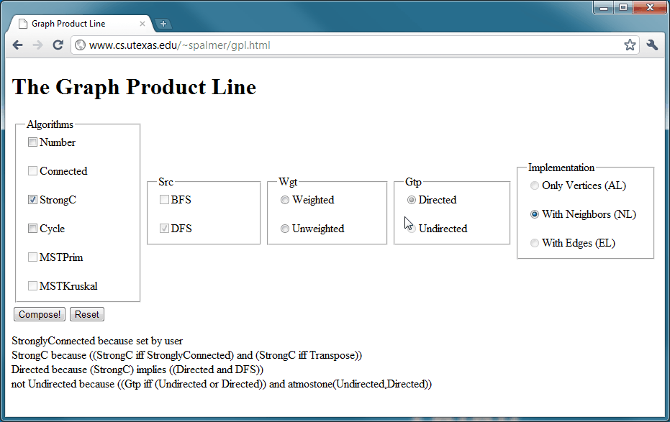
Demo WebGuiDsl
Notes:
At this point we demo a live version of WebGuiDsl for GPL actually running on the CS server!

Slide 18
Cycles
Directed Graph
A path of length 2 or more that connects a vertex to itself
Undirected Graph
A path of length 3 or more that connects a vertex to itself
Notes:
The next few slides will give a short review of the algorithms that can be composed using GPL. We found other java graph algorithm packages that implemented the same algorithms for our benchmark tests. The cycles test simply checks to see if the graph input contains a cycle. It returns true or false.

Slide 19
Cycles
CycleChecker
Set Flag
DFS
Return True
Done?
Return Flag
Throw Exception
Set Flag
Yes
No
Cycle?
No
Yes
Runs in O(|E|) time.
Notes:
One optimization we made to GPL for cycle checking can be demonstrated by this flow diagram. The original algorithm set a flag to true once a cycle was found but continued checking the graph for cycles regardless. We short circuited this behavior by throwing an exception when a cycle was detected at this point we exit out of the DFS and return true. Before the optimization other graph library cycle checkers ran faster than GPL, but currently GPL is faster because of the optimization.

Slide 20
Connected Graph
GPL uses either BFS or DFS to find connected components
b
f
b
f
h
h
a
a
e
e
c
c
g
g
d
d
This method works in O(|V||E|) time
Notes:
To find a connected graph GPL uses either a BFS or DFS. The algorithm checks each vertex and visits the edges for each. Real cost comes from having to run a search for every vertex. No extra cost comes from choosing BFS over DFS because they both run in linear time.

Slide 21
Strongly Connected Graph
GPL uses Kosaraju's algorithm
3. Depth first search on transposed graph
2. Reverse all Edges
4
3
4
3
4
3
a
b
a
a
b
b
a
a
b
b
1. Depth First Search to number vertices
d
c
d
c
c
d
c
d
d
c
1
2
1
2
1
2
Can be completed in O(|V|+|E|) time
Notes:
There are a handful of ways to find strongly connected components GPL uses Kosaraju’s algorithm. Strongly connected components are only defined for a directed graph. A component is strongly connected if for every vertex u in the connected component there is a path to every other vertex, v, in the component as well as a path from v back to u. When the algorithm backs out of recursion of the DFS it numbers the vertices, during the second DFS we start from the vertex with the highest number. The majority of the cost is in building a graph and reversing the edges.

Slide 22
Minimum Spanning Tree
Prim’s Algorithm
Loop while U ≠ V, where U and V are sets of vertices
Follow lowest cost edge in U and add that vertex to U
1
1
6
5
2
2
4
1
4
V = {1,2,3,4,5,6}
5
3
3
5
U = {1,3,6,4,2}
U = {1,3,6,4,2,5}
U = {1}
U = {1,3,6}
U = {1,3}
U = {1,3,6,4}
3
6
4
2
5
5
6
6
6
Prim’s algorithm runs in O(n²) time
Notes:
The implementation of Prim’s algorithm that GPL uses starts by adding a vertex to a set U and then evaluated each edge and following the lowest cost edge in to a vertex in V-U. That vertex is then added to U and it’s lowest cost edge is followed. This continues until the set of vertices U equals V, so every vertex has been visited.

Slide 23
Minimum Spanning Tree
Kruskals Algorithm
Sort edges and add the lowest cost edges in different
connected components.
Stop when all vertices are in one connected
component.
1
1
6
5
2
2
4
1
4
5
3
3
5
{1,3} = 1 {4,6} = 2
{2,5} = 3
{3,6} = 4
{1,4},{2,3},{3,4} = 5
{1,3} = 1 {4,6} = 2
{2,5} = 3
{3,6} = 4
{2,3} = 5
{1,3} = 1 {4,6} = 2
{2,5} = 3
{1,3} = 1 {4,6} = 2
{2,5} = 3
{3,6} = 4
{1,3} = 1 {4,6} = 2
{1,3} = 1
{1,3} = 1 {4,6} = 2
{2,5} = 3
{3,6} = 4
{1,4},{2,3},{3,4} = 5
{1,2},{3,5},{3,6} = 6
3
6
4
2
5
5
6
6
6
Kruskal’s algorithm runs in O(|E| log |E|) time
For a graph where |E| < V² we prefer Kruskal otherwise Prim
Notes:
Kruskals algorithm spends time sorting the edges and then selects the cheapest edge such that each vertex at the end of the edge does not belong to the same connected component. This continues until all vertices belong to the same connected component. The time complexity comes from sorting the edges. This is more efficient than Prim as long as the number of edges is less than the number of vertices squared.

Slide 24
Java Graph Algorithm Libraries
jdsl – open source
Cycle Tests
MSTPrim Tests
jgrapht – open source
Cycle Tests
Connected Tests
Strongly Connected Tests
MSTKruskal Tests
Notes:
Now I will talk briefly about some of the java graph algorithm packages we used to test against. We looked for popular packages that contained the same algorithms that GPL contains. We looked at four packages, jdsl, jgrapht, yfiles, and jung. As the slide shows jdsl had two of the algorithms we wanted to test and jgrapht had all of the algorithm aside from Prim’s. Both of these packages were open source.

Slide 25
Java Graph Algorithm Libraries
yfiles - closed source trial
Cycle Tests
Connected Tests
Strongly Connected Tests
MSTPrim Tests
MSTKruskal Tests
jung – open source
MSTPrim
Notes:
The other packages we used are yfiles and jung. yfiles is a closed source graph algorithm library that contained all of the algorithms we were looking to test GPL against. We also chose to use jung for one more test of Prim’s algorithm. jung is an open source library.

Slide 26
Experiment Data
Graph Data
Default GPL Graph
500 Vertices - 45,000 Edges
Random Simple Graph
One edge between any two vertices, no loops
2,000 Vertices – 201,486 Edges
Random Multigraph
Multiple edges are allowed (no loops)
2,000 Vertices – 214,440 Edges
Random Pseudograph
Multigraph that allows loops
2,000 Vertices – 216,743 Edges
Linear Graph
5,000 Vertices – 4,999 Edges
Notes:
We used the jgrapht package to generate different types of random graphs for test data. We generated the following graphs: a simple graph, which only allows one edge between any two vertices; a multigraph, which allows multiple edges between vertices but no loops (as specified by jgrapht); a pseudograph, which is multigraph that allows loops; and finally a linear graph to test our cycle checker. Based on our previous analysis we would expect Kruskal to outperform Prim for all of these graphs because of the number of |V|^2 is 4,000,000.

Slide 27
Test Environment
Processor Name AMD Athlon(tm) XP 3200+
Frequency 2200.00MHz
Cache Size 512kb
Total Memory 960872 kB
Notes:
All benchmarking was done on the same hardware a single core 2.2Ghz AMD Athlon.

Slide 28
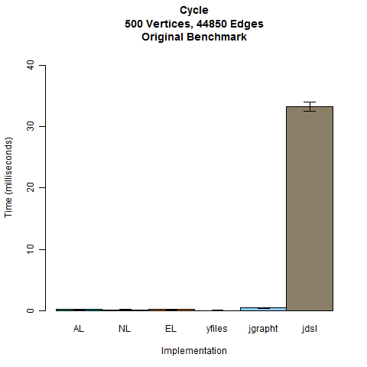
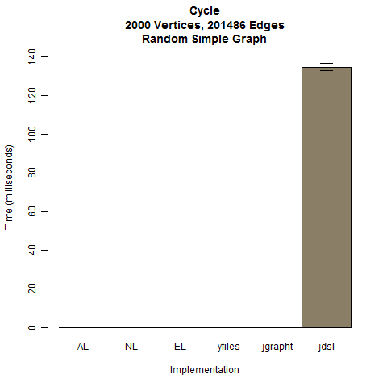
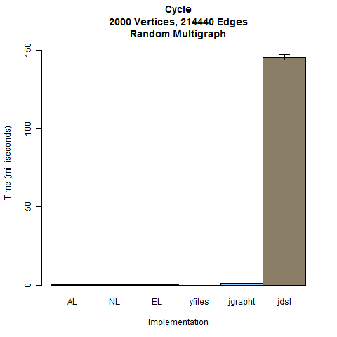
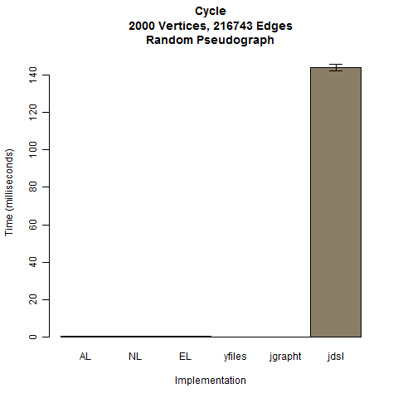
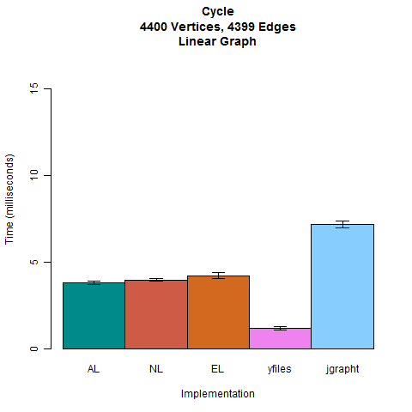
No statistical
difference between
AL and EL. NL is faster.
yFiles is fastest.
No statistical
difference and faster
than yFiles and jgrapht
No statistical
difference between
AL and NL. yFiles is
fastest then AL and NL.
yFiles is fastest then
NL, then AL and EL
Notes:
These are the run-times for the algorithms to determine if a cycle exists in the graph.
AL, NL, and EL are different graph representations of GPL.

Slide 29
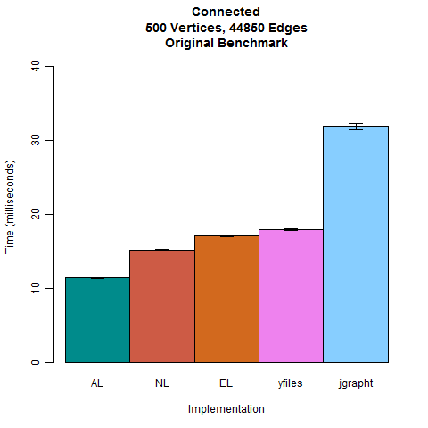
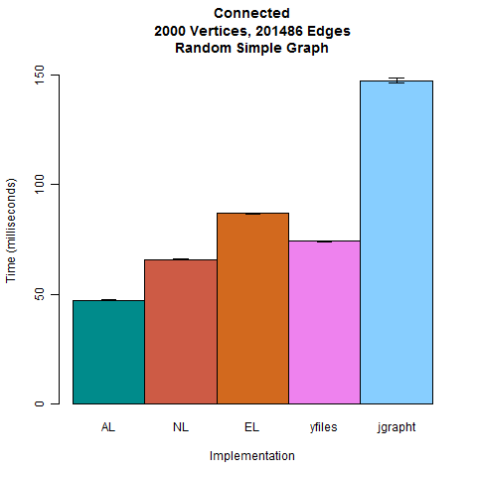
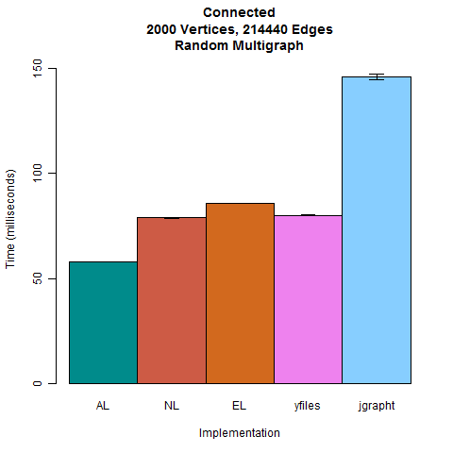

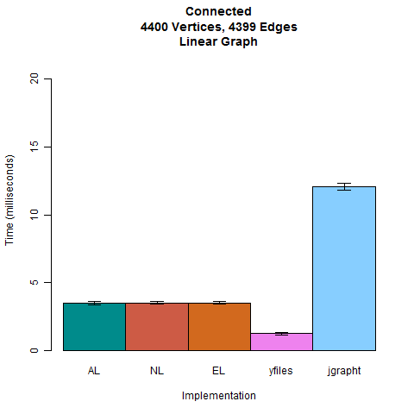
No statistical
difference
Notes:
These are the run-times for the algorithms to calculate connected components in the graph.
AL, NL, and EL are different graph representations of GPL.

Slide 30
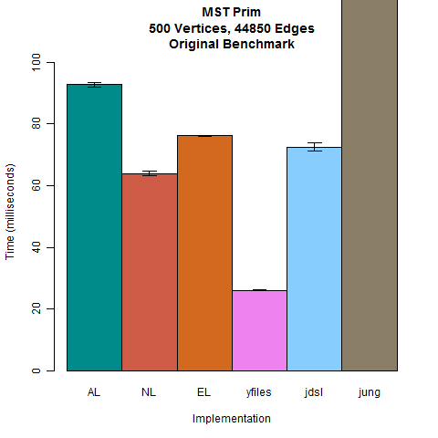
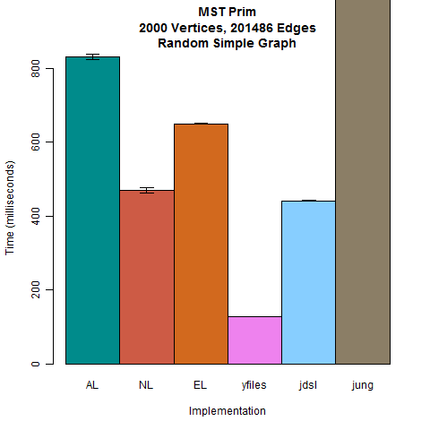
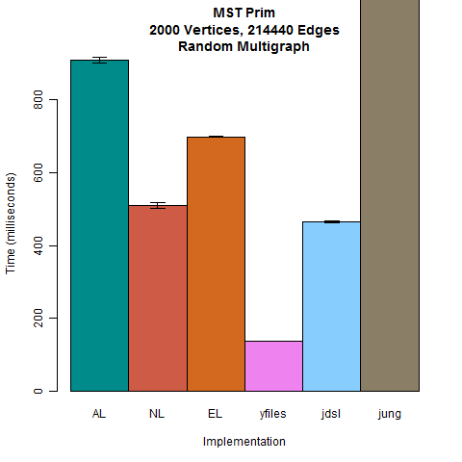
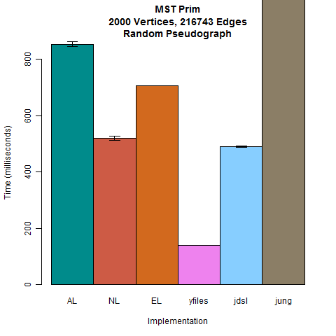
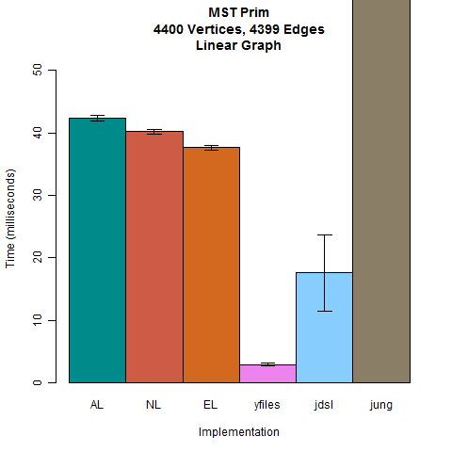
Notes:
These are the run-times for Prim’s minimum spanning tree algorithm.
AL, NL, and EL are different graph representations of GPL.

Slide 31
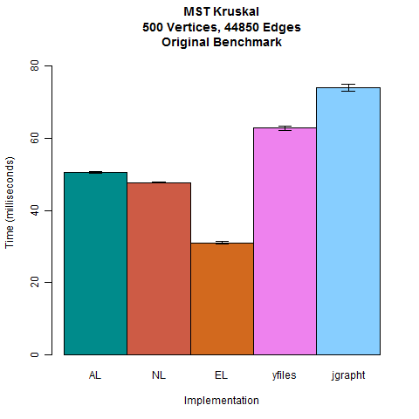
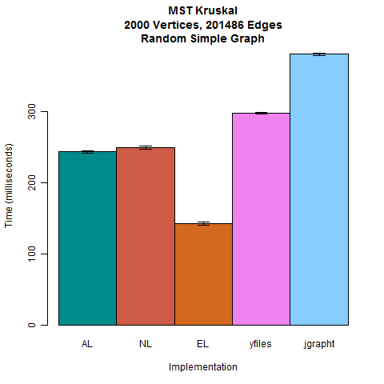
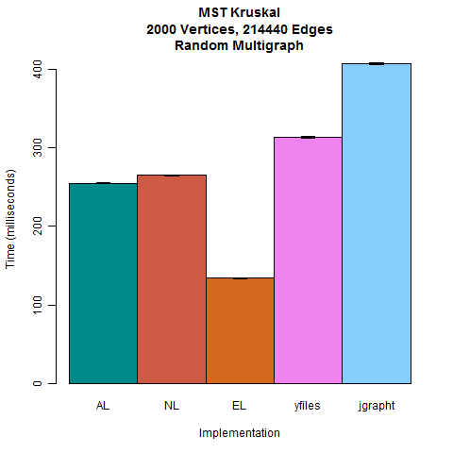

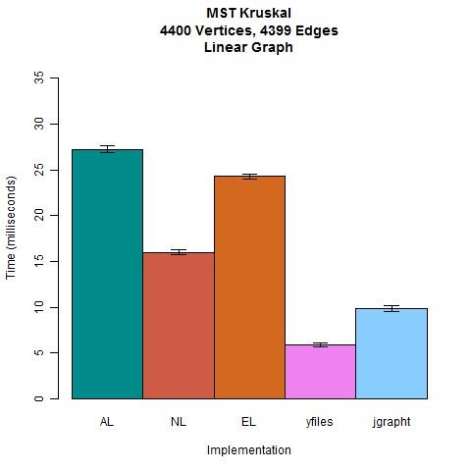
Notes:
These are the run-times for Kruskal’s minimum spanning tree algorithm.
AL, NL, and EL are different graph representations of GPL.

Slide 32
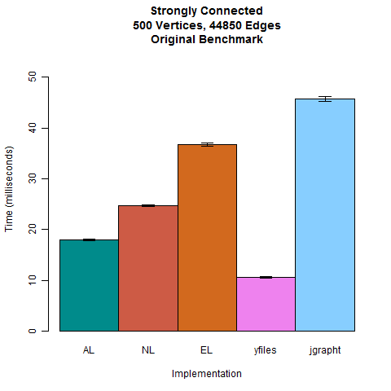
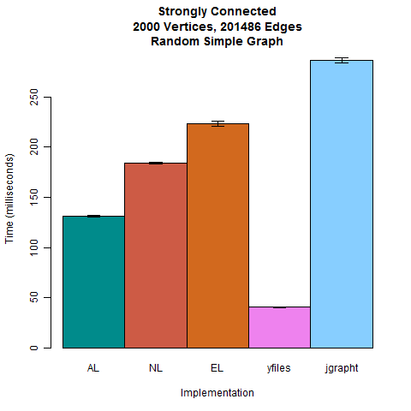
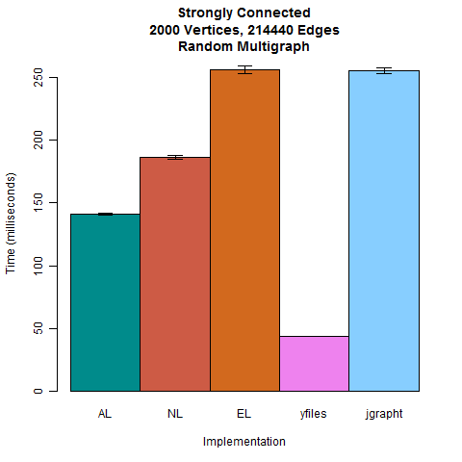
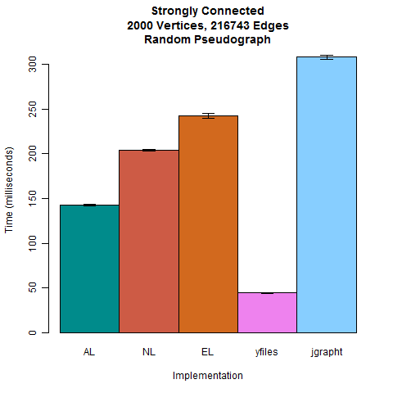
Notes:
These are the run-times for the algorithms that determine if the graph is strongly connected.
AL, NL, and EL are different graph representations of GPL.
The Linear Graph is absent because GPL’s algorithms continued to overflow the stack. Presumably, there is an infinite recursion error that manifests with that type of graph.

Slide 33
GPL Correctness
GPL passed all of our correctness tests.
Some algorithms (cycle checker) easier to verify correct than others.
A deeper analysis of correctness is left for future work.

Slide 34
Conclusions
GPL is at least as fast as the other implementations for most algorithms with the provided 500 vertex graph
Maybe you get what you pay for
yFiles seems faster with arbitrary graphs
For the price of $2,700 + $810 annual subscription (single developer price)
$18,000 + $5,400 annual subscription to peek at the source code
Be thankful for 30-day trials

Slide 35
Future Work
WebGuiDsl for GPL can be generalized for any feature model
Only client code would change
Currently webguidsl.js has GPL specific code
Currently
Non-Existent
Tool
mymodel.html
mymodel.m
validatemymodel.js
Notes:
Currently WebGuiDsl is specific to GPL. This, however, does not mean that it was built without a larger picture in mind. The validation function in webguidsl.js is the only one that is specific to GPL. The server-side portion of this application is completely independent of GPL.
While outside of the scope of this semester’s project, we envision a tool that can read a model file (e.g. mymodel.m) and produce the corresponding HTML document and validation JavaScript. This JavaScript file can then be used in conjunction with the model independent JavaScript code. This would also reduce the somewhat tedious task of creating the HTML file. This is tedious because webguidsl.js requires input tag ids to be the exact name of the feature in the model since it selects objects based on the feature names.
Another option would be to move validation to the server.

