Slide 1

Financial Capability Workshop
Notes:
Minutes: 1

Slide 2
Today’s FinCap Workshop
$ | Strategy and practice: Identify strategies for setting and achieving financial goals and dreams. | … with a step-by-step financial action plan to increase income and savings, improve credit and reduce debt!
T | Taking stock: Assess your current financial situation to understand new and healthy possibilities. | … using a budget and savings plan, and understanding how financial products work!
E | Experience: Share and learn from the lessons and experiences of others. | … and strengthen the financial practice of our community!
P | Planning and action: Take the next steps toward your financial future by signing up for a one-0n-one session with your MEDA coach. | … enrolling in MEDA’s FREE full-service programs!

Slide 3
Core Services: Financial Capability & Coaching
“Financial education is what we know; financial capability is what we do.”
D
I
S
C
Debt: Pay down, negotiate and dispute debt.
Income: Benefits, taxes and career pathways.
Savings: Create and maintain a savings plan for short- and long-term goals.
Credit: Build and/or repair credit.
Financial coaching is included in every program to help you succeed!
Notes:
1 min

Slide 4


Community Brain Storming
How do…. - Income, Savings, Credit, and Debt -
affect our lives today?
Income
Credit
Savings
Debt

Slide 5

Next Steps
Work together for 12 months as a team: client and coach
Equip you with professional assistance, services, and safe financial tools
Help you reach your life financial goals
+
Increase Income
Improve Credit
Increase Savings
Reduce Debts
Individual Financial Goals
We are all:  Creative  Resourceful  Whole
★ C – Client-driven Goals  O – Ongoing Growth  A – Action Planning  CH – Checking In
Notes:
This slide links economic justice with participants life financial goals and MEDA programs.
Introduction of the four core outcomes: Income, Savings, Credit, Debt
*Outcomes should be circled on Workshop Action Sheet
1min

Slide 6
Three-Minute Financial Assessment
Do You … | Not yet | More or less | Yes
Have a written financial action plan that includes cost breakdowns of short- and long-term financial goals ?
Use a budget to manage money and track your expenses?
Review credit reports every three to six months, and understand how to establish and protect scores?
Feel in control of debts?
Know how different financial products work, and how to access and take advantage of them?
Know which benefits, subsidies and tax breaks you may qualify for in the state of California?
Do something specific every day to nurture your financial future?
Notes:
Ejercicio:
Pida a los participantes responder a las siguientes preguntas para determinar donde están con su manejo de las finanzas.
De ejemplos sobre establecer una meta financiera: “Mi meta es”…ahorrar $5 cada día, hacer un presupuesto con mi esposa/o, etc.

Slide 7
Goal Setting: The SMART Way
“A goal without a plan is only a wish”
S
M
A
R
T
Specific
Measureable
Actionable
Realistic
Time-Bound

Slide 9

Debt
So what can you do about debt?
Credit card
Medical
Homeownership
Student Loan
Collections Tax (City, State, Federal)
Personal Loans
Family/
Car Title Loans
Pay Day Loans
Refund Anticipation Loans
Loan Sharks
Expenses

Slide 10
Reducing Our Debt
Plan: Establish a written financial action plan
Budget: Using your budget add all amounts to calculate total amounts of monthly debt/surplus.
Save: Using your MEDA budget sheet, set a monthly savings goal and timeline for paying all debts
Check Your Credit Report: For accuracy and debt totals for free: Online, www.annualcreditreport.com and @ MEDA and submit disputes if relevant.
Prioritize debts by deciding which bills to pay first, second, third, etc. Current active trade line debts are most important, followed by newest collections and judgments.
Organize: Gather and organize all additional debt correspondence, statements and personal debt amounts you have into a folder. Write down your total debt amount, debtors, and contact information into your MEDA Financial Action
Pay: Call up Collection Agencies indicated on your credit report and pay off all collections and public records. Most collectors will settle at 30% if you contact them, public records must be paid in full or in installments. Collections can only be on your credit report within 7 years of delinquency, know how old each collection is!
10

Slide 11

Benefits Screening @ MEDA
Everyone has a benefits screening done @ MEDA and find out if you and your family qualify for financial support programs in the City of San Francisco and the State of California

Slide 12
Local Resources in San Francisco
Cal Works www.cdss.ca.gov/calworks/ www.benefits.gov/benefits (916) 657-2128
California LifeLine: www.californialifeline.com (877) 858-7463 Discount phone service for income-eligible customers
California Low Cost Auto Insurance: www.insurance.ca.gov (866) 607-8861
PG&E: www.pg&e.com (800) 743-5000
REACH (Relief for Energy Assistance through Community Help) Salvation Army at (800) 933-9677 (REACH)
SparkPoint Centers Bay Area: http://sparkpointcenters.org
211 Bay Area Helplink: http://211bayarea.org/san-francisco

Slide 13
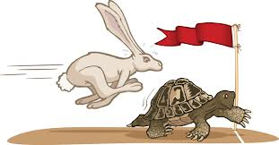
Savings Leaks
Saving every day | Instead of buying | Save x week | 6 months | 2 years | 5 years | 20 years
$1 | Gum | $7 | $183 | $730 | $1,825 | $7,300
$4 | Coffee | $28 | $730 | $2,920 | $7,300 | $2,9200
$7 | McD’s | $49 | $1,281 | $5,110 | $12,775 | $51,100
$10 | Drink @ Bar | $70 | $1,830 | $7,300 | $18,250 | $73,000
$25 | Restaurant | $175 | $4,563 | $18,250 | $45,625 | $18,2500
$3 a day for 1 week
Notes:
1. Help a few clients with creating an action plan for saving based on their life financial goal. Once done, ask the client if this Saving Goal is realistic. If not, adjust it until they feel comfortable with the “Amount of Savings Per Month” and “# of Months to Achieve My Goal”.
2. Have the class go through their own action plan for saving in order to calculate their “Amount of Savings Per Month” and “# of Months to Achieve My Goal”.
3. Once done, have everyone go to their ACTION PLAN and under the INCREASE SAVINGS box write down the “Amount of Savings Per Month” and “# of Months to Achieve My Goal”.

Slide 14
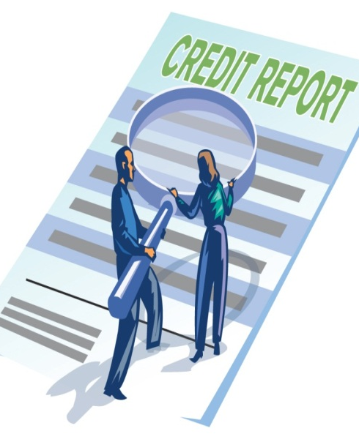
Credit Report
Single most powerful financial evaluation tool that exists about you and your debts in the United States.
Acts as your financial X-ray, debt resume and credibility report card, regardless of your immigration status
Constantly screened by lenders, creditors, employers, landlords and insurance companies for positive and negative information to quickly determine whether they will work with you and to set your interest rates.
Will open and close doors.
Notes:
1. Ask for a volunteer to read the definition.
2. Explain the function of a credit report. Ask how many people have ever seen their credit reports. How many have seen their credit report in the past 12 months? Past 6 months?

Slide 15

What’s in your Credit Report?
Personal Information: Name, addresses, date of birth, Social Security #.
Credit History: Lists balances, payment history and contact info for real estate, auto, student, and credit card accounts debts.
Collections and Public Records: Lists balances and contact info for all collections, judgments, tax liens and child support debts that you may owe to past creditors or that are currently held in a court of law.
Three Credit Scores: Your numerical evaluations or national grades.
Does Not Contain: Gender, politics, status, religion, income, orientation.
Accuracy Is Crucial: All report info must be correct and yours. Inaccurate reports can lead to hundreds of thousands of dollars in increased rates, inability to rent apartments, employment difficulty, loan denial, lack of financing and lack of upward mobility, plus lack of equity and justice.

Slide 16



FICO Credit Scores
16
FICO Credit Score Range: 300-850
(Fair Isaac’s Corporation – 1956)
Big Three National Credit Bureaus
All Three Credit Scores Are Important: Know your whole story and how you’re being judged!
TransUnion | 732
Equifax | 687
Experian | 720
TUC
EFX
XPN

Slide 17
100 Percent Credit Score Control
Always pay on time.
Keep balances low.
Let accounts grow.
Don’t ask for more.
Show variety.

Slide 18








Financial Products @ MEDA
Savings and Checking Accounts | Protected Bank Accounts
Secured Credit Cards | Establish and Build Healthy Credit
Prepaid Debit Cards | Direct Deposit and Cash Management
Adelante Fund small business loans | Build Credit and Increase Savings
Lending Circles and Fresh Start Loans | Finance Business and Build Credit
K2C | Kinder to Collegue
US Savings Bonds, CD’s | Protected Savings With Restricted Access
Computers and Internet @ Low Cost | Technology and Access
Benefits Screening | California Benefits

Slide 19
Financial Products @ MEDA Continued
Bank Accounts:
Even if you are in the Checks System due to a challenged banking history, there are still options for you! For example, a savings account at Self-Help Credit Union or similar
You can open a bank account, regardless of your immigration status!!
Documentation needed:
Government ID from any government (i.e passport, matricula, DL), Social Security card or ITIN letter, & proof of mailing address
Credit Building & Repair (and Savings) Products:
Secured credit cards and Fresh Start loans are a great way to build or repair credit history & build savings
Both are also available options even if you are undocumented!!

Slide 20

Establishing or Rebuilding Credit
If you currently have no healthy active trade lines, it will be important to establish a new trade line, take good care of it and through this process, prove yourself financially in the United States to the three credit bureaus. Open a credit builder secured credit card at MEDA, or participate in a Lending Circle!
Active trade lines on our credit reports are the single most important elements to maintain healthy and agile, representing 90 percent of our total scores.
Real Estate
Installment
Revolving
Notes:
Explain the difference between the 3 types of credit.
Talk about the importance of having the 3 types.

Slide 21
The High Cost of Credit
Before making a major asset purchase, improve your credit scores first
The higher your FICO® credit score, the lower your payments For example, on a $450,000 Principle, 30 year fixed rate mortgage:
A 100 point difference in credit score = $160,000 over the lifetime of the loan That’s enough money to realize many of our financial dreams
FICO ® | Interest Rate | Monthly Payments | Total Interest Paid
760-850 | 4.00% | $2,148 | $382,034
700-759 | 4.25% | $2,213 | $403,879
680-699 | 4.50% | $2,280 | $443,066
660-679 | 4.75% | $2,762 | $544,303

