Slide 1


WELCOME TO
MEDA
Orientation
ORIENTATION
+

Slide 2


MEDA’S MISSION
MEDA’s mission is to strengthen low- and moderate- income Latino families by promoting economic equity and social justice through asset building and community development.

Slide 3
INTRODUCTION
What is your name?
If you had $1 million, what would you do with it?
1
2
+

Slide 4



YOUR FUTURE
What do you want
for your future?
How does it feel to
be there?
What values do you strive for?
5 MINS
+

Slide 5

YOUR FUTURE
Where are you today?
How does it feel?
How are you working towards your future?
5 MINS
+

Slide 6
Your
Future
6
5
1
MEDA can help!
1. Tax Preparation
2. Workforce Development
3. Housing Opportunities
4. Business Development
5. Adelante Fund
6. Financial Capability
4
2
3

Slide 7

Tax
Preparation
6
5
1
MEDA will help you prepare your taxes for free:
Free year-round tax return preparation
Apply for ITIN
Benefits screening and assessment for other related services
Self-employed tax education
4
2
3

Slide 8
Workforce
Development
6
5
1
One-on-one job coaching and job placement programs
Work with clients of any background: undocumented, formerly incarcerated, live in or around SF
Help you with resume, applications, networking, and referrals
Skills and job placement:
Mission Techies
Bilingual Bank Teller program
4
2
3

Slide 9
Housing
Opportunities
6
5
1
Workshops and one-on-one coaching to help you with your housing needs:
Rental assistance: find affordable rents
First time home buyers: learn how to buy a home in the SF Bay ($50 fee)
Homeowner assistance: help you keep your home through foreclosure prevention and refinancing
4
2
3

Slide 10
Business
Development
6
5
1
Variety of free services to help you get started or grow your small business:
Business workshops: training and certificate, 7 weeks
One-on-one consultations to help you develop your own business step by step
Business loans help to prepare a loan package to submit to a lender
4
2
3

Slide 11
Adelante
Fund
6
5
1
Micro lending program for small business owners:
Apply for $5,000-100,000 loan at 5-7% interest rate
Must also attend the business development 7-week course
No cost to apply
4
2
3

Slide 12

Financial
Capability
6
5
1
Together with a coach you can achieve your financial goals:
One-on-one coaching appointments to help you reach your life financial goals
Equip you with professional assistance, services, and safe financial tools
4
2
3

Slide 13




To assess our financial health,
We look to our four main factors…
Orientation
Debt
Income
Debt
Credit

Slide 14

Life
Goal

Slide 15
Debt can be both good and bad
In general it’s best to keep your debts low and pay off your debts as much as you can
Your Debt to Income ratio affects interest get
Debt
+

Slide 16
Evaluate your income and spending
Brainstorm ways to earn more money; look for a career path
Know your benefits: through employer and public benefits
Income
+

Slide 17
Saving is for everyone, not just the wealthy
Define what you’re saving for, and make a plan to start saving
Evaluate your income and spending and create a budget that includes setting aside savings
Savings
+

Slide 18
Your credit report is a detailed report of your credit history and current debts
Your credit report determines your credit score, and is used to decide interest rates, loan qualification, and even job qualification
Credit
+

Slide 19
Benefits, taxes, and career pathways
Negotiate and pay down debts
Debt
Income
Create and maintain a savings plan for short and long-term goals
Build and/or
repair credit
Savings
Credit

Slide 20
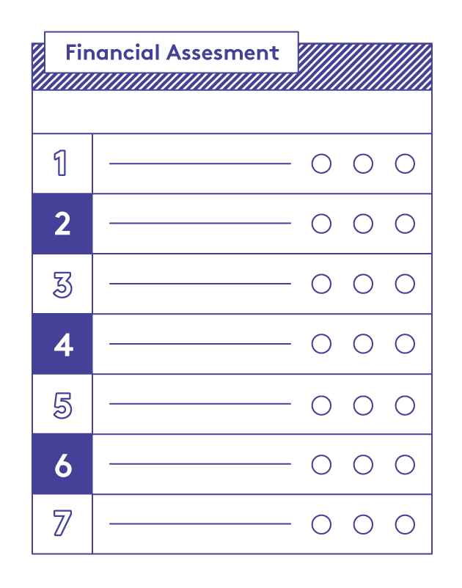
FINANCIAL ASSESSMENT
Fill out the Financial Assessment worksheet.
Be honest with yourself!
We will use this to help you think about your action plan.
3 MINS
+

Slide 21

YOUR JOURNEY FROM HERE TO THERE
Based on what we’ve talked about today, think about your journey.
What are all the things you think need to happen in order for you to achieve your future.
List them out!
3 MINS
+

Slide 22
YOUR COMMITMENT
Think about what you’re doing today and write down:
1
Thing you can start doing
(small steps are important!)
Thing should stop doing
Thing you can continue to do
1
1
3 MINS

Slide 23
Thank
You!
Orientation
MEDA
+

