Slide 1
TEAM CASSAVA
Team members:
Felix Kimeu,
Charles owusu-Ansah,
Ruth achiaa Frimpong,
brandon obasogie

Slide 2
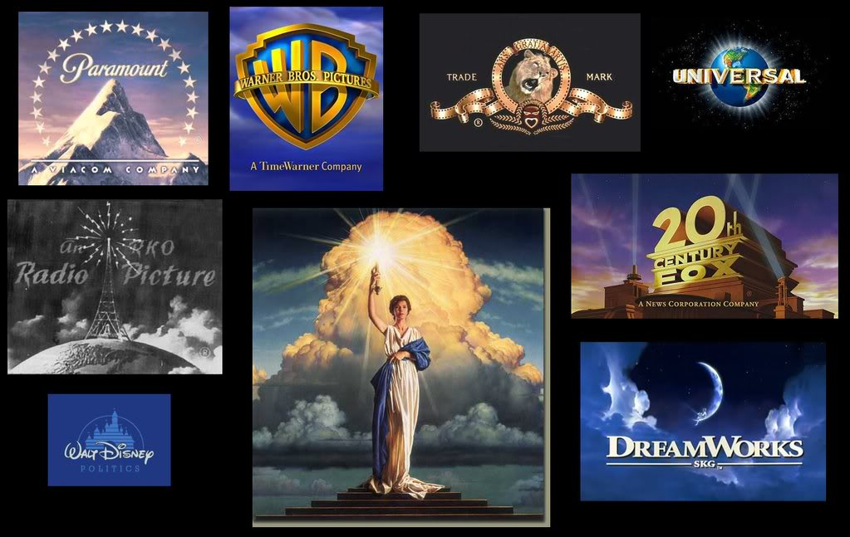
Overview:
Objectives
Data Cleaning Methods
Questions
Conclusions
Photo credit to :
https://panandslam.com/2017/04/07/5-times-hollywood-got-it-right/

Slide 3
Aim:
We intend to use an IMDB dataset to produce useful information for business and entertainment purposes by asking strategic questions.

Slide 4
Question 1:
Which studios have the best rate of return on their production budget for division acquisition ?
Develop a screening criteria to help users select a movie to watch based on the filters they apply.
Years with highly rated movies based on customized metascore.
Notes:
1. When major studios want to acquire subsidiaries, they use many factors among which is profitability,

Slide 5
Dataset Source:
Source : Kaggle.com
https://www.kaggle.com/stefanoleone992/imdb-extensive-dataset
Notes:
Facebook, Inc. is a social networking company that has acquired 89 other companies, including WhatsApp.
Disney own – pixar, espn , marvel and others
1. When major studios want to acquire subsidiaries, they use many factors among which is profitability,

Slide 6
Dataset Cleaning:
We visualized the dataset to understand and select the correct methods for our analysis.
We cleaned the data by dropping NAN, removing currency signs and performed other data pre-processing methods.
Notes:
1. When major studios want to acquire subsidiaries, they use many factors among which is profitability,

Slide 7
Question 1:
Which studios have the best rate of return on their production budget for division acquisition ?
Notes:
1. Disney owns pixar, espn, marvel
1. When major studios want to acquire subsidiaries, they use many factors among which is profitability,

Slide 8
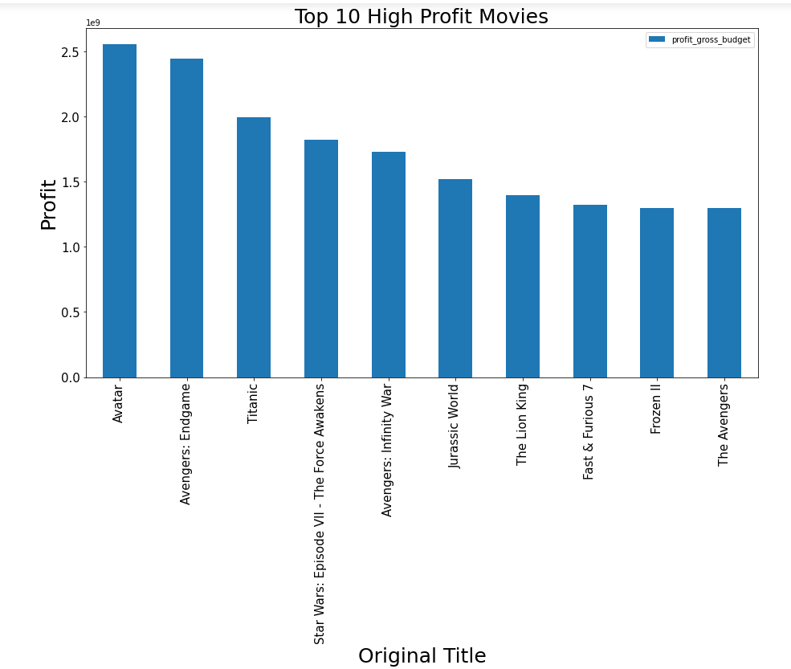
Studios Budgets & Profits
Workout the from
profit = gross - budget
Plotted top 10 profitable movies
Having one profitable movie does not necessarily makes a studio most profitable

Slide 9
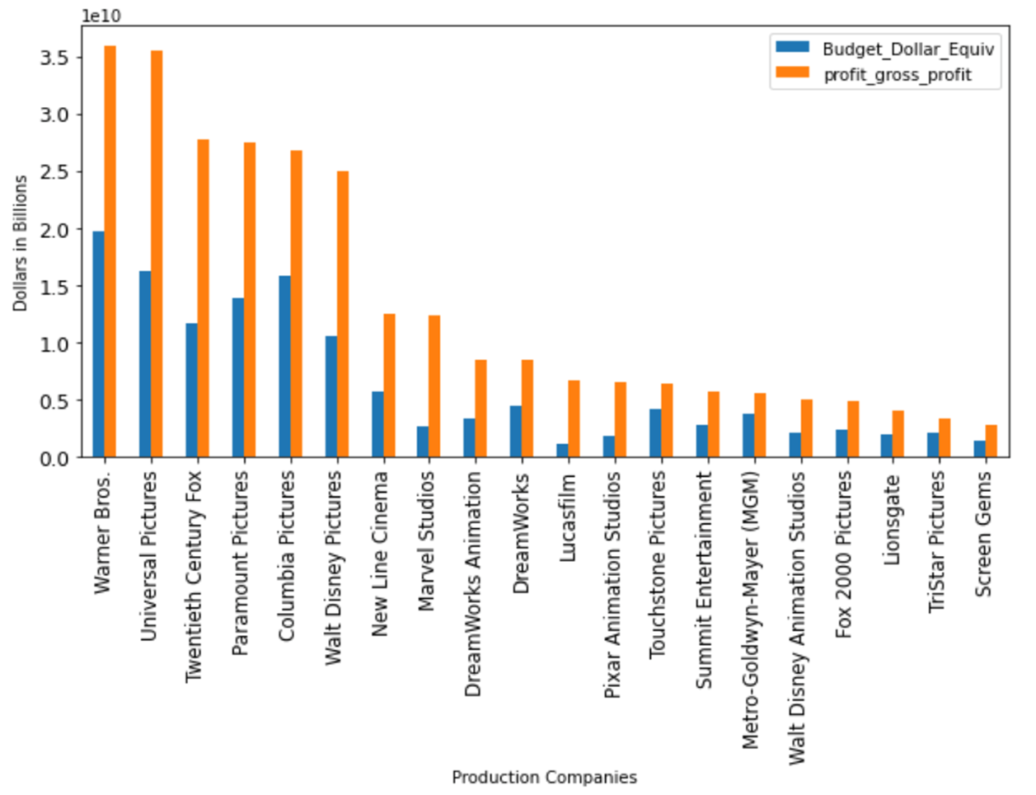
Studios Budgets & Profits
Deduced the profit/loss as follows:
profit = gross - budget
Produced 20 studios with topmost profit.
Plot the studios showing the budget and profit.

Slide 10
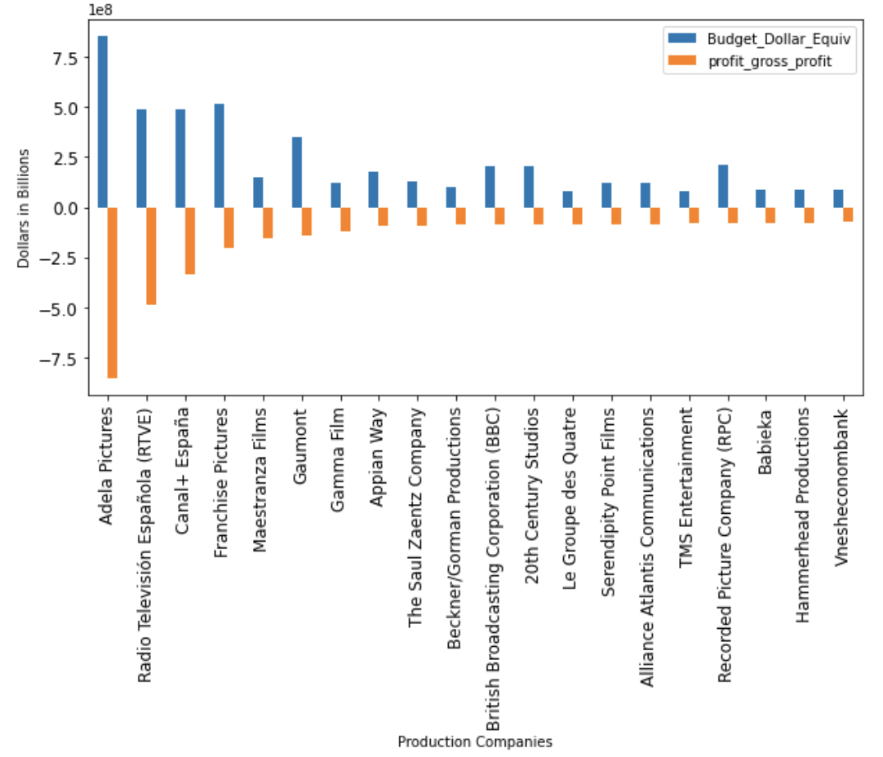
Studios Budgets & Profits Cont’d
Studios with greatest reported losses

Slide 11
Question 2:
Develop a screening criteria to help users select a movie to watch based on user input.

Slide 12
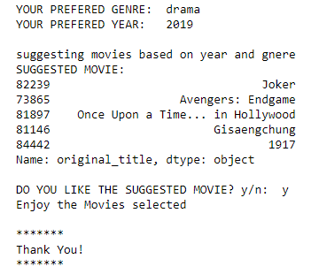
User Input:
PROVIDED | NOT PROVIDED
Year | genre
genre | year
 | genre and year
genre and year
Based on user’s input(s), movies are suggested.

Slide 13
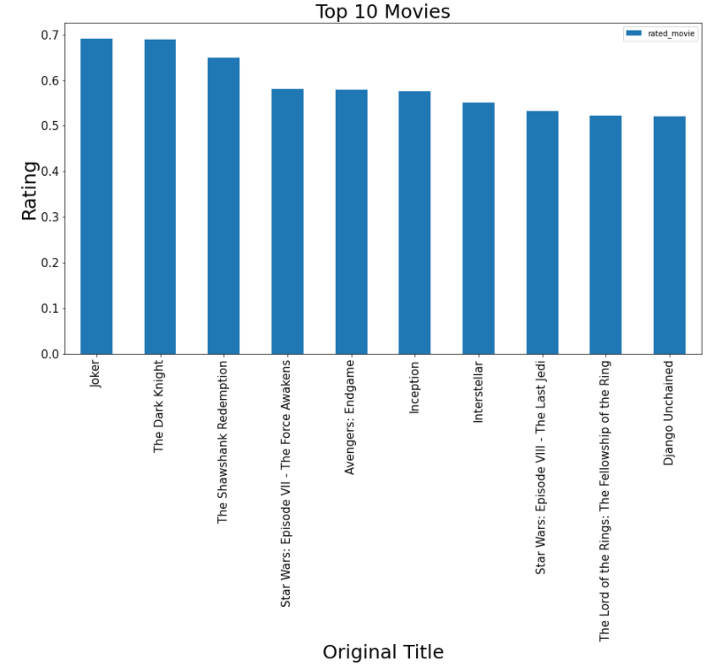

Slide 14
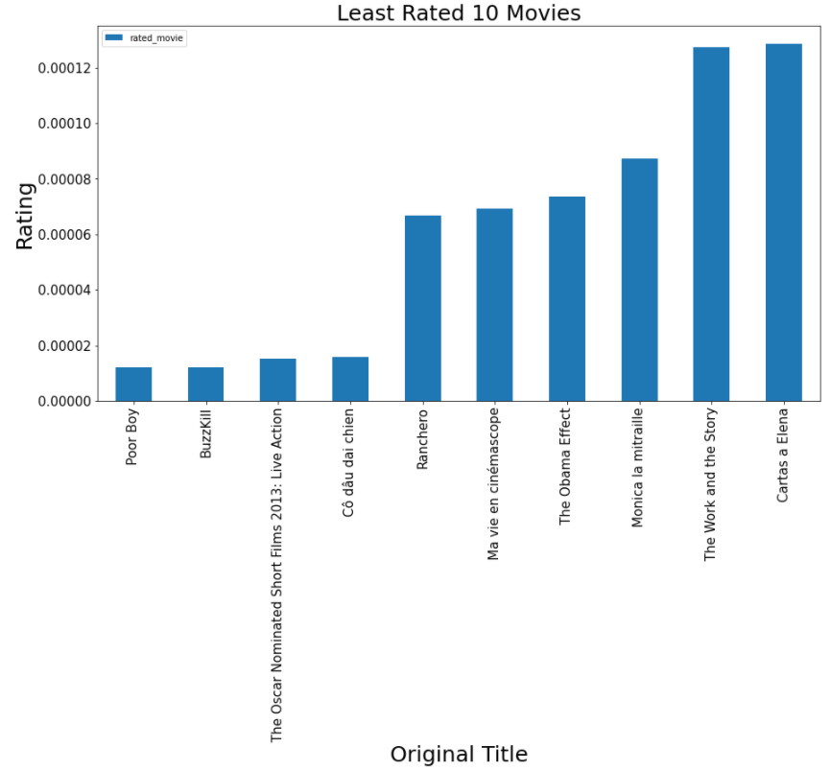

Slide 15
Question 3:
Years with highly rated movies based on customized metascore.
Metascore = the mean of normalized (Votes, user reviews and critics review)

Slide 16
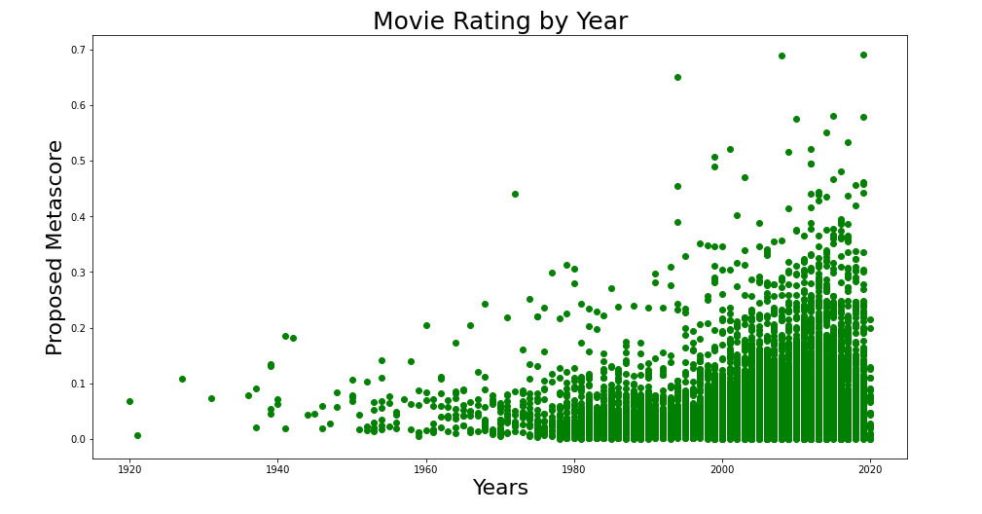

Slide 17
Challenges :
In experience with coding in python
Normalizing our data
Finetuning our questions

Slide 18
Conclusion :
We were able to produce information necessary for major studios to acquire subsidiaries, by finding the profits made by various studios
Enable a user to pick movies to watch based on inputs which are used to filter DataFrame to make Movie Suggestions

