Slide 1
Decentralized Shares by Toon Macharis

Slide 2
Contents
Design
Functionality of Smart Contracts (partial)
Demo (not yet)

Slide 3
I. Design
Cryptoshares
Cryptoshare Concepts
Relationships between Concepts
Important Decisions
Implementation
Three Separate Smart Contracts
Shares and Scrutineer – One or Two Contracts?
Shares and Scrutineer in a Smart Contract
Size Reduction of Smart Contract
Diamond Pattern
EIP-2535 Contract Interface
Types of Decentralized Exchanges
Which Exchange is Best?
Liquidity Pool Exchange Problems
Public Offering
Impermanent Loss Example
Liquidity Pool Exchange Audience
Order Book Exchange Audience
Stimulate Liquidity on Order Book Exchange
Arbitrage Chain
Equivalent Arbitrage Chains
Arbitrage Chain Break Up
Arbitrage Example
Exchange Smart Contract
Cryptoshares Adoption

Slide 4
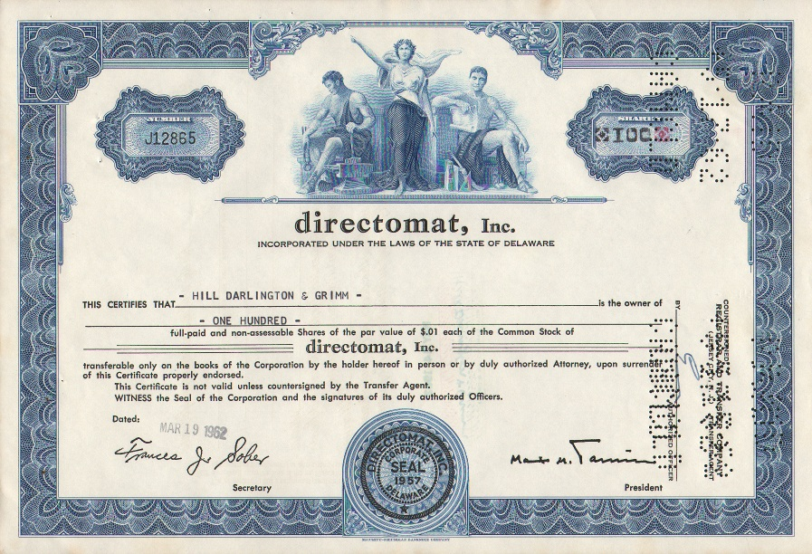
Cryptoshares
There exist a lot of cryptocurrencies on the Ethereum blockchain
What about cryptoshares = ownership of an organization?

Slide 5
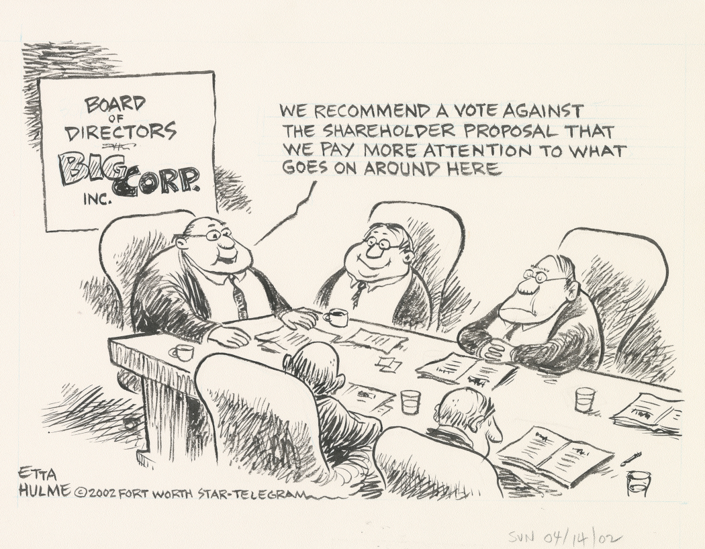
Cryptoshare Concepts
Company: an organisation with multiple stakeholders
Share: partial ownership of an organisation
Shareholder: someone who controls shares
Exchange: a place where shares are traded
Scrutineer: a place where votes are registered

Slide 6
Relationships between Concepts
Shareholders own part of a company through the shares they hold
Shareholders buy and sell shares through an exchange
Shareholders make important decisions through votes that are proportional to the number of shares they own
A Scrutineer validates decisions made by shareholders

Slide 7
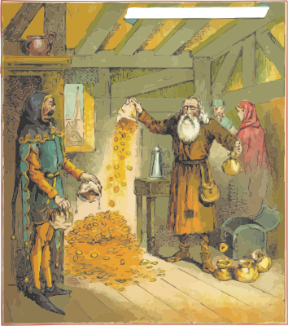
Important Decisions
A company issues shares that it can sell on an exchange to raise funds
A company repurchases its own shares from shareholders that want to reduce their stake in the company and may destroy the repurchased shares
A company distributes dividends among its shareholders
A scrutineer may have to validate these decisions

Slide 8

Implementation
Company: represented by an address, controls its shares
Share: an extension of ERC20 to allow the company to issue and destroy shares, to sell and buy its own shares on an exchange and to distribute dividends
Shareholder: represented by an address
Exchange: decentralized smart contract
Scrutineer: decentralized smart contract

Slide 9

Three Separate Smart Contracts
Smart contract for
  Shares: a reference smart contract, based on ERC20 and adding functionality
  Scrutineer: a reference smart contract that can be used by the shares smart contract to control the actions of the shares smart contract
  Exchange: crucial for raising funds and trading shares

Slide 10
Shares and Scrutineer – One or Two Contracts?
Together in one contract?
Or 2 separate contracts?
What do you think?

Slide 11
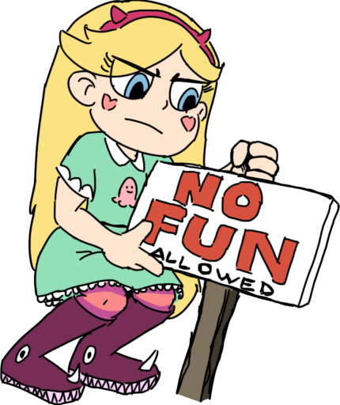
Shares and Scrutineer in a Smart Contract
It were 3 separate contracts!
Until I realized that the 3rd contract split off only gained 153 bytes in the main contract while introducing a lot of extra gas costs
Why?
  I tried one contract, but Ethereum forbids it. Compiled contracts can be 24 KB in size and no more (Spurious Dragon)
I ended up with 2 contracts:
  Scrutineer: 12035 bytes
  Share: 24058 bytes (518 bytes below limit after having removed 12 KB of the smart contract through restructuring it)

Slide 12
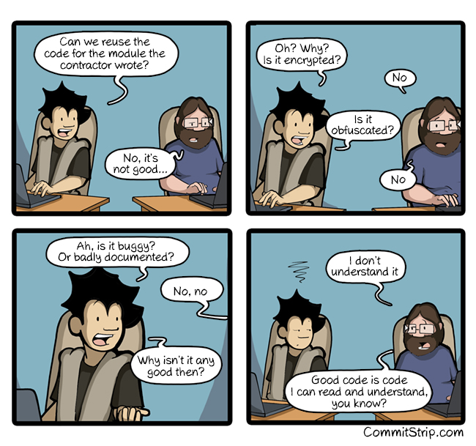
Size Reduction of Smart Contract
Split off some functionality to other smart contracts, this results in a net increase of the size of all contracts, but each individual contract is smaller than all contracts put together
  Scrutineer smart contract split off
Optimize the code in the contract
  Reuse code wherever possible: > 12 KB
  Remove code that can be put elsewhere: ? bytes
  Putting modifier code in a function: 400 bytes
  Drop error messages: 254 bytes

Slide 13
Diamond Pattern
There is a way to work around the contract size limit
It is called the “Diamond Pattern”
  Because a cut diamond has a lot of faces (or facelets)
  You are supposed to break up your contract in many separate contracts called facelets
  A diamond smart contract acts as your contract with no size limit and finds the right code in the facelets through assembly magic
The formal name is EIP-2535
There are actually 3 different reference implementations!
(You can trade off between complexity and gas costs)

Slide 14
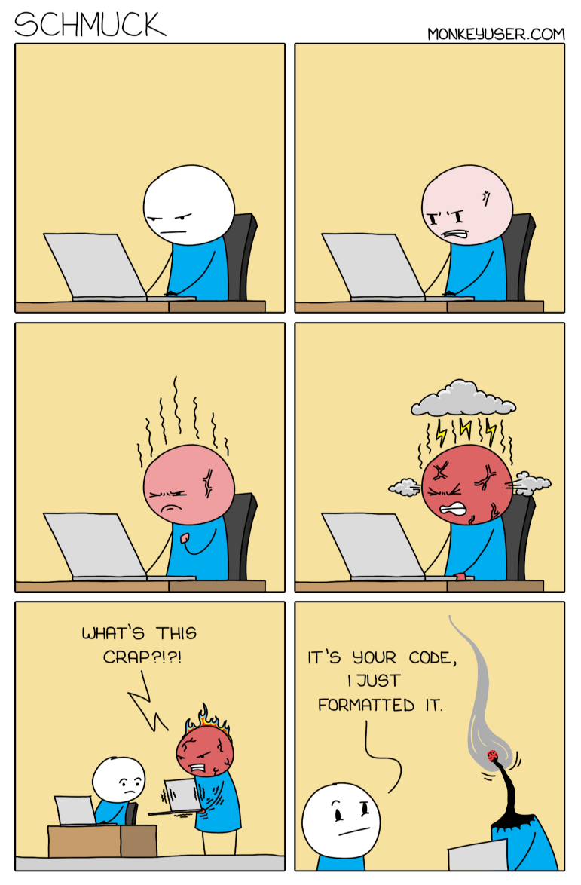
EIP-2535 Contract Interface
fallback() external payable {
LibDiamond.DiamondStorage storage ds;
bytes32 position = LibDiamond.DIAMOND_STORAGE_POSITION;
assembly { ds.slot := position }
address facet = ds.facetAddressAndSelectorPosition[msg.sig].facetAddress;
require(facet != address(0), "Diamond: Function does not exist");
assembly {
calldatacopy(0, 0, calldatasize())
let result := delegatecall(gas(), facet, 0, calldatasize(), 0, 0)
returndatacopy(0, 0, returndatasize())
switch result
case 0 { revert(0, returndatasize()) }
default { return(0, returndatasize()) }
}
}
No Way!

Slide 15
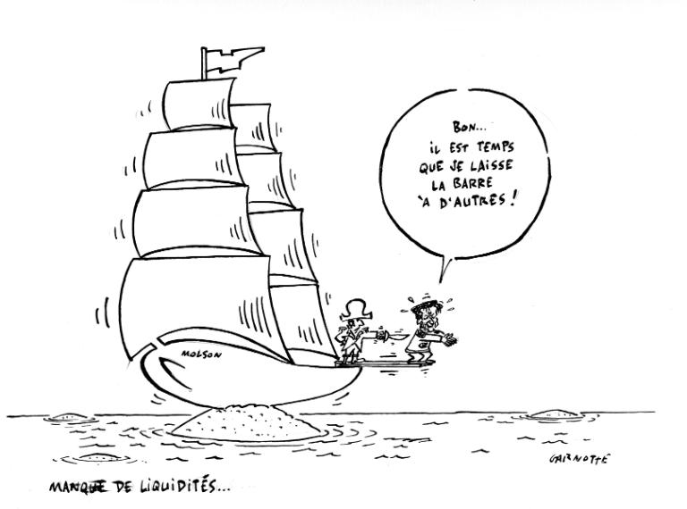
Types of Decentralized Exchanges
Order book exchange:
  Straightforward
  People say how much they want to sell for which price (ask) or how much they want to buy for which price (bid)
  Requires both sellers and buyers to be present at the same time or there is no liquidity
Liquidity pool exchange:
  Provides liquidity even though no one else is there
  Similar to how banks work, except 2 tokens instead of 1
Aggregators search on multiple exchanges to increase liquidity

Slide 16

Which Exchange Is Best?
Order book exchange versus liquidity pool exchange
Which one is better for traders?
Which one is better for companies?

Slide 17
Liquidity Pool Exchange Problems
How does a public offering to raise money work?
The value of a company cannot be put in a formula, e.g. its value may change instantly on signing a contract
Liquidity pools suffer from impermanent loss with volatile assets and do not work well with non-volatile assets
Trades in a liquidity pool require a fee (at least to partially offset the impermanent loss), while trades through an order book can happen without a fee (except for the gas fee)

Slide 18

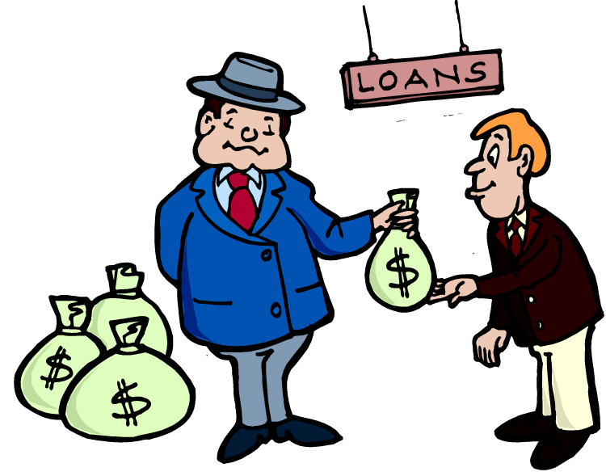
Public Offering
Company X has Y shares to offer for a price of Z per share
On an order book exchange:
  Company X places an ask order of Y shares for a price of Z
  Interested buyers place bid orders for a price of Z
  Company X raises Y*Z of funds
On a liquidity pool exchange:
  Company X thinks each share is worth Z
  Company X needs to put Y shares and Y*Z of funds in a liquidity pool
  Company X lends Y*Z of funds

Slide 19
Impermanent Loss Example
Alice and Bob each have 100 X and 100 Y. Alice keeps her tokens in a wallet, Bob puts them in a liquidity pool.
Initially 1*X = 1*Y, then the value of 1*Y instantly rises to 2*X
Traders inject X in Bob’s liquidity pool and extract Y from it until there are twice as many X as Y. For Bob’s liquidity pool:
X*Y = 10 000, thus Bob keeps 141.42… X and 70.71… Y
The remaining value in Alice’s wallet is 300 X, the remaining value in Bob’s wallet is 282.84… X
Bob loses 17.16 X for putting his tokens in a liquidity pool (but the traders are happy)

Slide 20
Liquidity Pool Exchange Audience
Impermanent loss is only impermanent for impermanent fluctuations, impermanent loss is permanent for permanent fluctuations!
Traders pocket the permanent impermanent loss
Companies cannot raise funds easily in a liquidity pool exchange
Liquidity pool exchanges are for traders

Slide 21
Order Book Exchange Audience
Companies can easily raise funds through an order book exchange
If there are interested buyers, they will buy shares wherever the company sells them and liquidity is not an issue
Decentralized order book exchanges can (and should) ask no trade commission, so they are also the cheapest way to trade
Order book exchanges are for (shares of) companies

Slide 22
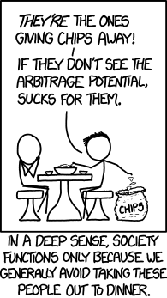
Stimulate Liquidity on Order Book Exchange
Take away the incentive to fork an order book exchange smart contract, so trades will be more concentrated. This implies that order book exchanges cannot ask for fees.
Provide support for arbitrage. Extra liquidity will be provided by people who identify arbitrage opportunities.

Slide 23
Arbitrage Chain
Imagine tokens A, B, C, D, E.
We have an initial amount of A tokens,
  we swap the A tokens to B tokens,
  the B tokens to C tokens,
  the C tokens to D tokens,
  the D tokens to E tokens and
  the E tokens back to A tokens.
We may end up with more tokens of A than we started with
This is an arbitrage opportunity (we gain from only trading)

Slide 24
Equivalent Arbitrage Chains
If we assume that A → C → A keeps the amount of A constant,
  Then the swap A → B → C → D → E → A
  will result in the same gain of A tokens as
  the two swaps A → B → C → D → E → A and A → C → A,
  which could be reorganized to
  the two swaps A → B → C → A and A → C → D → E → A
A → B → C → D → E →A results in a gain of A if and only if
  A → B → C → A results in a gain of A or
  A → C → D → E → A results in a gain of A

Slide 25
Arbitrage Chain Break Up
If we assume that for any tokens X and Y, the swap X → Y → X results in the same amount of original X tokens, then from the results on the previous slide, we can always break up an arbitrage chain to smaller chains until only arbitrage chains between 3 different tokens are left
Swapping multiple tokens offers an arbitrage opportunity only if there exists an arbitrage opportunity between only 3 of the tokens
It is sufficient to only detect arbitrage opportunities between any 3 different tokens

Slide 26
Arbitrage Example
Imagine 3 tokens, A, B and C with the following swaps possible:
  120 A → 100 B and 100 B → 110 A
  150 B → 100 C and 100 C → 140 B
  110 C → 100 A and 100 A → 100 C
Imagine we start with 100 A, we can try to swap in 2 directions:
  100 A → 250/3 B →500/9 C → 5000/99 A = 50.50... A, we lose > 49 A
  100 A → 100 C →140 B → 14*11 A = 154 A, we gain 54 A
Traders can gain from arbitrage, even though there is a spread between any 2 different tokens

Slide 27
Exchange Smart Contract
The Share smart contract needs to interact with an Exchange smart contract
This project will provide an order book reference implementation
The order book reference implementation will not ask for fees and have some functions to detect arbitrage opportunities
The Share smart contract only needs to interact with an interface with 3 functions: ask, bid and cancel order
If people want to use another exchange (possibly a liquidity pool exchange), that is fine, as long as the Exchange smart contract implements the interface

Slide 28

Cryptoshares Adoption
This project only aims to showcase the technical possibility
There are also legal requirements, if you own shares of an incorporated company, you have legal rights of ownership, no one guarantees these rights will be enforced for cryptoshares
Maybe cryptoshares could work in specific use cases, e.g. when there is a lot of stakeholder involvement
Exploring when or how cryptoshares could work is out of scope

Slide 29
II. Functionality of Smart Contracts
Scrutineer Voting
Scrutineer Decision Parameters
Scrutineer Proposal
Scrutineer Events
Scrutineer Interface
Share Events
Share Interface Overview
Share Information Functions
Shareholder and Exchange Helper Functions
Get Proposal Details Functions
Change Owner Functions
Change Decision Parameters Functions
Corporate Action Functions
Corporate Action Types
Exchange Interface
Future

Slide 30

Scrutineer Voting
Voting starts if someone makes a proposal for an ERC20 token
Owners of the ERC20 token can vote as many times as they want before voting ends, only the last vote counts
Before voting has ended, the owner can withdraw the vote
After voting has ended, the owner can resolve the vote:
  There is a time limit to resolve the vote, otherwise the vote expires
During vote resolution, the last vote of each voter is counted and the weight of the vote is how many ERC20 tokens the voter holds at that moment

Slide 31
Scrutineer Decision Parameters
Vote choices are one of: in favor, against, abstain or no vote
Voting occurs with some decision parameters:
  decisionTime: how much time ERC20 token holders can vote
  executionTime: how much time to resolve the vote after voting ends
  Quorum: the fraction of the total supply of the ERC20 token that needs to vote in favor, against or abstain
  Majority: the threshold that the fraction (in favor)/(in favor + against) must reach. This fraction must be greater than 1/2
A vote only passes if the quorum and majority are met and if the owner resolves the vote in time

Slide 32
Scrutineer Proposal
Decision Parameters are set before by the vote owner
Different Decision Parameters can be set for different vote types
  A vote type is just an integer, the default vote type is 0
At a new proposal:
  Decision parameters are copied from the owner for the vote type
  The start time is copied to the proposal
  The ERC20 token address with which is voted is copied to the proposal
  These cannot be changed any more for the vote
The proposal gets a new unique id

Slide 33
Scrutineer Events
Change of decision parameters for an owner and a vote type
  Indexed parameters: owner, vote type
  Other parameters: decision time, execution time, quorum, majority
A vote is opened
  Indexed parameters: owner, id, ERC20 token
  Other parameters: vote type, last vote date, last resolution date
A vote is resolved
  Indexed parameters: owner, id, result

Slide 34
Scrutineer Interface
Only owner:
  Set decision parameters
  Propose, withdraw or resolve a vote
  Get votes
Everyone:
  Get decision parameters of anyone
  Get vote details
  Vote
  Get vote results

Slide 35
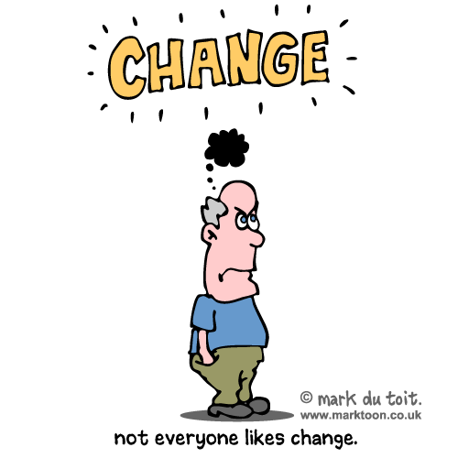
Share Events
Request to change the owner
Resolve a change of owner vote
Request to change the decision parameters
Resolve a change of the decision parameters vote
Request a corporate action
Resolve a corporate action vote
Different from Scrutineer: everyone can resolve the votes!

Slide 36
Share Interface Overview
Share information functions
Shareholder and exchange helper functions
Get proposal details functions
Change owner functions
Change decision parameters functions
Corporate action functions

Slide 37
Share Information Functions
Get the amount of
  locked up ERC20 tokens at exchanges
  (because of pending ask and bid orders)
  available ERC20 tokens owned by the Share contract
  treasury shares (shares held by the Share contract that are not locked)
  outstanding shares (shares not held by the Share contract)
  maximum outstanding shares (outstanding shares + locked up shares)
Get the number of shareholders

Slide 38
Shareholder and Exchange Helper Functions
The Share smart contract keeps track of
  Its shareholders in case it needs to pay out dividends
  Its exchanges to calculate locked up tokens
Only one function is on the interface (it is used by exchanges):
  Register a shareholder
External functions:
  Pack shareholders and exchanges and get pack information
Internal function:
  Register an exchange for an ERC20 token

Slide 39
Get Proposal Details Functions
Get the proposed new owner of the Share smart contract
Get the proposed changed decision parameters of the Share smart contract
Get the proposed corporate action details
The details are also in the events (event storage is cheap)
Only 1 proposal of each type can be active at the same time!
(A design decision to avoid confusion)
To come with a new proposal, the vote for the previous proposal has to either be resolved or withdrawn

Slide 40
Change Owner Functions
Change the owner
  Can only be initiated by the owner
  This is automatically approved if there are no outstanding shares,
  an event is still emitted, otherwise a vote is opened
Resolve a vote to change the owner
  Can be initiated by anyone after voting has ended
Withdraw a vote to change the owner
  Can only be initiated by the owner before voting has ended

Slide 41
Change Decision Parameters Functions
Change the decision parameters
  Can only be initiated by the owner
  This is automatically approved if there are no outstanding shares,
  an event is still emitted, otherwise a vote is opened
  Each different kind of action has a different vote type
Resolve a vote to change the decision parameters
  Can be initiated by anyone after voting has ended
Withdraw a vote to change the decision parameters
  Can only be initiated by the owner before voting has ended

Slide 42
Corporate Action Functions
Execute a corporate action
  Can only be initiated by the owner
  This is automatically approved if there are no outstanding shares
  (if applicable), an event is still emitted, otherwise a vote is opened
Resolve a corporate action vote
  Can be initiated by anyone after voting has ended
Withdraw a corporate action vote
  Can only be initiated by the owner before voting has ended

Slide 43
Corporate Action Types
Issue shares
Destroy shares
Raise funds (i.e. sell shares on an exchange)
Buy back shares (on an exchange)
Cancel an order on an exchange
Reverse split (only allowed when no shares are locked up)
Distribute a dividend (includes stock splits and optional dividends)
Withdraw funds (from the Share smart contract)

Slide 44
Exchange Interface
Minimal on purpose:
  Ask
  Bid
  Cancel order
An exchange still has to behave the way the Share contract expects

Slide 45
Future
Reference implementation for an exchange
Tests
User interface
Pagination when iterating over shareholders, votes or orders?

Slide 46
Picture Credits
In order of appearance:
  https://commons.wikimedia.org/wiki/File:Directomat_100_Shares_1960s.300dpi.jpg
  https://libraries.uta.edu/ettahulme/image/20113326
  https://openclipart.org/detail/228980/money-money-money
  https://www.pngkey.com/detail/u2q8q8o0o0r5a9o0_the-icon-is-shaped-like-a-square-but/
  https://www.seekpng.com/ipng/u2y3q8t4o0t4e6u2_thc-hydra/
  https://www.seekpng.com/ipng/u2y3q8w7w7a9o0e6_microsoft-resurrects-clippy-and-then-brutally-kills-star/
  https://www.commitstrip.com/en/2016/06/07/good-code/
  https://www.monkeyuser.com/2020/schmuck/
  https://collections.musee-mccord-stewart.ca/en/objects/250670/short-of-liquidity
  https://garystockbridge617.getarchive.net/amp/media
  /cmdr-christopher-kendrick-center-left-executive-officer-of-navy-recruiting-4dbe43
  https://pixy.org/1642503/
  https://flyclipart.com/borrow-money-clipart-clip-art-images-no-money-clipart-86523
  https://xkcd.com/1499/
  https://www.pngkey.com/detail/u2y3q8w7y3q8a9r5_broken-communication/
  https://www.pngkey.com/detail/u2w7i1i1e6w7w7o0_the-art-and-science-of-building-a-crowd/
  http://clipart-library.com/clipart/1186466.htm

