Slide 1
QGame

Slide 2
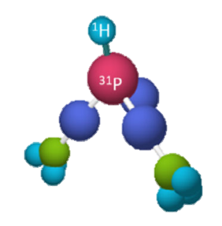

Theory

