Slide 1


XE TỰ HÀNH FEEE ROBOTICS
Team: BYTEUS
Members:
Đinh Văn Tính
Nguyễn Minh Tiến Đạt
Vũ Quốc Khánh

Slide 2

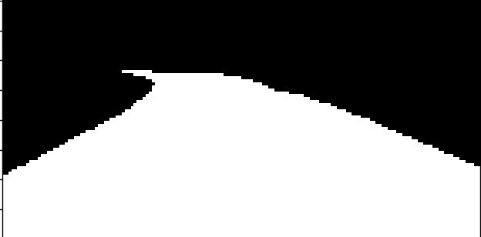
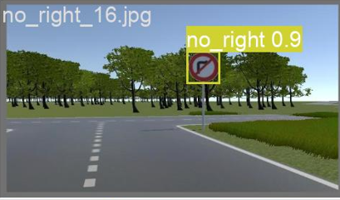
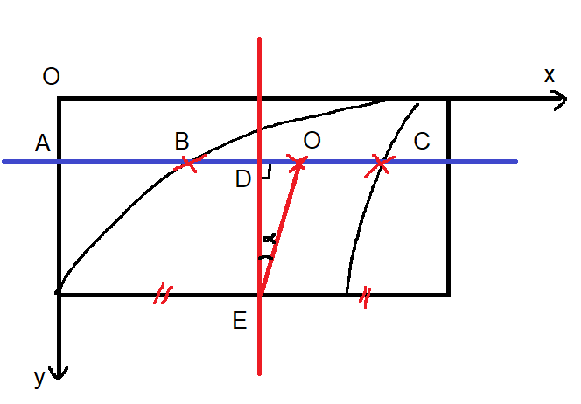
PIPELINE
Lane Segmentation
Trafic Sign Detection
Controller

Slide 3
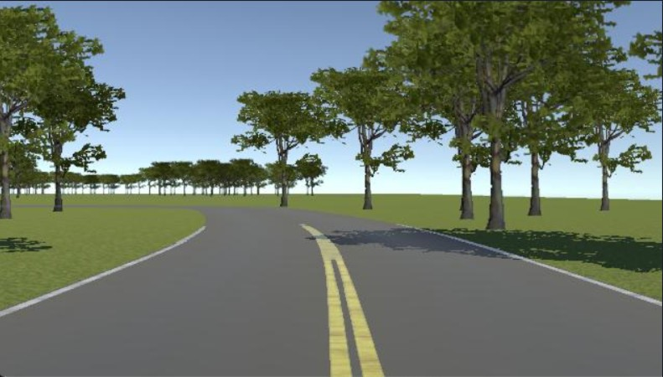
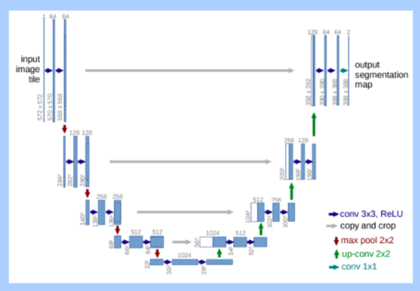
Lane Segmentation
Input
(RGB image)
Model U-NET
Output
(Binary image)

Slide 4
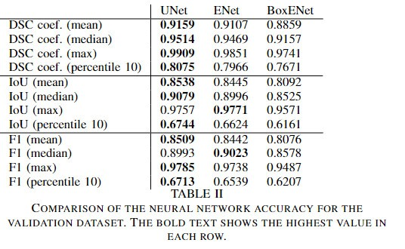
https://arxiv.org/abs/1909.06840v3

Slide 5
Traffic Sign Detection
Input
(RGB image)
Model Yolov8m
Output
With 5 classes

Slide 6
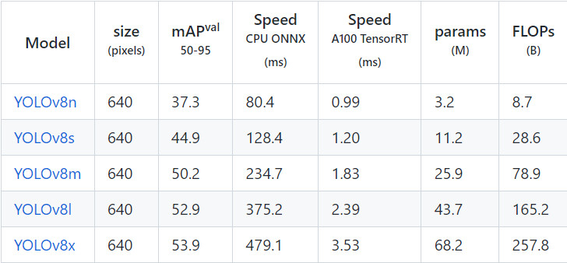
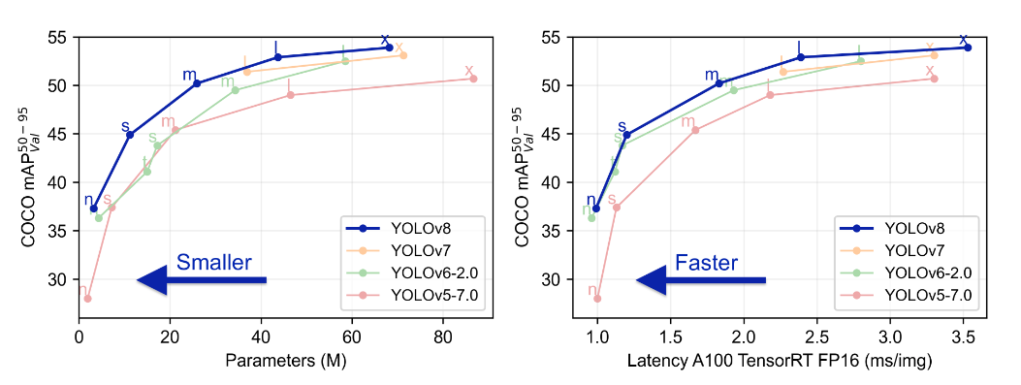

Slide 7
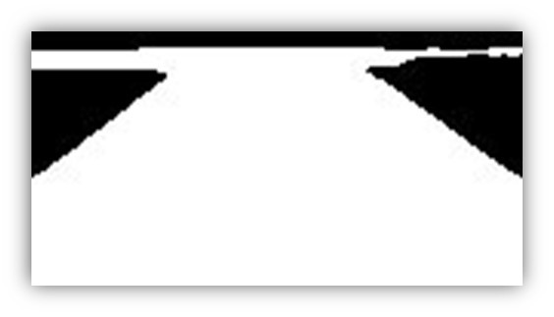
Controller
Turn left
Traffic Sign Detect
Speed = 35
Turn right
Straight
Speed = 50

Slide 8
THANK YOU

