Slide 1
Environment Engineering: Configuration Management & Audit System

Slide 2
Operating Systems Configuration

Slide 3
Performing the install
Unpack the audit_system.tar file into any directory.
There are two main scripts
INSTALL
AUDIT
Run the INSTALL script to collect the current configuration to use as a base.
Run the AUDIT script to check for changes and create a report with all the configuration
Add a cron job for the AUDIT script to check fro changes each day

Slide 4
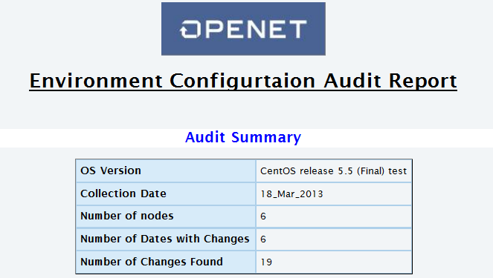
Audit Report: Summary View
Once the AUDIT script will generate a HTML Web report with Summary of the Audit:
Collection Date
Number of Hosts
Number of Dates with changes & how many changes have been made

Slide 5
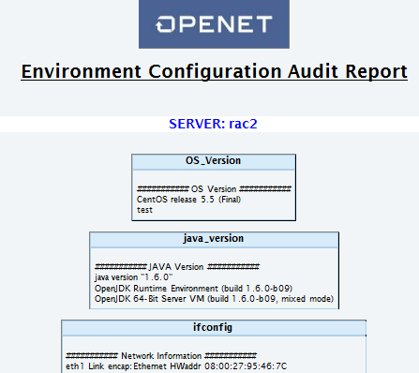
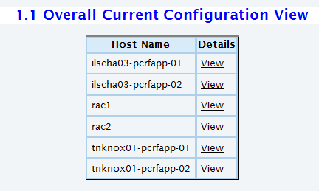
Audit Report: Overall Configuration
View the Overall configuration of each server by selecting the ‘view’ option

Slide 6
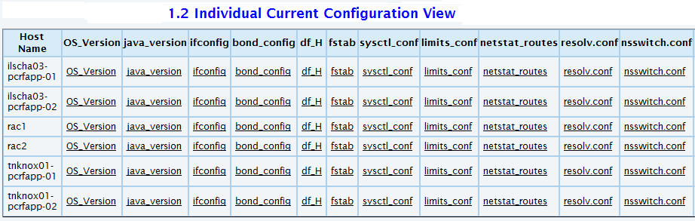
Audit Report: Individual View
Alternatively, you can view each Individual Configuration for each server

Slide 7
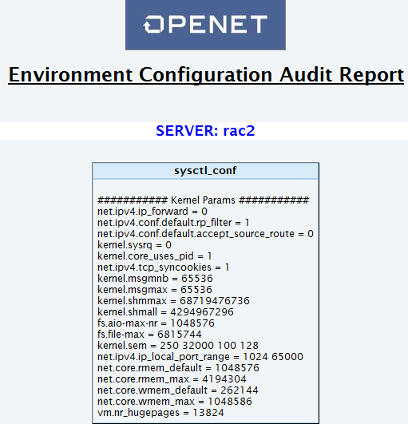
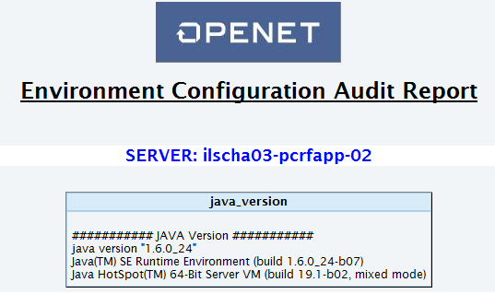
Audit Report: Individual View
Select each link to view the configuration:

Slide 8
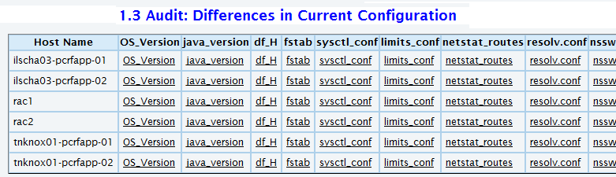
Audit Report: Differences in Current Configuration
The Audit Report will compare each servers configuration.
Select each link to view which configuration is missing or different

Slide 9
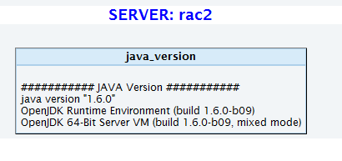
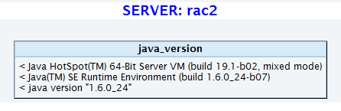
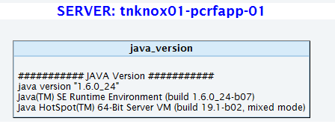
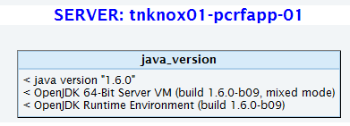
Audit Report: Differences in Current Configuration
Select each link to view the configuration missing or different

Slide 10
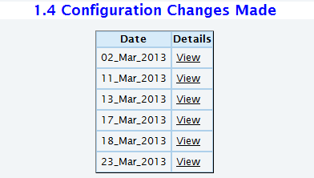
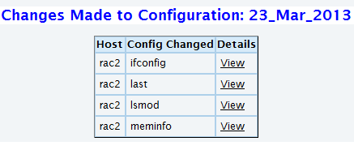
Audit Report: Configuration Changes Made
The Audit Report will find changes made to the system and log them by date.
Click on the Date to find changes made on each server.

Slide 11
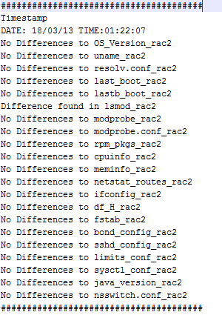
Audit Report: Configuration change Log
There will be a log made of all changes to the system

Slide 12
Configuration to be added to next Version of the Configuration Management & Audit System

Slide 13
Audit Report: Configuration to be added
All new configuration can be added quite easily now that the framework for the system is a available and working.
The following items will be added to the next version/iteration
Fusionworks Environment
Install.history file and patches installed
Install.properties files
DSD Script of all Component configuration.
OCLI Scripts for configuration (Framework 7.x)

Slide 14
Audit Report: Configuration to be added
Oracle Configuration
Export of FW Config
Export of DSD
Oracle Parameter Settings
SGA/PGA settings
Oracle Version Information and Installed packages
Oracle ASM configuration and ASM Disks.
Oracle RAC VIPs, Priv IPs, shared storage
Oracle Client information on Fusionworks nodes.
User permissions

