Slide 1
Dictionary size
1
Vector[i]=1 if i==1 else 0
12
One Hot Encoding
Vector[i]=1 if i==12 else 0
0
Input length
Vector[i]=1 if i==0 else 0
Input length
d
Vector[i]=1 if i==d else 0
5
Vector[i]=1 if i==5 else 0
Symbol id

Slide 2
Embedding length
Symbol id：0
Vector 0
Symbol id：1
Vector 1
Dictionary size
.
.
.
Symbol id：d
Vector d

Slide 3
Embedding length
Vector 0
1
Vector 1
12
0
Input length
Dictionary size
.
.
.
d
5
Vector d
Symbol id

Slide 4
Embedding length
1
Vector 1
12
Word Embedding
Vector 12
0
Input length
Vector 0
Input length
d
Vector d
5
Vector 5
Symbol id

Slide 5
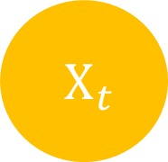


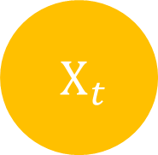
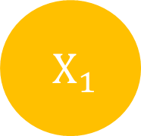
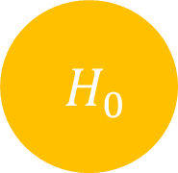
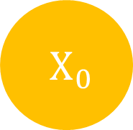

$H_{t}$
$H_{0}$
$H_{1}$
$H_{t}$
$X_{t}$
$X_{0}$
$X_{1}$
$X_{t}$

Slide 6
Input length
Input
Target length
Output
Target
Target length

Slide 7
Input
Output
Target
Target’
Target length
+1

Slide 8
Output
Encoders
Decoders
Positional Encoding
Positional Encoding
Embedding
Embedding
Input
Target

Slide 9
Encoder
Decoder
Encoder
Decoder
Encoder
Decoder

Slide 10


Scaled
Dot-Product Attention
$V_{input}=K_{input}$
Linear
V
Linear
K
$Q_{input}$
Linear
Q

Slide 11


K depth
K length
K depth
$×$
$=$
Q length
Q length
K length
Q
K
QK

Slide 12





K length
K length
Q length
Q length
$$=$$
$$($$
$$)$$
$$Softmax$$
$\frac{ }{\sqrt{K depth} }$
Attention
Weight

Slide 13


-1e30
Q length
Q length
Q length
$+$
$=$
Q length
Q length
Q length
Masking
QK
QK
Masking

Slide 14


K length
V depth
V depth
Q length
$×$
$=$
K length
Q length
Attention
Weight
V

Slide 15

Embedding length
Multi-Head Attention Output
Q length
V depth $×$ Head number
Q length
Linear

Slide 16
Scaled Dot-Product Attention
Scaled Dot-Product Attention
Scaled Dot-Product Attention
Linear
Linear
Linear
Linear
Linear
Linear
Linear
Linear
Linear
V
K
Q

