Slide 1
Dictionary size
1
[0, 1, 0, 0, 0, 0, 0, 0,...]
7
One Hot Encoding
[0, 0, 0, 0, 0, 0, 0, 1,...]
0
Input length
[1, 0, 0, 0, 0, 0, 0, 0,...]
Input length
3
[0, 0, 0, 1, 0, 0, 0, 0,...]
5
[0, 0, 0, 0, 0, 1, 0, 0,...]
Symbol id

Slide 2
Embedding length
Symbol id：0
Vector 0
Symbol id：1
Vector 1
.
.
.
Dictionary size
Symbol id：d
Vector d

Slide 3
Embedding length
1
Vector 0
12
Vector 1
0
Input length
.
.
.
Dictionary size
d
5
Symbol id
Vector d

Slide 4
Embedding length
1
Vector 1
12
Word Embedding
Vector 12
0
Input length
Vector 0
Input length
d
Vector d
5
Vector 5
Symbol id

Slide 5
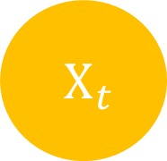


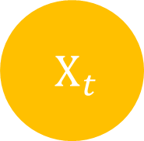
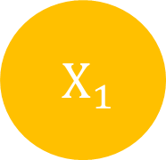

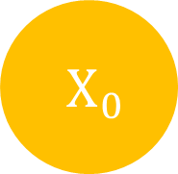

$H_{t}$
$H_{0}$
$H_{1}$
$H_{t}$
$X_{t}$
$X_{0}$
$X_{1}$
$X_{t}$

Slide 6
Input length
Input
Target length
Output
Target
Target length

Slide 7
Input
Output
Target
Target’
Target length
+1

Slide 8
Embedding length
Embedding length
Attention
注意力
is
就是
all
你
K length
Q length
you
所
need
需要
的

Slide 9
Q_{input}
K_{input} V_{input}
query₁
value₀
key₀
query₂
key₁
value₁
query₀
value₃
key₃
value₂
key₂

Slide 10
Q_{input}
K_{input} V_{input}
query₁
value₀
key₀
query₂
key₁
value₁
query₀
value₃
key₃
value₂
key₂

Slide 11
Q_{input}
K_{input} V_{input}
query₁
value₀
key₀
query₂
key₁
value₁
query₁’
query₀
value₃
key₃
value₂
key₂

Slide 12
Output
Linear
& Sotfmax
Encoders
Decoders
Positional Encoding
Positional Encoding
Embedding
Embedding
Input
Target

Slide 13
Output
Linear
& Sotfmax
Encoders
Decoders
Positional Encoding
Positional Encoding
Embedding
Embedding
Input
Target

Slide 14
Output
Linear
& Sotfmax
Encoders
Decoders
Positional Encoding
Positional Encoding
Embedding
Embedding
Input
Target

Slide 15
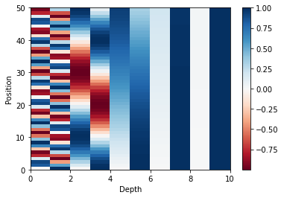
Position
Depth

Slide 16
Output
Linear
& Sotfmax
Encoders
Decoders
Positional Encoding
Positional Encoding
Embedding
Embedding
Input
Target

Slide 17
Encoder
Decoder
Encoder
Decoder
Encoder
Decoder

Slide 18
Encoder
Decoder
Encoder
Decoder
Encoder
Decoder

Slide 19
In
Out
LayerNorm
V
K
Q
Multi Head Attention
+
+
Feed Forward
LayerNorm

Slide 20
In
Out
LayerNorm
V
K
Q
Multi Head Attention
+
+
Feed Forward
LayerNorm

Slide 21
Out
Linear
Concat
Scaled Dot-Product Attention
Vin
Scaled Dot-Product Attention
Linear
V
Scaled Dot-Product Attention
Linear
V
Linear
V
Kin
Linear
K
Linear
K
Linear
K
Linear
Q
Qin
Linear
Q
Linear
Q

Slide 22
Embedding length
depth
Symbol length
Linear
Symbol length

Slide 23


K depth
K depth
Input length
Input length
$×$
$=$
Input length
Input length
Q
T
QK
K

Slide 24





Input length
Input length
Input length
Input length
$$=$$
$$($$
$$)$$
$$Softmax$$
$\frac{ }{\sqrt{K depth} }$
Attention
Weight

Slide 25


Input length
V depth
V depth
Input length
$×$
$=$
Input length
Input length
Attention
Weight
V

Slide 26

Embedding length
Multi-Head Attention Output
Input length
V depth $×$ Head number
Input length
Linear

Slide 27
In
Out
LayerNorm
V
K
Q
Multi Head Attention
+
+
Feed Forward
LayerNorm

Slide 28
Encoder
Decoder
Encoder
Decoder
Encoder
Decoder

Slide 29
In
Out
LayerNorm
V
K
Q
Masked Multi Head Attention
+
Feed Forward
+
LayerNorm
LayerNorm
+
Q
Multi Head Attention
Encoder
K
V

Slide 30
In
Out
LayerNorm
V
K
Q
Masked Multi Head Attention
+
Feed Forward
+
LayerNorm
LayerNorm
+
Q
Multi Head Attention
Encoder
K
V

Slide 31
In
Out
LayerNorm
V
K
Q
Masked Multi Head Attention
+
Feed Forward
+
LayerNorm
LayerNorm
+
Q
Multi Head Attention
Encoder
K
V

Slide 32


-1e30
Target length
Target length
Target length
Target length
$+$
Target length
$=$
Target length
QK
Masking
QK
Masking

Slide 33
Target length
Target length
Target length
$$=$$
Target length
$$($$
$$)$$
$$Softmax$$
$\frac{ }{\sqrt{K depth} }$
Attention
Weight

Slide 34


K depth
K depth
Input length
Target length
$×$
Target length
$=$
Input length
Q
T
QK
K

Slide 35
Input length
Input length
Target length
Target length
$$=$$
$$($$
$$)$$
$$Softmax$$
$\frac{ }{\sqrt{K depth} }$
Attention
Weight

Slide 36


Input length
V depth
V depth
Target length
Input length
Target length
$×$
$=$
Attention
Weight
V

Slide 37
Embedding length
Multi-Head Attention Output
Target length
V depth $×$ Head number
Target length
Linear

Slide 38
Output
Linear
& Sotfmax
Encoders
Decoders
Positional Encoding
Positional Encoding
Embedding
Embedding
Input
Target

Slide 39
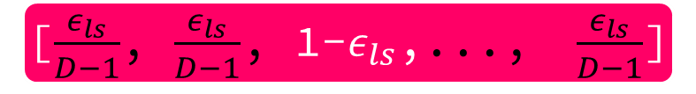
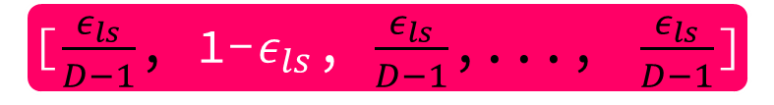
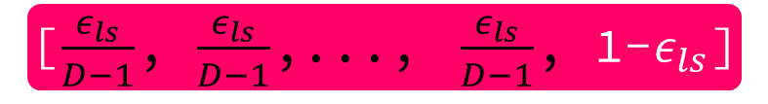
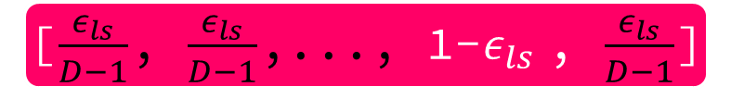
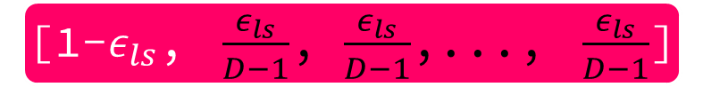
Dictionary size = D
Dictionary size = D
[0, 1, 0,..., 0]
[$\frac{ε_{ls}}{D−1}$, 1-$ε_{ls}$, $\frac{ε_{ls}}{D−1}$,..., $\frac{ε_{ls}}{D−1}$]
[0, 0, 1,..., 0]
Label Smoothing
[$\frac{ε_{ls}}{D−1}$, $\frac{ε_{ls}}{D−1}$, 1-$ε_{ls}$,..., $\frac{ε_{ls}}{D−1}$]
[1, 0, 0,..., 0]
[1-$ε_{ls}$, $\frac{ε_{ls}}{D−1}$, $\frac{ε_{ls}}{D−1}$,..., $\frac{ε_{ls}}{D−1}$]
[0, 0,..., 1, 0]
[$\frac{ε_{ls}}{D−1}$, $\frac{ε_{ls}}{D−1}$,..., 1-$ε_{ls}$ , $\frac{ε_{ls}}{D−1}$]
[0, 0,..., 0, 1]
[$\frac{ε_{ls}}{D−1}$, $\frac{ε_{ls}}{D−1}$,..., $\frac{ε_{ls}}{D−1}$, 1-$ε_{ls}$]

Slide 40
 | N | d_{model} | d_{ff} | h | d_{k} | d_{v} | P_{drop} | ϵ_{ls} | train steps | PPL (dev) | BLEU (dev) | params$×$10⁶
base | 6 | 512 | 2048 | 8 | 64 | 64 | 0.1 | 0.1 | 100K | 4.92 | 25.8 | 65

Slide 41
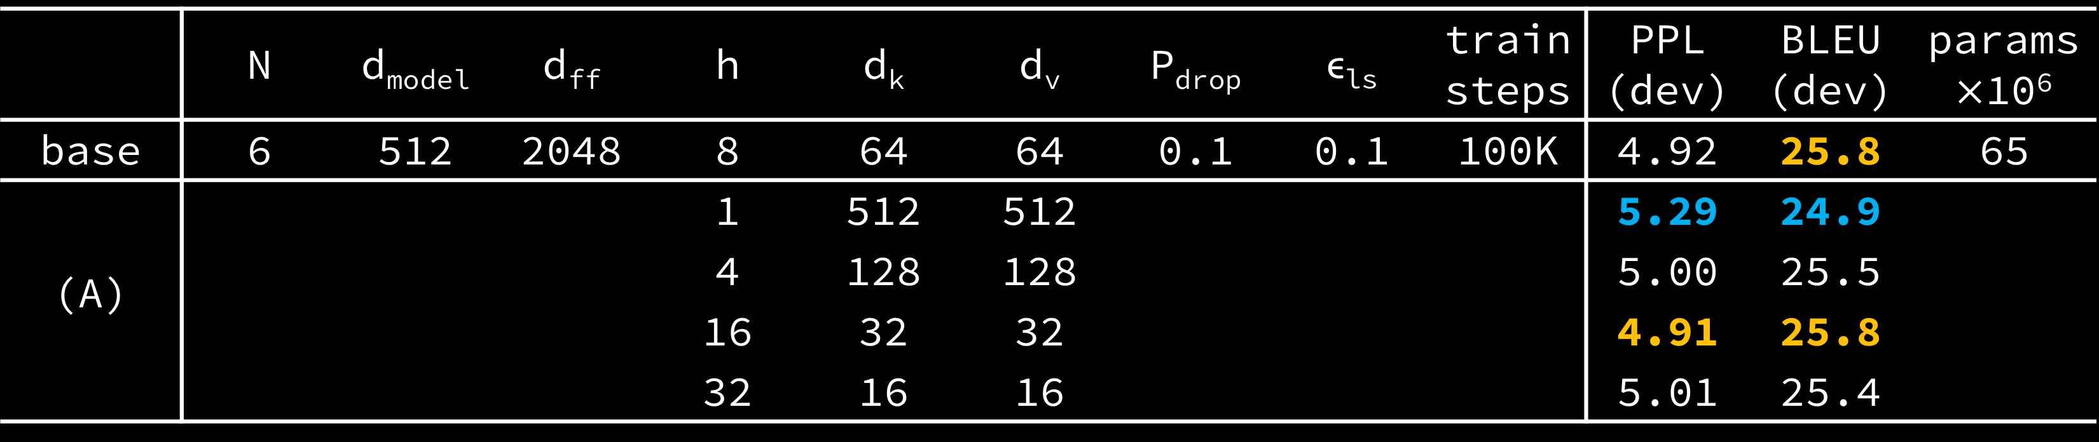
 | N | d_{model} | d_{ff} | h | d_{k} | d_{v} | P_{drop} | ϵ_{ls} | train steps | PPL (dev) | BLEU (dev) | params$×$10⁶
base | 6 | 512 | 2048 | 8 | 64 | 64 | 0.1 | 0.1 | 100K | 4.92 | 25.8 | 65
(A) |  |  |  | 1 | 512 | 512 |  |  |  | 5.29 | 24.9
 |  |  |  | 4 | 128 | 128 |  |  |  | 5.00 | 25.5
 |  |  |  | 16 | 32 | 32 |  |  |  | 4.91 | 25.8
 |  |  |  | 32 | 16 | 16 |  |  |  | 5.01 | 25.4

Slide 42
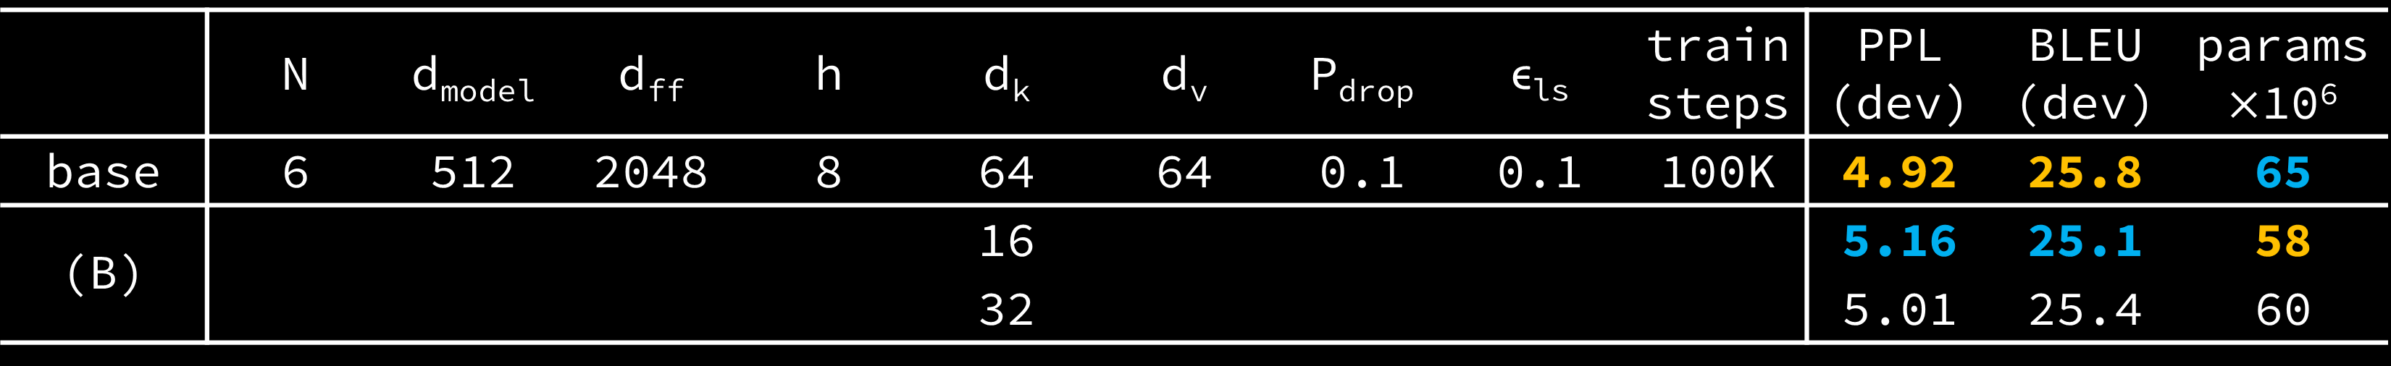
 | N | d_{model} | d_{ff} | h | d_{k} | d_{v} | P_{drop} | ϵ_{ls} | train steps | PPL (dev) | BLEU (dev) | params$×$10⁶
base | 6 | 512 | 2048 | 8 | 64 | 64 | 0.1 | 0.1 | 100K | 4.92 | 25.8 | 65
(B) |  |  |  |  | 16 |  |  |  |  | 5.16 | 25.1 | 58
 |  |  |  |  | 32 |  |  |  |  | 5.01 | 25.4 | 60

Slide 43
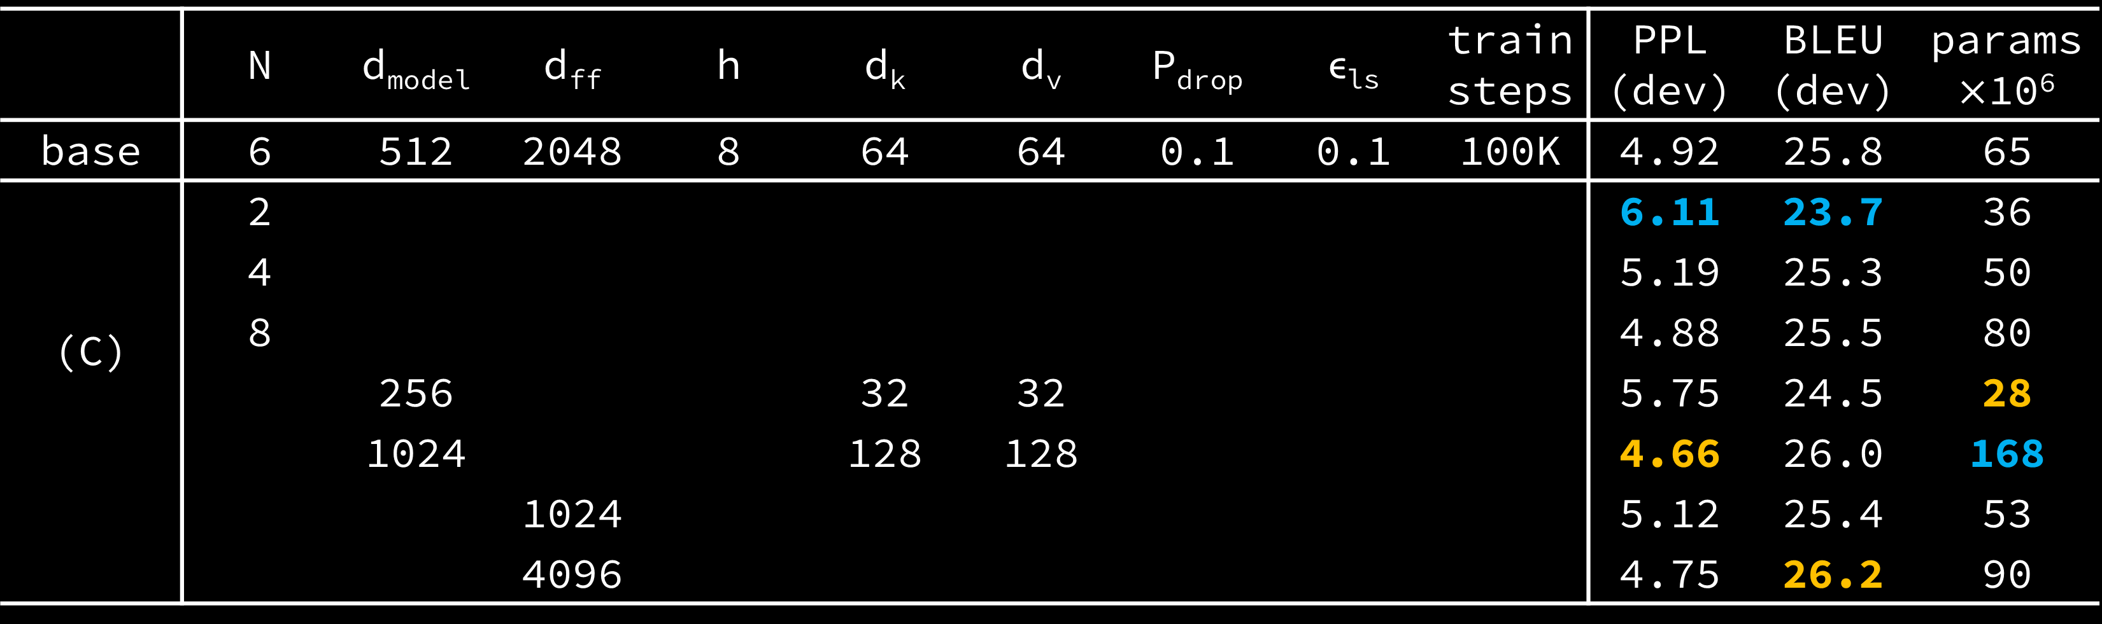
 | N | d_{model} | d_{ff} | h | d_{k} | d_{v} | P_{drop} | ϵ_{ls} | train steps | PPL (dev) | BLEU (dev) | params$×$10⁶
base | 6 | 512 | 2048 | 8 | 64 | 64 | 0.1 | 0.1 | 100K | 4.92 | 25.8 | 65
(C) | 2 |  |  |  |  |  |  |  |  | 6.11 | 23.7 | 36
 | 4 |  |  |  |  |  |  |  |  | 5.19 | 25.3 | 50
 | 8 |  |  |  |  |  |  |  |  | 4.88 | 25.5 | 80
 |  | 256 |  |  | 32 | 32 |  |  |  | 5.75 | 24.5 | 28
 |  | 1024 |  |  | 128 | 128 |  |  |  | 4.66 | 26.0 | 168
 |  |  | 1024 |  |  |  |  |  |  | 5.12 | 25.4 | 53
 |  |  | 4096 |  |  |  |  |  |  | 4.75 | 26.2 | 90

Slide 44
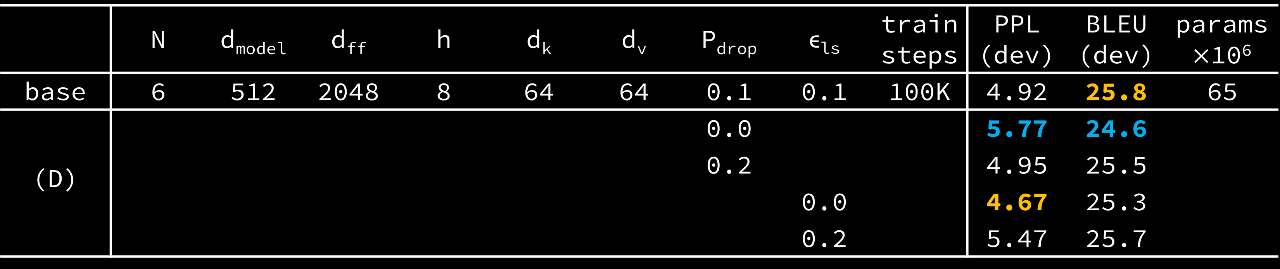
 | N | d_{model} | d_{ff} | h | d_{k} | d_{v} | P_{drop} | ϵ_{ls} | train steps | PPL (dev) | BLEU (dev) | params$×$10⁶
base | 6 | 512 | 2048 | 8 | 64 | 64 | 0.1 | 0.1 | 100K | 4.92 | 25.8 | 65
(D) |  |  |  |  |  |  | 0.0 |  |  | 5.77 | 24.6
 |  |  |  |  |  |  | 0.2 |  |  | 4.95 | 25.5
 |  |  |  |  |  |  |  | 0.0 |  | 4.67 | 25.3
 |  |  |  |  |  |  |  | 0.2 |  | 5.47 | 25.7

Slide 45

 | N | d_{model} | d_{ff} | h | d_{k} | d_{v} | P_{drop} | ϵ_{ls} | train steps | PPL (dev) | BLEU (dev) | params$×$10⁶
base | 6 | 512 | 2048 | 8 | 64 | 64 | 0.1 | 0.1 | 100K | 4.92 | 25.8 | 65
(E) | positional embedding instead of sinusoids |  |  |  |  |  |  |  |  | 4.92 | 25.7

Slide 46
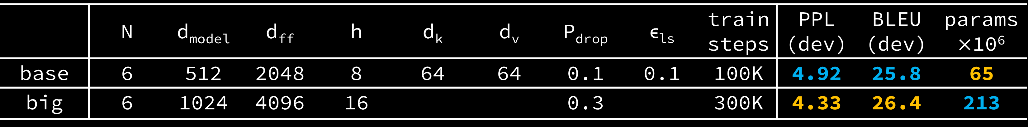
 | N | d_{model} | d_{ff} | h | d_{k} | d_{v} | P_{drop} | ϵ_{ls} | train steps | PPL (dev) | BLEU (dev) | params$×$10⁶
base | 6 | 512 | 2048 | 8 | 64 | 64 | 0.1 | 0.1 | 100K | 4.92 | 25.8 | 65
big | 6 | 1024 | 4096 | 16 |  |  | 0.3 |  | 300K | 4.33 | 26.4 | 213

Slide 47
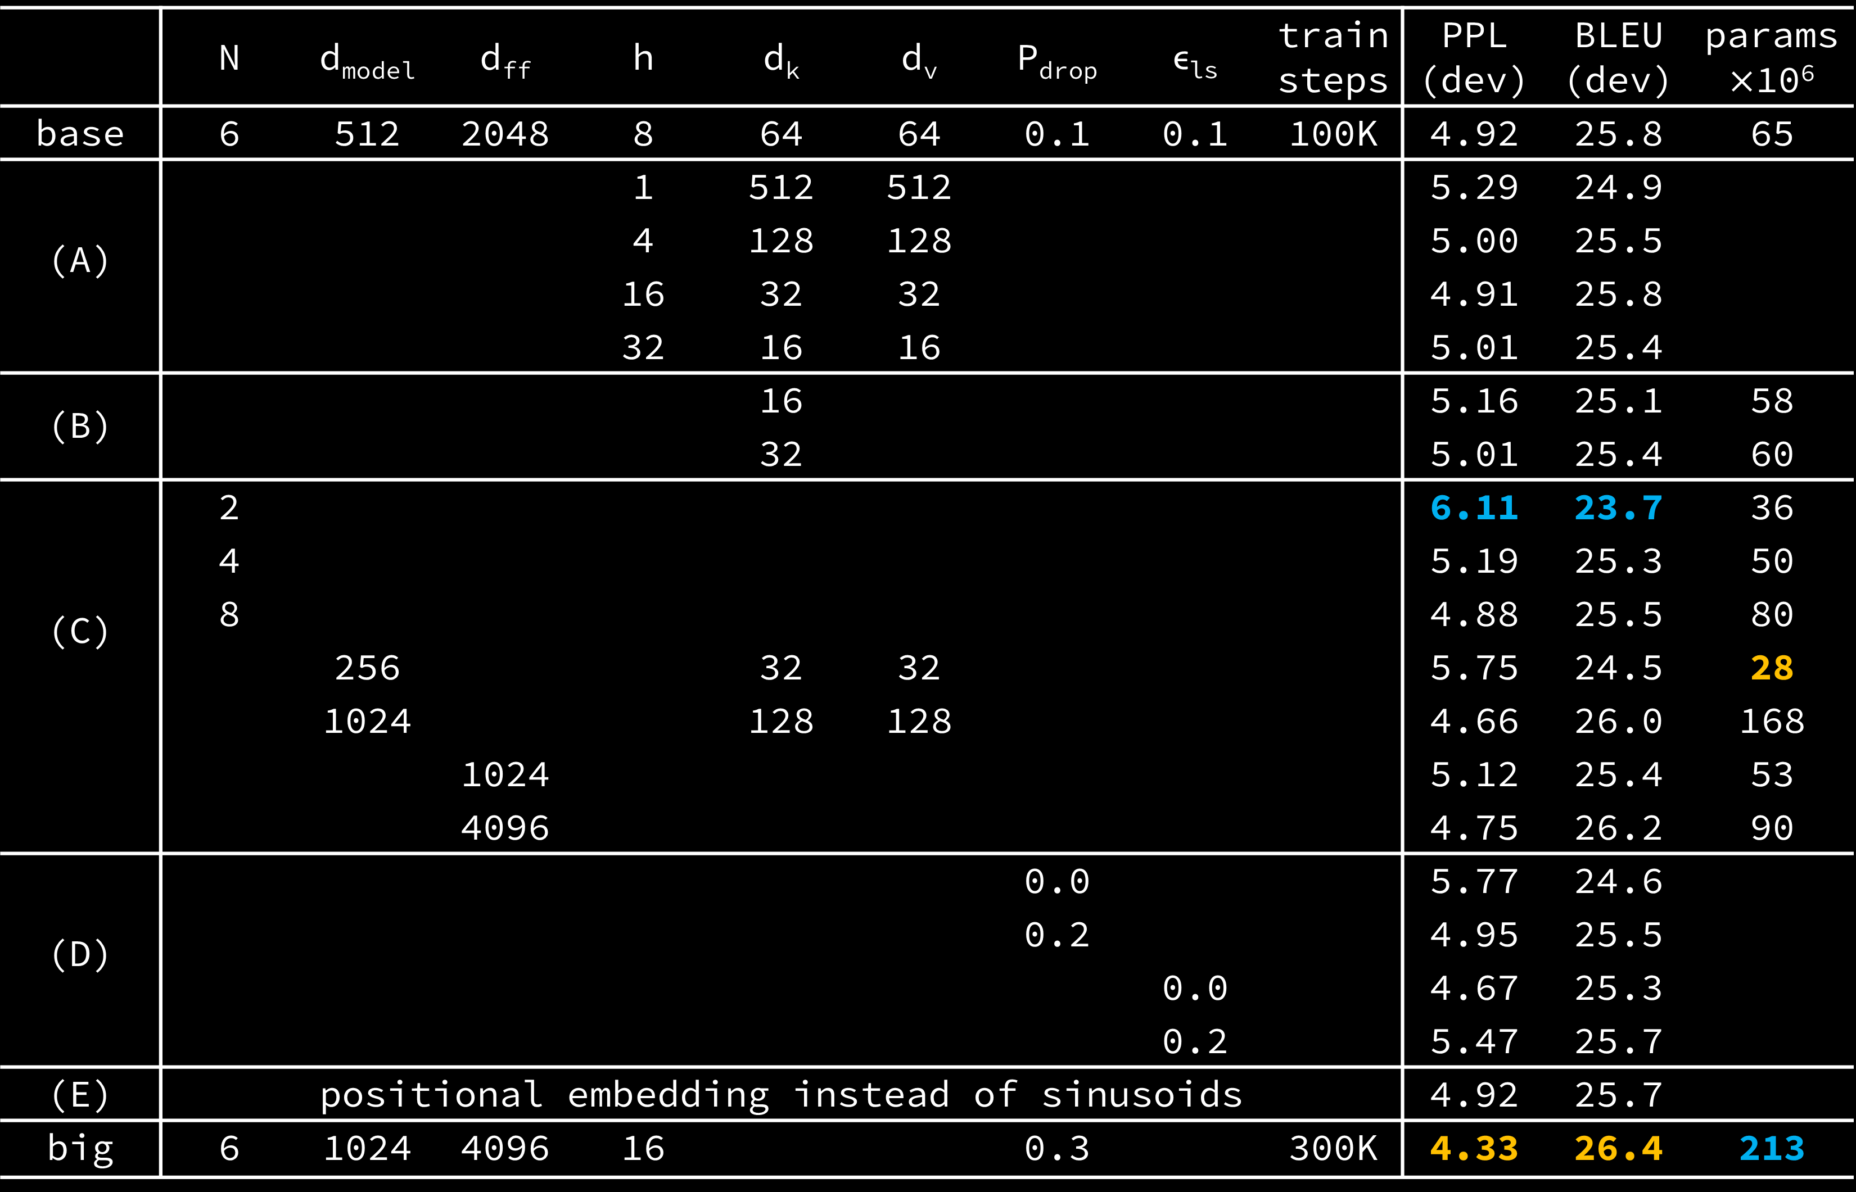
 | N | d_{model} | d_{ff} | h | d_{k} | d_{v} | P_{drop} | ϵ_{ls} | train steps | PPL (dev) | BLEU (dev) | params$×$10⁶
base | 6 | 512 | 2048 | 8 | 64 | 64 | 0.1 | 0.1 | 100K | 4.92 | 25.8 | 65
(A) |  |  |  | 1 | 512 | 512 |  |  |  | 5.29 | 24.9
 |  |  |  | 4 | 128 | 128 |  |  |  | 5.00 | 25.5
 |  |  |  | 16 | 32 | 32 |  |  |  | 4.91 | 25.8
 |  |  |  | 32 | 16 | 16 |  |  |  | 5.01 | 25.4
(B) |  |  |  |  | 16 |  |  |  |  | 5.16 | 25.1 | 58
 |  |  |  |  | 32 |  |  |  |  | 5.01 | 25.4 | 60
(C) | 2 |  |  |  |  |  |  |  |  | 6.11 | 23.7 | 36
 | 4 |  |  |  |  |  |  |  |  | 5.19 | 25.3 | 50
 | 8 |  |  |  |  |  |  |  |  | 4.88 | 25.5 | 80
 |  | 256 |  |  | 32 | 32 |  |  |  | 5.75 | 24.5 | 28
 |  | 1024 |  |  | 128 | 128 |  |  |  | 4.66 | 26.0 | 168
 |  |  | 1024 |  |  |  |  |  |  | 5.12 | 25.4 | 53
 |  |  | 4096 |  |  |  |  |  |  | 4.75 | 26.2 | 90
(D) |  |  |  |  |  |  | 0.0 |  |  | 5.77 | 24.6
 |  |  |  |  |  |  | 0.2 |  |  | 4.95 | 25.5
 |  |  |  |  |  |  |  | 0.0 |  | 4.67 | 25.3
 |  |  |  |  |  |  |  | 0.2 |  | 5.47 | 25.7
(E) | positional embedding instead of sinusoids |  |  |  |  |  |  |  |  | 4.92 | 25.7
big | 6 | 1024 | 4096 | 16 |  |  | 0.3 |  | 300K | 4.33 | 26.4 | 213

Slide 48
model | BLEU |  |  | Training Cost (FLOPs)
 | EN-DE | EN-FR |  | EN-DE | EN-FR
ByteNet | 23.75
Deep-Att + PosUnk |  | 39.2 |  |  | 1.0·10²⁰
GNMT + RL | 24.6 | 39.92 |  | 2.3·10¹⁹ | 1.4·10²⁰
ConvS2S | 25.16 | 40.46 |  | 9.6·10¹⁸ | 1.5·10²⁰
MoE | 26.03 | 40.56 |  | 2.0·10¹⁹ | 1.2·10²⁰
Deep-Att + PosUnk Ensemble |  | 40.4 |  |  | 8.0·10²⁰
GNMT + RL Ensemble | 26.30 | 41.16 |  | 1.8·10²⁰ | 1.1·10²¹
ConvS2S Ensemble | 26.36 | 41.29 |  | 7.7·10¹⁹ | 1.2·10²¹
Transformer (base model) | 27.3 | 38.1 |  | 3.3·10¹⁸
Transformer (big) | 28.4 | 41.8 |  | 2.3·10¹⁹

